Slide 1
Electric Cars analysis

Slide 2
Introduction to data
This dataset provides detailed information on 103 electric car models, focusing on various technical and performance aspects. It includes data points such as the brand and model of each car, its acceleration (time to reach 100 km/h), top speed, and range (distance it can travel on a full charge). Additionally, it features efficiency metrics like energy consumption per kilometer, fast charging capabilities, and whether the car supports rapid charging. The dataset also covers powertrain types, plug types, and body styles, along with essential consumer-focused details like seating capacity and price in euros.
This information is valuable for comparing electric car models in terms of performance, cost-efficiency, and technology, helping users make informed decisions about electric vehicle choices.

Slide 3
Page Navigator
Amit : Makes you go to the official page
Overview : Makes you go the page Overview
Sales : Makes you go the page Sales
Details : Makes you go the page details

Slide 4

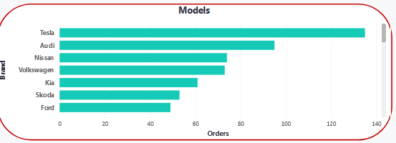
the chart suggests that Tesla is the most popular brand among the customers represented in the data, while Ford and Skoda are the least popular.

Slide 5
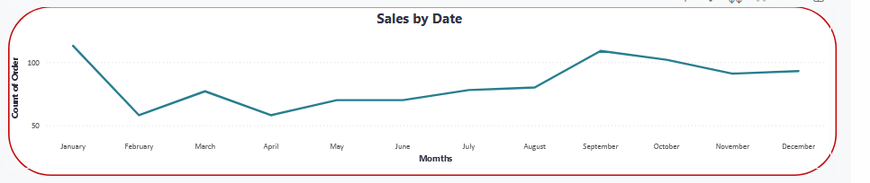
the chart provides a visual representation of how sales volume changed over the year. This information can be useful for understanding seasonal trends and making informed business decisions.
Don’t Forget click up and Down

Slide 6
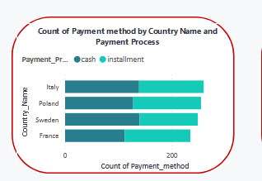
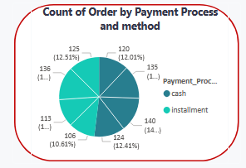
1.The chart shows that cash and installment payments are both popular in all four countries, but the proportions vary. Italy and Poland have a higher overall volume of payments and a more balanced distribution between payment methods, while Sweden and France have lower volumes and a slightly more skewed distribution.
2.The chart shows that installment payments are the most popular method among the orders analyzed,
followed by cash payments. The remaining payment methods have a more balanced distribution.

Slide 7
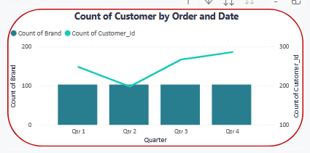
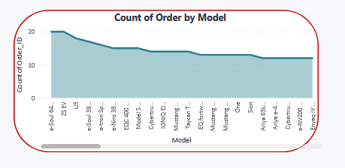
1.The chart shows that the number of brands remains relatively consistent throughout the year, while the number of customers fluctuates. There is a general correlation between the two, but other factors may also influence the number of customers.
2.The chart reveals that the e-Soul 64 is the most popular car model, followed by other electric vehicles. Some less popular models may need further analysis to understand their market position.

Slide 8
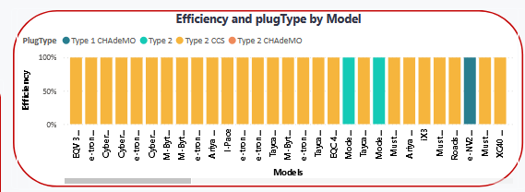
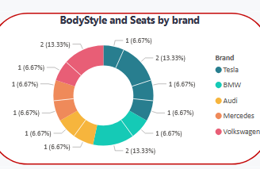
1.The chart illustrates the efficiency and plug types of various car models, revealing that most have high efficiency while showcasing a range of plug types. This information aids in assessing compatibility with charging infrastructure and helps consumers make informed purchasing choices.
2.The chart shows Tesla as the most represented brand, followed by BMW, Audi, Mercedes, and Volkswagen, along with insights on body styles and seating across these brands.

Slide 9
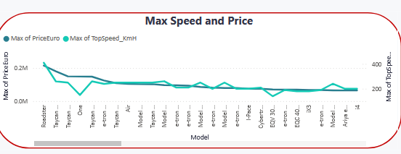
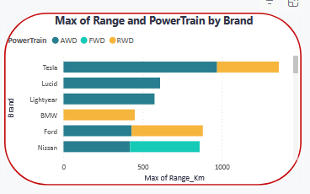
1.The chart shows that there is a wide range of prices and top speeds among the car models analyzed.
While there is a general correlation between price and top speed, there are also some variations, we show
Roadster have max price and top speed.
2.The chart shows that Tesla and Lucid have the highest maximum range among the brands analyzed.
The chart also demonstrates the distribution of powertrain types across the different brands

