Slide 1
Sample Code Memsim
MD Shaherier Khan

Slide 2
CONTENTS
Introduction
Data Structure
Memory Allocation
Memory Deallocation
Print Function

Slide 3
INTRODUCTION
Memsim is a dynamic partition memory allocation simulator inspired by the functionality of malloc() and free() in the standard C library. It efficiently manages memory allocation and deallocation using custom data structures, providing an approximation of real-world memory management.

Slide 4
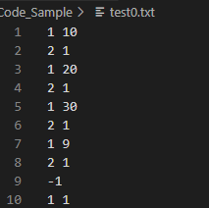
Input
The input of the simulator
A page size (a positive integer)
list of allocation and deallocation requests.

Slide 5

Line 1- 8 (Allocation)
What if I have tag 2 and 1 remove (Deallocation)
Tag : 1
Size: 10
Address : 0
Tag : 2
Size: 1
Address : 10
Tag : 1
Size: 20
Address : 11
Tag : 2
Size: 1
Address : 31
Tag : -1
Size: 10
Address : 0
Tag : 2
Size: 1
Address : 10
Tag : -1
Size: 20
Address : 11
Tag : 2
Size: 1
Address : 31
Tag : 1
Size: 30
Address : 32
Tag : 2
Size: 1
Address : 62
Tag : 1
Size: 9
Address : 63
Tag : 2
Size: 1
Address : 73
Tag : 1
Size: 1
Address : 32
Tag : -1
Size: 29
Address : 33
Tag : 2
Size: 1
Address : 62
Tag : -1
Size: 9
Address : 63
Tag : 2
Size: 1
Address : 73
Line 9 (Deallocation)
Tag : -1
Size: 10
Address : 0
Tag : 2
Size: 1
Address : 10
Tag : -1
Size: 20
Address : 11
Tag : 2
Size: 1
Address : 31
Tag : -1
Size: 30
Address : 32
Tag : 2
Size: 1
Address : 62
Tag : -1
Size: 9
Address : 63
Tag : 2
Size: 1
Address : 73
Line 10 (Allocation)
Tag : -1
Size: 10
Address : 0
Tag : 2
Size: 1
Address : 10
Tag : -1
Size: 20
Address : 11
Tag : 2
Size: 1
Address : 31
Tag : 1
Size: 1
Address : 32
Tag : -1
Size: 29
Address : 33
Tag : 2
Size: 1
Address : 62
Tag : -1
Size: 9
Address : 63
Tag : 2
Size: 1
Address : 73

Slide 6

Output
● n_pages_requested equal to the total number of pages requested during the simulation. Notice that this could be 0, but only if there are no allocation requests in the input.
● Set result.max_free_partition_size to the size of the largest free partition at the end of the simulation. You will set this to 0 if there are no free partitions.
● Set result.max_free_partition_address to the address of the largest free partition at the end of the simulation. You will set this to 0 if there are no free partitions. In case of ties, report the smallest address.

Slide 7
Data Structures
Node Struct
Vector
Hash-map
Sets
Doubly Linked List
struct Node {
int64_t address; int64_t pid;
bool free;
int64_t size;
}
Used: Node represents a memory chunk with attributes like address, pid, free status, and size.
std::vector<LI>
using LI = std::list<struct Node>::iterator;
Used: To Store list of Node iterators.
std::unordered_map<int64_t, std::vector<LI>>
Used: A map that associates process IDs with vectors of iterators to the Nodes, representing allocated memory chunks for each process.
std::set<LI, decltype(&cmp)>
Used: A set of iterators to the Nodes in the list, sorted based on a custom comparison function (cmp) that compares Node sizes and address and used to get the largest free space
std::list<struct Node>
Used: A linked list of Nodes. To traverse back and forth between node so that we can compute the address.
New node’s address =sum of prev node’s address and size.

Slide 8
Memory Allocation

Slide 9
Memory Allocation
Pseudocode for allocation request:
search through the list of partitions from start to end, and
find the largest partition that fits requested size
- in case of ties, pick the first partition found
- if no suitable partition found:
get minimum number of pages from OS, but consider the
case when last partition is free
- add the new memory at the end of partition list
- the last partition will be the best partition
- split the best partition in two if necessary
- mark the first partition occupied, and store the tag in it
- mark the second partition free

Slide 10
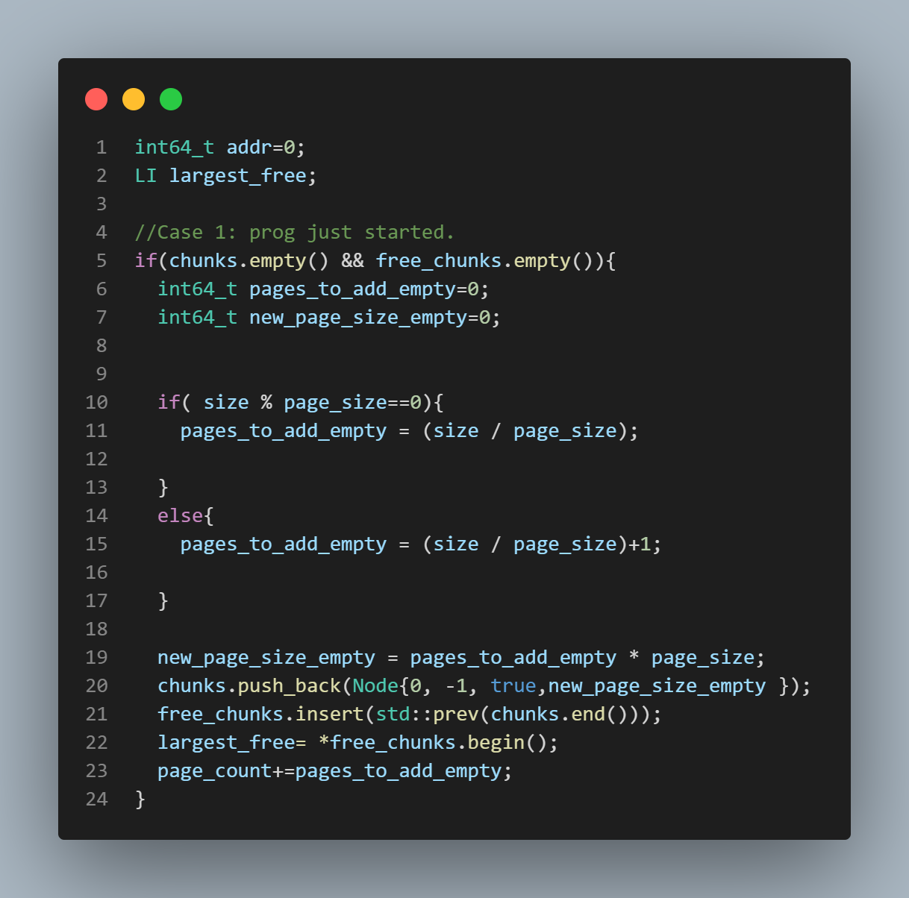
Memory Allocation
Case 1
When the doubly Linked list is empty and the set for free space is empty.
Determine the pages required based on request and determine the total size
Push the newly requested page size in the link-list and since the node is free its add to the set
I also need to track the largest free node and the pages the system is requesting.

Slide 11
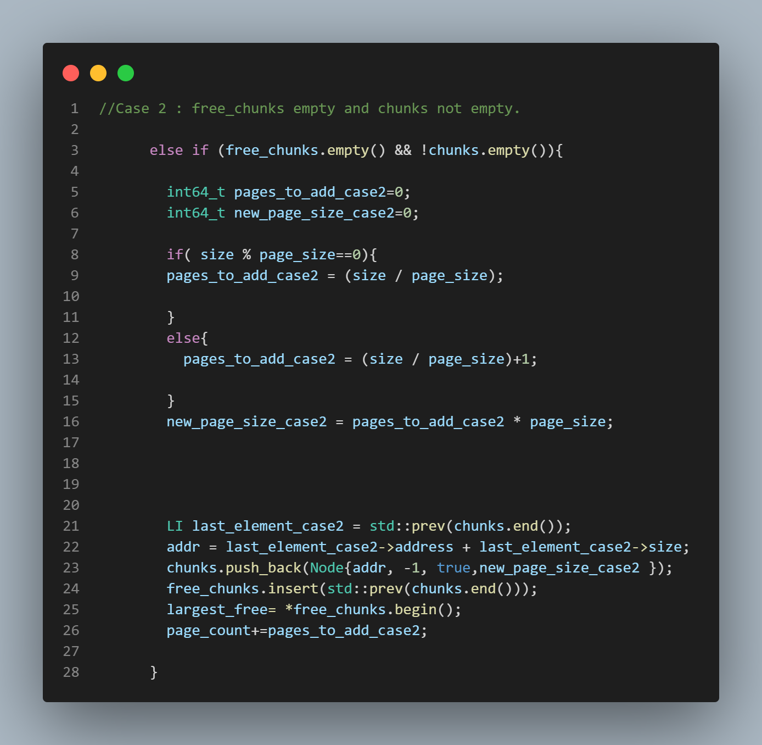
Memory Allocation
Case 2
When the set is empty which mean there is no free space but there are node/ partition, so the link-list is not empty
Determine the pages required based on request and determine the total size
The new requested space will be appended at the end of link-list and to get the address, I was required the last node.
Add the request space to the set that store free nodes
I also needed to track the largest free node and the pages the system is requesting.

Slide 12
Case 2
Assumption
Inputs: Page size = 50;
Linked-list has nodes from before and Set is empty( no free space)
I will allocate 1 60 so I will get two pages of 50
Linked-list (chuck)
Set (Free chuck)
Tag 1
Size: 20
Address: 0
Tag 2
Size: 30
Address: 20
Tag -1
Size: 100
Address: 50
Tag -1
Size: 100
Address: 50

Slide 13
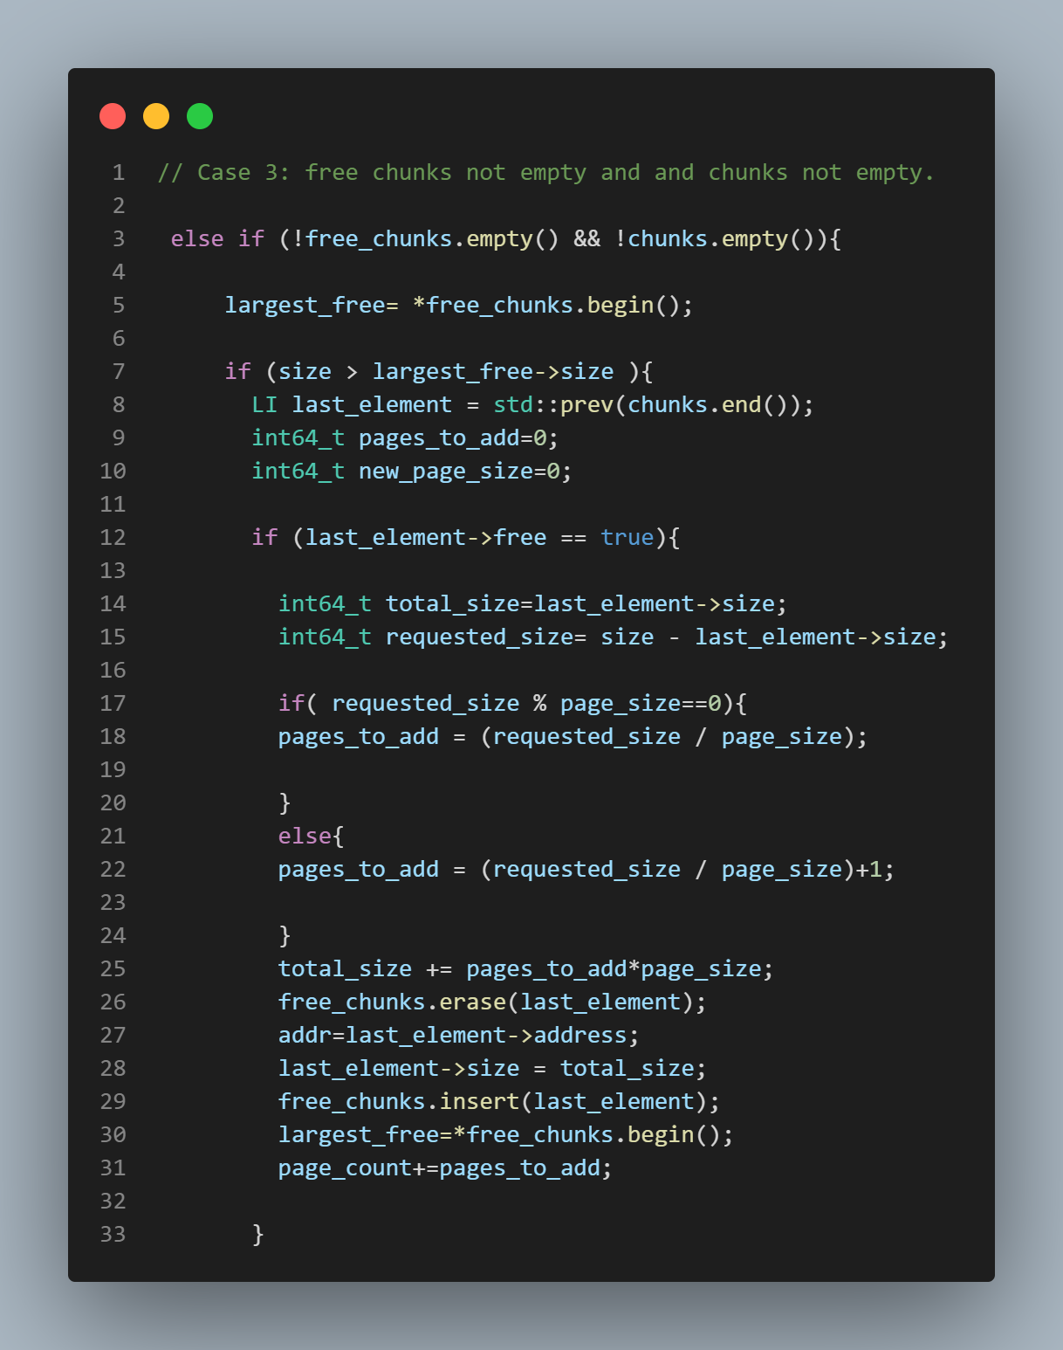
Memory Allocation
Case 3
When there are free Nodes in set and when there are Nodes/ partition in linked link.
Get the largest free node from set
Check if that node satisfies the requested node
check if the last element is free
if it is free then determine the pages need.
Now since I am using the last free node, I remove it from set.
Fix the address and size of the node added
Set the new largest free node and the page count.

Slide 14
Case 3 part 1 with free last node
Assumption
Inputs: Page size = 50;
I have a process that need to allocate memory of size 70
Linked-list (chuck)
Set (Free_chuck)
Tag -1
Size: 70
Address: 30
Tag 1
Size: 30
Address: 0
Tag -1
Size: 20
Address: 30
Tag -1
Size: 70
Address: 30
Tag -1
Size: 20
Address: 30
Yes
Request Size > largest free size so need to request more pages

Slide 15
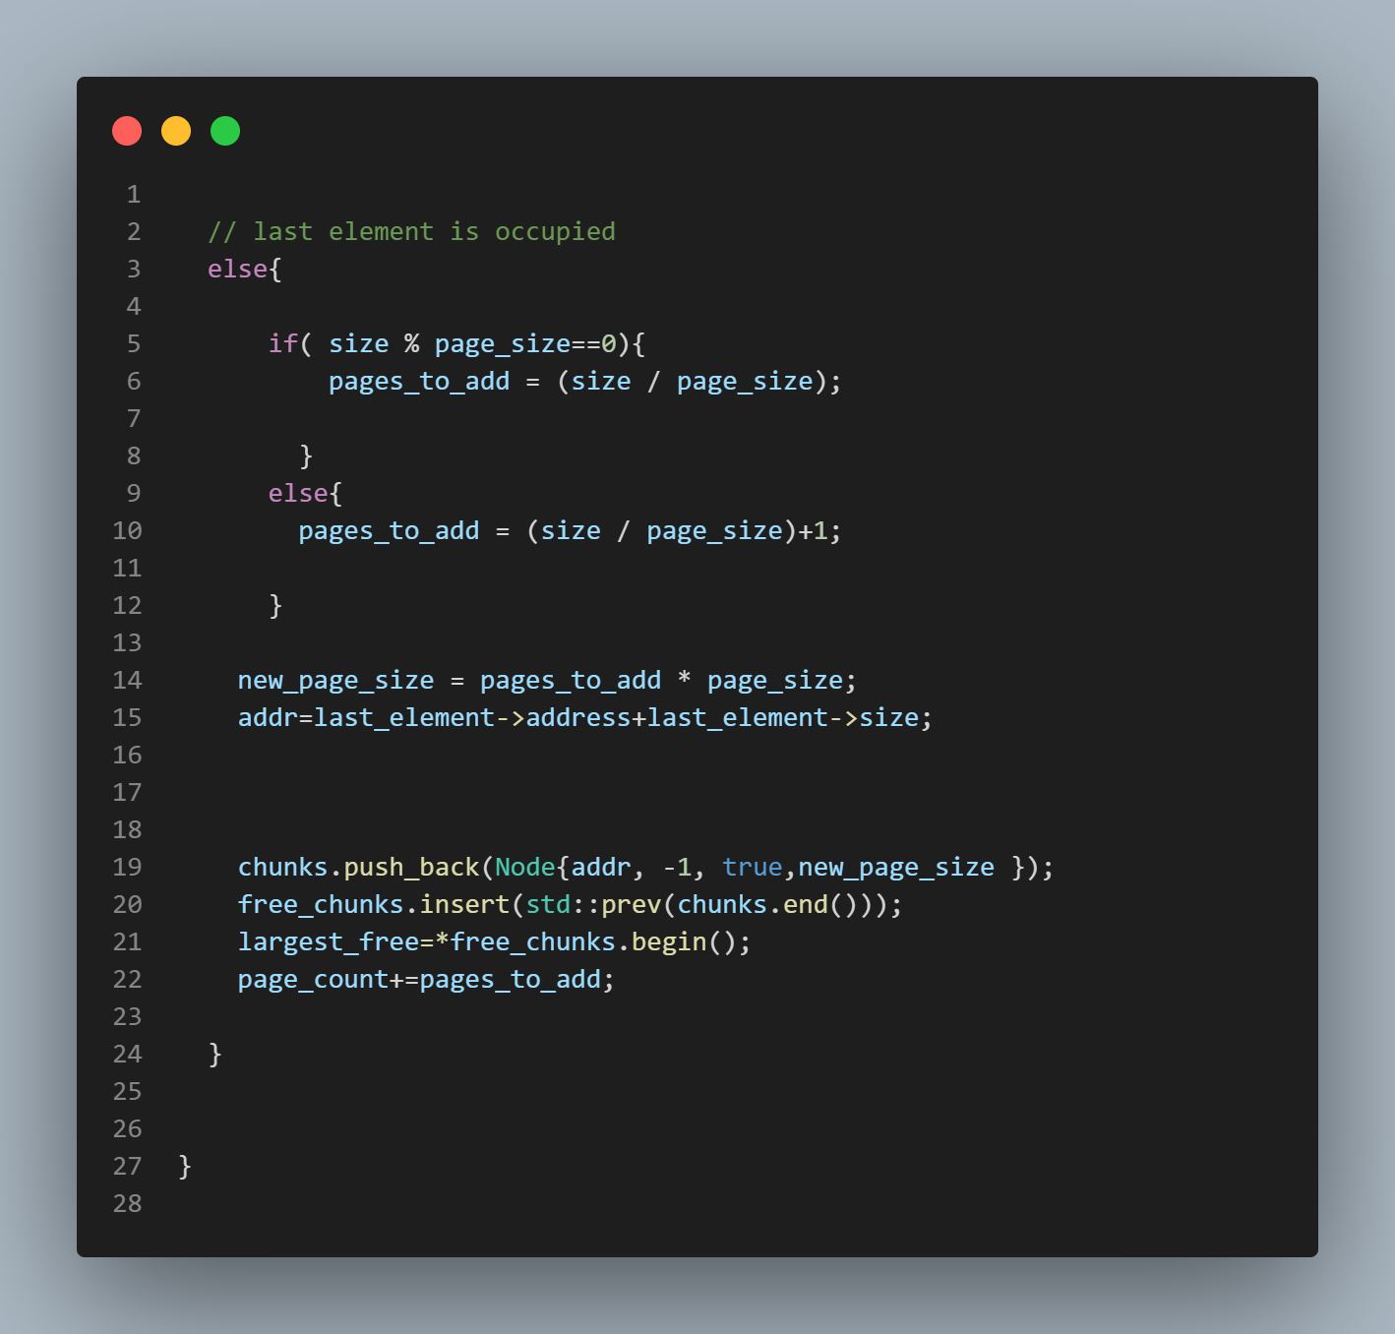
Memory Allocation
Continuation of Case 3
If the last element node is Occupied.
Determine the pages and the size
Determine the address
Push the requested free Node to the linked list
Push the free node to the Set
Set the new largest free node and the page count.

Slide 16
Case 3 part 2 where last node is not free
Assumption
Inputs: Page size = 50;
I have a process that need to allocate memory of size 70 as 2 pages = 100
Linked-list (chuck)
Set (Free_chuck)
Tag 1
Size: 30
Address: 0
Tag -1
Size: 20
Address: 30
Tag 3
Size: 40
Address: 50
Tag -1
Size: 100
Address: 90
Tag -1
Size: 20
Address: 30
Tag -1
Size: 100
Address: 90
No
Request Size > largest free size so need to request more pages

Slide 17
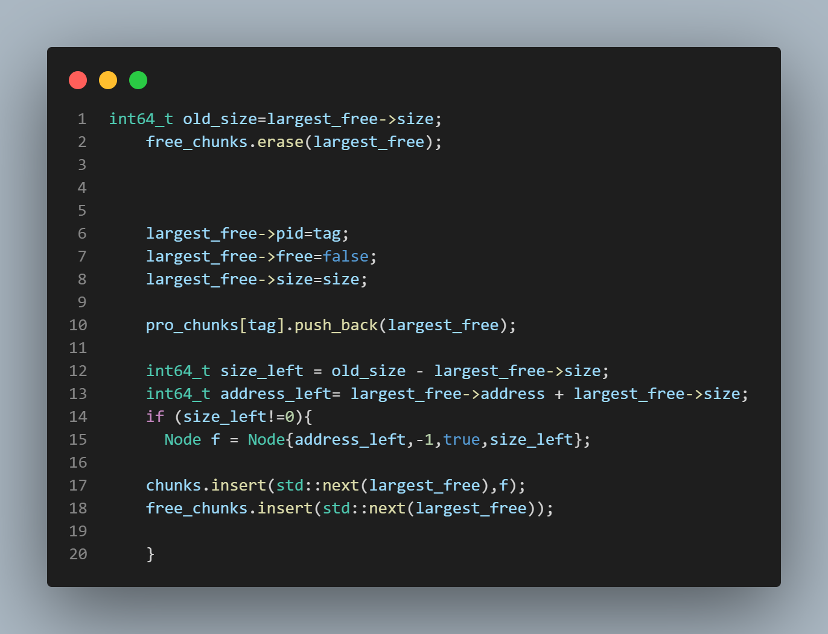
Memory Allocation
Get the largest free node from the set.
Remove it from the set
Change the attributes of the free node to the attributes of the requested node.
Push the node into a hash-map based on the tag
Determine if there is free memory left from the largest free node.
If there is free memory, then insert it to linked-list and Set.

Slide 18
Case 3 part 2 where last node is not free
Assumption
Inputs: Page size = 50;
I have a process (Tag 2) that need to allocate memory of size 70 as 2 pages = 100
Linked-list (chuck)
Tag -1
Size: 100
Address: 90
Tag 2
Size: 70
Address: 90
Tag -1
Size: 30
Address: 160
Tag 2
Size: 70
Address: 90
Tag 1
Size: 30
Address: 0
Tag -1
Size: 20
Address: 30
Tag 3
Size: 40
Address: 50
Tag -1
Size: 100
Address: 90
Tag -1
Size: 30
Address: 160
Hash map (Pro_chuck)
Set (Free_chuck)
Tag | Vector
1
3
2
Tag -1
Size: 100
Address: 90
Tag -1
Size: 20
Address: 30
Tag 1
Size: 30
Address: 0
Tag 3
Size: 40
Address:50
Tag 2
Size: 70
Address: 90

Slide 19
Memory Deallocation

Slide 20
Deallocation
Pseudocode for deallocation request:
- for every partition
- if partition is occupied and has a matching tag:
- mark the partition free
- merge any adjacent free partitions

Slide 21
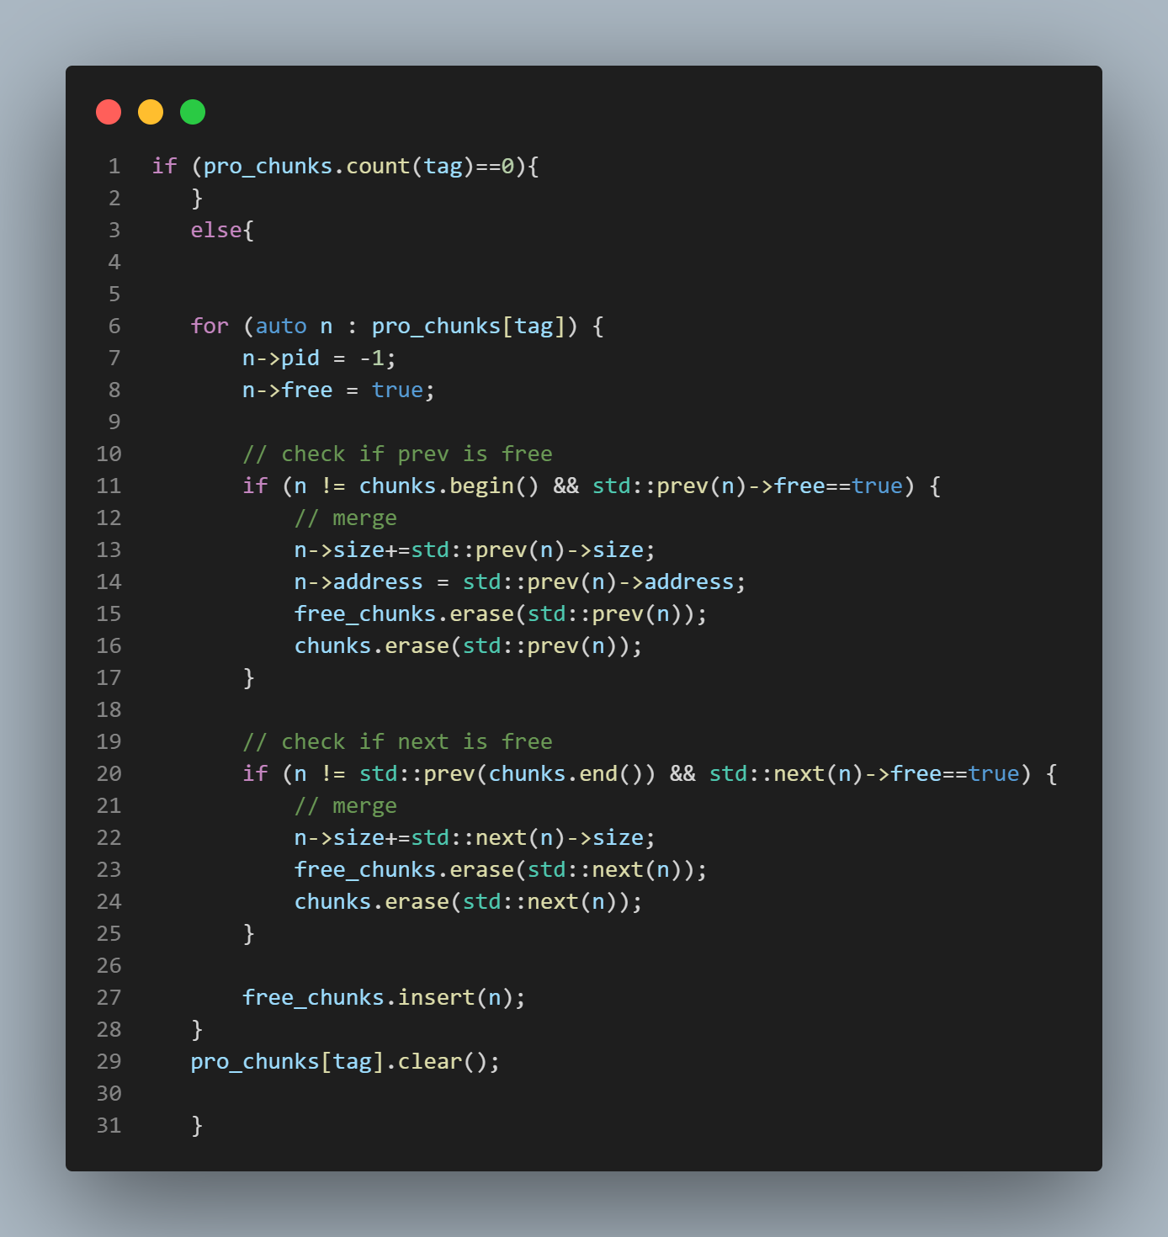
Deallocation
Search the hash-map for the tag that need to get deleted
Check if prev node is free then merge the free spaces/nodes and added to set
Check if next node is free then merge the free spaces/nodes and added to set
Clear the node from linked-list HashMap

Slide 22
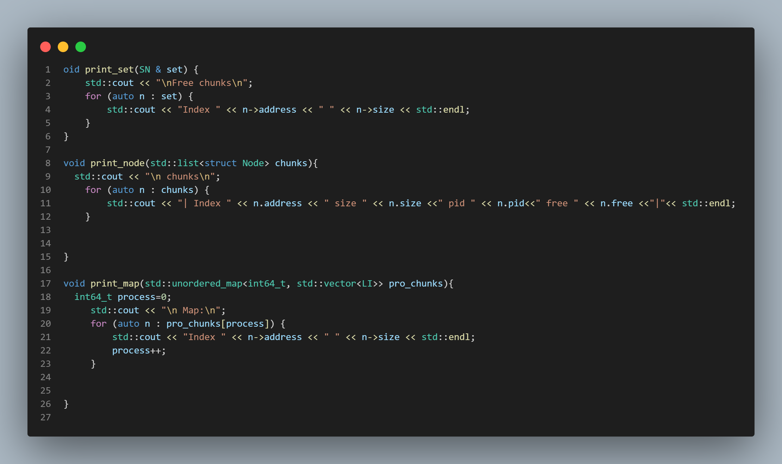
Print Functions
With these functions I can print and display all the data structures that I have used like linked-list, sets, hash-map.
These were handy for debugging

Slide 23
THANK YOU
MD Shaherier Khan
mdshaherierkhan@gmail.com

