Slide 1
Capstone Project
PRESENTATION
Predicting Band Gaps of SnSe-Based Materials from Composition
Group [TBD] | Predicting Band Gaps of SnSe-Based Materials from Composition | Presenter: TBD
FDP: Machine Learning for Materials and Metallurgical Engineering | 13–18 July 2026
Slide 1 / 7

Slide 2
Problem & Motivation
Can a composition-only model predict whether a Sn-Se-based compound is a metal or an insulator, and its band gap?
SnSe is one of the best thermoelectric materials found in the last ten years — it turns heat into electricity efficiently. Scientists try adding small amounts of other elements, such as lead, sulfur, or silver, to make it work even better. But testing every possible combination in the lab, or with expensive supercomputer calculations (DFT), takes a lot of time and money. A quick computer model that only needs the chemical formula can act as a first filter — it tells scientists which combinations are worth testing further, before they spend time and money on slower methods. This project builds two such models: one that predicts metal-or-insulator, and one that predicts the band gap size for insulators.
FDP: Machine Learning for Materials and Metallurgical Engineering | 13–18 July 2026
Slide 2 / 7

Slide 3
Data
Source | The Materials Project (materialsproject.org), queried via mp-api
Size | 220 raw entries → 192 unique compounds after cleaning
Features | 132 composition-derived descriptors (matminer, Magpie preset)
Target | band_gap (eV)
Cleaning needed | De-duplicated by formula; dropped missing/failed-featurization rows
Step 1: Query the database → Step 2: Clean the results → Step 3: Turn formulas into features
Step 1 — Query: pulled 220 Sn-Se-based compounds live from the Materials Project API. Step 2 — Clean: removed duplicate formulas and entries with no computed band gap, leaving 192 unique compounds. Step 3 — Featurize: turned each chemical formula into 132 numeric features (electronegativity, atomic size, valence electron count, and more) using matminer — no crystal structure needed, just the formula. About seven in ten compounds ended up insulators and three in ten metals.
FDP: Machine Learning for Materials and Metallurgical Engineering | 13–18 July 2026
Slide 3 / 7

Slide 4
Method
Step 4: Split the data → Step 5: Train two models → Step 6: Evaluate carefully
Step 4 — Split: a stratified 80/20 train/test split for classification (153 training, 39 test compounds). Step 5 — Train: Logistic Regression vs. Random Forest (300 trees) to classify metal-or-insulator; a separate Random Forest (300 trees) regresses the band gap value on the insulator subset only. Step 6 — Evaluate: with only 192 compounds against 132 features, a single train/test split is noisy — so we use 5-fold cross-validation (5 different splits, averaged) as the trustworthy number throughout, not just the single-split result.
FDP: Machine Learning for Materials and Metallurgical Engineering | 13–18 July 2026
Slide 4 / 7

Slide 5
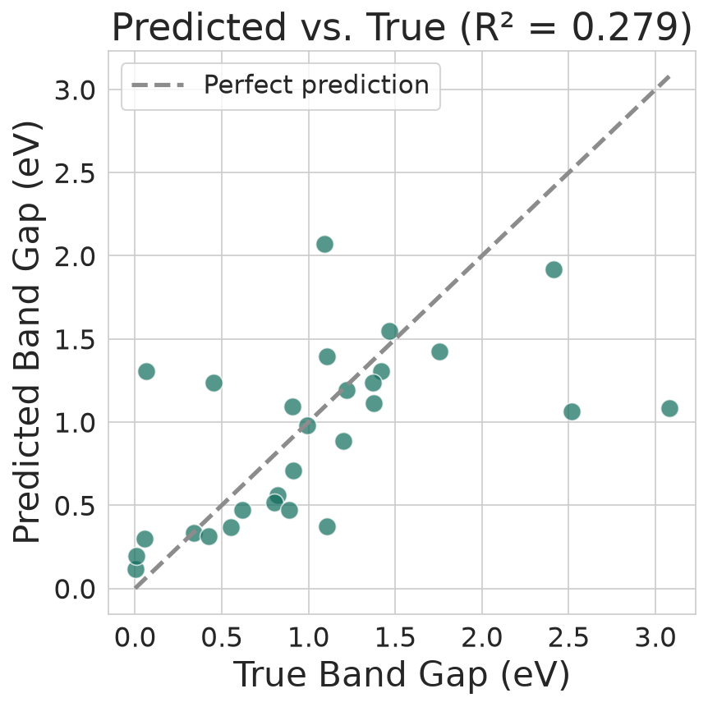
Results — Model Performance
Classification Accuracy | 80.2% (5-fold CV)
Regression MAE | 0.357 eV (5-fold CV)
Regression R² | 0.401 (5-fold CV)
Random Forest reaches 80.2% classification accuracy and explains ~40% of band-gap variance (R²) from composition alone — a fast screen, not a DFT replacement.
FDP: Machine Learning for Materials and Metallurgical Engineering | 13–18 July 2026
Slide 5 / 7

Slide 6
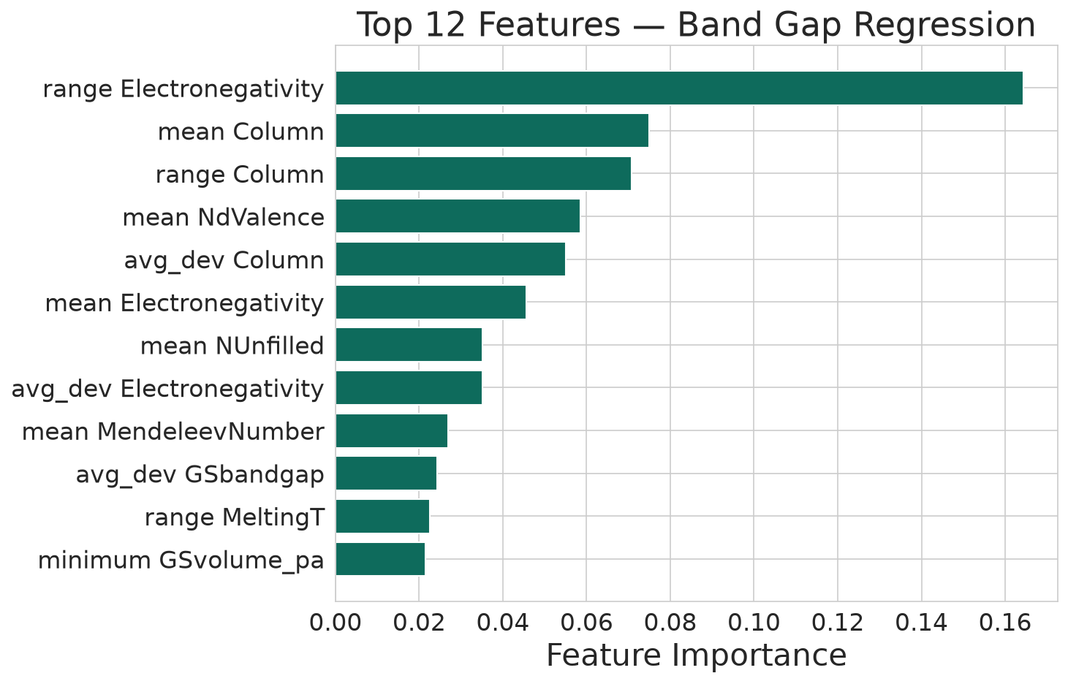
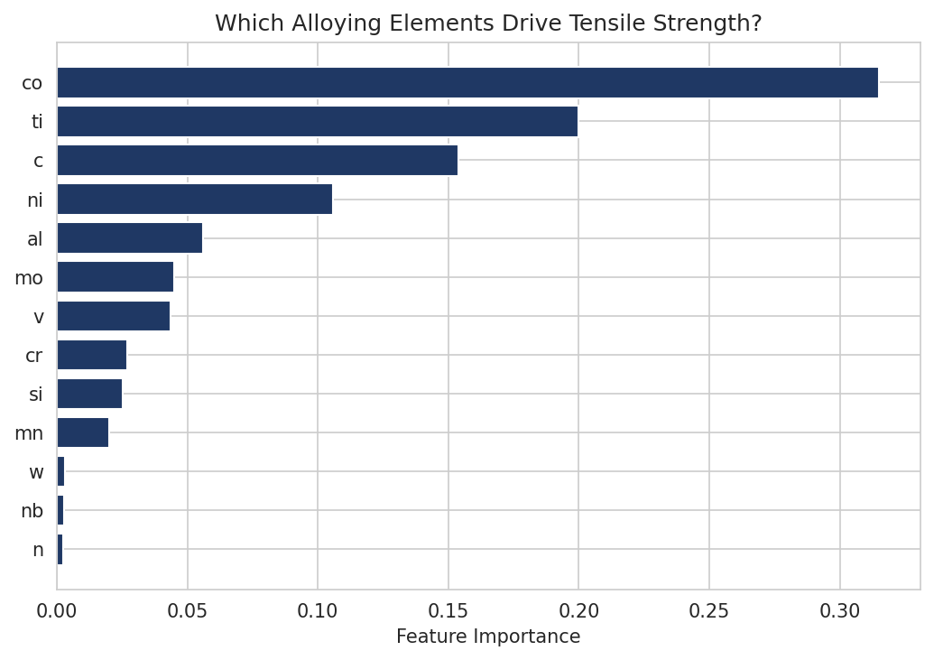
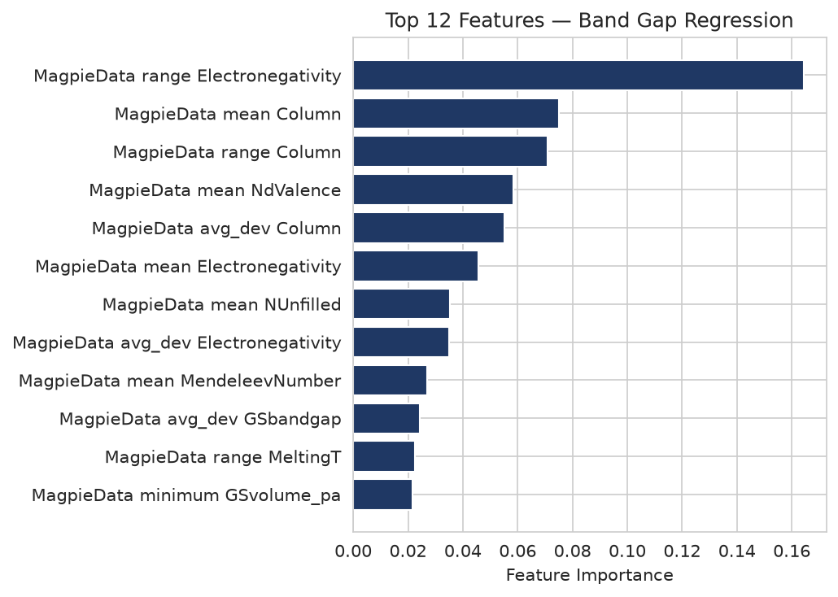

Results — What Drives Band Gap?
Electronegativity-related descriptors — especially the range of electronegativity across a compound's elements — emerge as the most influential, consistent with known SnSe band-engineering mechanisms.
FDP: Machine Learning for Materials and Metallurgical Engineering | 13–18 July 2026
Slide 6 / 7

Slide 7
Takeaway & Limitations
Using only the chemical formula, our Random Forest model correctly labels a compound as metal or insulator about 80% of the time, and predicts the band gap of insulators to within about 0.36 eV on average — not perfect, but a genuinely useful first filter for narrowing down candidates before expensive DFT calculations or lab experiments.
Limitations: the model only sees the chemical formula, so it cannot tell apart two compounds with the same formula but different crystal structures — SnSe's everyday room-temperature form and its high-temperature form get treated as identical, even though their band gaps differ. The dataset is also fairly small (about 190 compounds) compared to the 132 numbers describing each one, so results can vary between different train/test splits — which is why we relied on 5-fold cross-validation rather than a single split. A natural next step: add structural information, or gather more compounds from the wider family of similar materials (SnS, SnTe, PbSe, and others). | Code & notebook: github.com/ShahiDDU/snse-bandgap-ml-capstone
FDP: Machine Learning for Materials and Metallurgical Engineering | 13–18 July 2026
Slide 7 / 7

