Slide 1
Salutation removal - Tool

Slide 2
AIM:
The Data Entry team will receive raw data of candidates' names with random salutations, which can appear clumsy.
Our goal is to remove these salutations wherever they occur to obtain the proper names of the candidates.

Slide 3
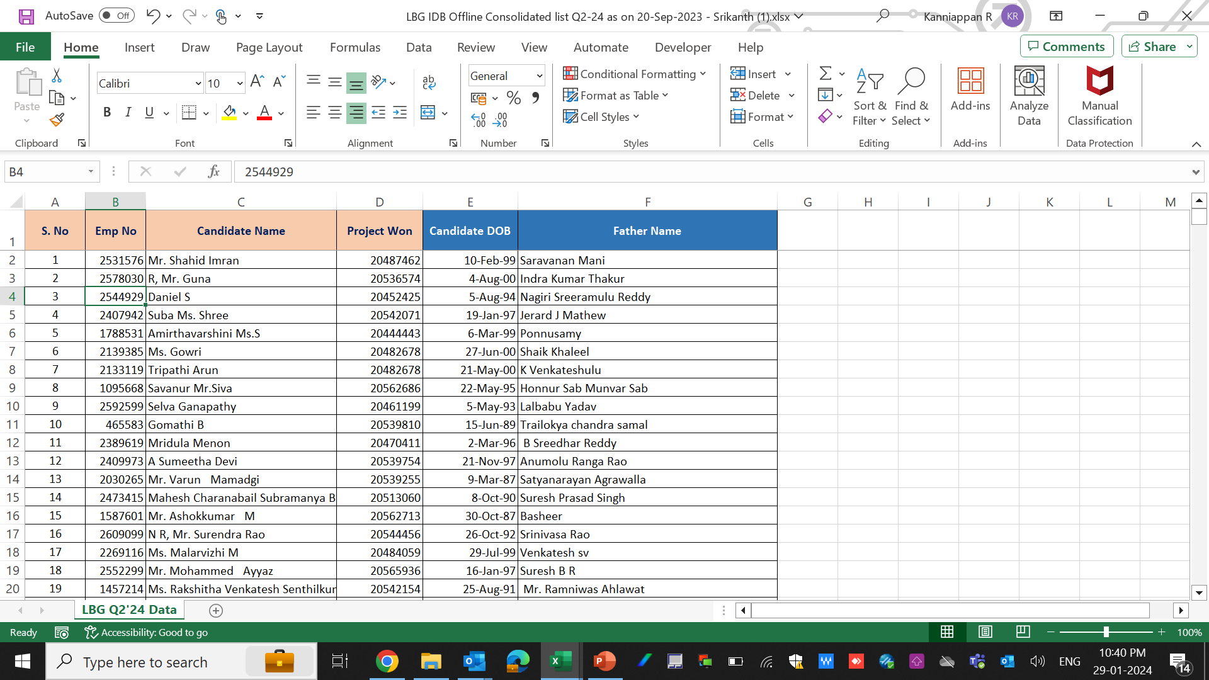
Steps to be followed:
Step 1: Copy the required data from the Raw Data.

Slide 4
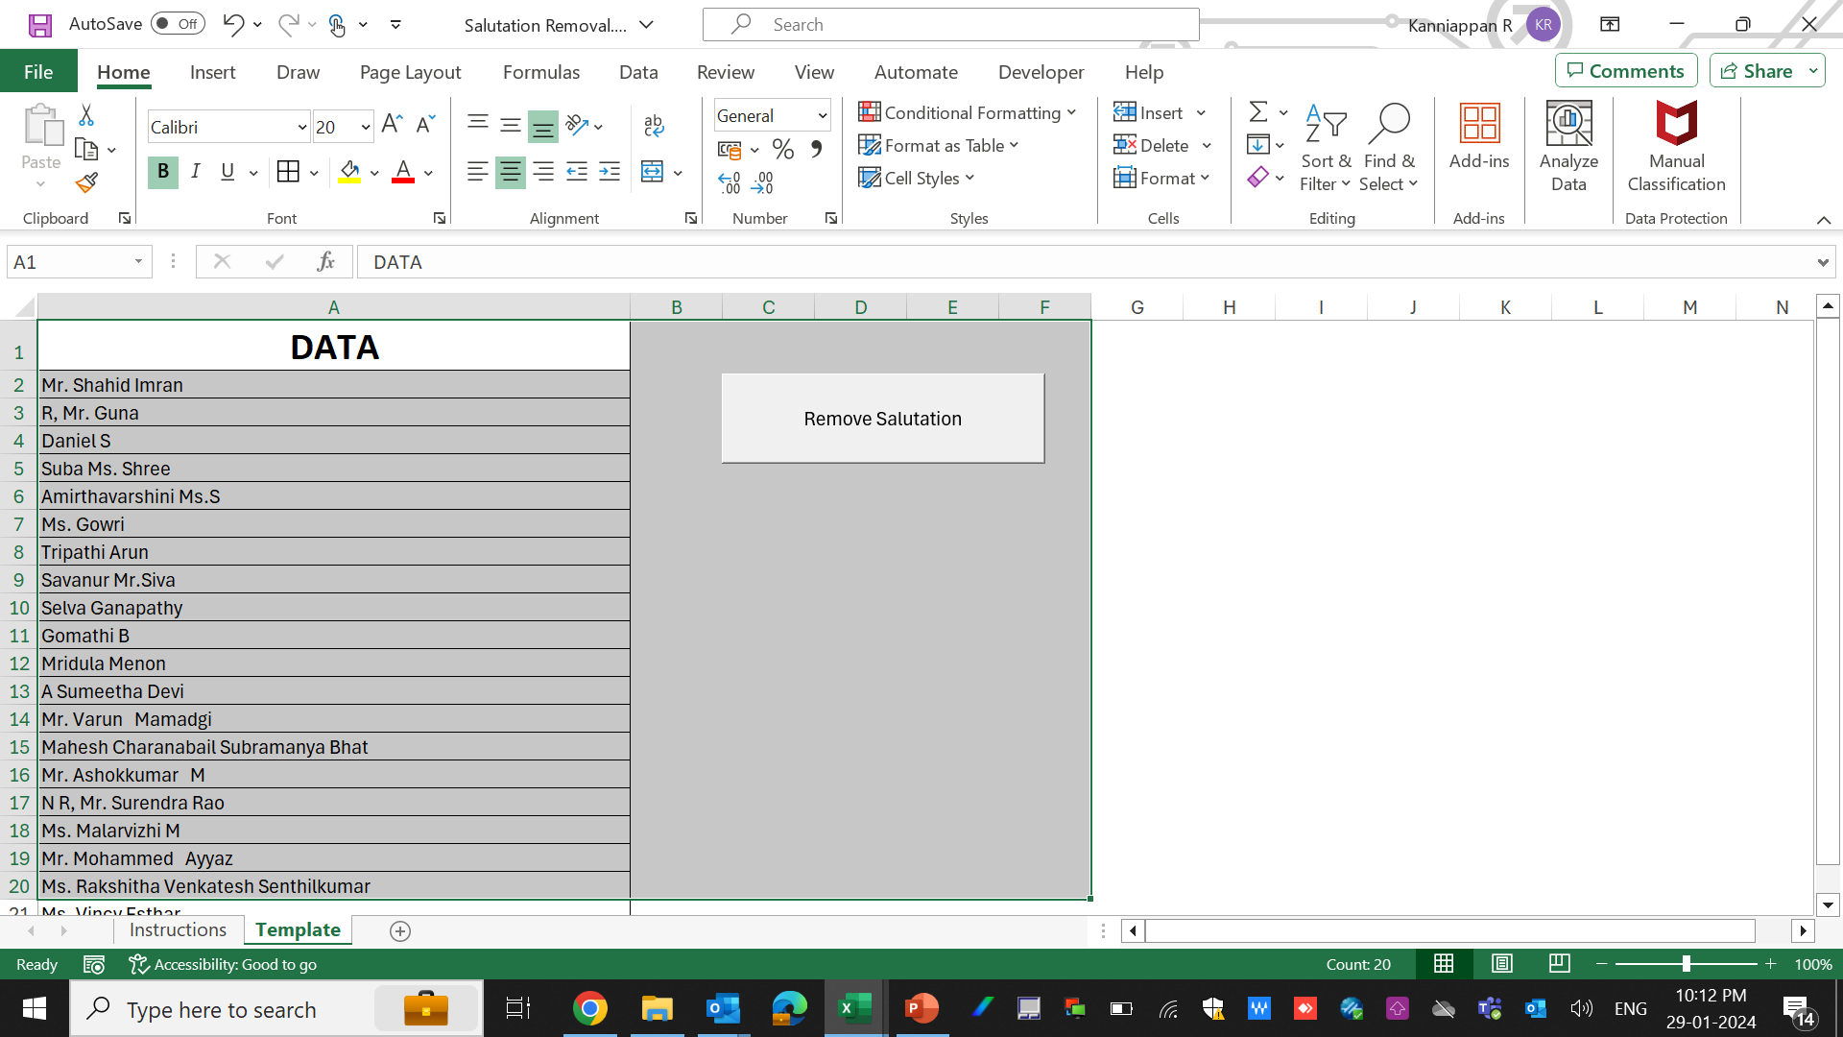
Step 2: Paste the required data into "Column A" on the Template page.

Slide 5
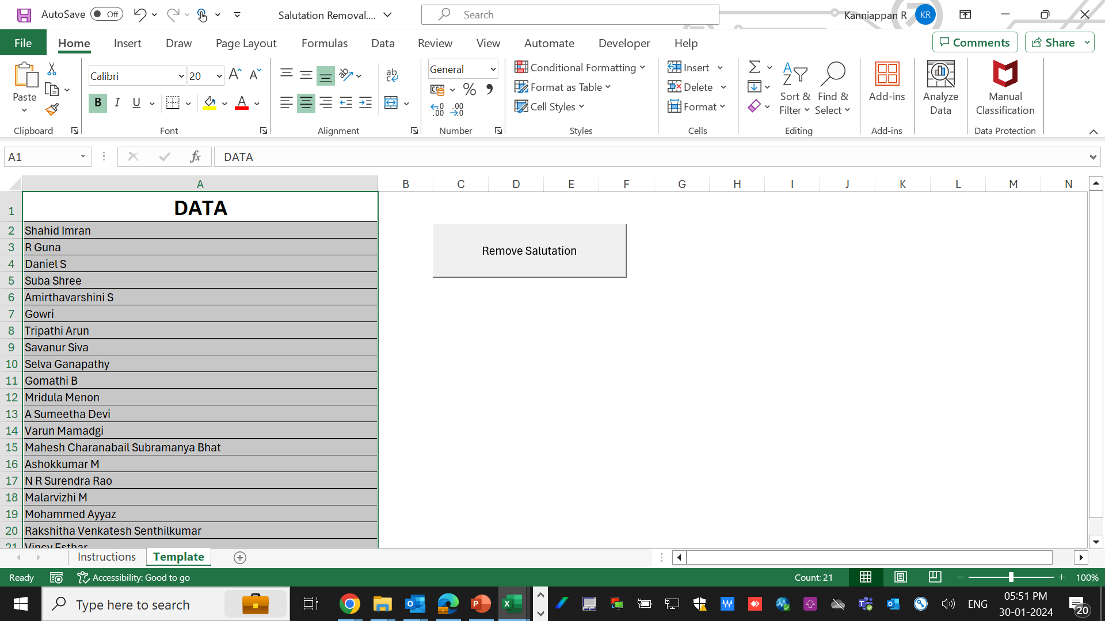
Step 3: Click the “Remove Salutation” button to remove the salutations.
OUTPUT DATA:

Slide 6
As per our goal, the salutations has been removed and the proper names of the candidates has been generated.
RESULT:
After clicking the “Remove Salutation” Button, it will remove the salutations from the list of names.
As per our goal, the salutations has been removed and the proper names of the candidates has been generated.

Slide 7
The team is currently performing the process manually, finding and replacing text, which is consuming a significant amount of manual work and time.
With the help of this tool, manual work is eliminated, and the time taken has been drastically reduced.

