Slide 1
UCSD ECE 226 – Optimization and Acceleration of Deep Learning on Various Hardware Platforms
Benchmarking Methodologies & Profiling Ecosystems
Group 23
Shahid Mulla, Cheng-Lun Tai, Subhon Ghosh
March 12, 2026

Slide 2
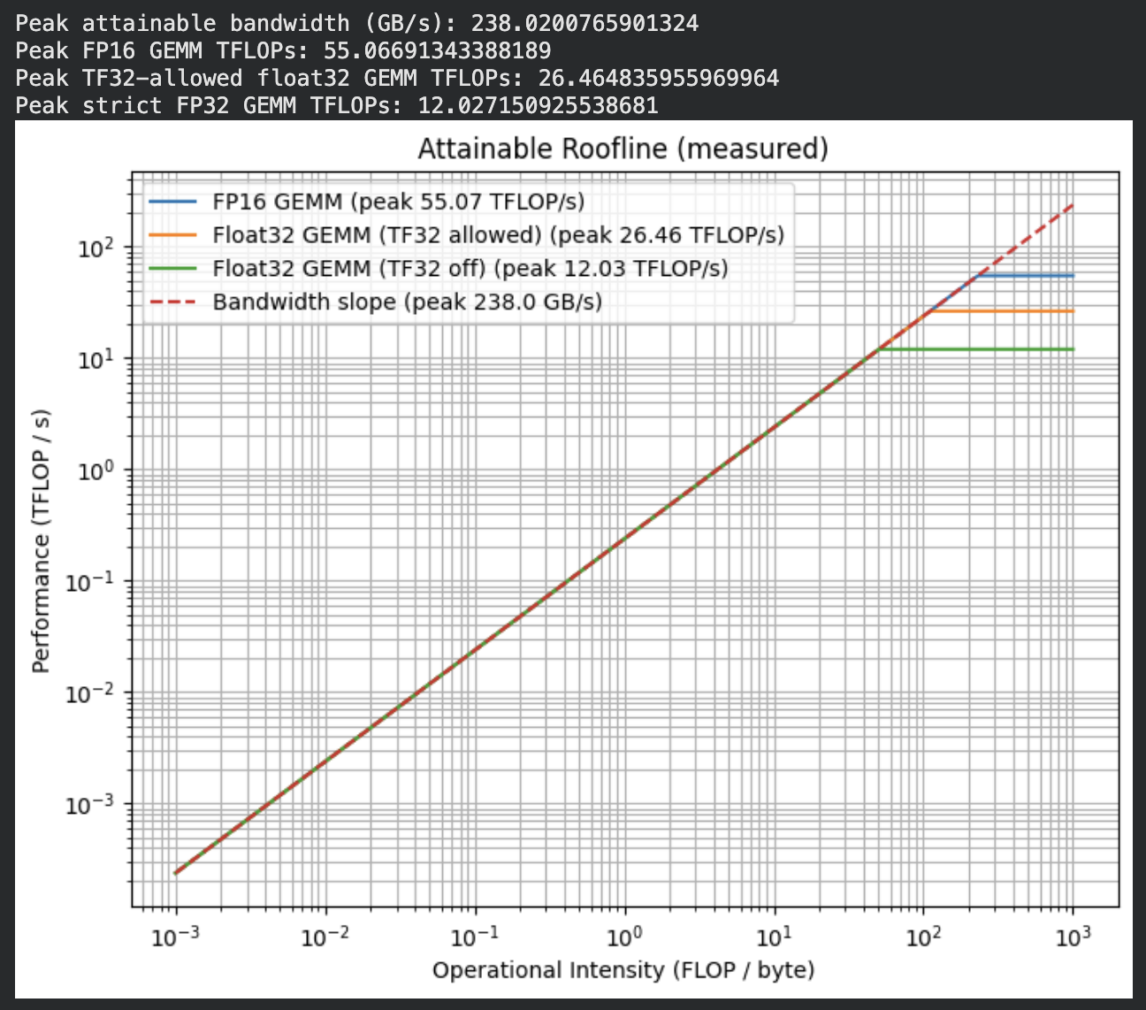
Roofline Model
Relates kernel’s OI to maximum achievable performance
Performance limited by memory or compute bounds
Measured peak bandwidth: ~238 GB/s
Reduced precision enables higher throughput
Kernels with low OI are memory bound
Kernels with high OI are compute bound
Notes:
The roofline model relates a kernel’s operational intensity (OI) to the maximum achievable performance on a given hardware platform. The OI is measured in FLOPs per byte of memory traffic.
The two fundamental performance limits shown in a roofline model are the memory bandwidth and compute throughput, where memory bandwidth is the data movement limit and compute throughput is the peak FLOP per second.
With our roofline model we measure the peak bandwidth to be about 238 GB/s, which defines the sloped region on the plot where we see the performance is scaling with the OI until the compute limits are reached.
We have different compute ceiling depending on our arithmetic precision. We achieve 55 TFLOP/s for FP16, 26 TFLOP/s for TF32, and 12 TFLOP/s for FP32. So lowering our precision yields much higher compute throughput.
Therefore, kernels with low OI will be memory-bound, and kernels with high OI will be compute-bound. Memory-bound kernel performance can be improved with bandwidth reduction strategies like fusion and better memory reuse, while compute-bound kernel performance can be improved with tensor core acceleration.

Slide 3
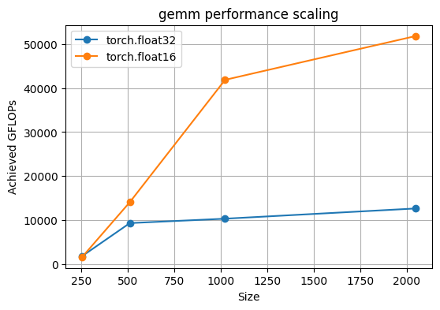
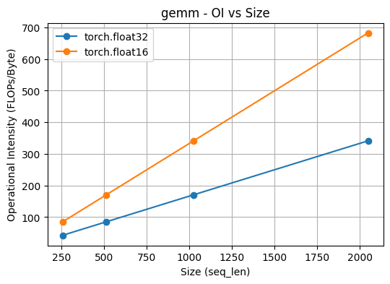
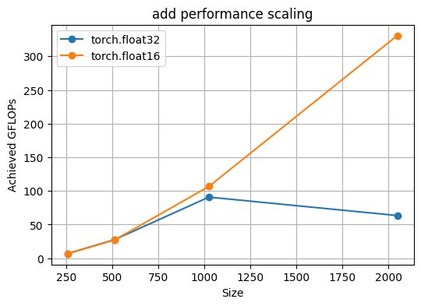
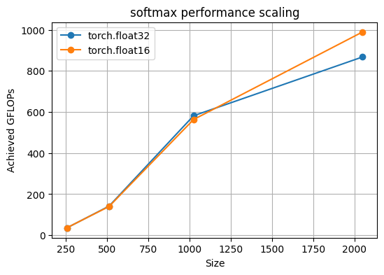
Kernel Performance
Key Observations
Throughput increases with problem size due to improved GPU utilization
FP16 consistently achieves higher throughput than FP32
Different kernels exhibit different operational intensity patterns

Slide 4
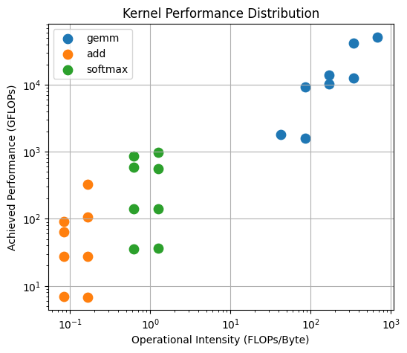
Kernel Distribution
Key Observations
GEMM appears in the high-intensity, high-throughput region
Element-wise add lies in the low-intensity region (memory-bound behavior)
Softmax shows intermediate characteristics between compute and memory limits

Slide 5
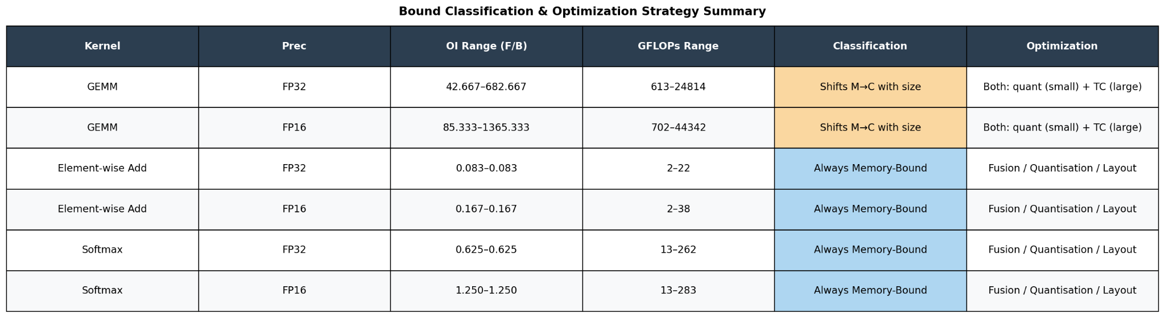
Roofline Based Optimization Strategy
GEMM becomes compute-bound at scale, making Tensor Cores the optimal choice.
Element-wise Add is always memory-bound, where kernel fusion eliminates redundant HBM round-trips
Softmax is bandwidth-limited, and FlashAttention directly resolves this bottleneck

