Slide 1
AI Chatbot
Presented By :- J Shahid Aqeel
Presentation subtitle

Slide 2
Overview
The AI Chatbot is a customer support solution developed using Streamlit, Python, a custom knowledge base, and the Groq AI platform. The application helps customers obtain information related to Chit Fund services through a conversational interface.
Technologies Used
Streamlit for User Interface
Python for Backend Processing
Groq API for AI Response Generation
Chit data for Knowledge Base

Slide 3
Core Components
1. Streamlit User Interface
Provides an interactive chat window where customers can type questions and receive responses.
2. Python Backend
Handles business logic, session management, knowledge base loading, and communication with Groq API.
3. Knowledge Base
Contains Chit Fund-related information that serves as the trusted source for generating responses.
4. Groq AI Model
Processes customer questions and generates intelligent responses based on the supplied context.

Slide 4
Customer Interaction Flow
The customer opens the chatbot and enters a question in the Streamlit chat interface.
Streamlit captures the user query and sends it to the Python backend.
The backend retrieves previous conversation history from the session state.
The Chit Fund knowledge base is loaded to provide relevant information.
A system prompt is added to guide the AI's behavior and responses.
The query, chat history, and knowledge base are sent to the Groq API.
The Groq AI model processes the request and generates a response.
The generated response is returned to the Python backend.
The response is stored in the session state for future reference.
Streamlit displays the AI-generated response to the customer.

Slide 5

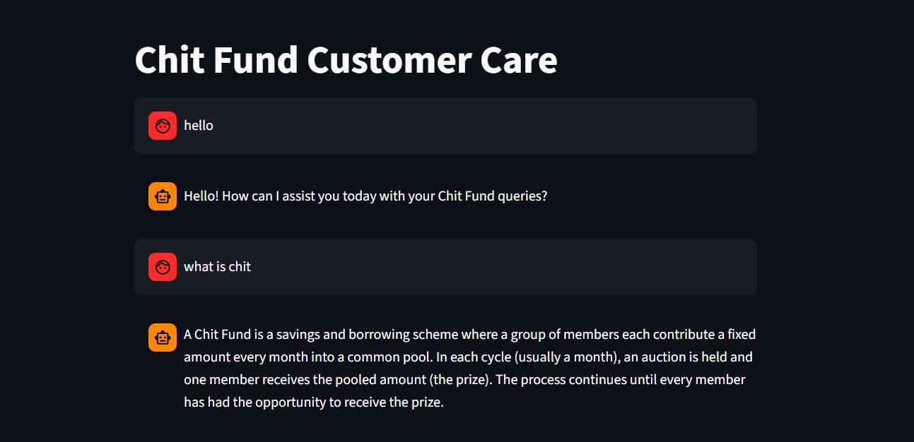
UI Design

Slide 6
System Prompt
A system prompt provides instructions to the AI model regarding how it should behave.
System Prompt Used:
System_prompt = f””” You are a Chit Fund Customer Care executive. Your job is to answer customers questions politely.Only use the knowledge base below. If a question is outside the knowledge base, say you do not have that information
{kb} “””
Benefits:
Controlled Responses :- Ensures the chatbot remains within its intended scope.
Consistent Behavior :- Maintains a uniform communication style across all conversations.
Improved Accuracy :- Directs the AI to use approved organizational information.

Slide 7
Session State
A conversation consists of multiple questions and responses.
Example
Customer: "What is my payment schedule?"
Follow-up Question: "When is my next installment due?"
The chatbot needs previous context to understand the second question properly.
Session State Functions
Stores customer messages
Stores assistant responses
Maintains conversation continuity
Improves user experience

Slide 8
Groq api Integration
The Python backend communicates with Groq through secure HTTPS requests.
Data Sent
System Prompt
Knowledge Base Content
Customer Question
Previous Conversation History
Processing
The Groq model analyzes all supplied information and generates an appropriate response.
Response Returned
The AI-generated answer is returned to Python, processed, and displayed to the customer.

Slide 9
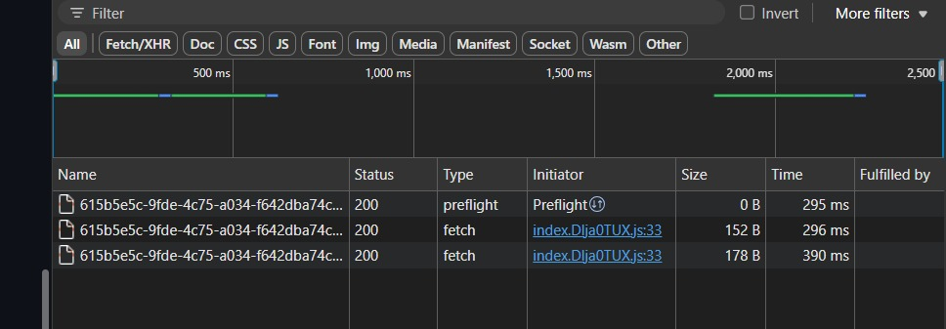
Network Tab analysis
The browser communicates with the Streamlit application primarily through WebSocket connections.
Preflight Request
Validates cross-origin permissions.
Security-related check before certain requests.
Does not generate chatbot answers.
Fetch / XHR Request
Supports Streamlit communication.
Transfers user interactions and application updates.
May include telemetry or reporting requests.
Status Code 200
Indicates successful request processing.
Does not automatically mean the chatbot answer is correct.
The actual Groq API request is generally not visible in Chrome Developer Tools because it is executed by the Python backend rather than directly by browser JavaScript.

Slide 10
Conclusion
The AI Chatbot combines Streamlit, Python, the Chit Fund Knowledge Base, and the Groq AI Platform to provide intelligent customer support.
It delivers quick and accurate responses to customer queries, reducing response time and improving service efficiency.
The knowledge base ensures that responses are consistent, reliable, and aligned with business information.
Session management helps maintain conversation context, creating a smooth and natural user experience.

