Slide 1
Advanced point cloud registration

Slide 2
Implement Tr-ICP, a robust approach to Iterated Closest Point (ICP) point cloud registration.
Task: ICP, Tr-ICP
Choose an appropriate mesh/point cloud format (.XYZ, .PLY, etc.) and input two point clouds. (examples here and here - notice the limited overlap between the two clouds)
(If the input point clouds are well aligned, rotate and displace one of them, randomly.)
Perform Nearest-neighbor search using kd-trees! (you may use nanoflann or any other library for the task)
Implement ICP
Implement Tr-ICP

Slide 3
Input: use inputs with various overlaps and/or synthetically generate point clouds.
Test various noise levels (add gaussian noise to 3D point locations, synthetically)!
Measure alignment precision (angular: rotation error, euclidean: translaton error)!
Measure runtime!
Plot your results! (diagrams)
Also compare ICP to Tr-ICP

Slide 4
Subtask 3
3D Reconstruction scenario

Slide 5
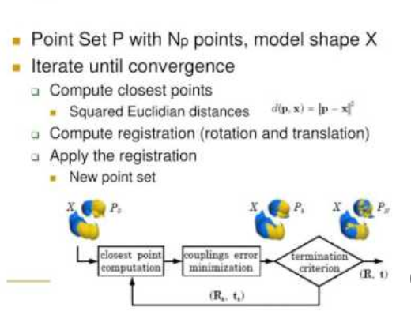

Slide 6
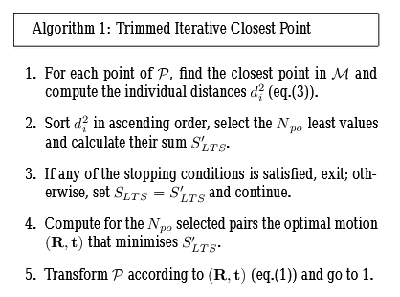
https://www.researchgate.net/publication/3974183_The_Trimmed_Iterative_Closest_Point_algorithm

Slide 7
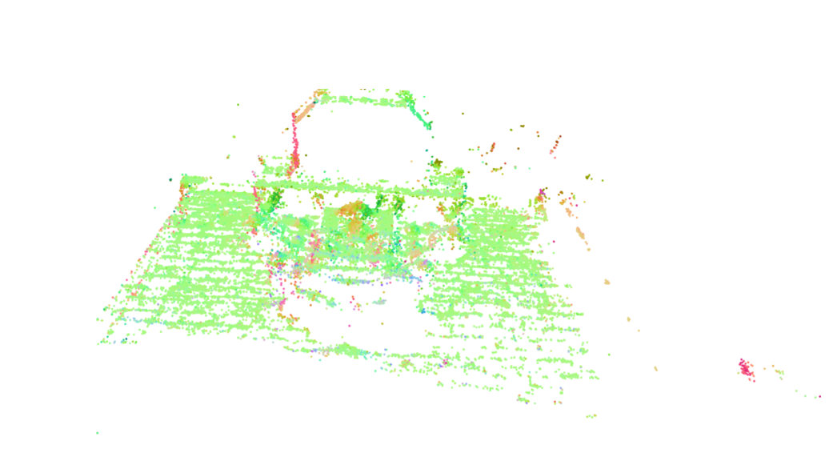
Original Point Cloud (Fountain)

Slide 8
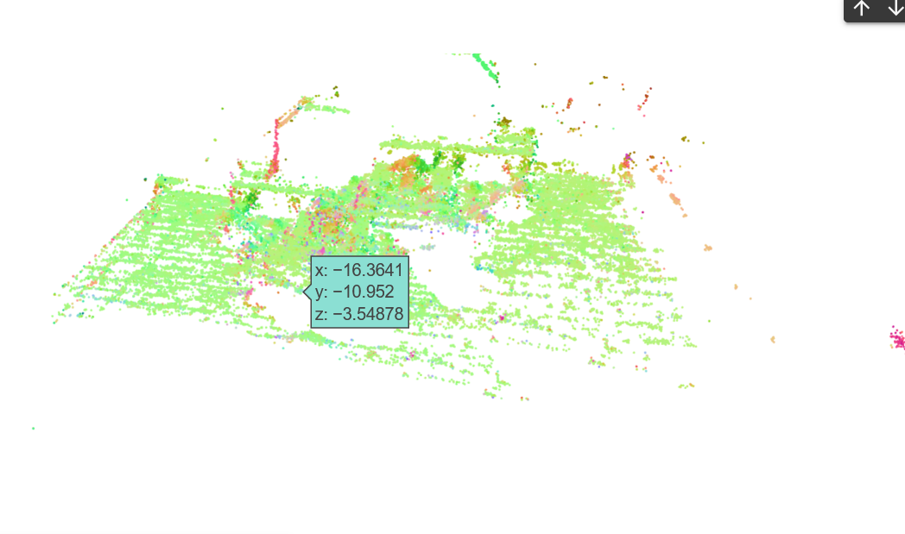
Changed Point Cloud
Translation: [0.05, 0.05, 0.05]

Slide 9
Running ICP algorithm
Tolerance=0.000001
Computation Time: 38.40920448303223s
No. of iterations - 123

Slide 10
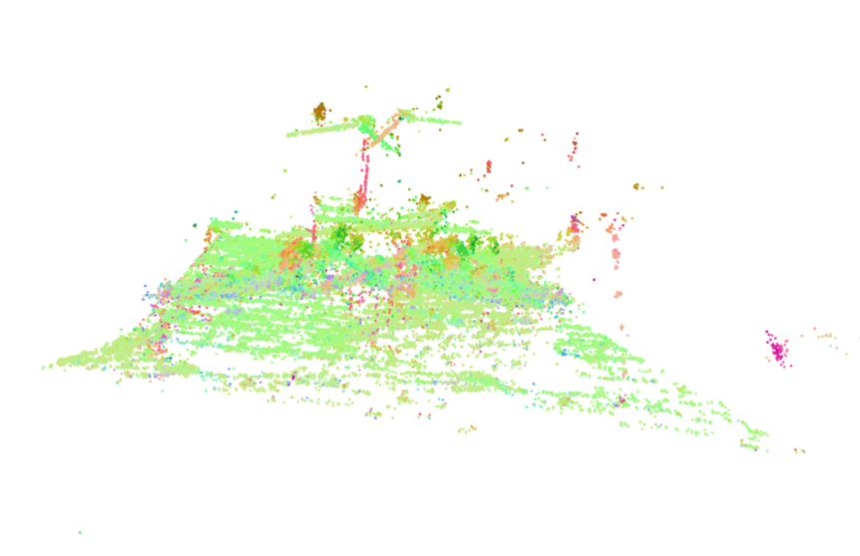
Results

Slide 11
Running Tr ICP algorithm
Tolerance=0.000001
Computation Time: 38.40920448303223s
No. of iterations - 123

Slide 12
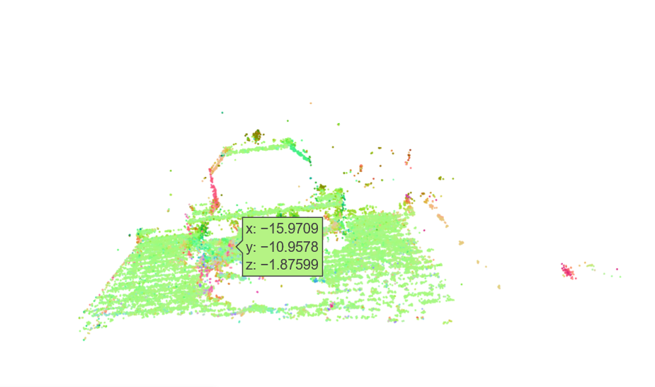
Result of Tr ICP

Slide 13
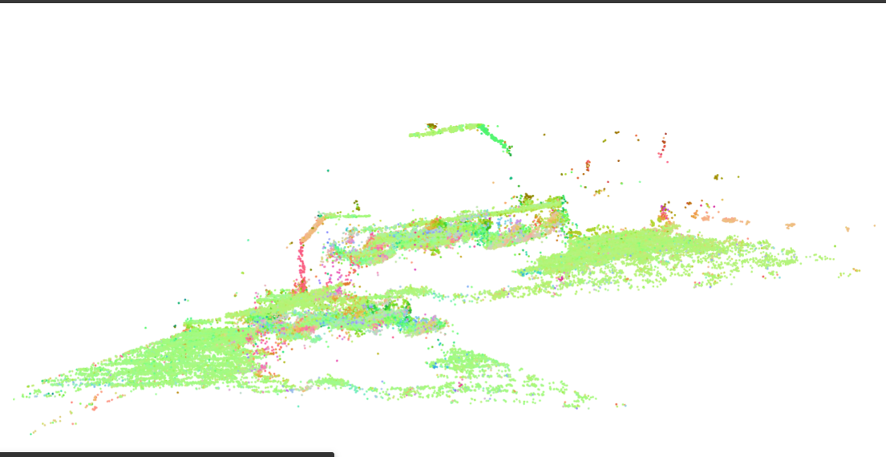
Translation [0.02 0.05 0.01]

Slide 14
ICP
Computation time: 38.50346922874451s
No. of iterations - 124

Slide 15
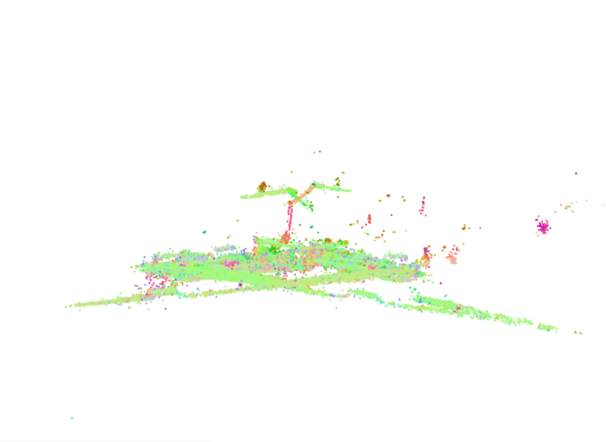
Results

Slide 16
Tr -ICP
12.480991840362549s
iterations - 26

Slide 17
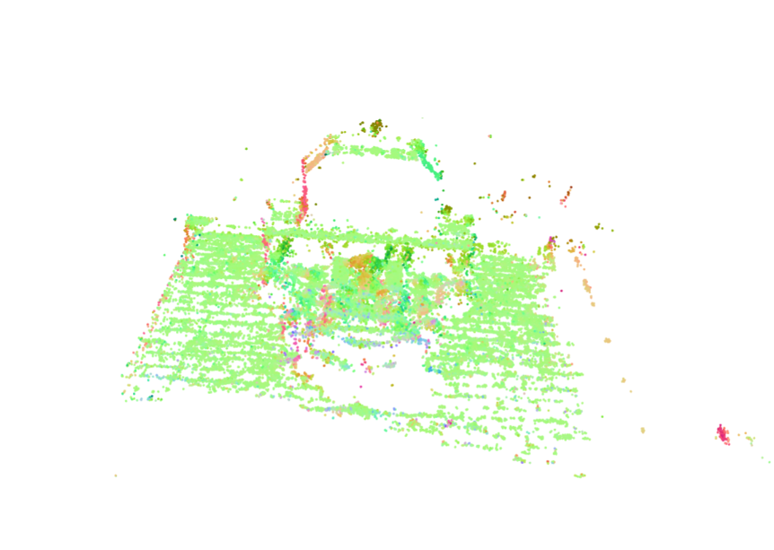
Results

Slide 18
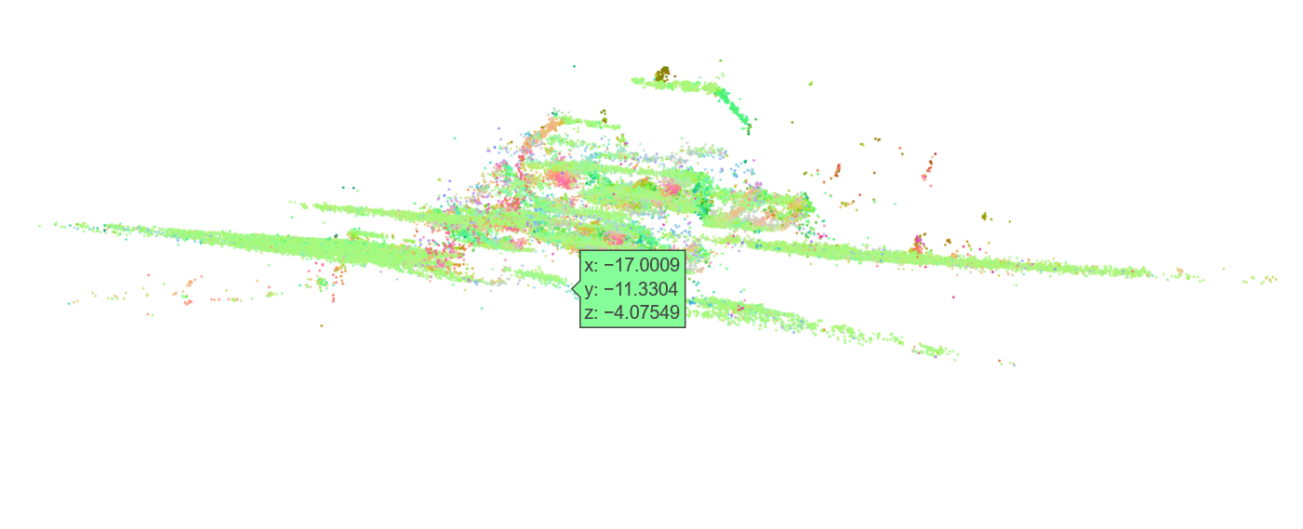
[0.06, 0.04, 0.01]

Slide 19
ICP
36.50570273399353s
iterations - 120

Slide 20
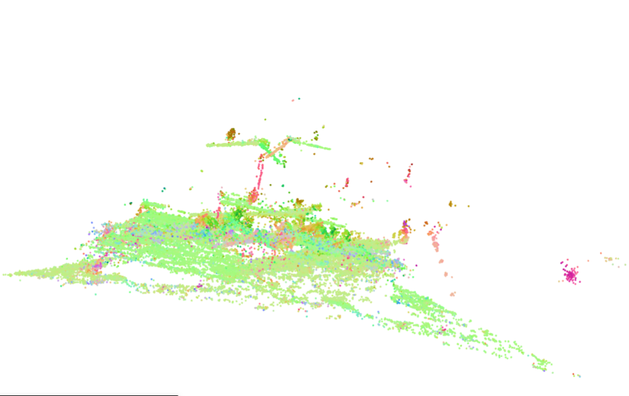
Results

Slide 21
Tr ICP
44.09294629096985s
Iterations - 96

Slide 22
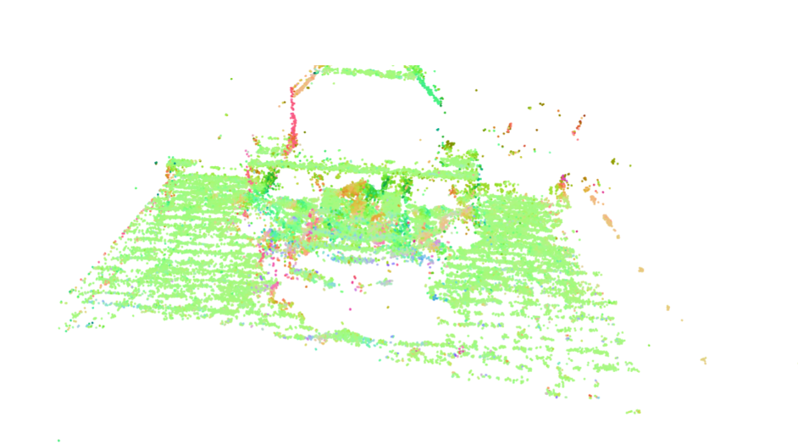
Results

Slide 23
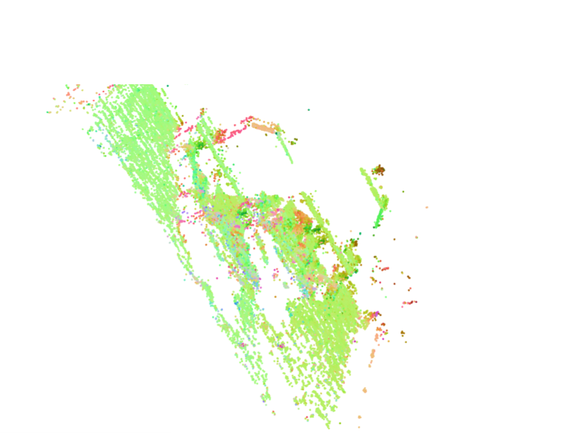
0.03, 0.05, 0.01

Slide 24
ICP
40.03980469703674s
iterations - 133

Slide 25
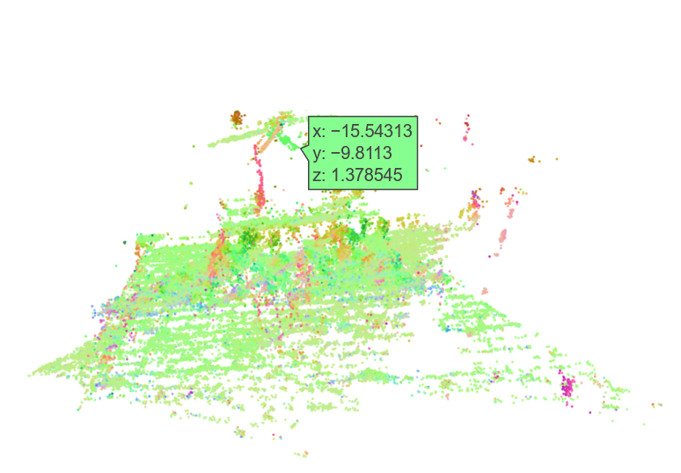
Result

Slide 26
Tr ICP
53.79613542556763
iterations - 115

Slide 27
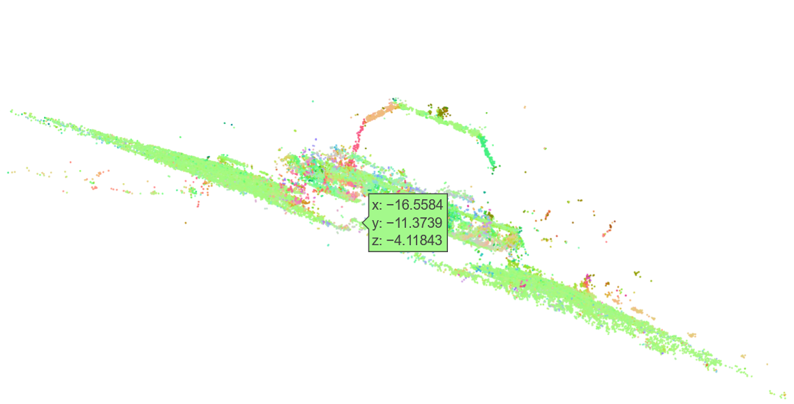

Slide 38
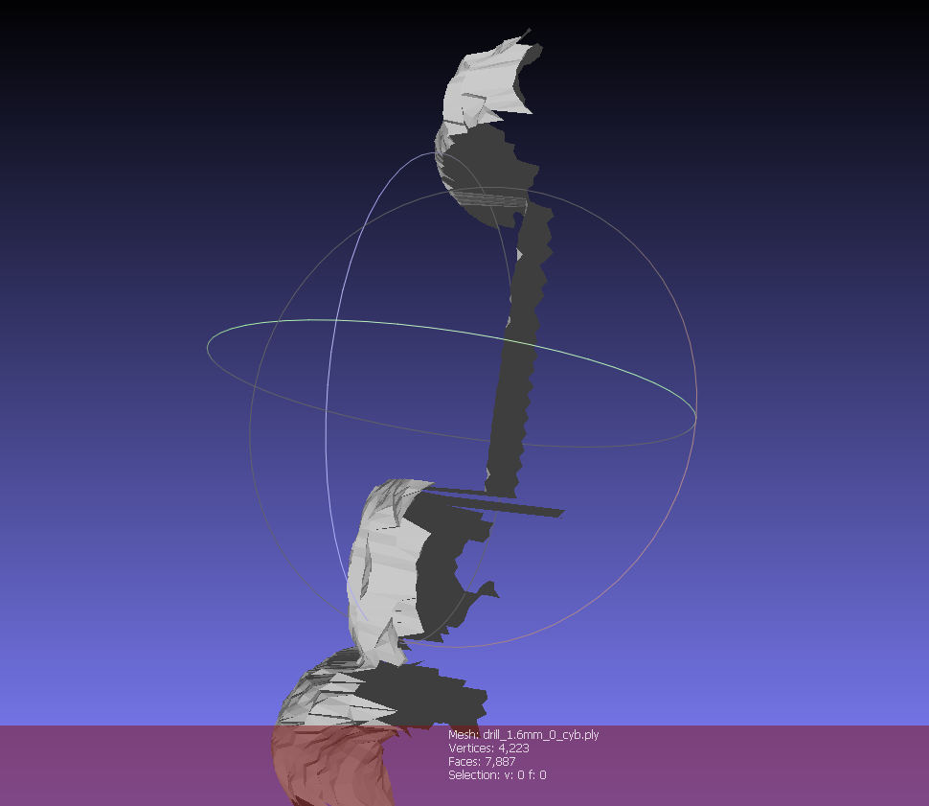

Slide 39
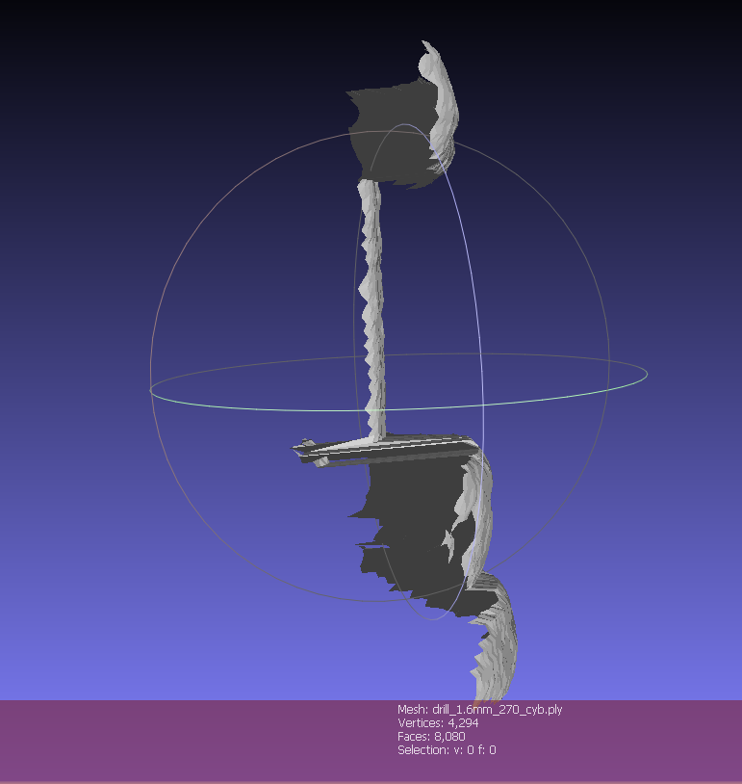

Slide 40
