Slide 1
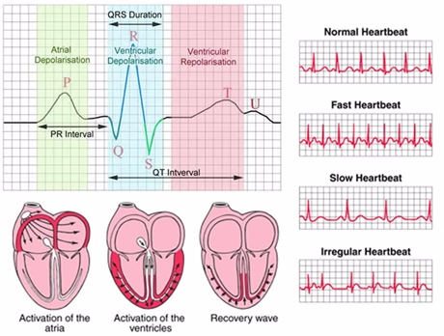
ECG Heartbeat Detection
Presented By: Shahid Gulzar Padder
Neptun code: XPXSKK
Under the guidance of:
Dr. Péter Kovács
Faculty of Informatics
ELTE, Budapest

Slide 2
INTRODUCTION
Electrocardiography is the process of producing an electrocardiogram (ECG)
It's a common and painless test used to quickly detect heart problems and monitor your heart's health.
The surface ECG is obtained by recording the potential difference between two electrodes placed on the surface of the skin
During an ECG, up to 12 sensors (electrodes) are attached to chest and limbs.
These electrodes detect the small electrical changes that are a consequence of cardiac muscle depolarization followed by repolarization during each cardiac cycle (heartbeat).

Slide 3
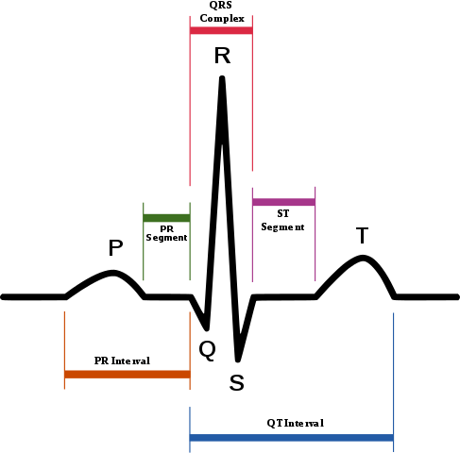
PRINCIPLE
Whenever an electrical potential is generated in a section of the heart, an electrical current is conducted to the body surface in a specific area
Three important pulses that complete the ECG wave:
P wave
QRS Wave
T wave

Slide 4
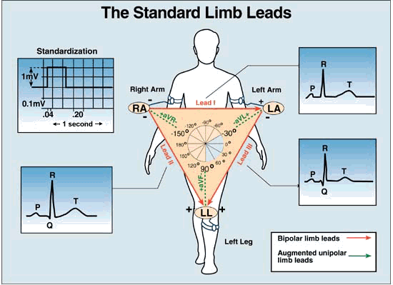
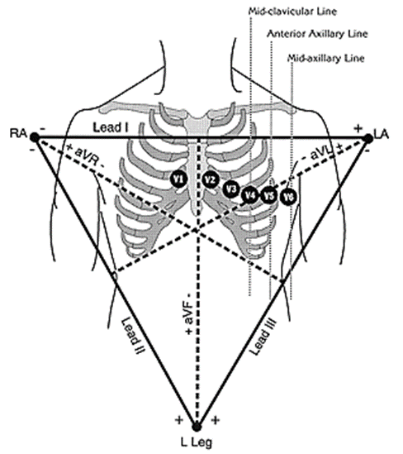
Measuring ECG
ECG commonly measured via 12 specifically placed leads

Slide 5
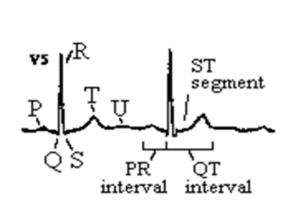
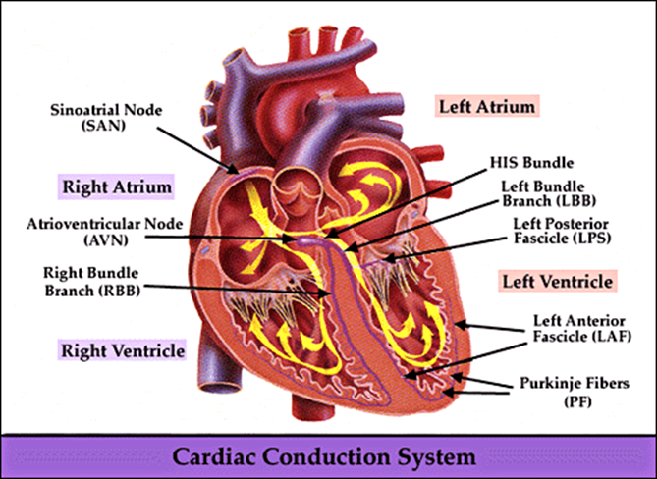
WORKING
P wave: the sequential activation (depolarization) of the right and left atria
QRS complex: right and left ventricular depolarization
T wave: ventricular repolarization
U wave: origin not clear, probably ”afterdepolarizations” in the ventrices

Slide 7
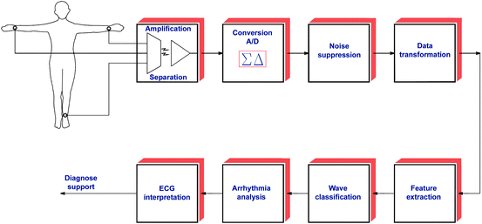

Slide 8
The major sources of noise
1. Power line interference
2. Muscle contractions
3. Electrode contact noise
4. Motion Artifacts
5. Baseline wandering
6. Noise generated by electronic devices used in signal processing circuits
7. Electrical interference external to the subject and recording system 8. High-frequency noises in the ECG
9. Breath, lung, or bowel sounds contaminating the heart sounds (PCG).

Slide 9
THANK YOU

