Slide 1

FYP Defense
Presentation
Tours & Travel
Mobile Application
A Smart Tourism Management & Booking Platform
Shahid Umer AUIC-22SG-BSCS-6732
Musharaf AUIC-22SG-BSCS-7029
Supervisor: Dr. Amjad Khan

Slide 2
Introduction
•
Tours & Travel is a Flutter-based mobile application designed to unify destination discovery, hotel booking, transport planning, maps, and traveler support in one platform.
•
The project targets Pakistan’s domestic tourism context, where users still depend on scattered sources for places, hotels, payments, and travel coordination.
•
Core objective: build a modular academic prototype that demonstrates authentication, bookings, maps, profile management, booking history, and user-created listings.
•
The system uses Flutter for the mobile interface and Firebase-backed services with local fallback support for stable final-year demonstration.
AUIC – CS/SE - FYP Presentation
2

Slide 3
Literature Review
App / System
It Gives
Gap
Our App Gives
Booking.com
Hotels, stays, flights, car rentals, and guest reviews.
Strong booking app, but not one local tourism flow for our project scope.
We give destination browsing, hotel booking flow, maps, profile, and booking history in one app.
Agoda
Hotels, homes, flights, transport, and activities.
Good travel deals app, but not focused on one local tourism workflow.
We give local destination details, booking support, maps, and user account features in one system.
Expedia
Stays, flights, cars, packages, and things to do.
Strong global travel bundles, but not tailored to our local academic use case.
We combine destination exploration, hotel flow, profile, and booking history in one app.
Trip.com
Hotels, flights, trains, attractions, and travel deals.
Strong international app, but it does not match our single local tourism demo flow.
We give maps, local destinations, hotel booking support, profile, and booking history together.
Summary: existing apps provide strong global booking services, while our app combines local destination discovery, hotel flow, maps, profile, and booking history in one academic mobile app.
AUIC – CS/SE - FYP Presentation
3

Slide 4
Problem Statement
Pakistan’s tourism planning process is still fragmented and semi-manual. Users discover destinations on one platform, research hotels somewhere else, arrange transport separately, and confirm details through calls or messages.
There is no single user-friendly mobile application that lets travelers move smoothly from exploration to booking confirmation while also supporting maps, profile data, booking history, and service listings.
This creates repeated data entry, weak cost visibility, inconsistent communication, and lower trust for both users and service providers. The project addresses that gap through one integrated tourism app prototype.
AUIC – CS/SE - FYP Presentation
4

Slide 5
Methodology
Academic software engineering approach — requirement-driven, modular, and iterative
Requirement Engineering
Core Feature Modules
•
Stakeholder identification and requirement analysis
•
Authentication, destination discovery, and booking workflow design
•
Functional / non-functional requirements definition
•
Hotel search, car rental, payment simulation, and map support
•
Feasibility study, risk assessment, and traceability planning
•
Profile management, booking history, and user listing modules
Data & Service Layer
Testing & Validation
•
Service-oriented separation of screens, models, and storage logic
•
Manual and integration testing across major user flows
•
Firebase Auth, Firestore, Storage, Shared Preferences, and in-memory fallback
•
Positive / negative case validation for forms, bookings, and routing
•
Reusable validators, constants, theme utilities, and navigation helpers
•
Honest reporting of defects, limitations, and production gaps
AUIC – CS/SE - FYP Presentation
5

Slide 6
Methodology (Cont..)
Development Tools & Practices
Technology Stack
Category
Tool / Practice
IDE
Android Studio
Flutter
Dart
Framework
Flutter with Dart
Cloud services
Firebase Auth, Cloud Firestore, Firebase Storage
Firebase
Firestore
Local support
Shared Preferences + in-memory booking store
Maps & location
Google Maps Flutter and Geolocator
Maps API
Shared Prefs
Testing
Manual and integration flow testing
AUIC – CS/SE - FYP Presentation
6

Slide 7
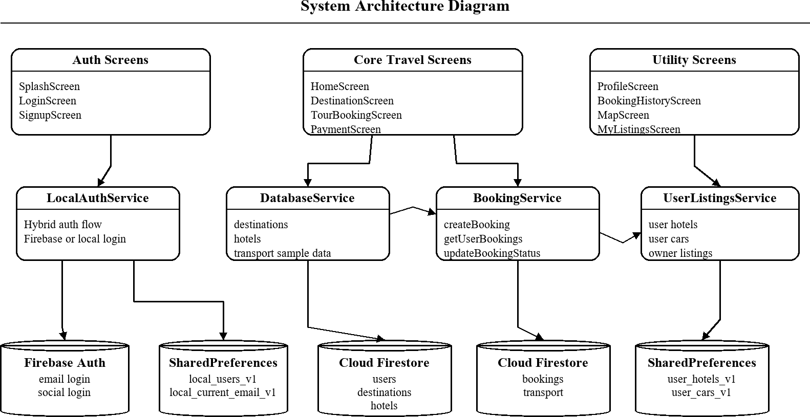
System Design
Proposed System Architecture Diagram
AUIC – CS/SE - FYP Presentation
AUIC – CS/SE - FYP Presentation
7
7

Slide 8
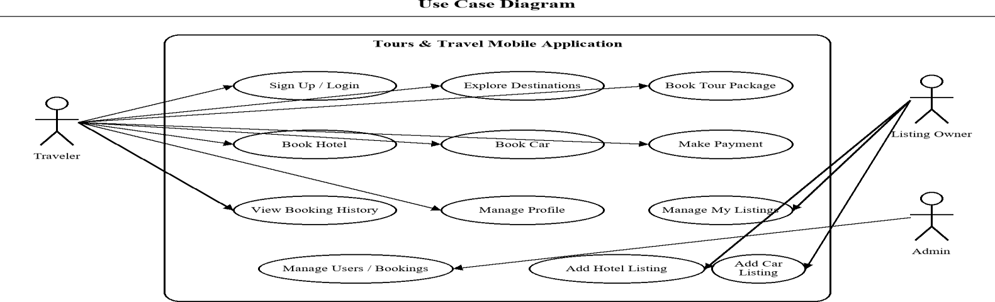
System Design (Cont..)
Use Case Diagram
Tours & Travel Mobile Application
Add Hotel Listing
Register Account
Login
Add Car Listing
VENDOR
Browse Destinations
Manage Listings
TRAVELER
View Destination Info
Update Prices / Availability
Book Tour / Hotel / Car
Manage Profile
View Map
Manage Users / Bookings
View Booking History
ADMIN
Manage Errors
Process Payment
Use Case Diagram
Use Case Diagram
AUIC – CS/SE - FYP Presentation
AUIC – CS/SE - FYP Presentation
8
8

Slide 9
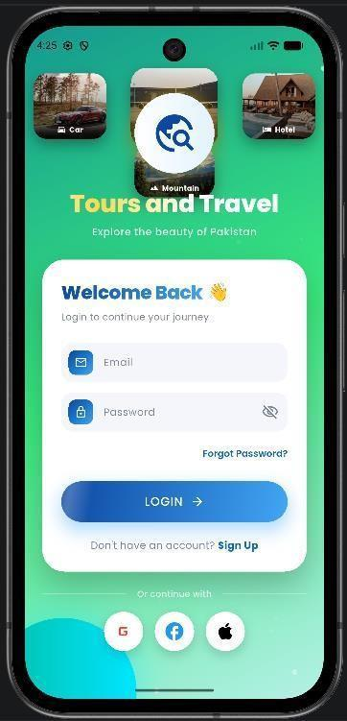
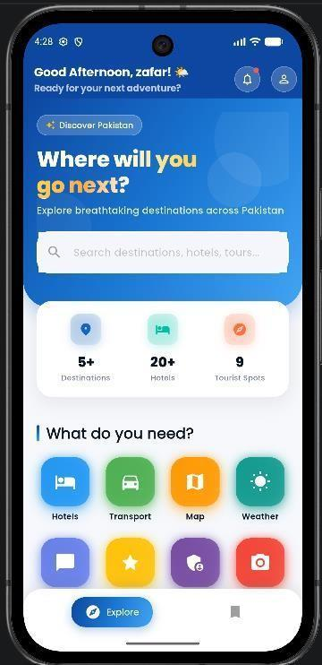
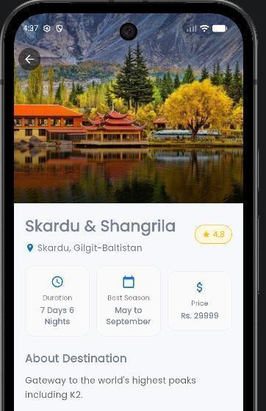
App Screens
Mobile App — Authentication & Discovery Interface
Login Screen
Home / Discovery Screen
Destination Detail Screen
User authentication entry
Browse destinations and services
Highlights, gallery, and booking CTA
AUIC – CS/SE - FYP Presentation
AUIC – CS/SE - FYP Presentation
9
9

Slide 10
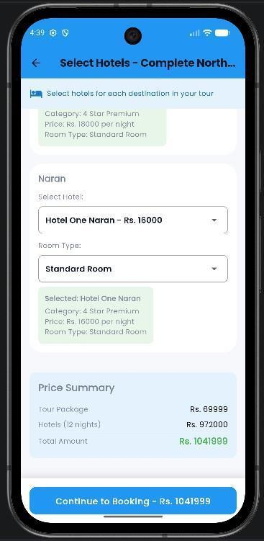
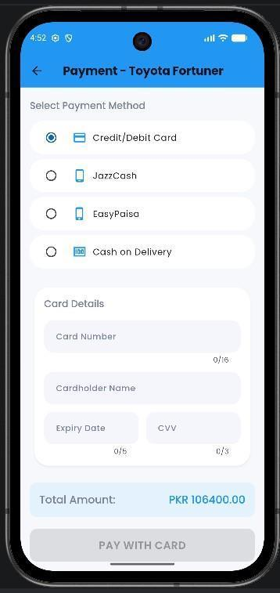
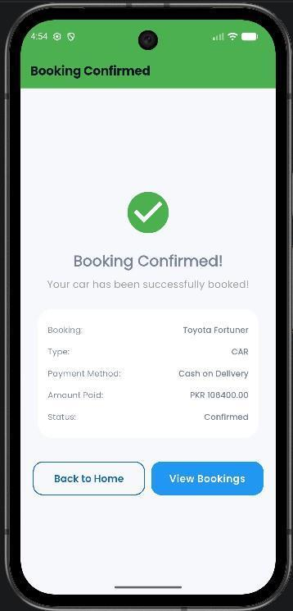
App Screens (Cont..)
Mobile App — Booking, Selection, and Confirmation
Hotel Selection Screen
Payment Screen
Booking Confirmation
User chooses hotel and room type
Simulated payment interface
Success state after confirmation
AUIC – CS/SE - FYP Presentation
AUIC – CS/SE - FYP Presentation
10
10

Slide 11
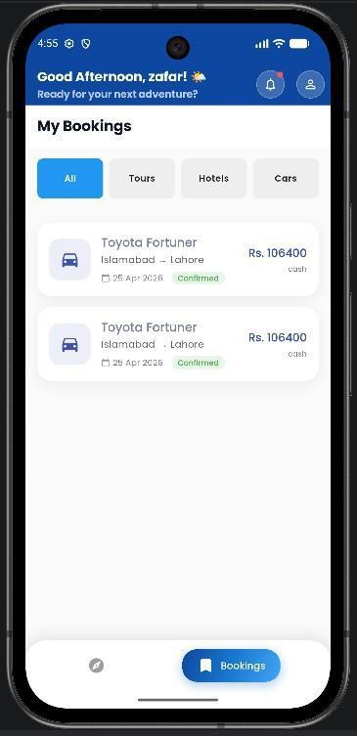
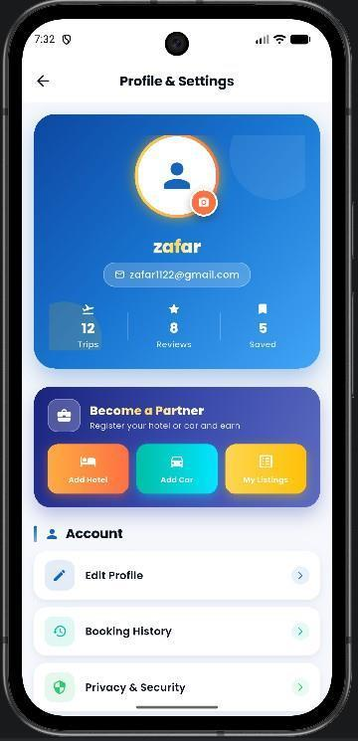
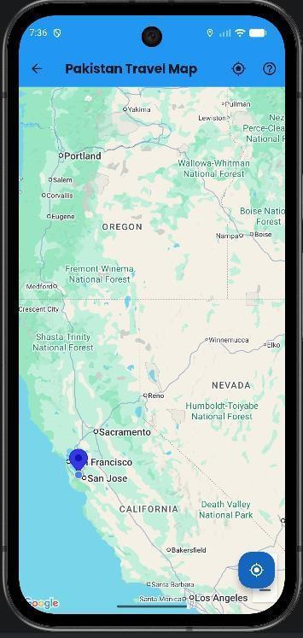
App Screens (Cont..)
Booking History, Profile, and Maps
Booking History Screen
Profile Management Screen
Tourist Map Screen
Confirmed trips visible to the user
User details, counts, and quick actions
Location markers and map-based support
AUIC – CS/SE - FYP Presentation
AUIC – CS/SE - FYP Presentation
11
11

Slide 12
Results and Analysis
Functional Testing — Core User Flows Validated
Test Case ID
Module
Description
Status
TC-01
Authentication
User registers / logs in successfully
PASS
TC-02
Validation
Invalid email or password shows appropriate feedback
PASS
TC-03
Booking
Destination and hotel selection flow completes correctly
PASS
TC-04
Payment
Simulated payment moves to booking success state
PASS
TC-05
History
Confirmed booking appears in booking history
PASS
TC-06
Maps / Listings
Map loads and local listings remain accessible
PASS
AUIC – CS/SE - FYP Presentation
12

Slide 13
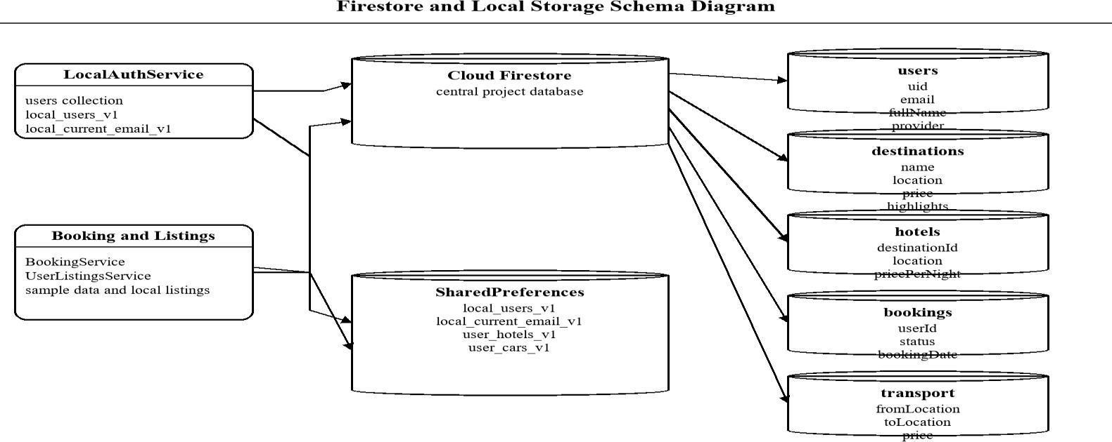
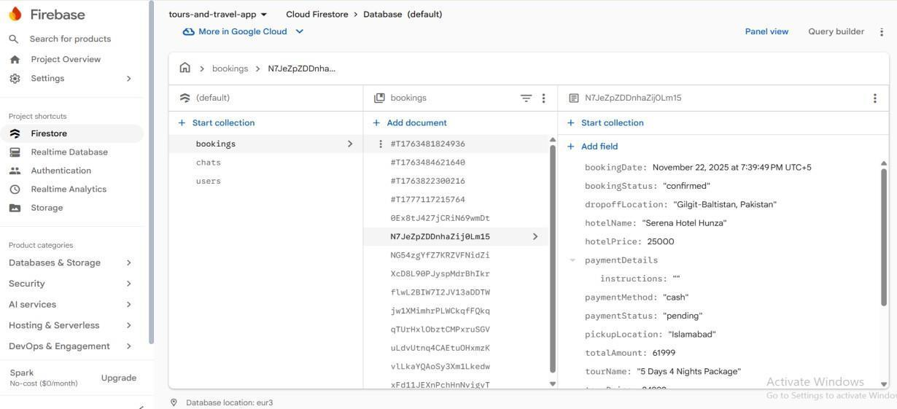
Results and Analysis (Cont..)
Prototype Readiness & Cloud Data View
The prototype demonstrates structured Firestore collections, initialized cloud data, and a maintainable service-driven design that can be extended beyond the current academic scope.
AUIC – CS/SE - FYP Presentation
AUIC – CS/SE - FYP Presentation
13
13

Slide 14
Challenges
•
Simulated payments instead of a live payment gateway mean the booking flow is demonstration-ready but not yet transaction-ready.
•
Automated testing coverage is still limited, so validation is stronger for manual user flows than for long-term regression control.
•
Some booking states and user-created listings currently rely on local or session-based persistence instead of complete cloud synchronization.
AUIC – CS/SE - FYP Presentation
14

Slide 15
Future Work
•
Integrate a real payment gateway for production-grade booking confirmation.
•
Add recommendation, search enhancement, features for better traveler decision support.
•
Introduce push notifications, stronger security rules, and broader automated unit / integration tests.
•
Move from a robust academic prototype toward a deployable tourism platform for Pakistan.
AUIC – CS/SE - FYP Presentation
15

Slide 16
Conclusion
•
The project successfully demonstrates that one modular Flutter application can combine destination discovery, hotel booking, car rental, maps, profile management, and booking history in one tourism workflow.
•
It applies requirement engineering, layered architecture, reusable UI, Firebase-backed services, and structured testing in a real final-year software project.
•
The prototype is academically valuable today and also leaves a credible path toward future commercial and research-oriented enhancement.
AUIC – CS/SE - FYP Presentation
16

Slide 17
References
[1] Google, "Flutter documentation," https://docs.flutter.dev/.
[2] Google, "Firebase documentation," https://firebase.google.com/docs.
[3] Google for Developers, "Google Maps Platform documentation," https://developers.google.com/maps/documentation.
[4] Material Design 3 guidelines, https://m3.material.io/.
[5] Dart documentation, "Dart language tour," https://dart.dev/guides/language/language-tour.
[6] Geolocator package documentation, https://pub.dev/packages/geolocator.
[7] Cloud Firestore package documentation, https://pub.dev/packages/cloud_firestore.
AUIC – CS/SE - FYP Presentation
17

Slide 18
Questions
Abasyn University Islamabad Campus | Department of Computer Science | 2022 – 2026
AUIC – CS/SE - FYP Presentation
18

