Slide 1
Forecasting Dengue Incidences in Bangladesh: A Univariate Time Series Approach
Shahidul Islam
Department of CSE
Fareast International University
Dhaka, Bangladesh
Supervisor:
Md Rifat Hasan
Lecturer

Slide 2
INTRODUCTION
Dengue fever, an acute health concern in Bangladesh, has dramatically increased in frequency and severity in recent years. The dengue epidemic experienced in 2023 represented an unprecedented peak in the incidence of the disease within the nation's recorded history.
In this study, the main goal was to create forecasting models for dengue-affirmed cases in the unique context of Bangladesh, primarily driven by the escalating health crisis of the dengue epidemics.

Slide 3
MOTIVATION
The motivation behind this study stems from the growing concern over the rising incidence of dengue in Bangladesh and its significant impact on public health. The unpredictable nature of dengue epidemics, compounded by the challenges in early detection and management, underscores the need for a more robust approach to predict and control dengue outbreaks.
Another driving factor for this study is the limited availability of reliable predictive models for dengue outbreaks in the context of Bangladesh. There is a critical need for models that can accurately predict dengue outbreaks, enabling health authorities to prepare and respond more effectively.

Slide 4
RELATED WORKS
Forecast of Dengue Incidence Using Temperature and Rainfall
In this study, Hii et al. (2012) proposed an early forecast system capable of anticipating dengue cases and delivering timely warnings up to 16 weeks in advance. A Poisson multivariate regression model was created utilizing weekly average temperature and total precipitation in Singapore for the years 2000-2010. The standardized Root Mean Square Error (RMSE), residual diagnosis, and Akaike’s Information Criteria (AIC) were used for model selection and evaluation. According to the study, the frequency of dengue was most prominent from June to October in Singapore. [1]

Slide 5
RELATED WORKS
Forecasting the incidence of dengue in Bangladesh—Application of time series model
Naher et al. (2022) highlighted the importance of early warning systems for controlling dengue epidemics in Bangladesh and emphasized the need for proactive measures to minimize the suffering caused by outbreaks. The researchers considered the Autoregressive Integrated Moving Average (ARIMA), Error, Trend, Seasonal (ETS), Trigonometric seasonality, Box-Cox transformation, ARMA errors, Trend, and Seasonal (TBATS) model for forecasting purposes. After checking the accuracy of the fitted models with Root Mean Square Percentage Error (RMSPE), Mean Percent Forecast Error (MPFE), and Theil Inequality Coefficient (TIC), ARIMA (2,1,2) turned out to be the superlative predictive model. [2]

Slide 6
RELATED WORKS
Forecast of Dengue Cases in 20 Chinese Cities Based on the Deep Learning Method
Xu et al. (2020) observed that the Long Short-Term Memory (LSTM) model fared better in forecasting dengue cases than already-published forecasting models, and the use of Transfer Learning (TL) may improve the model's capacity to draw conclusions about areas with fewer dengue cases. To forecast dengue fever (DF), the study built an LSTM-based model and evaluated its efficiency using Root Mean Squared Error (RMSE) against that of other potential models, including Gradient Boosting Machine (GBM), Support Vector Regression (SVR), Back Propagation Neural Network (BPNN), and Generalized Additive Model (GAM). [3]

Slide 7
Novelty
Unique Aspects of This Study
In the DF forecast scenario of Bangladesh, the Holt-Winters method has still been an unexplored region up until now, which our study aims to delve into.
The researchers have also endeavored to find new parameters for the SARIMA model based on the lowest AIC score.
This study is the first to analyze the Prophet model’s potential in forecasting dengue cases in Bangladesh.
By filling these identified gaps, this research aims to contribute significantly to the field of dengue forecasting and public health planning in Bangladesh.

Slide 8
DATA COLLECTION
The required data on monthly dengue cases in Bangladesh, spanning from January 2008 to December 2023, have been collected from two primary sources: the Institute of Epidemiology, Disease Control and Research (IEDCR) and the Directorate General of Health Services (DGHS) website.
This comprehensive dataset formed the basis for the subsequent analysis and modeling in this study.

Slide 9
DATA PRE-PROCESSING
The original dataset, housed in an Excel file, was structured into a wide format where months were represented as rows and years as columns with each cell having the corresponding value of dengue cases.
The dataset was refined into a chronological data frame consisting of two columns named ‘date’ (datetime64) and ‘cases’ (int64) respectively. The ‘date’ column was set as the index of the dataset.
The preprocessing steps yielded a dataset primed for time series analysis.
Notes:
To employ association rules, a clinical dataset with both categorical and numeric attributes must be converted to binary scales.

Slide 10
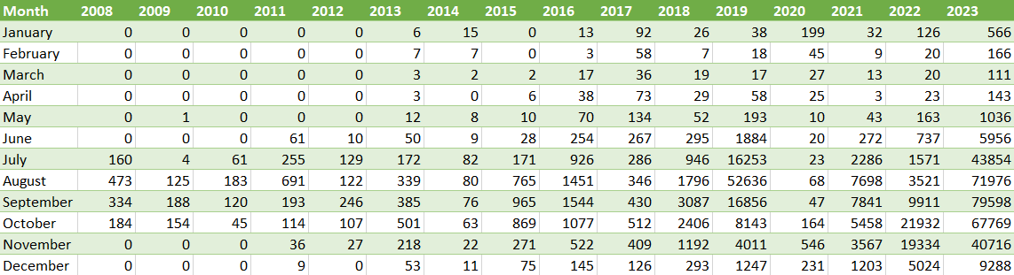
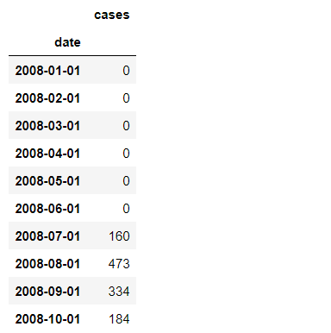

DATA PRE-PROCESSING
Raw Data
Sample Time Series Data

Slide 11
DATA Analysis
To understand the underlying patterns of DENV cases in Bangladesh over time, the initial phase of analysis focused on the following aspects of visualization
Time Series Graph
Seasonal-Trend Decomposition
Furthermore, the data went through some more statistical analyses that are:
Autocorrelation Analysis (ACF, PACF plots)
Stationarity Test (Augmented Dickey-Fuller Test)
Notes:
To employ association rules, a clinical dataset with both categorical and numeric attributes must be converted to binary scales.

Slide 12
METHODOLOGY
The methodology section provides the strategical approach for forecasting dengue cases by utilizing a range of 4 sophisticated time series models:
SARIMA
Seasonal Auto-Regressive Integrated Moving Average is an advanced iteration of the ARIMA model, introduced by Box and Jenkins in 1976. ARIMA is capable of forecasting future values based on its past values. [4]
HWES
Holt-Winters Exponential Smoothing extends upon Exponential Smoothing to capture various aspects like level, trend, and seasonality in the data. Employing exponentially decreasing weights and values for historical data, exponential smoothing is a technique for smoothing time series data. [5]
Prophet
Prophet is an algorithm that uses an additive mode to forecast time series data. Engineered in 2017 by the Data Science Team at Facebook, it handles strong seasonal effects and outliers well.
LSTM
A variant of the Recurrent Neural Network (RNN), the Long-Short Memory Network is adept at learning from sequences of time series data. It integrates short-term memory and long-term memory via gating mechanisms, effectively addressing the issue of vanishing gradients. [6]

Slide 13
METHODOLOGY
Summarized Pipeline:
Dataset Preprocessing
Data Visualization & Analysis
Data Transformation
Residual Analysis of the Best Model
Model Evaluation (RMSE, MAE)
Model Training & Forecasting

Slide 14
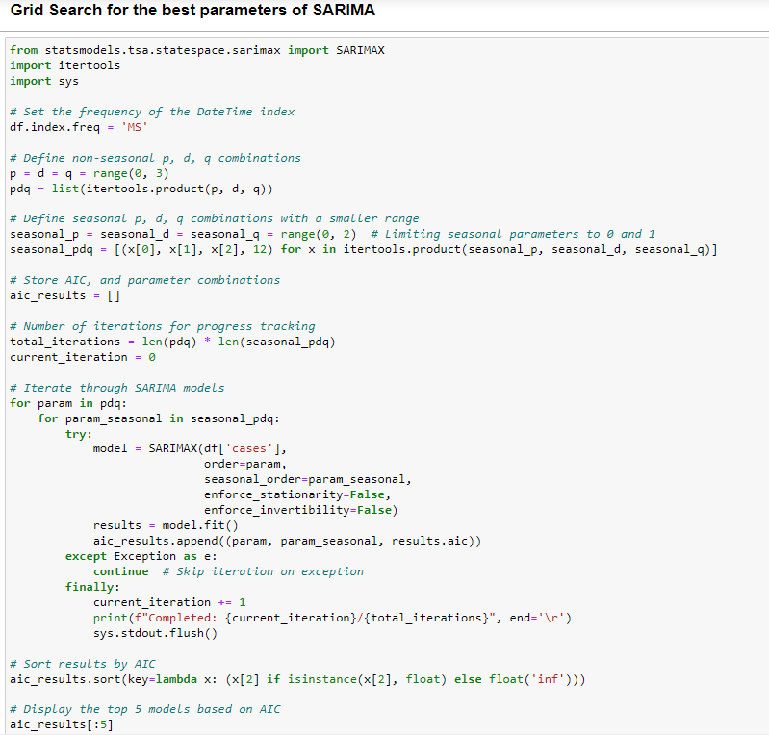
IMPLEMENTATION
SARIMA implementation:
Initial parameters are taken from ACF, PACF plots, and ADF test
Final parameters are from the lowest AIC score
Code snippet for finding the model with the lowest AIC:
SARIMA (p, d, q) (P, D, Q, S) | AIC Score
SARIMA (2, 1, 2) (0, 0, 0, 12) (From statistical tests) | 3822.114
SARIMA (2, 1, 2) (0, 1, 1, 12) (From Grid-search) | 3604.277

Slide 15
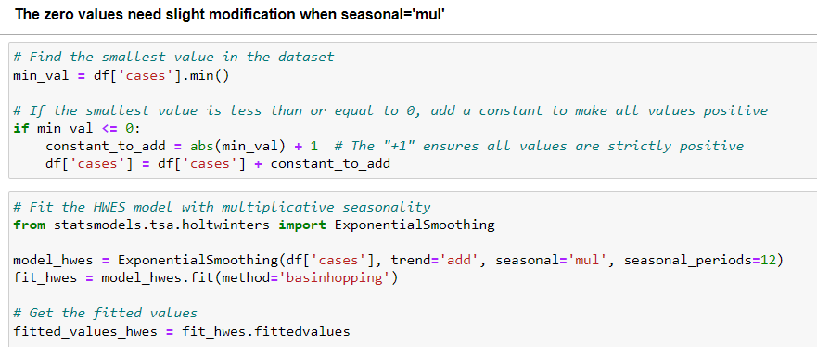
IMPLEMENTATION
Holt-Winters implementation:
Data transformation: Every ‘0’ value to ‘1’
Parameter selection:
Code snippet for data transformation and Model Training:
Parameter | Value | Description
Trend | ‘add’ | Additive trend
Seasonal | ‘mul’ | Multiplicative season
Periods | 12 | No. of steps in the cycle

Slide 16
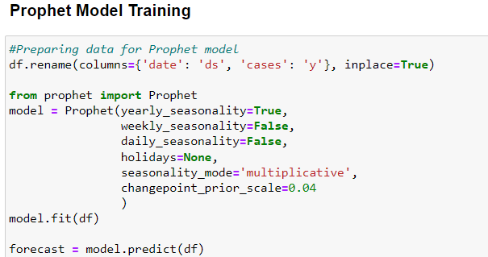
IMPLEMENTATION
Prophet implementation:
Data transformation: change column names
‘date’ : ‘ds’ & ‘cases’ : ‘y’
Parameter selection:
Code snippet for data transformation and Model Training:
Parameter | Value
Yearly seasonality | True
Weekly seasonality | False
Daily seasonality | False
Holidays | None
Seasonality mode | Multiplicative
Changepoint scale | 0.04

Slide 17
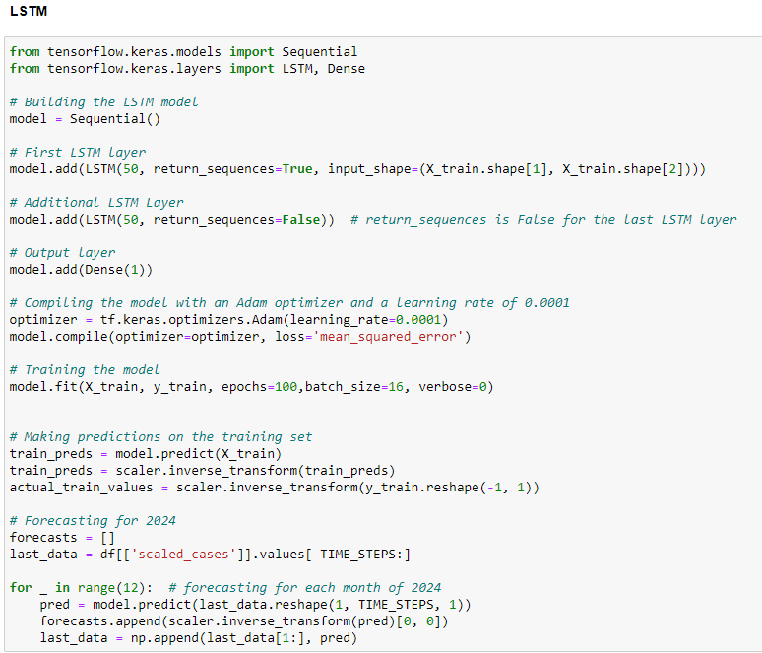
IMPLEMENTATION
LSTM implementation:
Data normalization and necessary transformation were performed
Hyperparameter selection:
Code snippet for Model Training:
Hyperparameter | Value
Optimizer | Adam
Learning Rate | 0.0001
Loss Function | MSE
Epochs | 100
Batch Size | 16
Verbose | 0

Slide 18
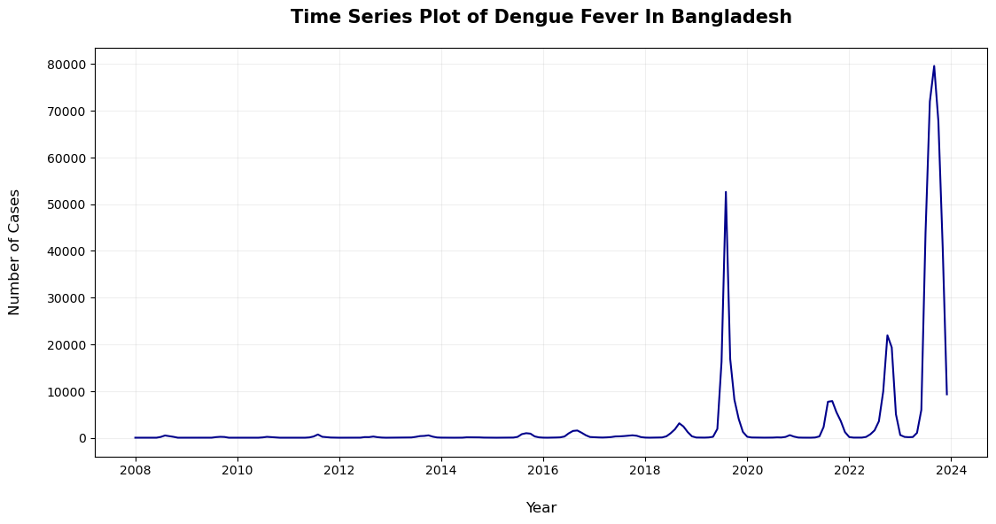
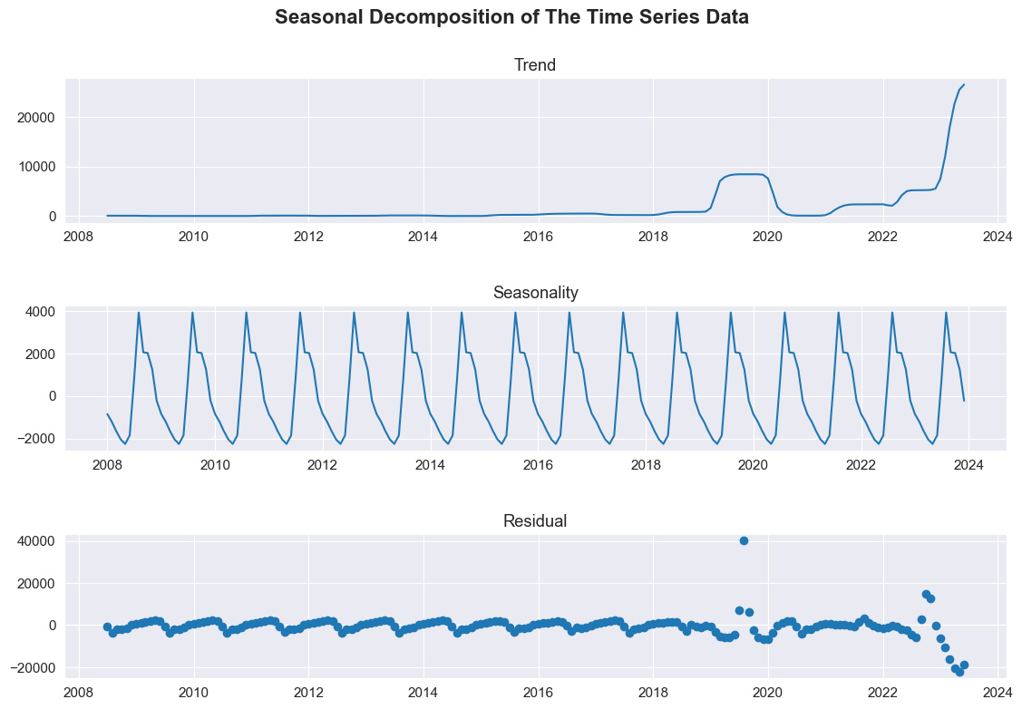
Results
Time Series Graph:
Seasonal Decomposition:

Slide 19
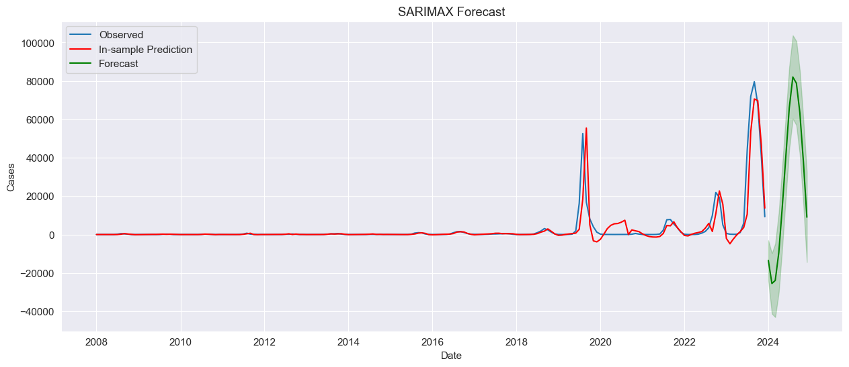
Results
SARIMA Forecast
SARIMA (2, 1, 2) (0, 1, 1, 12)

Slide 20
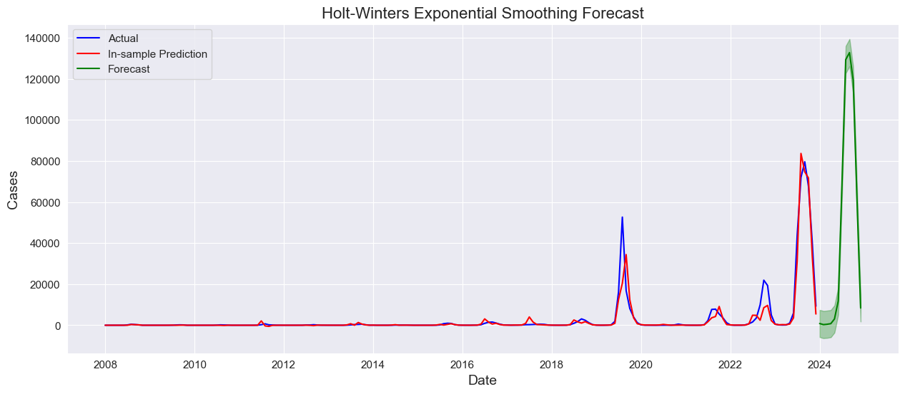
Results
HWES
Forecast
Holt-Winters method with additive trend & multiplicative seasonality

Slide 21
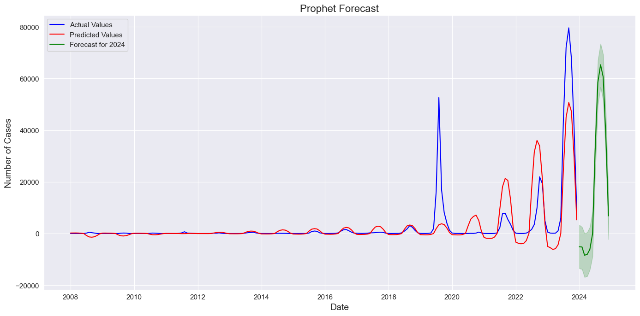
Results
Prophet
Forecast
Prophet

Slide 22
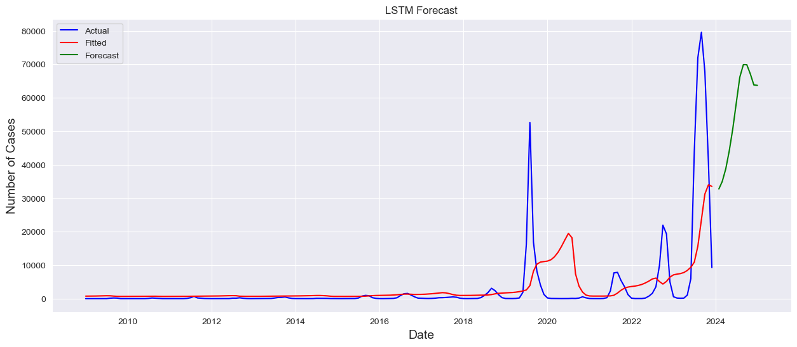
Results
LSTM
Forecast
LSTM

Slide 23
Results
Model Evaluation:
Forecast of the Best Model:
Month | Cases
January | 826
February | 303
March | 470
April | 773
May | 3048
June | 11880
July | 67961
August | 129307
September | 132736
October | 119331
November | 61413
December | 8399
Model | MAE | RMSE
SARIMA | 1572.096 | 5173.864
HWES | 963.865 | 3389.622
Prophet | 2543.344 | 6589.956
LSTM | 3701.169 | 9190.474

Slide 24
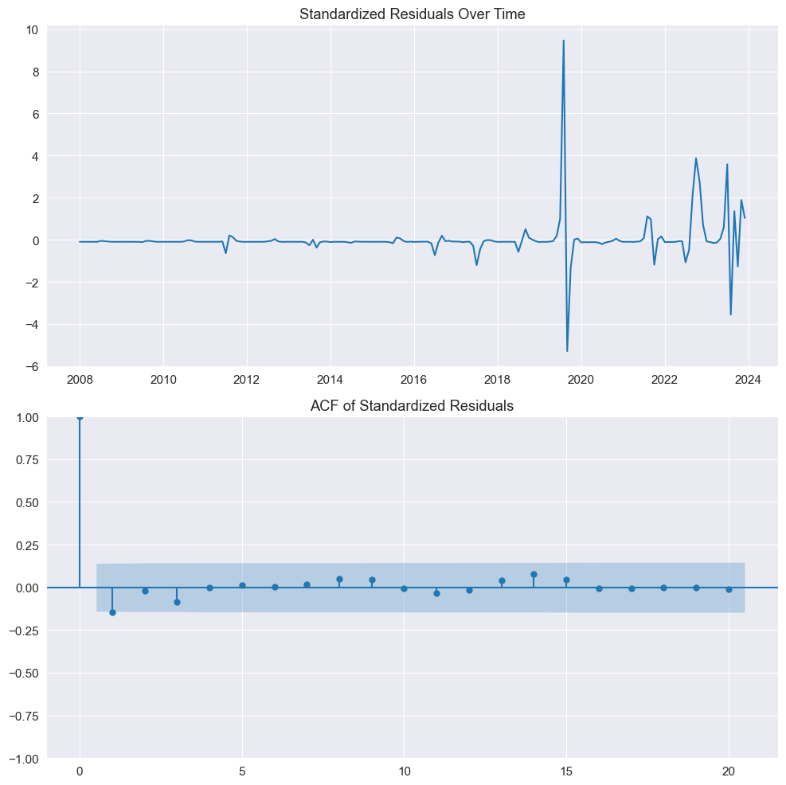
Results
Ljung-Box test:
Aside from the first lag having a p-value smaller than 0.05, the residuals appeared random
Both residual analyses suggest the robustness of the best model
Residual Analysis:
Random scattering of the residuals over time
Autocorrelation coefficients under 95% CI except lag 1 which is minuscule
Lag | p-value
1 | 0.041
2 | 0.119
3 | 0.131
4 | 0.227
5 | 0.339
6 | 0.460
7 | 0.570
8 | 0.621
9 | 0.672
10 | 0.756
11 | 0.807
12 | 0.861

Slide 25
DISCUSSION
The time series plot of the dengue dataset showed an overall increase of DENV-affected cases and a comparatively volatile rise in recent years, especially in 2023, surpassing the previous historical records. The re-emergence and dominance of the DENV-3 serotype have been identified as the probable cause of these recent dengue outbreaks in Bangladesh. [7]
SARIMA (2, 1, 2) (0, 1, 1, 12) model introduced new seasonal and non-seasonal parameters in comparison to other studies conducted in the scenario of forecasting dengue cases in Bangladesh. The model demonstrated noteworthy alignment with the actual data during in-sample periods and also turned out to be the second-best forecasting model in comparison.

Slide 26
DISCUSSION
Interestingly, the HWES model outperformed other models in terms of both MAE and RMSE. This superiority indicated its robustness in capturing both the trend and seasonal fluctuations of the dengue case time series. Its robustness against the volatile fluctuations in the time series data likely contributed to its superior performance.
Nevertheless, in the residuals analysis, we observed some limitations. The ACF of standardized residuals and Ljung-Box tests revealed that the autocorrelation was satisfactorily addressed, except for the first lag.
The predictions for the year 2024, as forecasted by this model, suggested an impending rise in dengue cases warranting immediate attention from public health authorities for potential outbreak management

Slide 27
DISCUSSION
The Prophet model, while capturing the general seasonal pattern, fell short in projecting the more dramatic epidemic outbreaks. The model's lack of constraints to prevent negative forecasts raised concerns about its applicability to this particular domain, where case counts should not have fallen below zero.
The LSTM model performed significantly poorly in contrast to the other forecasting models. Such substandard performance could be the result of several factors. A large dataset is recommended for the optimal functioning of the LSTM model [8], while our dataset only contains 192 data points. Training an LSTM model on a univariate time series with a small amount of data might not have been a fine decision.

Slide 28
Limitations
The scope of the research was confined to the occurrence of dengue fever exclusively within Bangladesh. While this focus allowed for a detailed and context-specific analysis, it also posed a limitation in terms of the generalizability of the findings.
The dataset used in this study was relatively small for complex statistical modeling, especially for deep learning models like LSTM.
Both SARIMA and Prophet models projected negative results due to their linear modality.
The study's exclusive focus on univariate analysis, considering only the number of dengue cases over time, was a significant limitation. This approach overlooked other potentially influential factors, such as climate variables (temperature, humidity, rainfall), demographic changes, urbanization, etc.

Slide 29
FUTURE RESEARCH DIRECTION
Further research should focus on refining current models, particularly in terms of parameter optimization. Enhancing the accuracy and reliability of these models can be achieved by addressing the limitations identified in this study.
Large-scale multivariate analysis consisting of environmental and socio-economic variables can offer more nuanced insights into the complex patterns of infectious diseases like dengue.
Given the evolving nature of dengue fever transmission, employing more sophisticated machine learning and deep learning models can be beneficial. Also, ensembles of the statistical and ML models may uncover deeper insights and patterns that simpler models miss.

Slide 30
CONCLUSION
The research provided an in-depth analysis of the time series data of monthly DENV-affected cases in Bangladesh from 2008 to 2023. Several models, including SARIMA, Holt-Winters, Prophet, and LSTM, were employed to predict the underlying trend and variations in dengue incidence.
The results indicated that the Holt-Winters Exponential Smoothing (HWES) model outperformed the other prediction models in terms of MAE, and RMSE. This model’s forecast for 2024 indicated a significant rise in dengue cases, highlighting the need for increased public health and preparedness.
It’s expected that the knowledge gained from this study will not only advance the field of epidemiological modeling but also pave the way for future studies to explore innovative methods for enhancing dengue forecasting and management strategies.

Slide 31
REFERENCES
Y. L. Hii, H. Zhu, N. Ng, L. C. Ng, and J. Rocklöv, ‘Forecast of Dengue Incidence Using Temperature and Rainfall’, PLoS Negl. Trop. Dis., vol. 6, no. 11, p. e1908, Nov. 2012, doi: 10.1371/journal.pntd.0001908.
S. Naher, F. Rabbi, Md. M. Hossain, R. Banik, S. Pervez, and A. B. Boitchi, ‘Forecasting the incidence of dengue in Bangladesh—Application of time series model’, Health Sci. Rep., vol. 5, no. 4, p. e666, Jun. 2022, doi: 10.1002/hsr2.666.
J. Xu et al., ‘Forecast of Dengue Cases in 20 Chinese Cities Based on the Deep Learning Method’, Int. J. Environ. Res. Public. Health, vol. 17, no. 2, p. 453, Jan. 2020, doi: 10.3390/ijerph17020453.
A. Kumar Dubey, A. Kumar, V. García-Díaz, A. Kumar Sharma, and K. Kanhaiya, ‘Study and analysis of SARIMA and LSTM in forecasting time series data’, Sustain. Energy Technol. Assess., vol. 47, p. 101474, Oct. 2021, doi: 10.1016/j.seta.2021.101474.
I. Djakaria and S. E. Saleh, ‘Covid-19 forecast using Holt-Winters exponential smoothing’, J. Phys. Conf. Ser., vol. 1882, no. 1, p. 012033, May 2021, doi: 10.1088/1742-6596/1882/1/012033.
W. Zha et al., ‘Forecasting monthly gas field production based on the CNN-LSTM model’, Energy, vol. 260, p. 124889, Dec. 2022, doi: 10.1016/j.energy.2022.124889.
M. E. H. Kayesh, I. Khalil, M. Kohara, and K. Tsukiyama-Kohara, ‘Increasing Dengue Burden and Severe Dengue Risk in Bangladesh: An Overview’, Trop. Med. Infect. Dis., vol. 8, no. 1, p. 32, Jan. 2023, doi: 10.3390/tropicalmed8010032.
K. Cho and Y. Kim, ‘Improving streamflow prediction in the WRF-Hydro model with LSTM networks’, J. Hydrol., vol. 605, p. 127297, Feb. 2022, doi: 10.1016/j.jhydrol.2021.127297.

Slide 32
THANK YOU!
ANY QUESTION PLEASE?

