Slide 1
PIZZA SALES PROJECT

Slide 2
INTRODUCTION Hello everyone, I'm Shahil Raj. In this project, I've used SQL queries to analyze and address various questions related to pizza sales. My goal through this analysis is to uncover key insights and trends within the data, which can guide decision-making and help optimize sales strategies.

Slide 3
INTRODUCTION
Hello everyone, I'm Shahil Raj. In this project, I've used SQL queries to analyze and address various questions related to pizza sales. My goal through this analysis is to uncover key insights and trends within the data, which can guide decision-making and help optimize sales strategies.

Slide 4
**Project Overview:** In this project, I conducted a comprehensive analysis of pizza sales data using SQL queries, structured into three levels of complexity: **Basic Analysis:** - Retrieved the total number of orders placed. - Calculated the total revenue generated from pizza sales. - Identified the highest-priced pizza. - Determined the most commonly ordered pizza size

Slide 5
Intermediate Analysis - Analyzed the distribution of orders by hour of the day. - Joined relevant tables to find the category-wise distribution of pizzas. - Grouped orders by date and calculated the average number of pizzas ordered per day. - Identified the top 3 most ordered pizza types based on revenue. Advanced Analysis - Calculated the percentage contribution of each pizza type to total revenue. - Analyzed the cumulative revenue generated over time. - Determined the top 3 most ordered pizza types based on revenue for each pizza category.

Slide 6
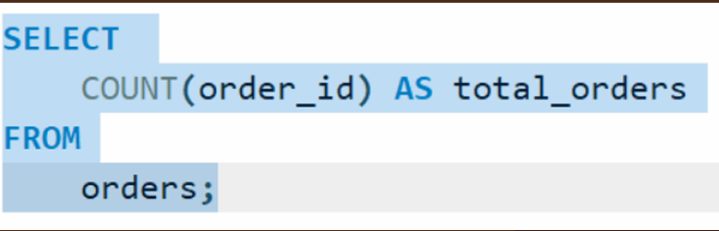
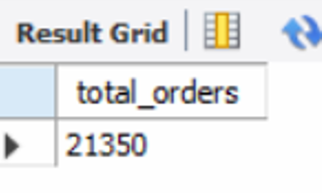
PIZZA SALES Retrieve the total number of orders placed.

Slide 7
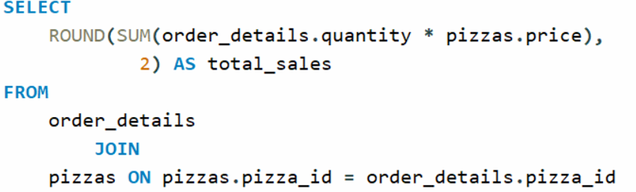
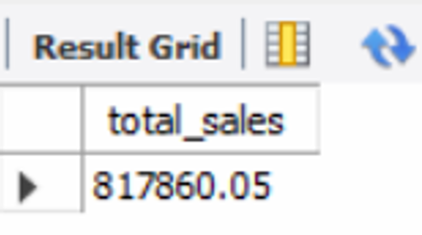
PIZZA SALES Calculate the total revenue generated from pizza sales..

Slide 8
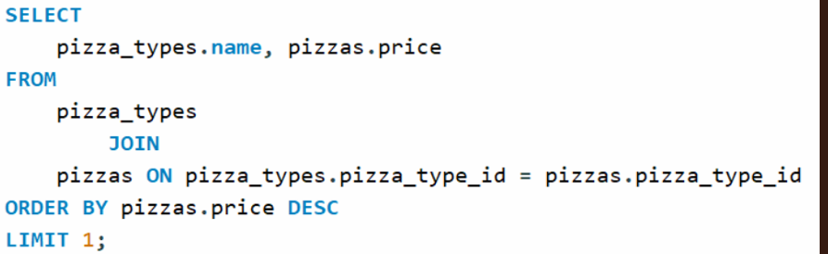
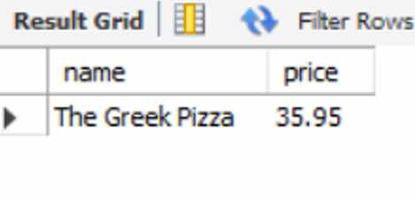
PIZZA SALES Identify the highest priced-pizza.

Slide 9
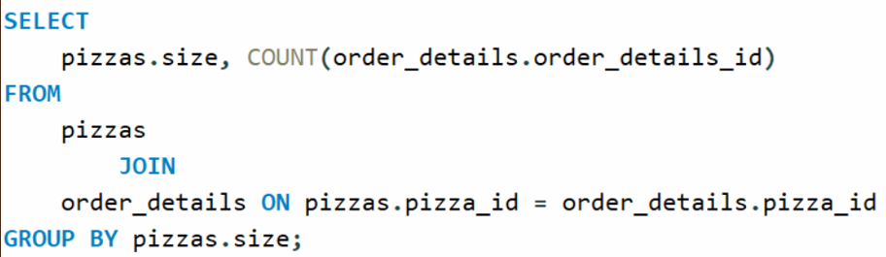
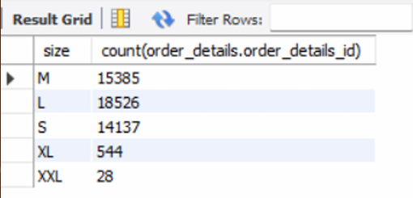
PIZZA SALES Identify the most common pizza size ordered..

Slide 10
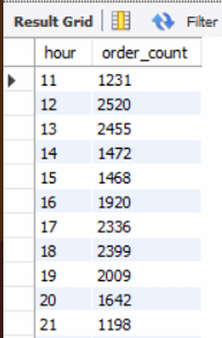
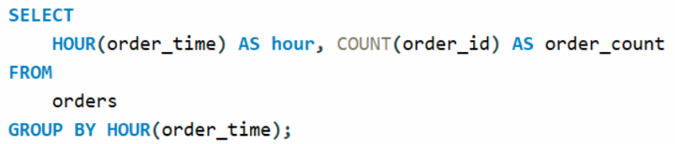
PIZZA SALES Determine the distribution of orders by hour of the day.

Slide 11
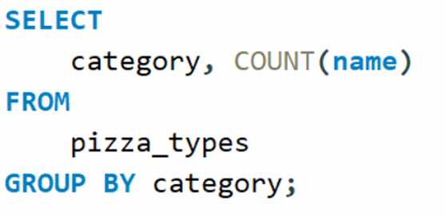
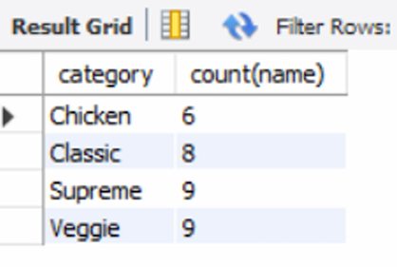
PIZZA SALES Join relevant tables to find the category-wise distribution of pizzas.

Slide 12
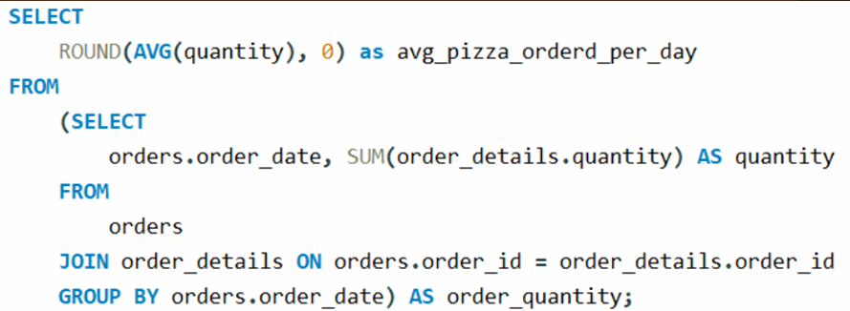
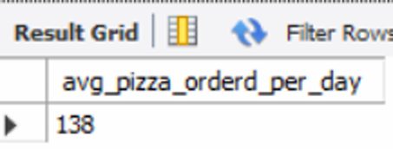
PIZZA SALES Group the orders by date and calculate the average number of pizzas ordered per day..

Slide 13
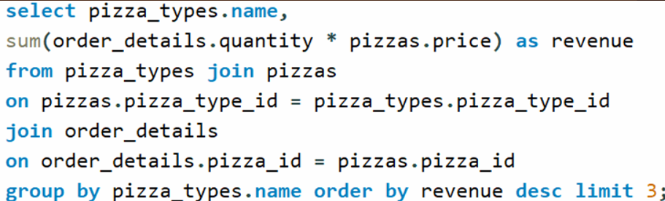
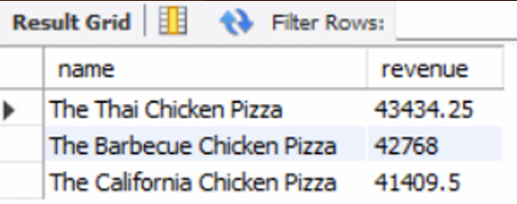
PIZZA SALES Determine the top 3 most ordered pizza types based on revenue..

Slide 14
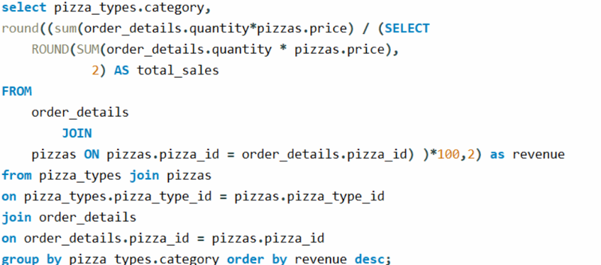
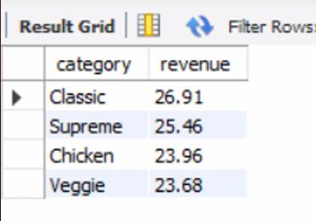
PIZZA SALES Calculate the percentage contribution of each pizza type to total revenue.

Slide 15
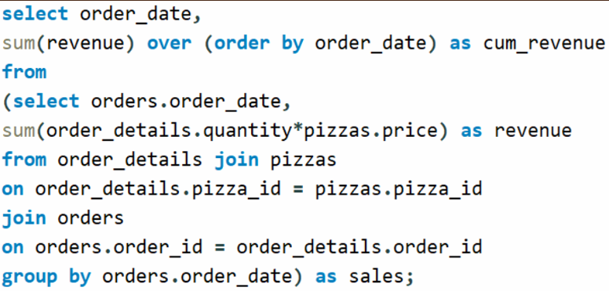
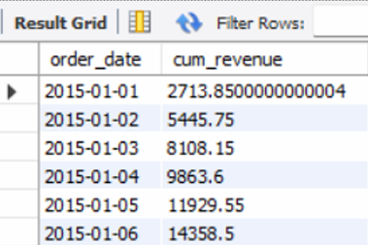
PIZZA SALES Analyze the cumulative revenue generated over time..

Slide 16
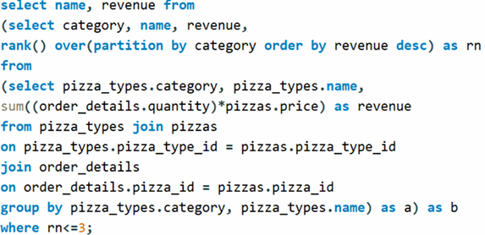
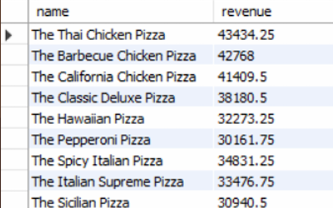
PIZZA SALES Determine the top 3 most ordered pizza types based on revenue for each pizza category..

Slide 17
THANK YOU
SHAHIL RAJ

