Slide 1
Adding gif in background
Shahin Sam
I am from Rajshahi.

Slide 2
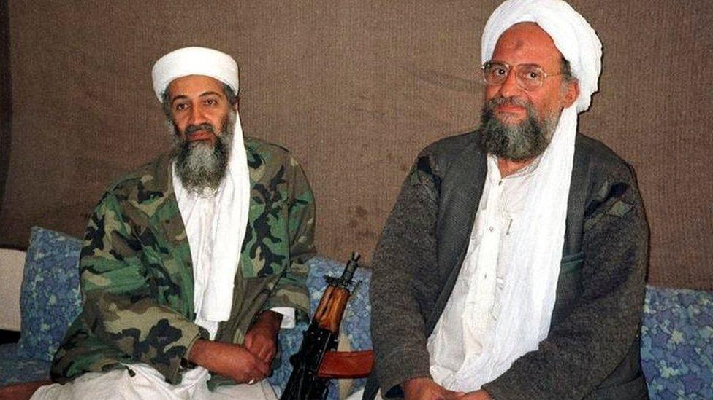
Two loving person.

Slide 3
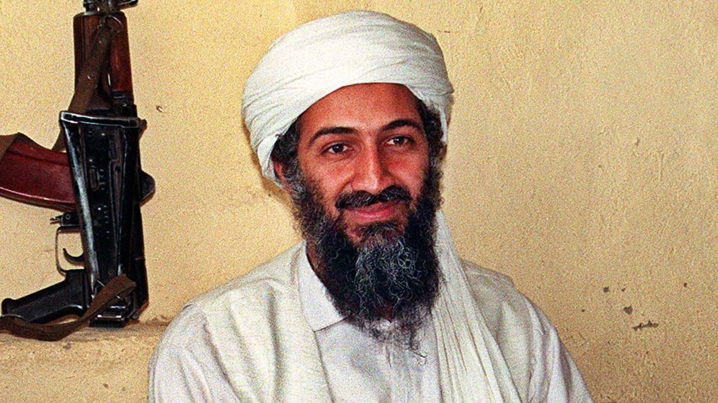
Osama bin Laden (Rhm)

Slide 4
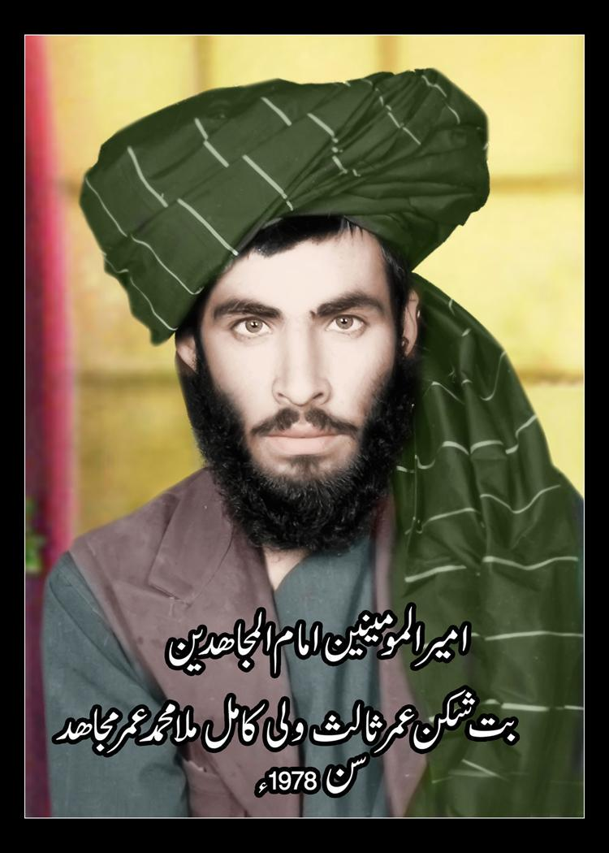
Mollah Mohammad Omar (Rhm)

Slide 5
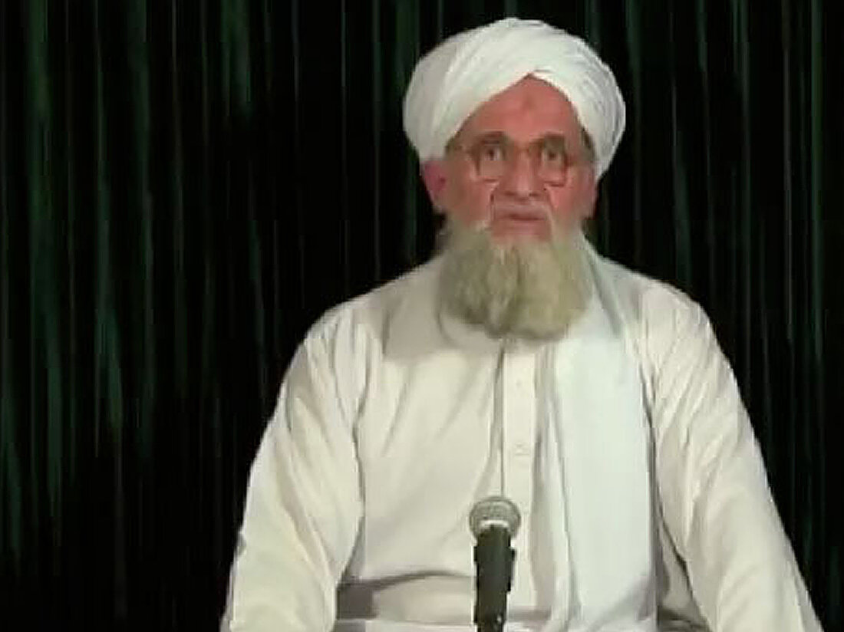
Ayman Al Zawahiri

Slide 6
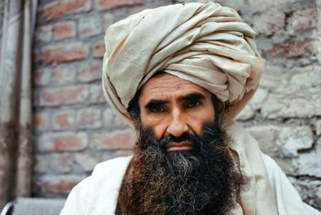
Jalaluddin Haqqani

Slide 7
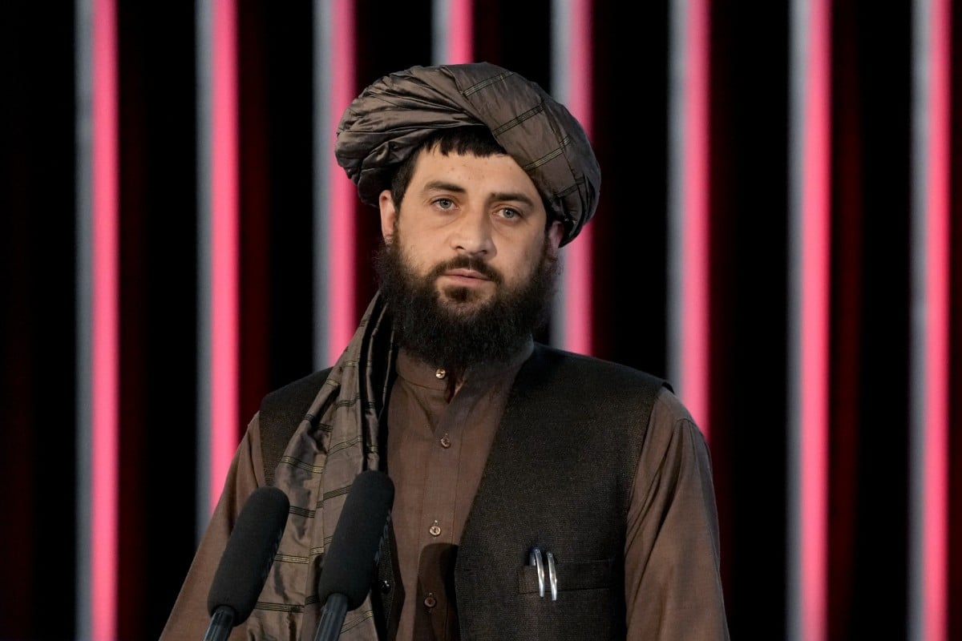
Mollah Yaqoob Muzahid

Slide 8
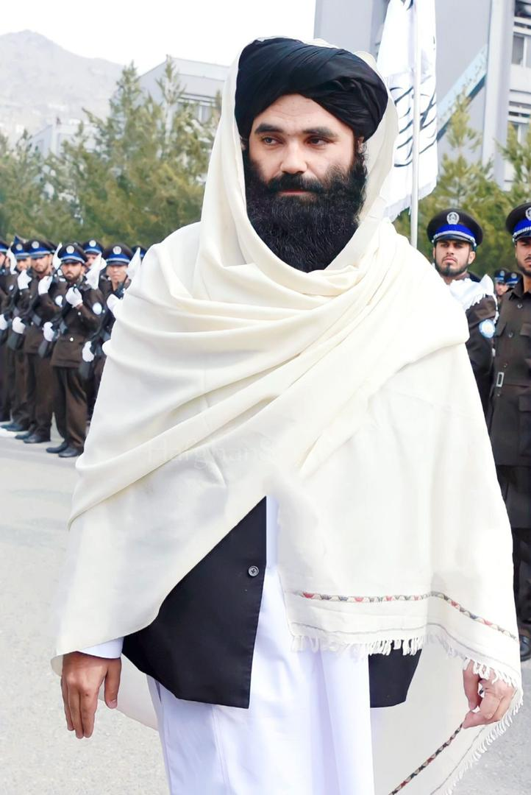
Sirajuddin Haqqani

Slide 9

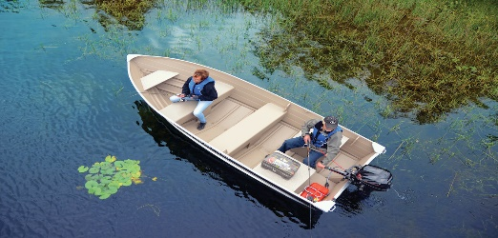
Add Animation

Slide 10
