Slide 1
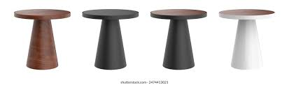


Exploratory Data Analysis of Coffee Quality Database
Project Workflow: Data Collection → Data Understanding → Data Cleaning → Feature Engineering → Data Filtering → EDA → Conclusion
PRESENTATION DONE BY,
SHAHINA NS

Slide 2
INTRODUCTION
Includes imputation of missing values and treatment of extreme values for features like sqft_lot, yr_built, and city.
The objective of this project is to perform an in-depth exploratory data analysis (EDA) on the Coffee Quality Database. This dataset contains detailed information on various coffee beans, including their origin, physical characteristics, and cupping scores. The primary goal is to understand the factors that influence coffee quality and to identify patterns and insights that could help coffee producers and consumers.
About in This Data:
Data understanding, pre-processing, and visualization are crucial steps in any data analytics project. They help to:
Identify and handle missing or erroneous data, ensuring the dataset is clean and reliable.
Detect outliers and inconsistencies that could skew the analysis.
Derive meaningful insights through visual representation, making it easier to interpret and communicate findings.
Provide a solid foundation for more advanced analyses and predictive modeling.
By thoroughly exploring and preprocessing the Coffee Quality Database, we aim to uncover valuable insights that can enhance our understanding of what makes a high-quality coffee.

Slide 3
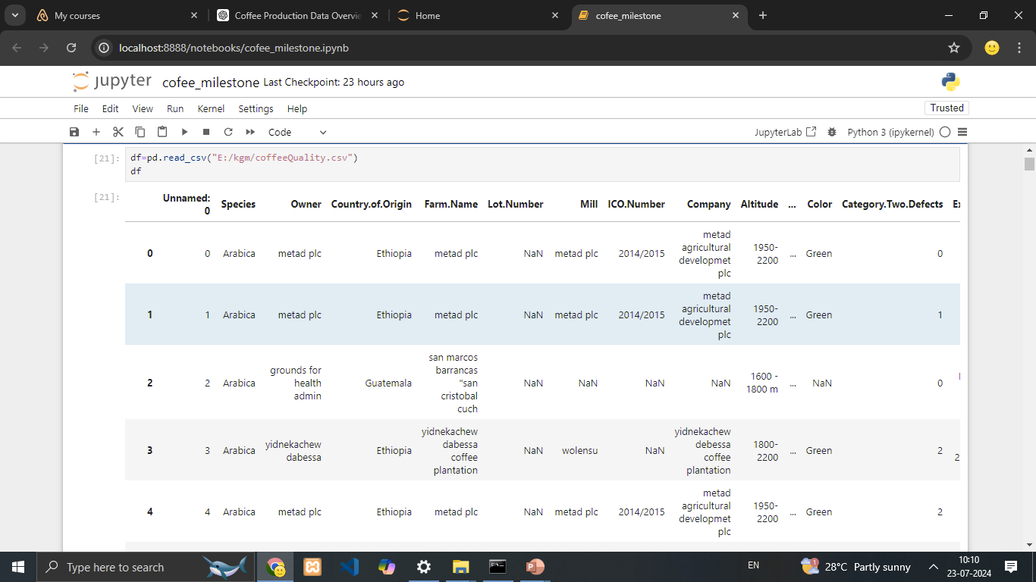

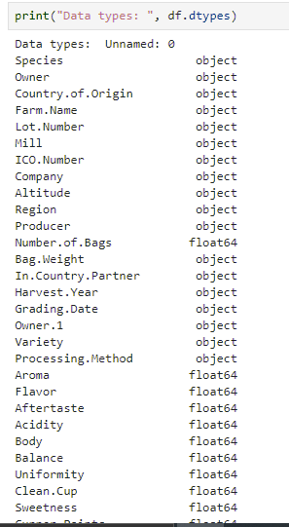
DATA UNDERSTANDING * Overview of the dataset structure: number of rows, columns, data types.

Slide 4
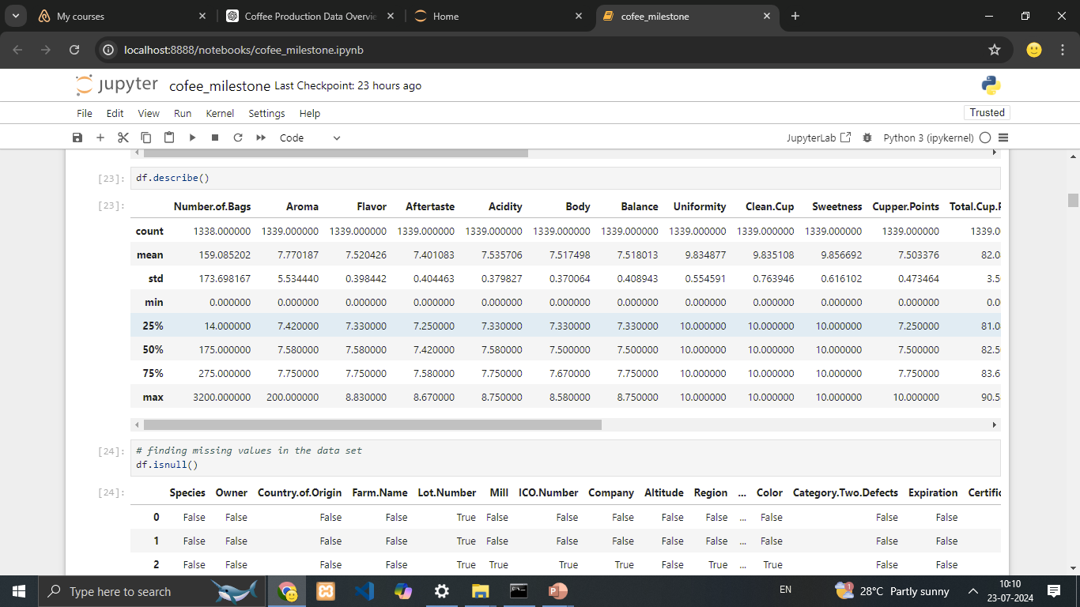
Summary statistics:
understanding mean, median, min, max for numerical features

Slide 5
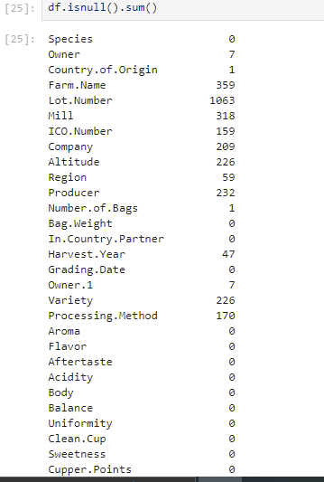
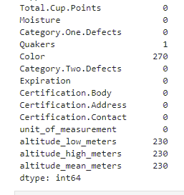
.
Initial Exploration.
Insights from initial exploration: any notable patterns, outliers, or missing values observed.
Missing Value Detection: Missing values can distort analysis and need appropriate handling, such as imputation or exclusion.

Slide 6
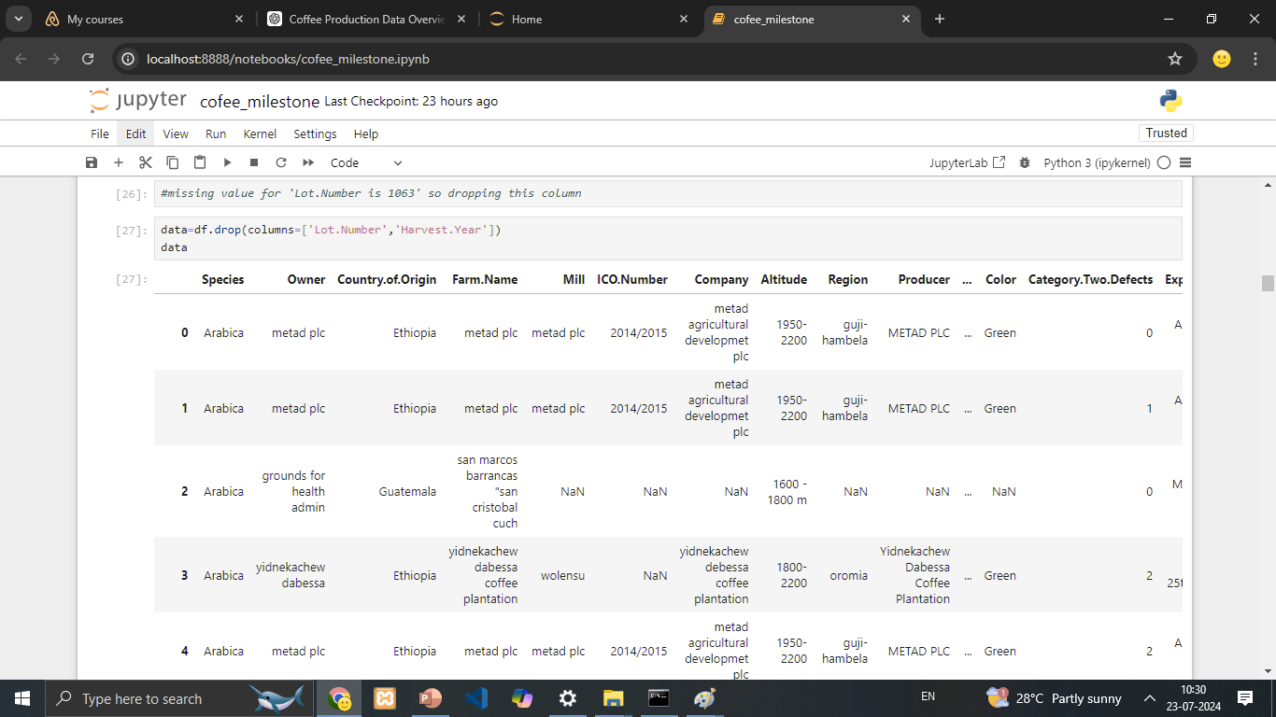
Dropping Less Important Columns
To simplify the dataset, improve analysis, and enhance model performance by removing less significant columns.

Slide 7
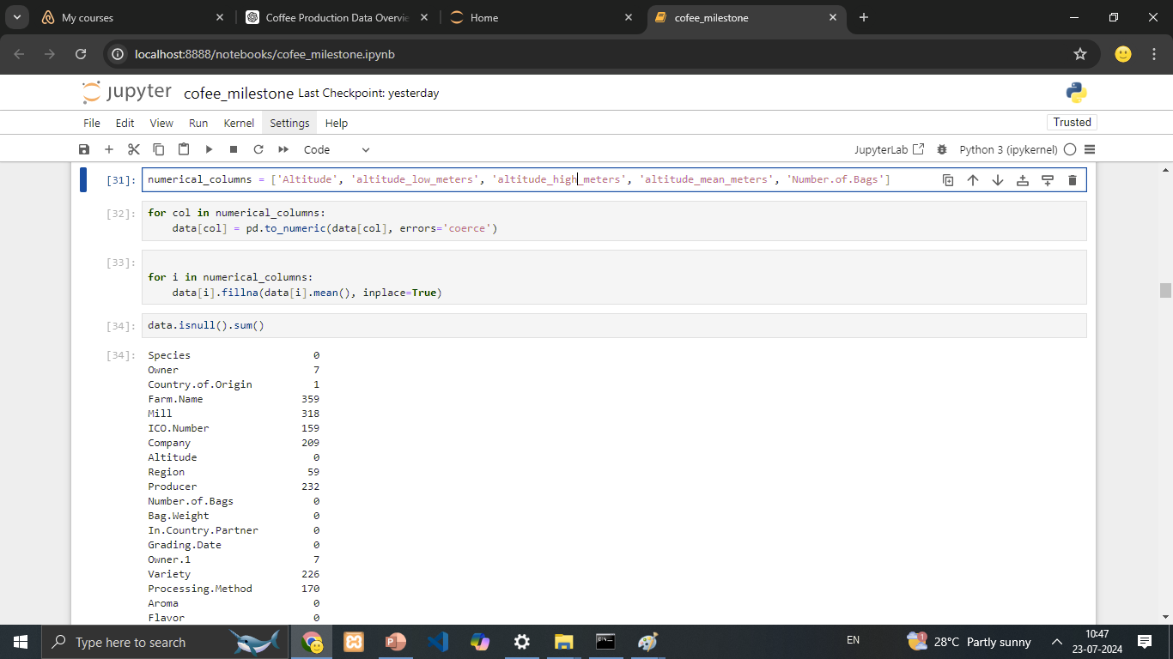
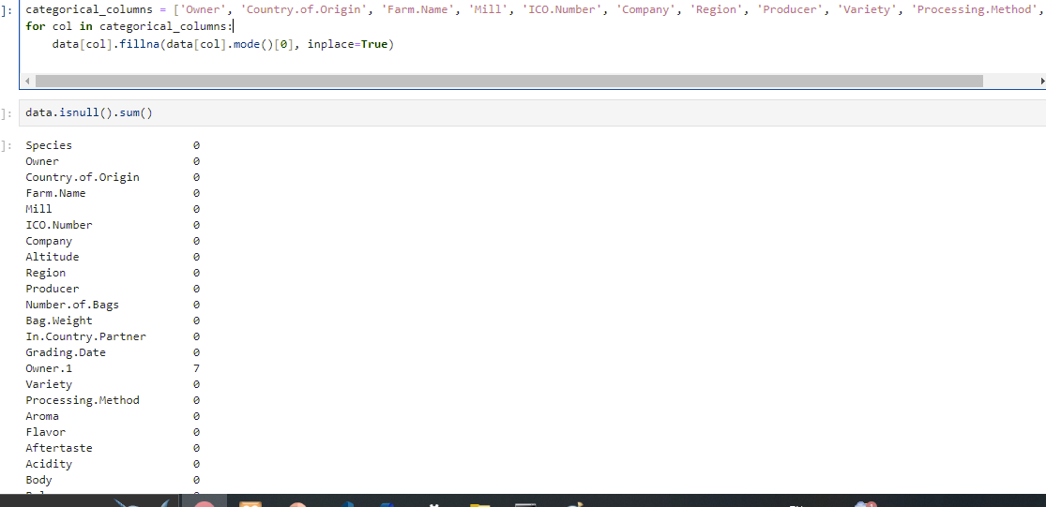
To address missing values, we replaced missing entries in numerical columns with the mean or median, depending on the distribution of the data, and filled missing values in categorical columns with the most frequent value (mode) to ensure completeness and preserve the dataset's integrity
Properly handling missing values is essential for maintaining the quality and reliability of our dataset. The chosen imputation methods—median for numerical data and mode for categorical data—are effective in preserving the integrity and usability of the dataset for subsequent analysis and modeling.

Slide 8
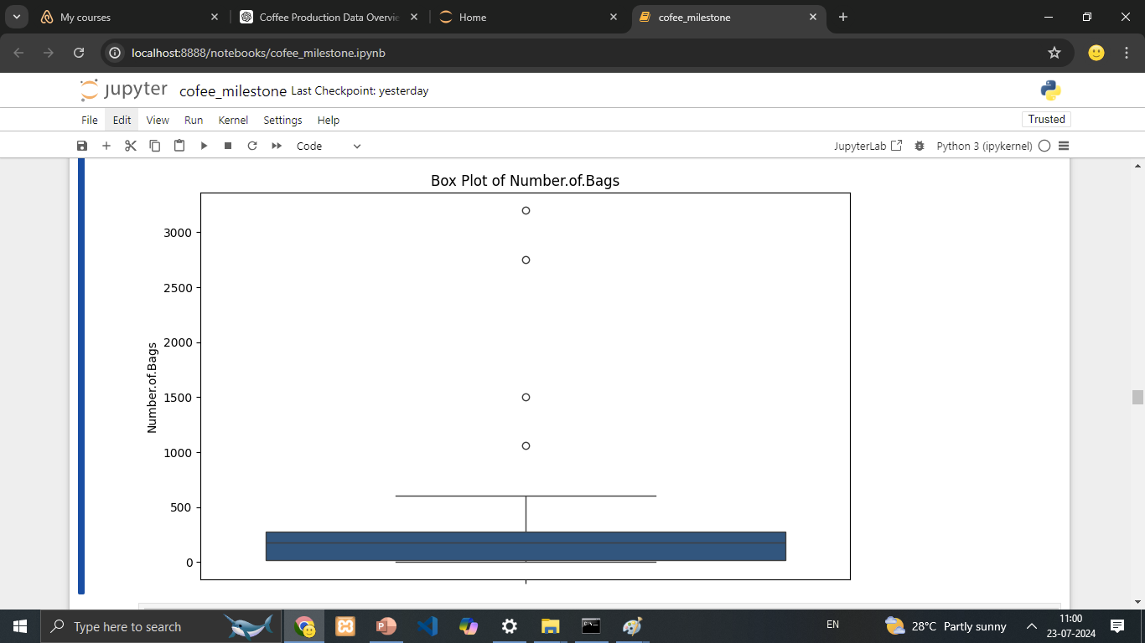
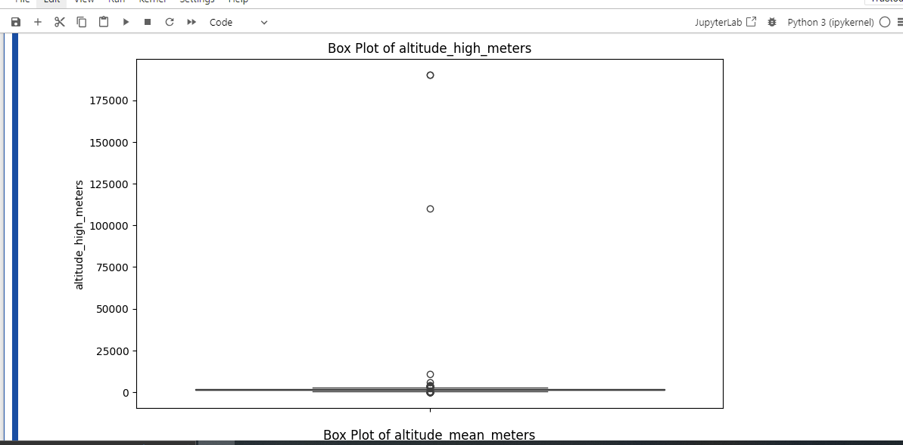
Outlier Detection: Identify and handle outliers to ensure data integrity and improve the quality of analysis.
Box Plot Visualization: Utilized box plots to visually assess the distribution of numerical data and identify potential outliers.

Slide 9
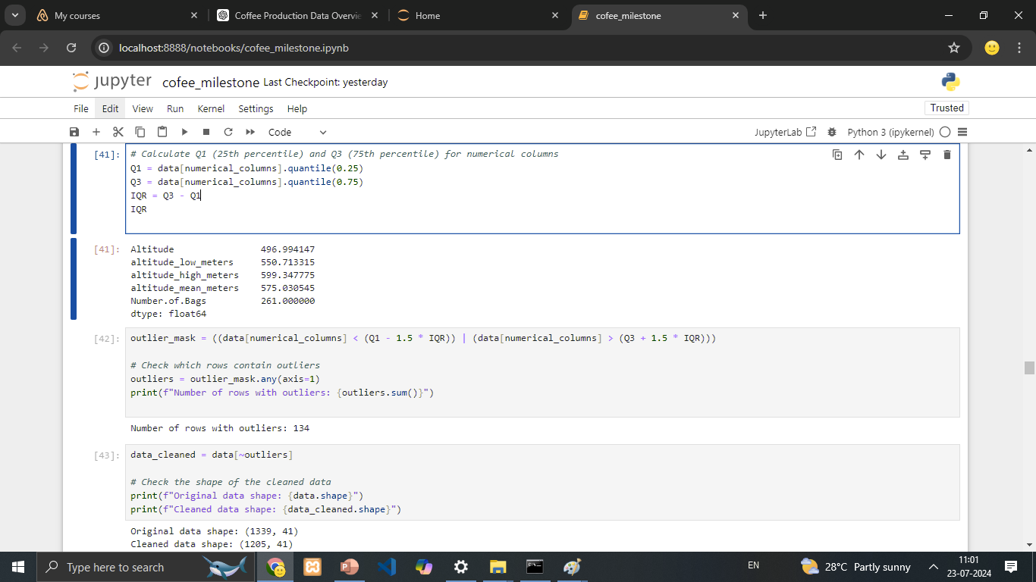
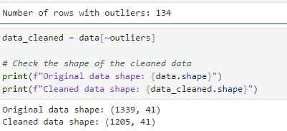
Quantitative Analysis:
Calculated Interquartile Range (IQR): Computed Q1 (25th percentile) and Q3 (75th percentile) for each numerical column to determine the IQR.
Outlier Detection: Identified data points outside the range defined by 1.5 times the IQR above Q3 and below Q1 as potential outliers.
Number of Outliers Detected: 134 rows were identified as containing outliers.

Slide 10
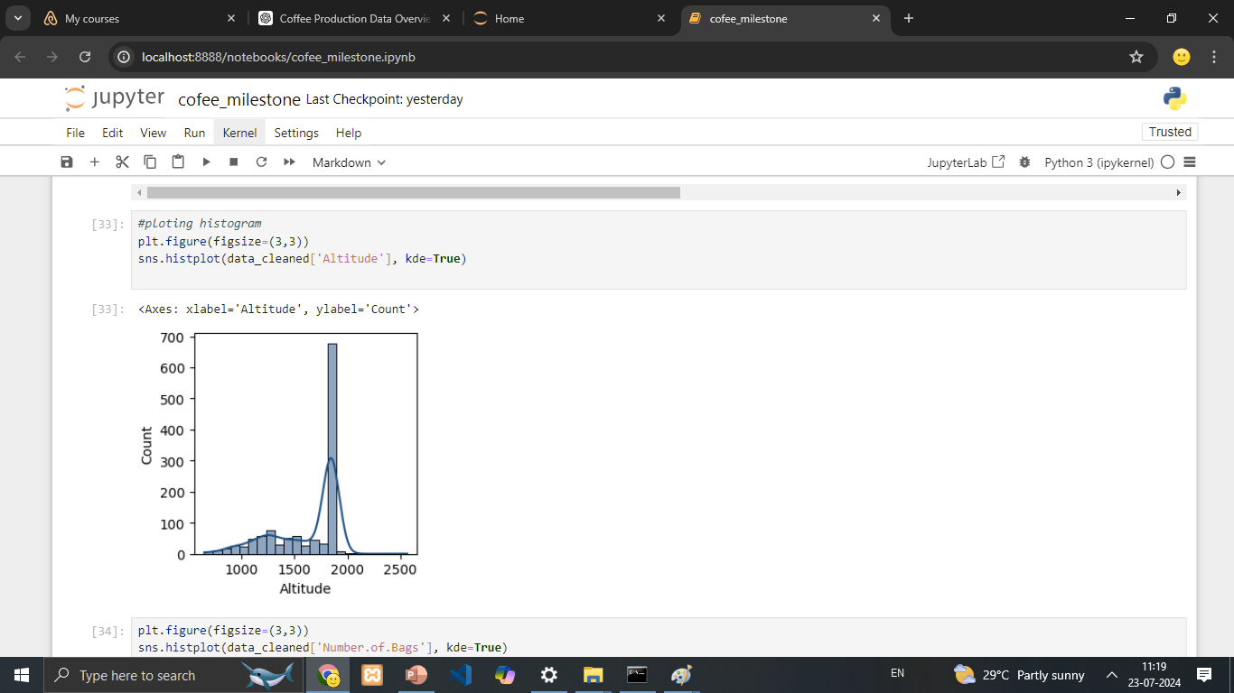
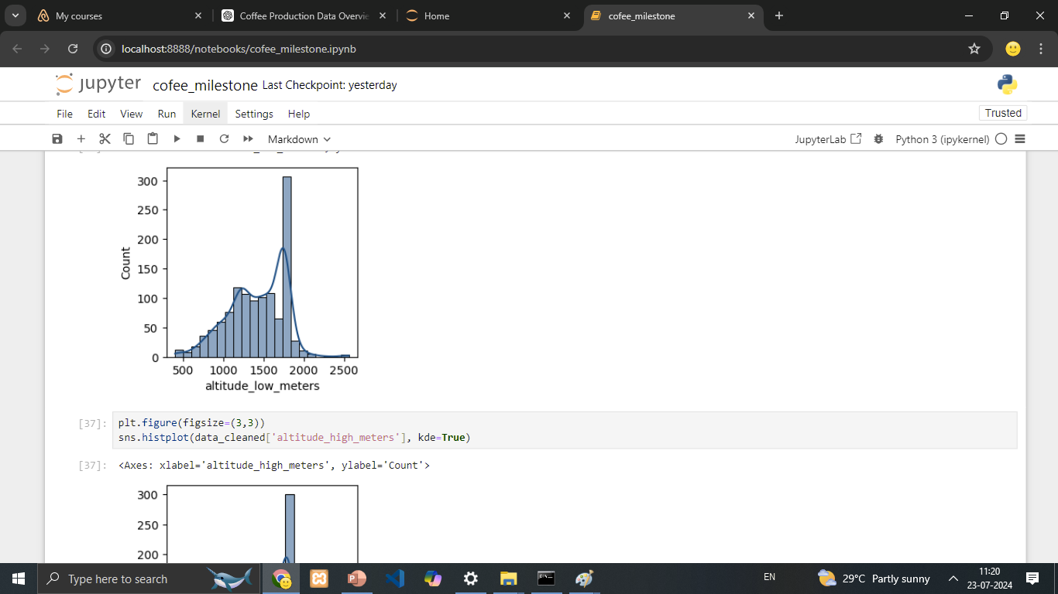
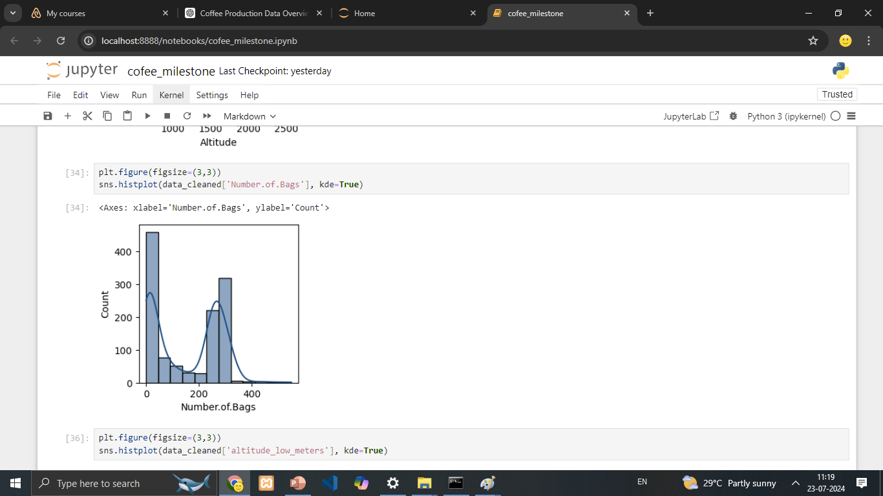
Univariate Analysis: Objective: To explore and understand the distribution and characteristics of each individual feature in the dataset.
Distribution of Number of Bags
Altitude Distribution of Coffee Farms
Distribution of Low Altitude of Coffee Farms
This histogram shows the distribution of the number of coffee bags produced,
The KDE curve reveals two primary peaks in the distribution, one near 0 and another around 200 bags, indicating a bimodal distribution.
These peaks could help in analyzing production practices, farm sizes, or market demands. For example, some farms may consistently produce very few bags due to their size or other constraints, while others may have optimal conditions for producing around 200 bags.
The majority of coffee farms are situated at altitudes between 1,500 and 2,000 meters.
There is a significant peak around the 1,950-meter mark, indicating a high concentration of farms at this altitude.
The histogram shows the distribution of the lowest altitude measurements of coffee farms in the dataset.
There is a noticeable peak around 1,950 meters, indicating a significant number of farms have their lowest altitude at this level.

Slide 11
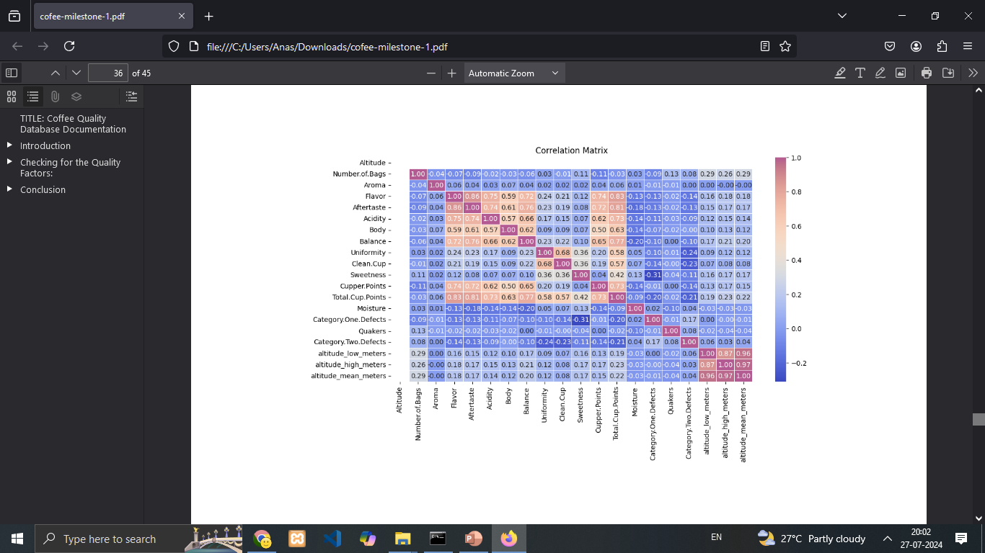
Bivariate Analysis - Correlation Matrix(heat map)

Slide 12
Key Observations from Correlation Matrix
Key Influencing Factors: From the correlation matrix, the most influential factors for coffee quality (as represented by Total.Cup.Points and Cupper.Points) are:
Flavor, Aftertaste, Acidity, Body, Balance attributes show the strongest positive correlations with overall coffee quality scores. Enhancing these aspects is likely to improve coffee quality.
Summary:
Overall, Flavor, Aftertaste, Acidity, Body, Balance, and Total.Cup.Points are crucial indicators of coffee quality. Attributes like Aroma, Uniformity, Clean.Cup, and Sweetness have lesser impacts but still contribute to the overall quality.

Slide 13
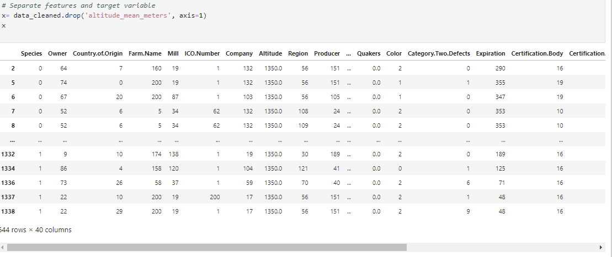
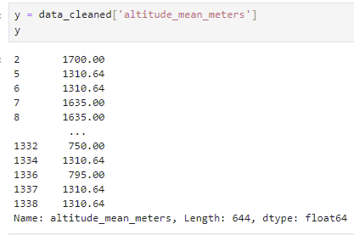
MULTIVARIATE ANALYSIS: Multivariate analysis involves analyzing more than two variables to understand relationships and patterns within the data

Slide 14
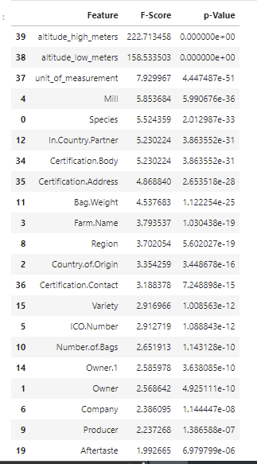
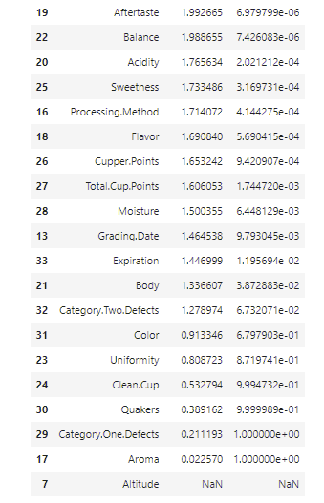
F-Score and P-Value Analysis

Slide 15
Summary of Findings:
Highly Significant Features:
Altitude_high_meters (F-Score: 222.71, p-Value: 0.000000e+00), altitude_low_meters (F-Score: 158.533 p-Value: 0.000000e+00)
These features have extremely high F-scores and very low p-values, indicating they are very significant in predicting the altitude_mean_meters.
Features like Category.Two.Defects, Color, Total.Cup.Points, Category.One.Defects, Clean.Cup, Uniformity, and Aroma have high p-values, indicating they are not significant in predicting the altitude_mean_meters.
Summary of the key insights and findings obtained from the analysis:
Higher altitudes are generally associated with better coffee quality.
Certain countries consistently produce higher quality coffee due to favorable growing conditions and better farming practices.
Certification and proper farm management significantly reduce defect counts. These insights can guide farmers and producers in optimizing their practices to enhance coffee quality and productivity.

Slide 16
Conclusion
Final conclusions drawn from the analysis:
Higher altitudes, particularly above 2000 meters, are associated with superior coffee quality. Minimizing defects through improved processing techniques is essential for high-quality coffee. Focus on enhancing flavor and Balance, and Total.Cup.Points attributes to boost overall coffee quality.
Recommendations or next steps for further analysis or action:
For Producers: Invest in high-altitude farming and stringent quality control to minimize defects. For Consumers: Choose high-altitude, Arabica coffees from reputable origins like Ethiopia for the best quality. Further Research: Investigate the impact of specific farming practices and environmental conditions on coffee quality. By understanding these factors and leveraging the insights from both univariate and multivariate analyses, coffee producers can improve their practices, and consumers can make more informed choices.

