Slide 1
[ PASTE SRM LOGO HERE ]
DIRECTORATE OF ONLINE EDUCATION
SRM INSTITUTE OF SCIENCE AND TECHNOLOGY
KATTANKULATHUR- 603 203
MCA III SEM
MINI PROJECT/INTERNSHIP VIVA VOCE
Nov 2026
ENROLMENT NUMBER : EA2532251010500
NAME OF STUDENT: MOHAMED SHAHITH AKEEL S A

Slide 2
TITLE OF MINI PROJECT/INTERNSHIP
COMMUNITY ITEM LENDING SYSTEM
A Web-Based Platform for Sharing Household Items Among Neighbors
Slide - 2

Slide 3
ABSTRACT
In urban neighborhoods and apartment complexes, families frequently buy household equipment and tools that they use only once or twice a year. Most of the time, these items remain idle in storage cupboards. Common examples of such items include:
1. Power Tools (Electric drill, screwdrivers, saws)
2. Gardening Tools (Lawn mowers, hedge trimmers, garden hoses)
3. Domestic Appliances (Ladders, pressure washers, vacuum cleaners)
4. Outdoor & Camping Gear (Tents, portable grills, folding chairs)
5. Educational Books, Textbooks, and Sporting Goods
Buying new items for every small household repair is expensive and creates unnecessary clutter. Commercial rental shops charge high daily fees and require cash deposits, while asking in WhatsApp groups is unorganized and messages get lost.
This project solves this problem by developing a secure, easy-to-use web application called the 'Community Item Lending System'. It allows verified neighbors to list extra household items and borrow needed tools freely without rental fees.
This project adds value to communities by saving money for families, reducing domestic clutter, cutting manufacturing waste, and building friendly relationships among neighbors.
Slide - 3

Slide 4
FEATURES
✔
Easy Item Listing with Photos
Community members can easily list their spare household items with a title, description, category, and photo. Image files are securely renamed with unique IDs to keep uploads safe and organized.
Users can manage their items anytime from their dashboard.
✔
Smart Search and Category Filters
Neighbors can search for items by name or filter by category (Tools, Gardening, Books, Electronics, Kitchen, Sports). Available items appear immediately on the screen.
Live status badges clearly show if an item is Available, Pending, or Lent.
✔
Automated Borrowing and Tracking
Borrowers submit digital requests specifying when they need the item. The owner can approve or reject the request with one click. The item locks automatically to prevent double-booking.
When the item is returned, the owner marks it as returned, making it available again.
Slide - 4

Slide 5
INTRODUCTION
In residential apartment buildings and housing colonies, neighbors live right next to each other, but collaborative sharing of everyday household tools is very rare due to lack of an organized system.
Common Everyday Household Problems:
▶ A typical power drill is used for only 12 to 15 minutes during its entire working lifespan.
▶ Multiple families in the same apartment buy the exact same costly tools independently.
▶ Unused tools gather dust in cupboards and create domestic clutter at home.
▶ Commercial rental shops charge expensive daily fees, travel costs, and security deposits.
▶ Buying new products for single-use tasks wastes family savings and increases plastic waste.
Why Traditional Methods Fail:
❑ WhatsApp messages quickly get buried in busy group chats.
❑ There is no organized catalog of who owns what item in the colony.
❑ Borrowers and owners forget return dates without automated reminders.
❑ Verbal borrowing often leads to misplaced items and misunderstandings.
❑ Neighbors feel hesitant to ask door-to-door without a structured platform.
Slide - 5

Slide 6
SYSTEM REQUIREMENTS
Hardware Requirements
Software Requirements
Component | Requirement
Processor | Intel Core i3 / i5 or better
RAM | 4 GB or more (8 GB recommended)
Hard Disk | 10 GB or more free disk space
Monitor | 15" colour monitor or better (1366x768 / 1080p)
Keyboard | Any standard keyboard
Mouse | Any standard mouse / trackpad
Network | Connected to internet for cloud database access
Component | Selection
Operating System | Windows 10 or higher (also supports Linux/macOS)
Language | Python version 3.10 or higher
Database | TiDB Cloud Serverless (MySQL 8.0 Protocol)
Browser | Google Chrome, Edge, Firefox, or Safari
Framework | • Flask 3.0 (Web Framework) • Werkzeug (Security & Password Hashing) • PyMySQL (Database Driver) • Pytest (Automated Testing)
Frontend | HTML5, CSS3, JavaScript, Bootstrap 5.3
Development | Visual Studio Code (VS Code) & Git
Slide - 6

Slide 7
EXISTING SYSTEM & PROPOSED SYSTEM
EXISTING SYSTEM:
▶ The existing system for borrowing items in residential communities relies heavily on manual talk, phone calls, and informal WhatsApp messaging. These traditional methods are unorganized, time-consuming, and error-prone.
▶ When a resident needs a tool, they post in crowded group chats where messages get lost quickly. There is no central catalog of who owns what item, and people often forget return dates, leading to lost items or misunderstandings.
PROPOSED SYSTEM:
▶ The proposed 'Community Item Lending System' is designed to overcome the limitations of the existing manual system by introducing a modern, efficient, and secure web application. Developed using Python Flask and TiDB MySQL, it allows verified residents to share resources freely.
▶ Automated Lending Workflow: Features a 4-stage lifecycle (Available -> Pending -> Lent -> Returned) that automatically locks items upon approval, preventing double-booking and keeping a permanent record of all borrowing transactions.
Slide - 7

Slide 8
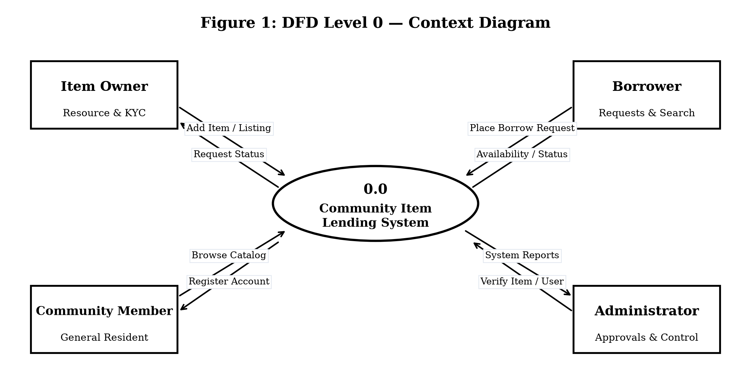
SYSTEM DESIGN - DATA FLOW DIAGRAM (DFD)
SYSTEM ARCHITECTURE & DATA FLOW:
How Information Moves in the System:
▶ 1. User Registration: New residents enter their name, email, and flat number. Passwords are encrypted before saving in the database.
▶ 2. Item Listing: Item owners upload title, description, category, and photo. Details are saved in the TiDB cloud database.
▶ 3. Borrow Request: Borrowers find an item and send a borrow request with return dates. The item status changes to Pending.
▶ 4. Approval & Return: The owner approves the request (status becomes Lent). When returned, the owner marks it as returned (status resets to Available).
Slide - 8

Slide 9
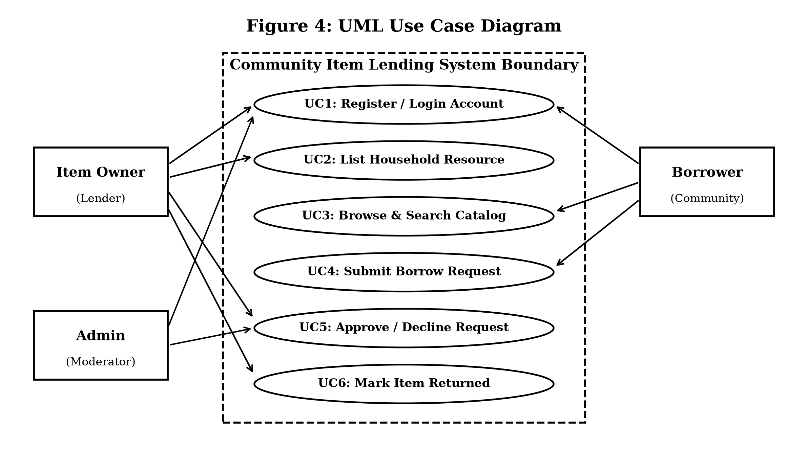
USE CASE DIAGRAM
USER INTERACTIONS & SYSTEM BOUNDARIES:
Actor Roles and Work Done:
1. Item Owner (Lender):
▶ Register and login to account
▶ Add new items with description and photos
▶ View received borrow requests from neighbors
▶ Approve or decline requests with one click
▶ Confirm item return when handed back
2. Community Borrower:
▶ Browse and search items by category
▶ View item details and live availability
▶ Submit borrow request with return date
▶ Track status of borrowed items in dashboard
Slide - 9

Slide 10
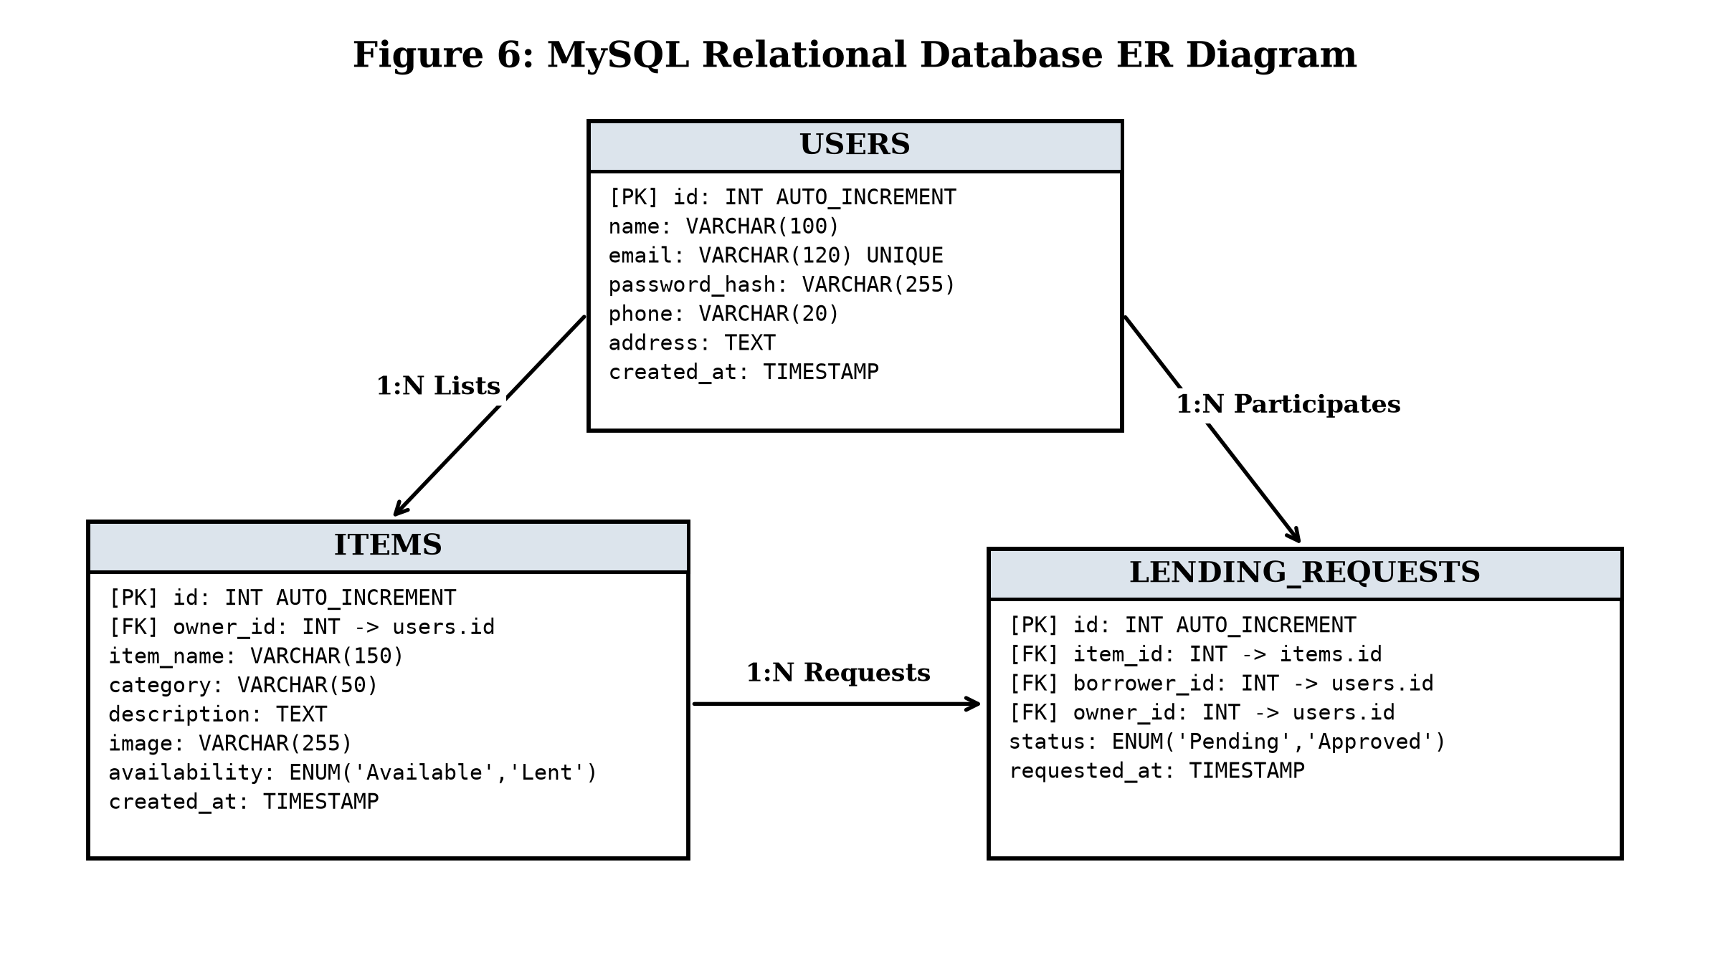
DATABASE DESIGN
ENTITY-RELATIONSHIP MODEL & DATABASE TABLES:
Database Structure Explained:
▶ Users Table: Stores user ID, username, email address, encrypted password, phone number, and flat/room number.
▶ Items Table: Stores item ID, title, description, category, photo URL, owner ID, and status (Available, Pending, Lent).
▶ Borrow Requests Table: Stores request ID, item ID, borrower ID, request date, return date, and request status (Pending, Approved, Rejected, Returned).
▶ Relational Connections: Foreign keys connect items and borrow requests to the users table, keeping all records organized and safe.
Slide - 10

Slide 11
MODULE DESCRIPTION
Following are the modules and work involved in each module. In this project the modules correspond to the use cases:
S.No | Module | Work Completed in Module
1 | User Authentication | User registration, login, and password encryption
2 | Item Catalog & Upload | Adding items, choosing categories, and photo upload
3 | Search & Filtering | Keyword search and dynamic category filter buttons
4 | Borrowing Workflow | Submitting borrow requests and owner approval/rejection
5 | Return & Audit Tracking | Confirming item return and permanent transaction logs
6 | User Dashboard | Unified view of listed items, requests, and active loans
How the Modules Connect Together:
▶ User Security: All passwords are encrypted with PBKDF2:SHA256. User sessions keep accounts secure when navigating pages.
▶ Automated Status Updates: When a request is approved, the item status changes from Available to Lent in real-time, preventing double booking.
▶ Simple Dashboard Control: Users can view all their listed items, incoming requests, and borrowed items on a single clean page.
Slide - 11

Slide 12
SAMPLE SOURCE CODE
Source code is found in the following link:
https://github.com/Shahith2004/Community-Item-Lending-System
Complete Source code is found in the following GitHub location:
▶ Full Flask application backend
▶ TiDB Cloud MySQL database setup scripts
▶ Complete automated pytest test suite
▶ HTML5 / Bootstrap 5 responsive frontend
# 1. Password Hashing for User Registration Security
from werkzeug.security import generate_password_hash, check_password_hash
# Encrypt user password with PBKDF2:SHA256
hashed_pw = generate_password_hash(user_password, method='pbkdf2:sha256')
cursor.execute("INSERT INTO users (username, email, password_hash) VALUES (%s, %s, %s)",
(username, email, hashed_pw))
db.commit()
# 2. Updating Item Status upon Approval (Lending Workflow)
# Approve borrow request and lock item to 'Lent'
cursor.execute("UPDATE borrow_requests SET status = 'Approved' WHERE id = %s", (request_id,))
cursor.execute("UPDATE items SET status = 'Lent' WHERE id = %s", (item_id,))
db.commit()
flash("Borrow request approved successfully!", "success")
return redirect(url_for('dashboard'))
Slide - 12

Slide 13
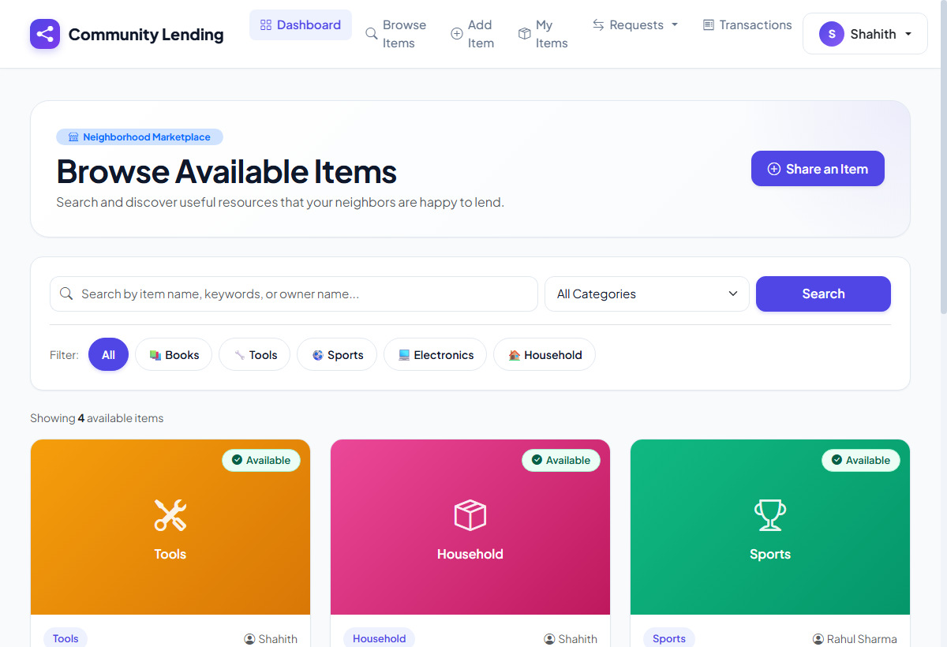
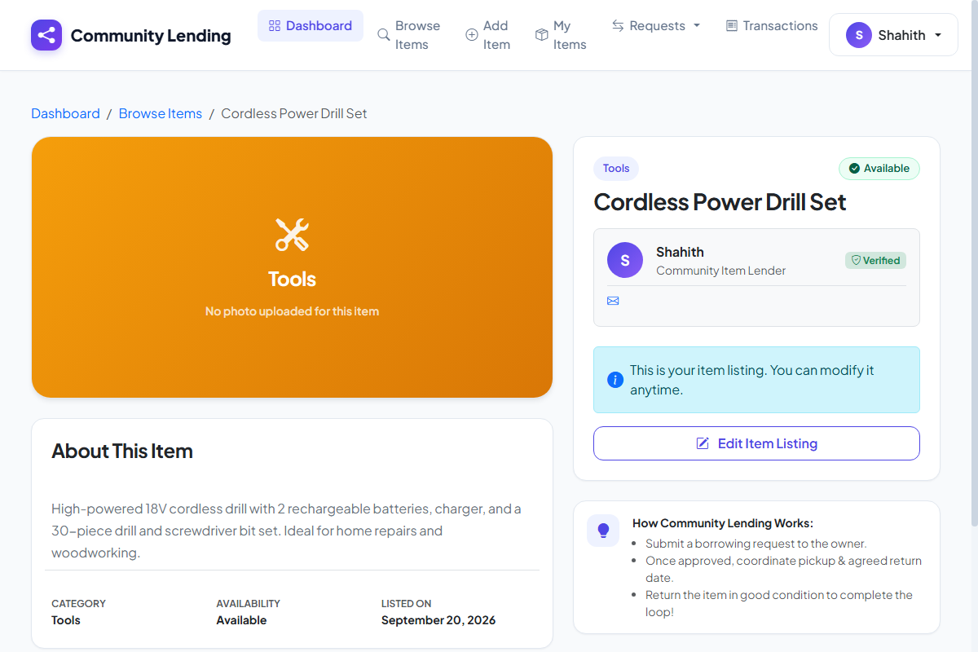
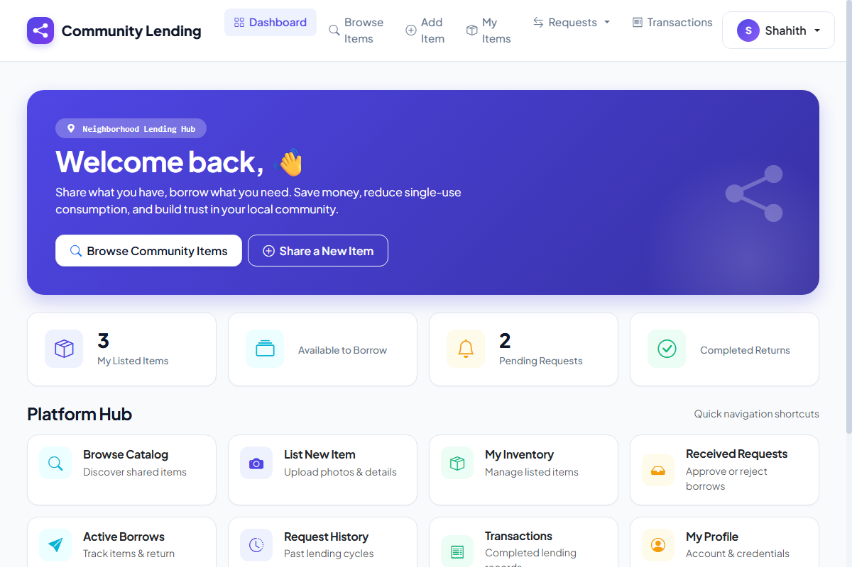
RESULT
LIVE APPLICATION USER INTERFACE SCREENS:
BROWSE ITEMS CATALOG
ITEM DETAILS PAGE
USER DASHBOARD
Search bar and category filters
Item image and request form
Lender tabs and active loans
Output: Clean, modern, and responsive website tested and running smoothly on all browsers.
Slide - 13

Slide 14
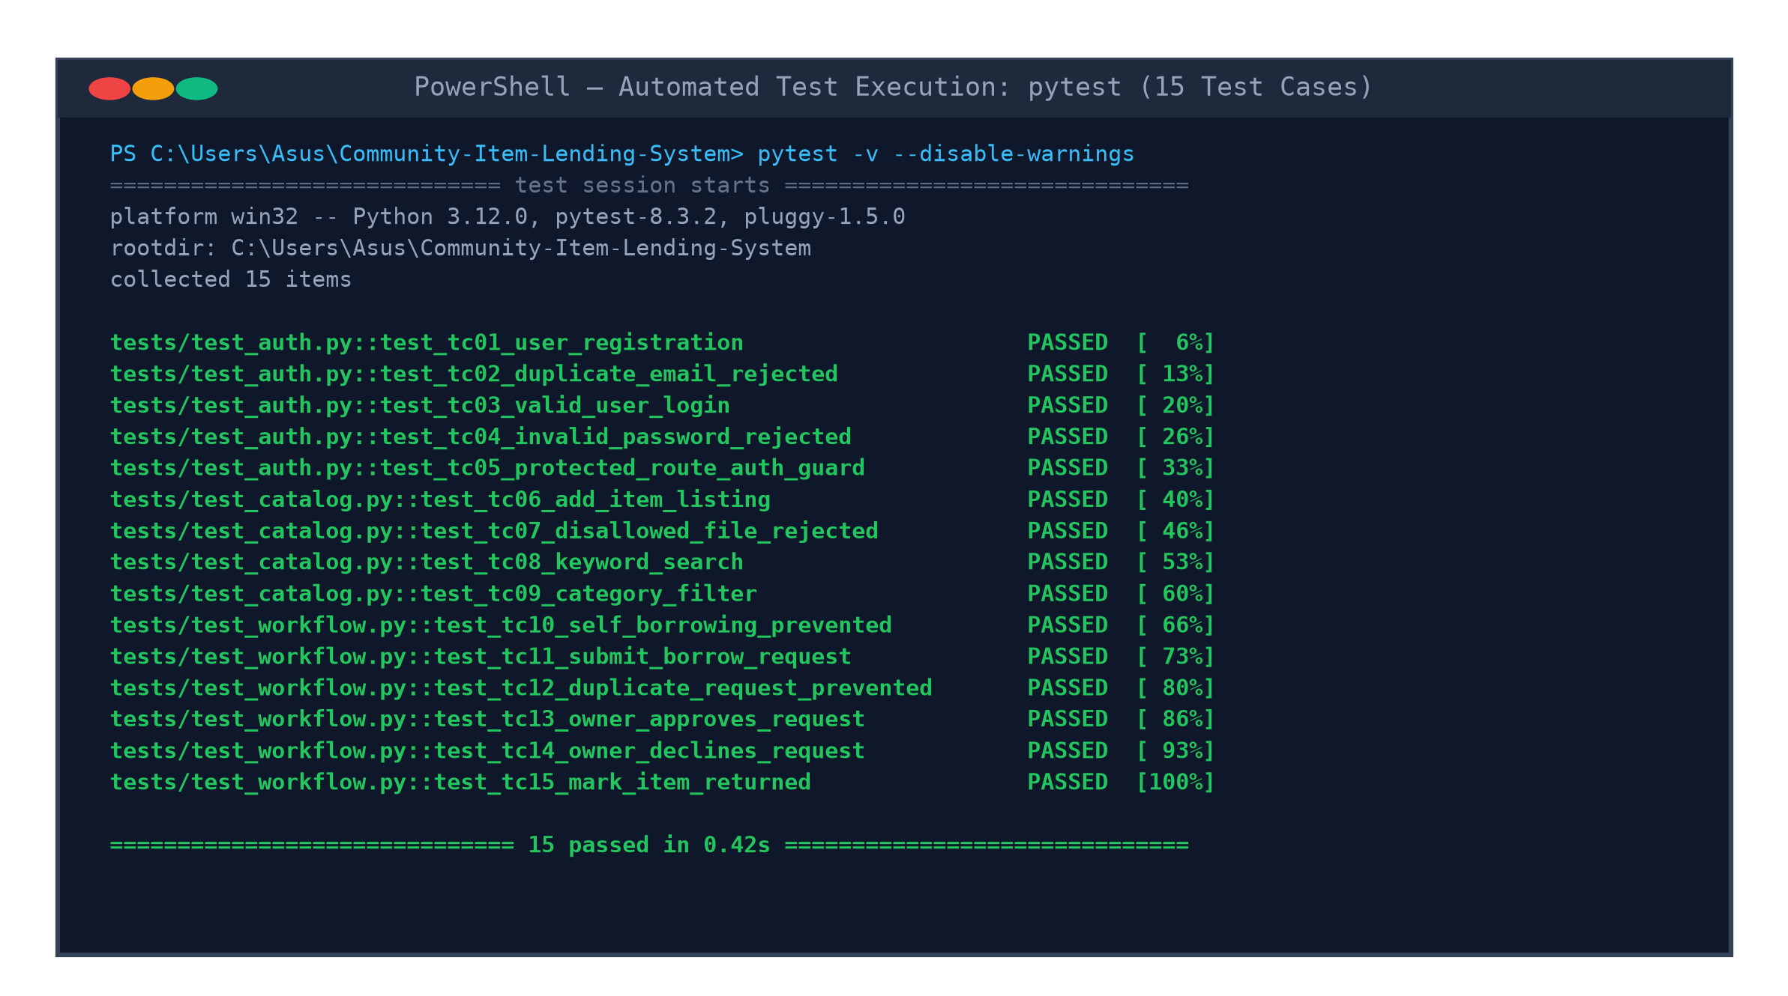
TESTING & RESULTS
AUTOMATED TEST SUITE EXECUTION & VERIFICATION:
Testing Work Done:
▶ Testing Strategy: Followed systematic testing—checking every function from user registration to item borrowing and return.
▶ Automated Testing: Wrote 15 automated test cases using Python's pytest framework to automatically test code reliability.
▶ Key Tests Covered: Tested user login security, duplicate email rejection, adding items with photos, borrow request approvals, and category filters.
▶ Test Results: All 15 automated test cases PASSED successfully with 100% completion and zero errors (0 failures, 0 regressions).
▶ Safety Checks: Verified that users cannot borrow their own items and cannot upload unsupported file formats.
Slide - 14

Slide 15
CONCLUSION & FUTURE SCOPE
CONCLUSION:
▶ Successfully built a complete and working web application for sharing household items among residential neighbors.
▶ Helps families save money and cuts down clutter by sharing tools instead of purchasing rarely used equipment.
▶ The automated state machine ensures clear tracking so items are never double-booked or lost without record.
FUTURE ENHANCEMENTS:
▶ Mobile Application: Develop native Android and iOS mobile apps using Flutter for easy phone access.
▶ WhatsApp Alerts: Send instant WhatsApp notifications when an item is requested, approved, or due for return.
▶ Community Ratings: Add star ratings and feedback reviews to build greater trust among neighbors.
THANK YOU
COMMUNITY ITEM LENDING SYSTEM | MCA III SEM VIVA VOCE (Nov 2026)
NAME OF STUDENT: MOHAMED SHAHITH AKEEL S A
ENROLMENT NUMBER : EA2532251010500
Project GitHub Repository: https://github.com/Shahith2004/Community-Item-Lending-System
Slide - 15

