Slide 1

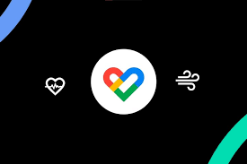
INTERACTION DESIGN
IXD801

Slide 2
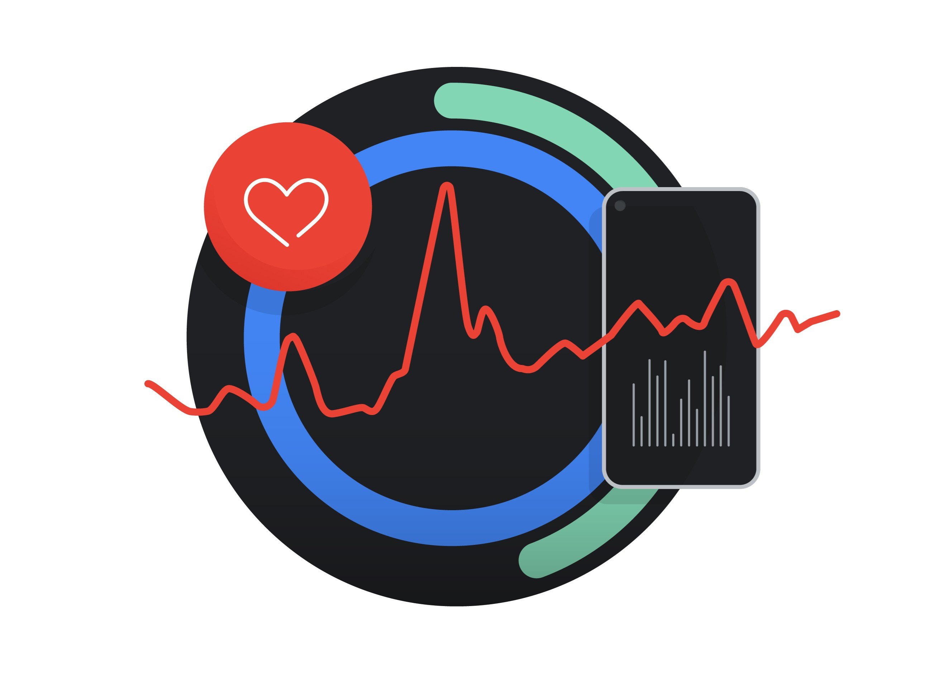
Problem statement identified
Redesign Google Fit App
There is a growing concern about the lack of physical activity and overall health issues in modern society. Sedentary lifestyles, poor diet choices, and limited access to health and fitness information contribute to the problem. People need a convenient and effective way to monitor their physical activity, track their fitness progress, receive personalized health recommendations, and stay motivated to adopt healthier habits.

Slide 3
OBJECTIVE AND TARGET AUDIENCE
GENERAL: To redesign the Google Fit app to create a visually appealing, user-centric, and highly functional interface that enhances the overall user experience. This redesign aims to address several key areas of improvement to ensure the app becomes more engaging, accessible, and aligned with contemporary mobile app design standards.
SPECIFIC:
Enhance User Interface (UI) Design: a. Improve overall app navigation and organization to make it more intuitive. b. Address visual impairment concerns by providing customizable font size and icon options. c. Implement a dark mode feature for improved readability and user preference.
Personalization and Customization: a. Introduce personalized settings to allow users to customize the app according to their preferences, such as workout goals, favorite activities, and motivational content. b. Provide options for users to upload their own motivational quotes or images for a more personalized experience.
Motivation and Engagement: a. Create a diverse and constantly refreshing pool of motivational content to prevent repetition. b. Incorporate personalized motivation features based on user achievements and progress.
Consistency and Syncing: a. Ensure consistent tracking display and syncing across all devices and platforms. b. Improve data synchronization to enhance the accuracy and reliability of fitness tracking.
Expanded Features and Integration: a. Integrate seamlessly with Wear OS devices to provide a unified fitness tracking experience. b. Introduce new features, such as in-app tutorials and guides, to assist new users in understanding the app's capabilities.
Accessibility: a. Enhance accessibility features, such as voice-guided navigation and compatibility with screen readers, to cater to users with disabilities.
User Feedback and Testing: a. Continuously gather user feedback through surveys, interviews, and usability testing to iteratively improve the app's design and functionality. b. Implement user-centric design principles to ensure that changes align with the needs and preferences of the target audience.

Slide 4
TARGET AUDIENCE
Fitness Enthusiasts:
Individuals who are dedicated to maintaining an active and healthy lifestyle.
They may include gym-goers, runners, cyclists, and other athletes.
They seek detailed tracking of their workouts, progress, and performance metrics.
Casual Exercisers:
People who engage in physical activity periodically to stay fit but are not hardcore fitness enthusiasts.
They may prefer simple and easy-to-use features for tracking their occasional workouts.
Seniors and Elderly Users:
Older individuals looking to maintain or improve their fitness as part of a healthy aging strategy.
Accessibility features and simplified navigation will be crucial for this group.
Individuals with Health Conditions:
People with specific health conditions like diabetes, heart disease, or obesity.
They require tailored fitness and health tracking to manage their conditions effectively.
People with Disabilities:
Individuals with various disabilities, including visual impairment, who want to stay active and monitor their fitness.
Accessibility features and customizable options are essential for this group to use the app effectively.

Slide 5
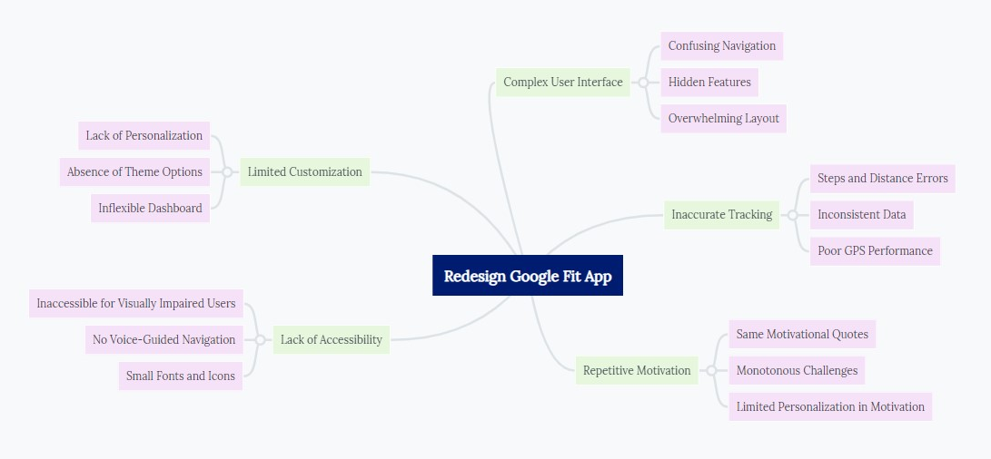
Brainstorming & Mind mapping

Slide 6
CASE STUDIES
Overview: Google Fit, a renowned fitness app, embarked on a redesign journey to overcome challenges related to user experience, accessibility, and engagement. The existing app faced criticism for its complex interface, limited customization options, and a lack of inclusivity for users with disabilities. The redesign aimed to create a more user-centric, accessible, and motivating fitness platform.
Approach:
User-Centric Design: The redesign started with a comprehensive overhaul of the app's user interface. The aim was to simplify navigation and enhance overall user experience. User feedback and usability testing were pivotal in shaping the new interface.
Accessibility and Inclusivity: A significant focus was placed on accessibility. The redesign introduced a suite of accessibility features, including screen reader compatibility, voice-guided navigation, and adjustable fonts. This aimed to ensure that the app was inclusive and user-friendly for all, regardless of disabilities.
Customization Options: Google Fit recognized the need for personalization. Users were empowered with customization features, enabling them to tailor their fitness journey. This included customizable dashboards, theme options, and the ability to set and track personalized fitness goals.
Motivation and Engagement: The redesigned app incorporated a variety of motivational features. Personalized quotes, dynamic challenges, and progress-based incentives were introduced to keep users engaged and motivated throughout their fitness journey.

Slide 7
5. Data Consistency: Data inconsistencies and syncing issues were addressed comprehensively. The redesign aimed to ensure that users could rely on accurate and consistent tracking of their fitness activities and health metrics.
Results:
The redesigned Google Fit app yielded significant positive outcomes:
Enhanced User Satisfaction: The simplified UI and enhanced customization options resulted in higher user satisfaction. Users found it easier to navigate and personalize their fitness experience.
Accessibility and Inclusivity: Users with disabilities, like Nandini, praised the newfound accessibility features, making the app more inclusive. This expanded the user base and earned positive recognition.
Increased User Engagement: The addition of motivational features led to increased user engagement. Users were more motivated to achieve their fitness goals, and challenges fostered a sense of community.
Data Accuracy: Resolving data inconsistencies and syncing issues improved user trust in the app's tracking capabilities, solidifying its position as a reliable fitness companion.
Conclusion:
The redesigned Google Fit app successfully transformed into a user-centric, accessible, and motivating fitness platform. It not only addressed existing challenges but also expanded its reach by accommodating users with disabilities. The redesign demonstrated the importance of listening to user feedback, prioritizing accessibility, and fostering user engagement. As a result, Google Fit solidified its position as a leading fitness app in the market, offering a personalized and inclusive fitness experience for users of all backgrounds and abilities.

Slide 8
COMPETITIVE ANALYSIS
Aspect | Google Fit | Fitbit | MyFitnessPal | Apple Health | Samsung Health
User Base | Android integration | Fitbit devices | Global diet tracking | Apple ecosystem | Samsung device users
Features | Basic tracking | Advanced fitness | Extensive food | Health data from | Fitness metrics &
 | (steps, distance) | tracking (HR, GPS) | & calorie tracking | various sources | stress tracking
UI/UX | Recent improvements | Clear dashboard | Intuitive design | User-friendly | Clean interface
 | Customization | Customizable widgets | Responsive design | Apple design | User-friendly
Accessibility | Limited features | Fair support | Good accessibility | Strong on iOS devices | Some accessibility
 |  |  | for visually impaired |  | for Samsung users

Slide 9
Aspect | Google Fit | Fitbit | MyFitnessPal | Apple Health | Samsung Health
Motivation | Basic quotes | Goal-based | Community support | Limited features | Challenges & rewards
Integration | Wear OS | Device compatibility | Fitness wearables | Apple ecosystem | Samsung ecosystem
Data Privacy | Privacy concerns | Transparent handling | Privacy-conscious | Emphasis on privacy | Privacy-focused
Monetization Model | Free, limited prem. | Hardware sales | Free, premium | Device sales & | Free, optional prem.
 |  |  | subscription | services | & device sales
Community | Limited | Active Fitbit | Large community | Limited | Challenges & achieves
Global Availability | Multiple countries | Many countries | Global availability | Apple presence | Samsung presence
Customer Support | Mixed reviews | Positive support | Positive support | Strong on Apple devices | Positive support

Slide 10
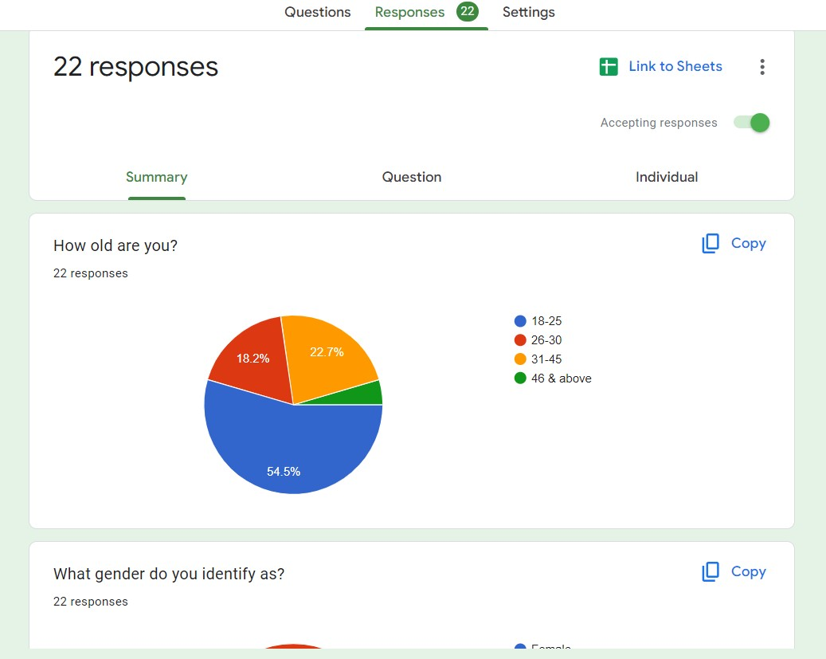
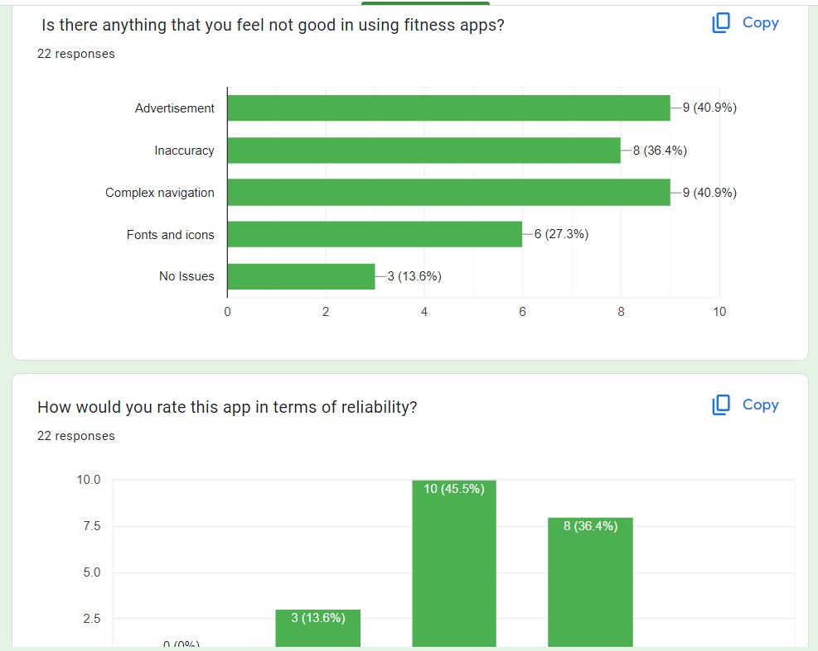
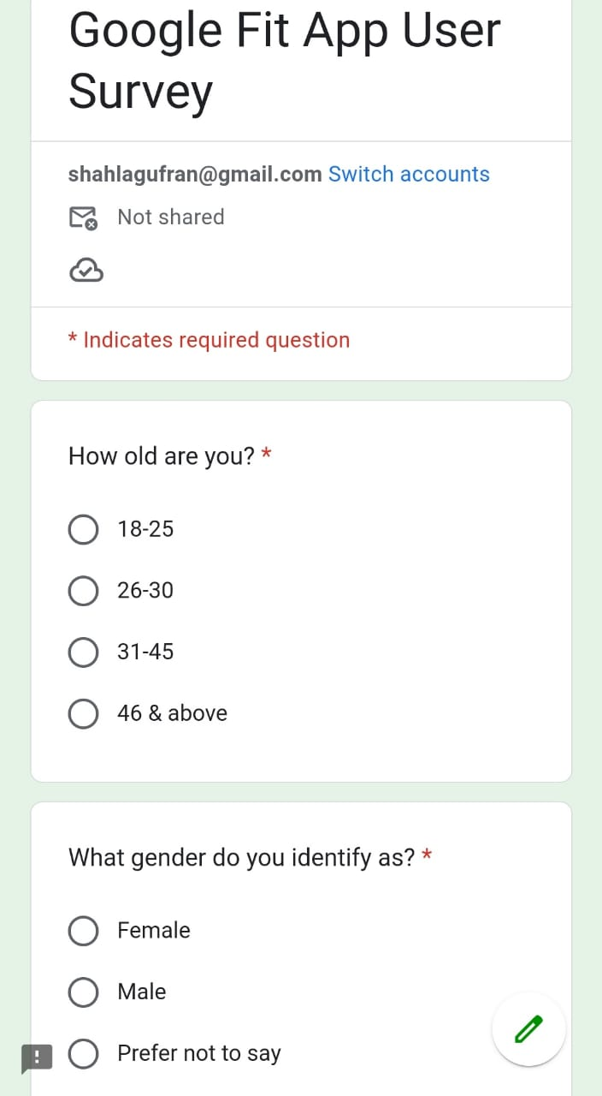
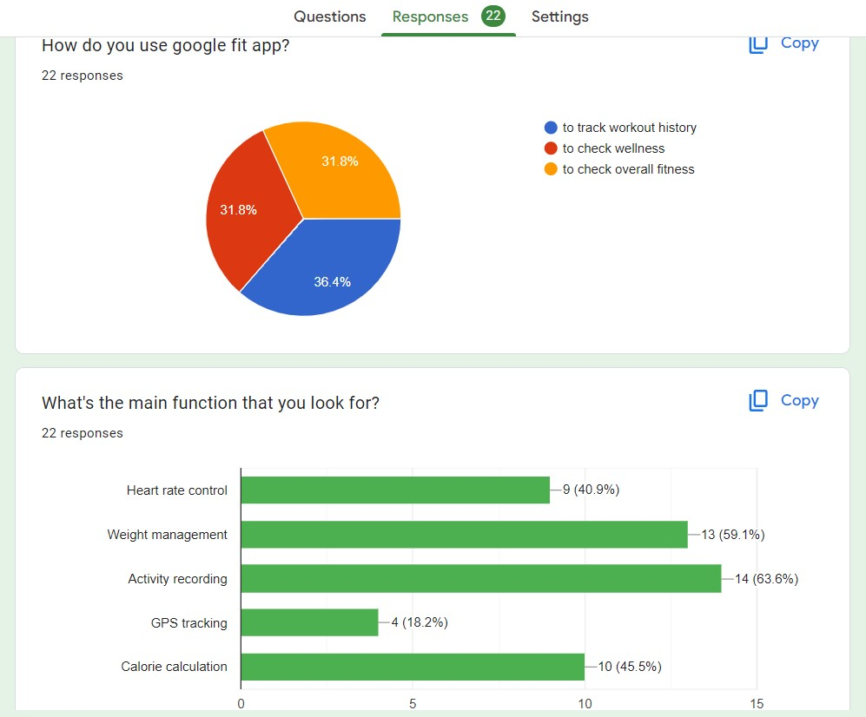
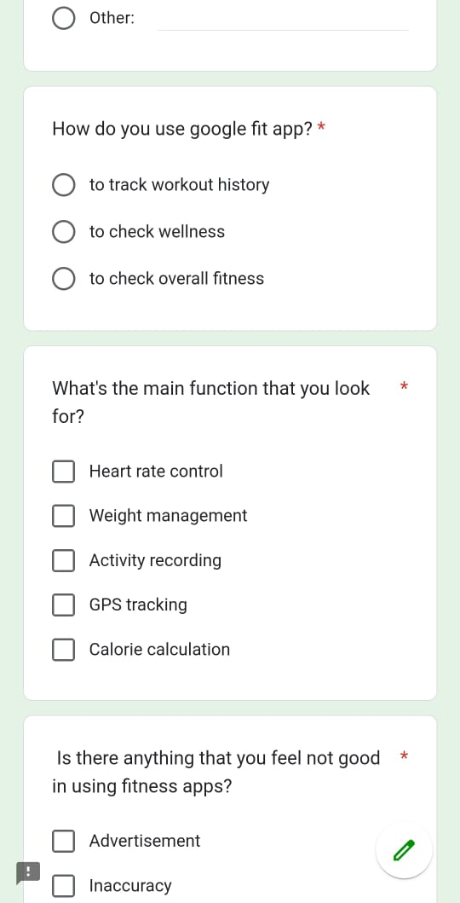
SURVEYS

Slide 11
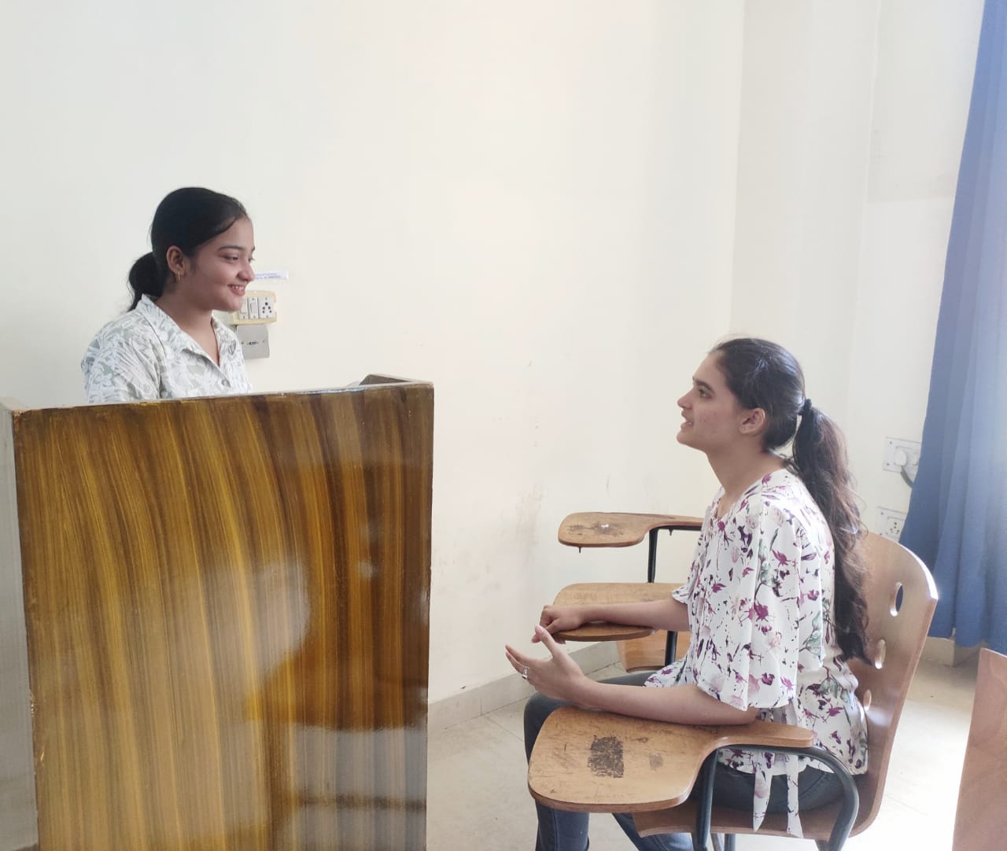
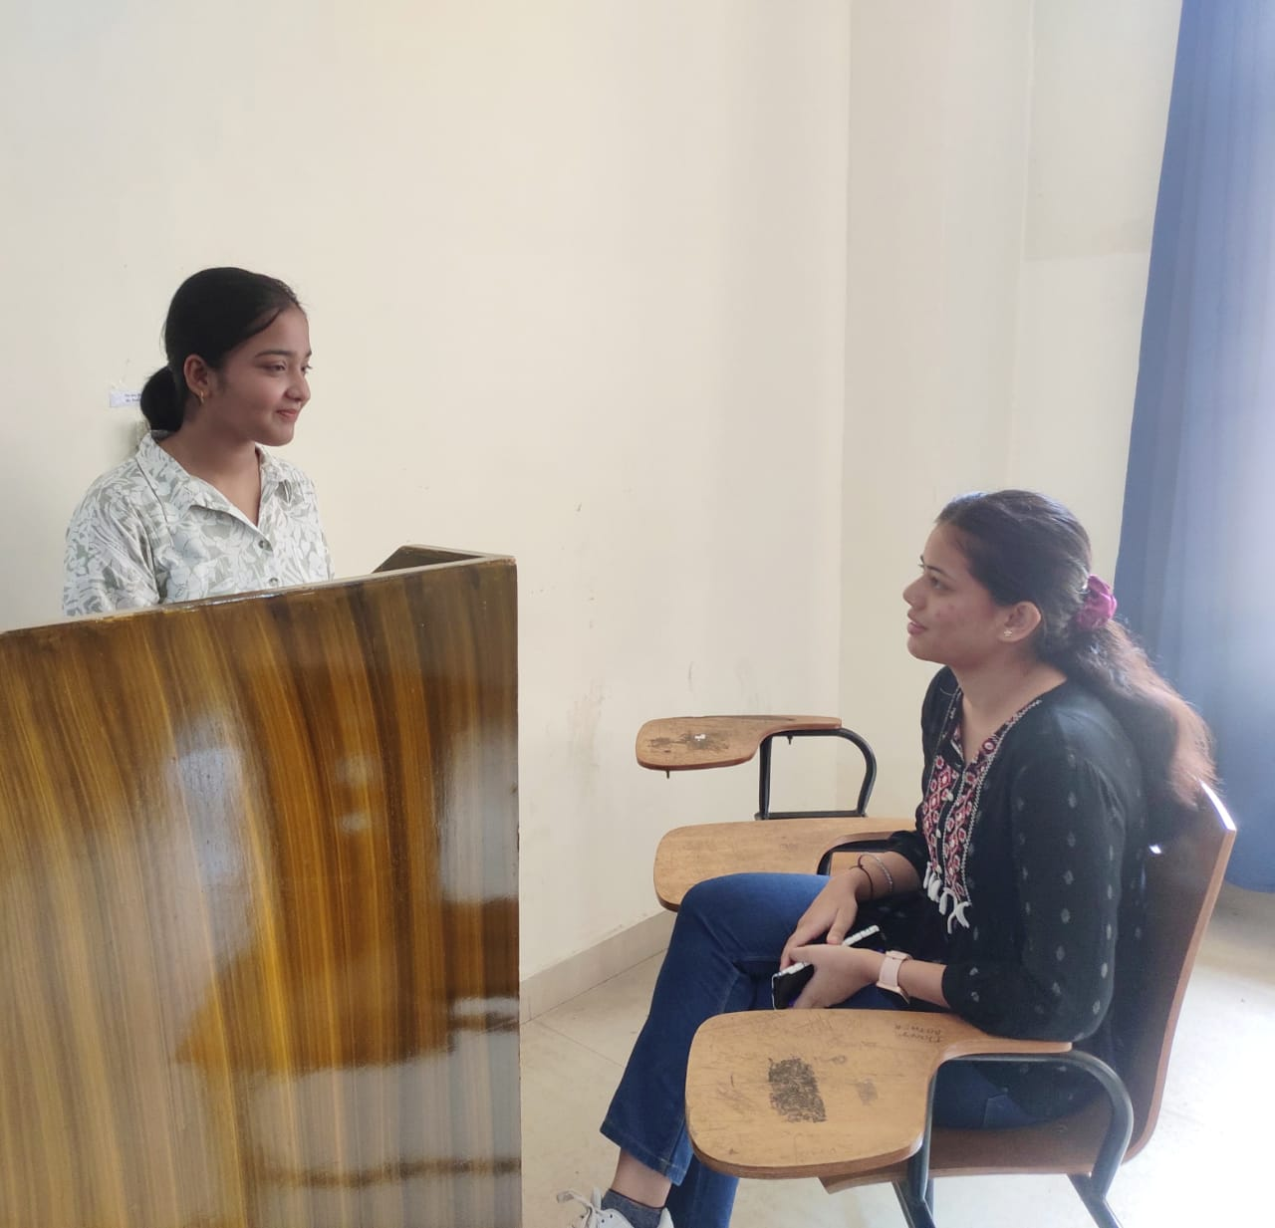
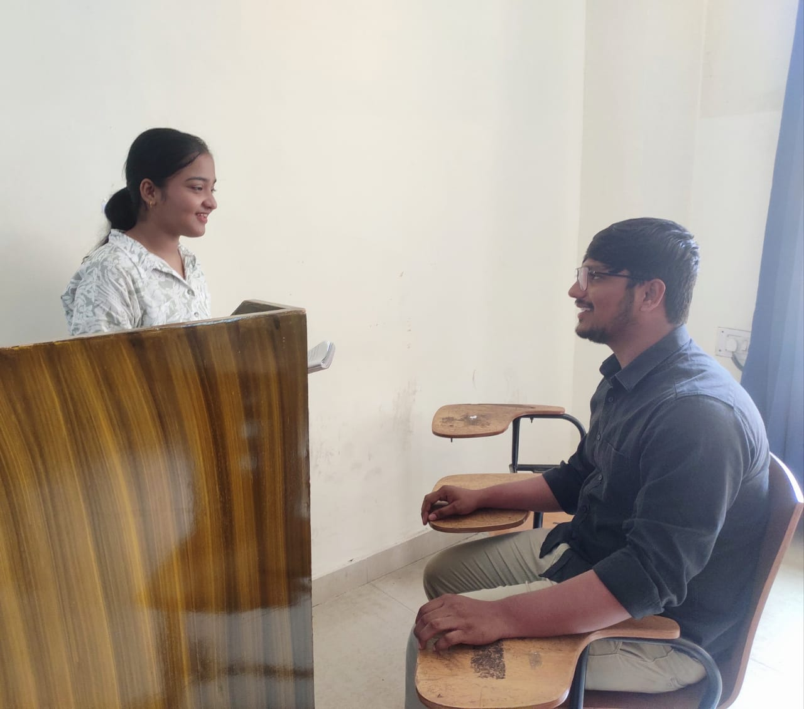
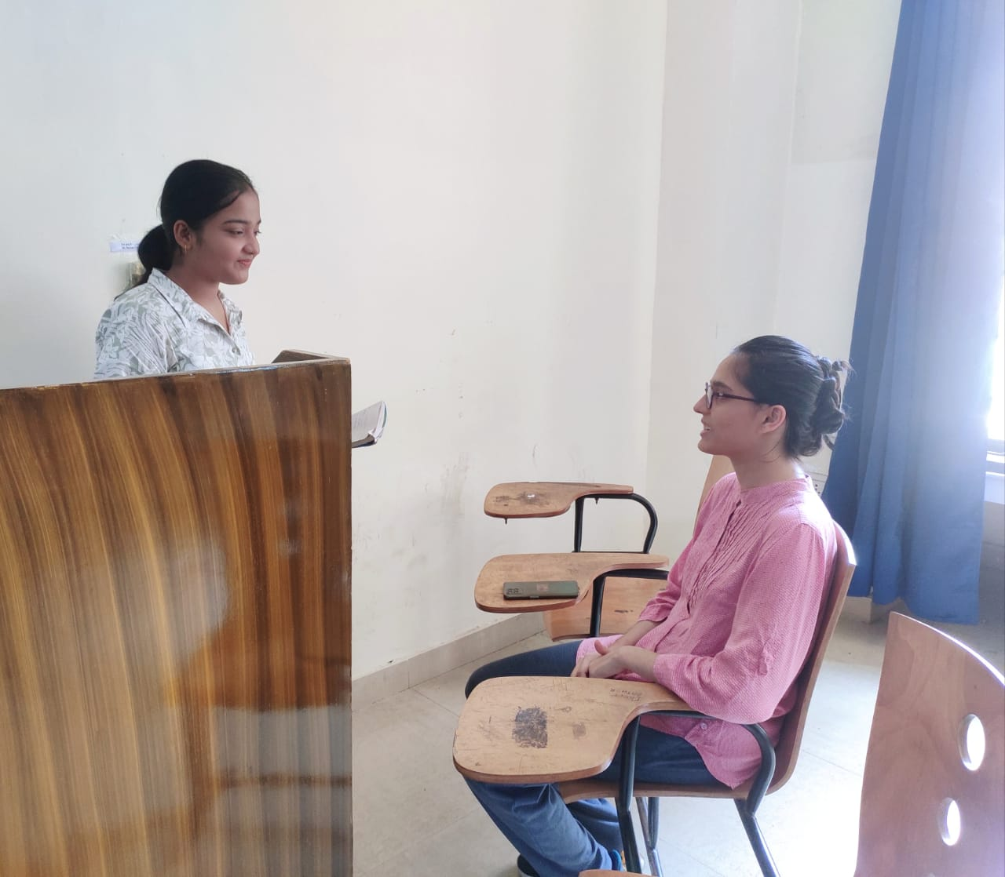
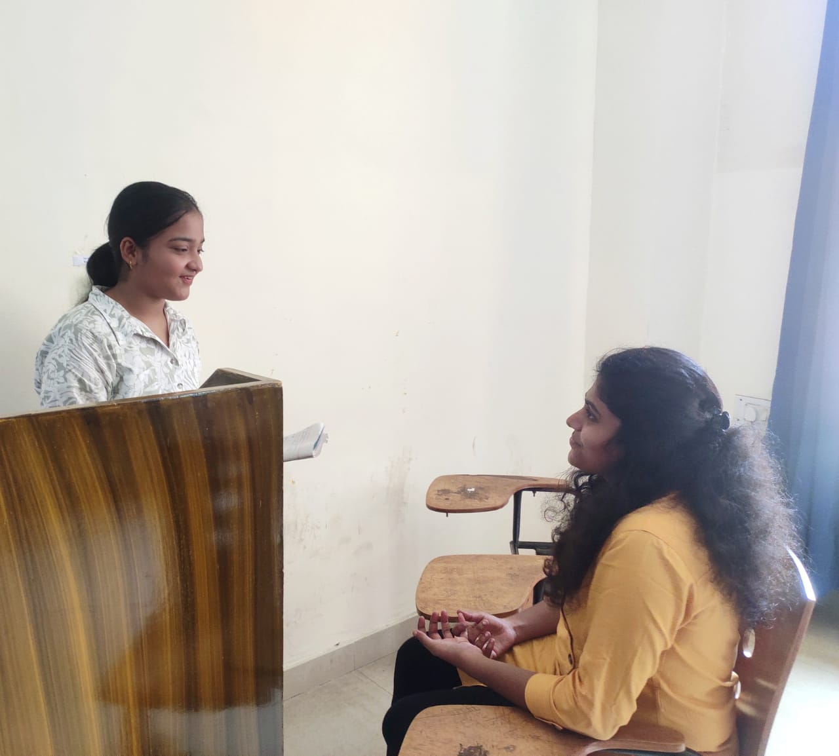
INTERVIEWS

Slide 12

USER PERSONA

Slide 13
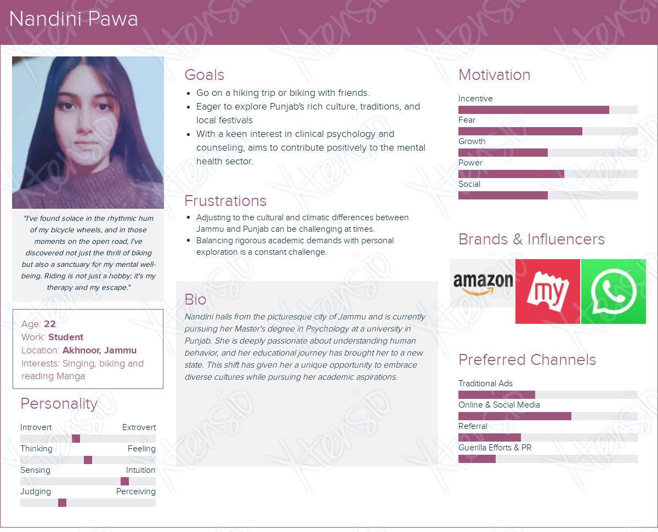

USER PERSONA

Slide 14
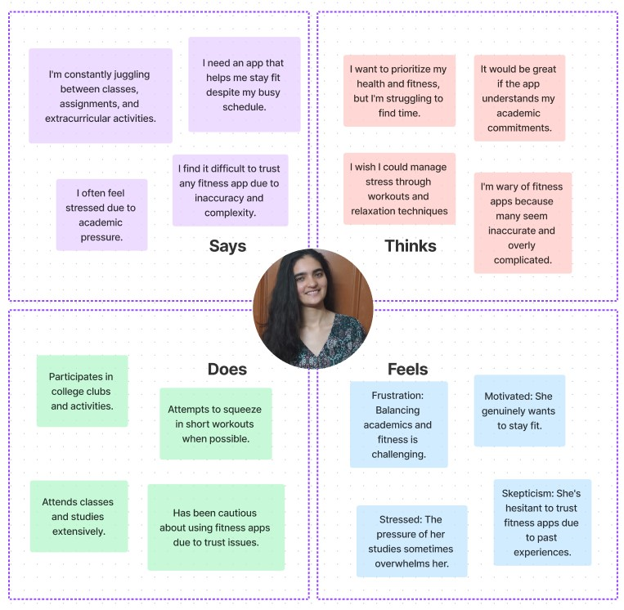
EMPATHY MAPPING
1.

Slide 15
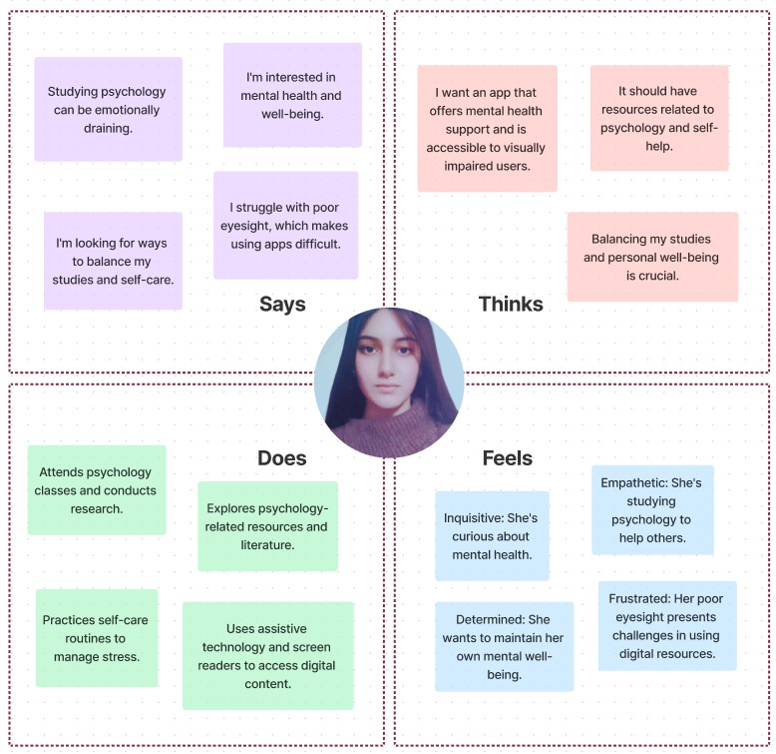
2.

Slide 16
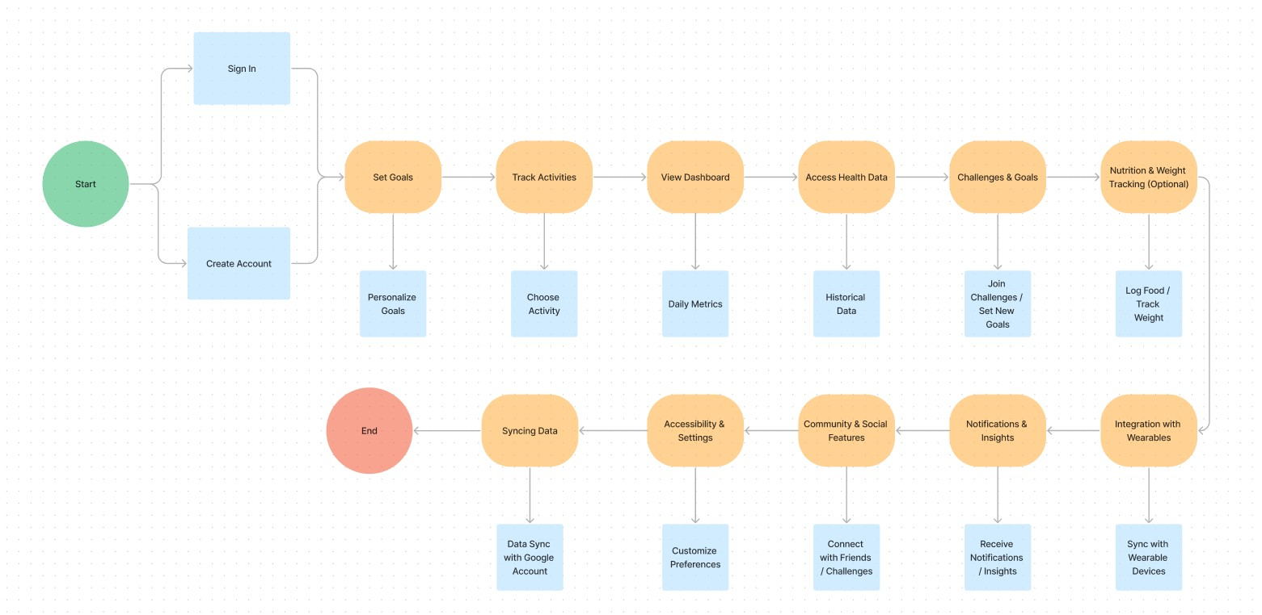
CURRENT USER FLOW

Slide 17
INSIGHTS
User-Centered Design: The top priority is to create an app that revolves around user needs, ensuring it's easy to use and intuitive.
Tailored Engagement: The app aims to engage users through personalized features and motivational content, enhancing their fitness experience.
Inclusivity: Accessibility is paramount, with a commitment to making the app usable for everyone, including individuals with disabilities.
Data Trustworthiness: Ensuring data accuracy and privacy is fundamental to building user confidence and trust in the app.
Continuous Improvement: The project follows an iterative approach, emphasizing ongoing enhancements based on user feedback, ensuring the app evolves to meet evolving user needs.

Slide 18
REDEFINE DESIGN BRIEF
Design Brief: Redesigning Google Fit for Enhanced User Experience and Accessibility
Project Overview: Google Fit, a widely recognized fitness app, has been facing usability and accessibility challenges. This design brief outlines the goals, objectives, and scope of the project to redesign Google Fit, with a focus on improving the user experience, customization, motivation, and accessibility for a diverse user base.
Project Objectives:
Enhanced User Interface (UI):
Improve the overall UI design for a more intuitive and user-friendly experience.
Enhance navigation and streamline menu options.
Implement customization features and introduce a dark mode for user preference.
Personalization and Customization:
Enable users to personalize their fitness journey by customizing their dashboards.
Provide options for users to set and track personalized fitness goals.
Introduce user-generated motivational content for a personalized touch.
Motivation and Engagement:
Diversify motivational content to prevent repetition.
Implement dynamic and progress-based motivational features.
Foster a sense of community and competition among users.

Slide 19
4. Accessibility and Inclusivity:
Enhance accessibility features to cater to users with disabilities.
Ensure compatibility with screen readers and assistive technologies.
Implement voice-guided navigation for improved usability.
5. Data Consistency and Integration:
Address inconsistencies in tracking and data syncing across devices.
Strengthen integration with Wear OS for a seamless experience.
Improve data privacy measures to build user trust.
Target Audience: The redesigned Google Fit app will cater to a diverse audience, including fitness enthusiasts, casual exercisers, seniors, individuals with health conditions, and people with disabilities. The design will prioritize accessibility and personalization to meet the needs of this wide-ranging user base.
Design Process: The project will follow an iterative design process, involving user research, prototyping, user testing, and continuous feedback collection. Design decisions will be data-driven and aligned with the specific needs and preferences of the target audience.
Success Metrics: The success of the redesigned Google Fit app will be evaluated based on user satisfaction ratings, engagement metrics, increased user base, and positive feedback from users with disabilities.
Conclusion: This design brief outlines the critical aspects of the Google Fit app redesign project, emphasizing improved user experience, personalization, motivation, accessibility, and data consistency. The goal is to create an inclusive and user-centric fitness app that addresses the needs of a diverse and health-conscious user base.

Slide 20
POSSIBLE SOLUTIONS & FEATURES
1. Enhanced Integration and Ecosystem
Solution- Strengthen integration with Google's ecosystem, including Google Calendar for scheduling workouts and Google Maps for tracking outdoor activities.
Feature- Seamlessly sync fitness data with other Google services to provide a unified health and wellness experience.
2. Personalized Health Insights
Solution- Utilize AI and machine learning algorithms to provide users with personalized health insights.
Feature- Offer recommendations on activity levels, nutrition, and sleep patterns based on individual data and goals.
3. Comprehensive Activity Tracking
Solution- Expand the range of activities tracked to cater to diverse user interests.
Feature- Include tracking for sports, strength training, yoga, and other activities alongside traditional metrics like steps and distance.

Slide 21
4. Advanced Wearable Integration
Solution- Improve compatibility with a wide range of wearables, including third-party devices.
Feature- Enable automatic data synchronization from popular fitness wearables, smartwatches, and heart rate monitors.
5. Comprehensive Goal Setting
Solution- Allow users to set holistic health goals.
Feature- Enable goal setting for physical activity, sleep, nutrition, and stress management, with progress tracking and notifications.
6. Health Data Privacy and Security
Solution- Address concerns about health data privacy.
Feature- Implement robust encryption, clear data sharing controls, and transparent privacy policies.
7. Gamification and Rewards
Solution- Motivate users through gamification.
Feature- Implement a rewards system, badges, and challenges to encourage consistent physical activity and goal achievement.

Slide 22
8. Offline Functionality
Solution- Recognize that users may not always have an internet connection.
Feature- Allow tracking and basic functionality even when offline, with data sync when a connection is available.
9. Accessibility Features
Solution- Promote inclusivity and accessibility.
Feature- Include features like voice-guided workouts, screen readers, and adjustable font sizes for users with disabilities.
10. Health Challenges and Events
Solution- Encourage participation in fitness events and challenges.
Feature- Showcase local fitness events, virtual races, and global health challenges users can participate in.
11. Nutrition and Meal Tracking
Solution- Recognize the importance of nutrition in overall health.
Feature- Include tools for tracking food intake, calorie counting, and nutritional analysis with a large database of food items.

Slide 23
SCENARIO BUILDING
Scenario 1: Personalized Health Improvement
Raghav, a 35-year-old professional, wants to improve his overall health and fitness. He's been using the new Google Fit app for a few weeks.
User Goal: Improve overall health and fitness.
App Features /Solutions Utilized:-
Personalized Health Insights - The app analyzes Raghav's activity, sleep, and nutrition data to provide tailored recommendations.
Comprehensive Activity Tracking - Raghav tracks his daily workouts, which include running, strength training, and yoga.
Health Challenges and Events - He joins a local fitness challenge within the app to stay motivated.

Slide 24
Scenario 2: Home Workout Enthusiast
Sana, a 19-year-old fitness enthusiast, prefers home workouts due to her busy schedule.
User Goal: Maintain a consistent home workout routine.
App Features/Solutions Utilized:-
Personalized Health Insights - Sana follows guided home workout routines according to her health insights.
Gamification and Rewards - She earns badges and rewards for completing workouts.
Comprehensive Goal Setting - Sana sets goals for workout frequency, sleep, and nutrition.
Scenario 3: Active Lifestyle Integration
Kabir, a 45-year-old avid runner, wants to seamlessly integrate his fitness routine into his daily life.
User Goal: Maintain an active lifestyle with a focus on running.
App Features/Solutions Utilized:-
Integration and Ecosystem - Kabir syncs Google Fit with Google Calendar for scheduling workouts and Google Maps for tracking outdoor activities.
Advanced Wearable Integration - He syncs his smartwatch to monitor heart rate during training.
Activity Insights: Kabir receives running route suggestions.

Slide 25
Scenario 4: Weight Maintenance and Healthy Aging
Naveen, a retiree in his 60s, is focused on maintaining his weight and overall health as he ages.
User Goal: Maintain a healthy weight and overall well-being.
App Features/Solutions Utilized:-
Comprehensive Activity Tracking - Naveen tracks his daily activities, which include brisk walks and light strength training.
Personalized Health Insights - The app provides recommendations for healthy aging.
Scenario 5: Remote Health Monitoring
Abha, a 45-year-old with a chronic health condition, needs to monitor her health remotely.
User Goal: Manage her chronic health condition through remote monitoring.
App Features/Solutions Utilized:-
Comprehensive Activity Tracking - Abha tracks her daily activities, including walking and heart rate.
Advanced Wearable Integration - She syncs her medical wearable to monitor vital signs.
Personalized Health Insights - The app provides recommendations for managing her condition.

Slide 26
SPECIFICATIONS
Platform and Compatibility-
Platform: The app will be available on both Android and iOS platforms.
Compatibility: It should be compatible with a wide range of smartphones and tablets, including the latest devices.
User Interface (UI)-
Intuitive Design: The app should have a user-friendly and intuitive interface with easy navigation.
Accessibility: Ensure accessibility features for users with disabilities, including support for screen readers and adjustable text sizes.
User Accounts and Profiles-
User Registration: Users can create accounts or sign in with their Google accounts.
User Profiles: Users can set up and customize their profiles with personal information, fitness goals, and health data.
Fitness Tracking-
Comprehensive Activity Tracking: Track various activities, including walking, running, cycling, swimming, strength training, and yoga.
Wearable Integration: Seamlessly integrate with a wide range of wearables and fitness devices for data synchronization.

Slide 27
Health Insights-
Personalized Health Insights: Utilize AI and machine learning to provide personalized health recommendations based on user data.
Nutritional Insights: Offer insights into nutrition and meal planning, including calorie tracking and nutritional analysis.
Goal Setting and Monitoring-
Comprehensive Goal Setting: Allow users to set goals for physical activity, sleep, nutrition, and stress management.
Progress Tracking: Provide users with real-time feedback on their progress toward their goals.
Integration and Ecosystem-
Google Integration: Seamlessly integrate with Google services like Google Calendar for scheduling workouts and Google Maps for tracking outdoor activities.
Third-Party Integrations: Support integration with popular third-party fitness apps and devices.
Health and Safety Features-
Health Alerts: Provide health alerts and reminders, especially for users with chronic conditions.
Emergency Features: Include emergency contact information and an emergency alert button for user safety.

Slide 28
Gamification and Rewards-
Badges and Rewards: Implement a gamification system with badges, achievements, and rewards to motivate users.
Challenges: Offer a variety of fitness challenges for users to participate in.
Data Privacy and Security-
Data Encryption: Ensure robust data encryption to protect user health data.
User Data Control: Allow users to control their data sharing and privacy settings.
Offline Functionality-
Offline Use: Enable users to track and view their data even when offline, with data synchronization when an internet connection is available.
Language and Localization-
Multilingual Support: Support multiple languages for a global user base.
Localization: Customize content and recommendations based on user location and preferences.
Development and Updates-
Regular Updates: Commit to regular updates, including bug fixes, performance improvements, and new features.
Feedback Channels: Provide a direct feedback channel for users to report issues and suggest improvements.

Slide 29
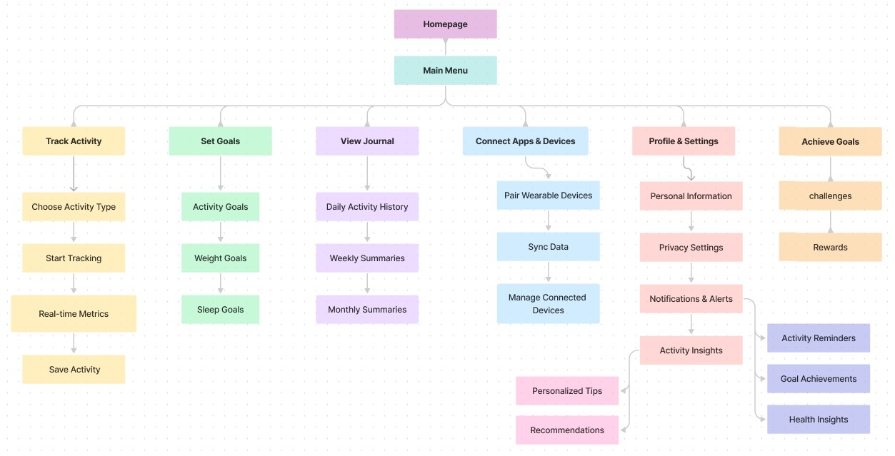
INFORMATION ARCHITECTURE

Slide 30
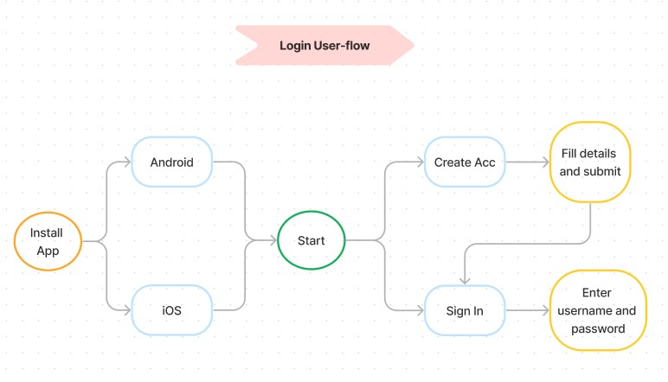
NEW USER-FLOWS
Login

Slide 31
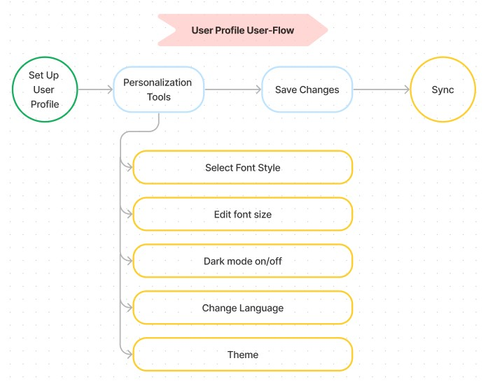
2. User Profile

Slide 32
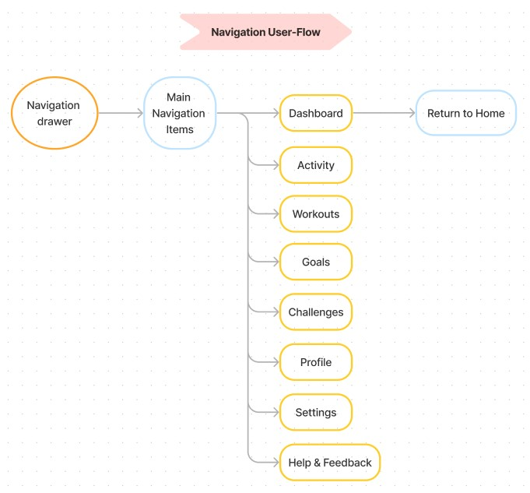
3. Navigation window

Slide 33
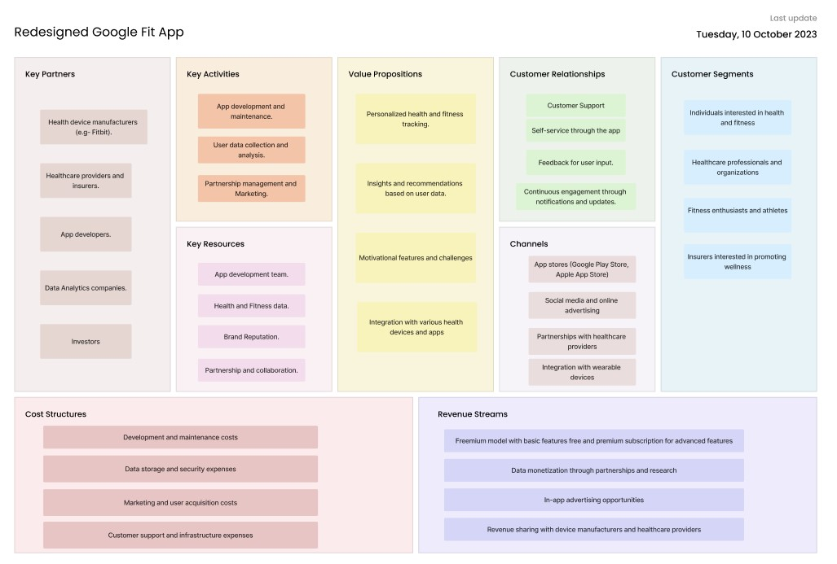
Business Canvas Model

Slide 34
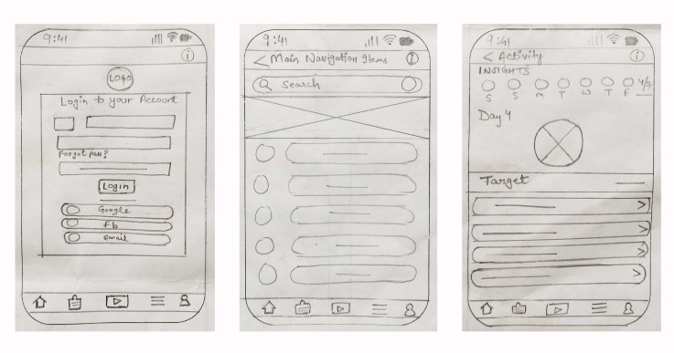
Low fidelity wireframes

Slide 35
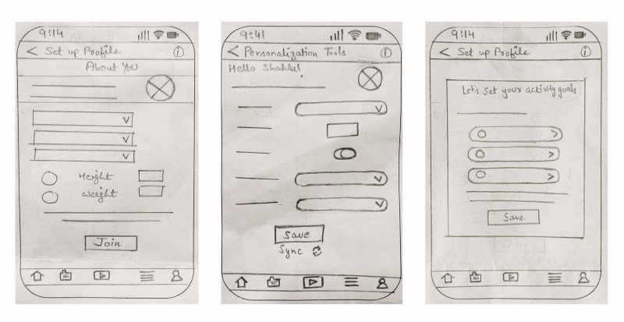
Low fidelity wireframes

Slide 36
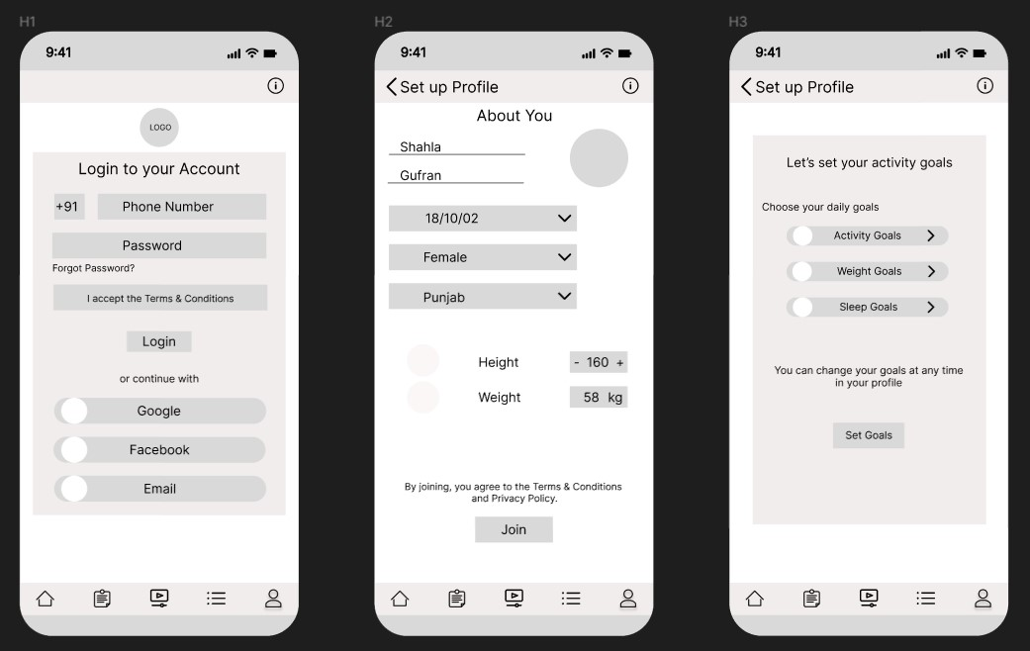
High Fidelity wireframes

Slide 37
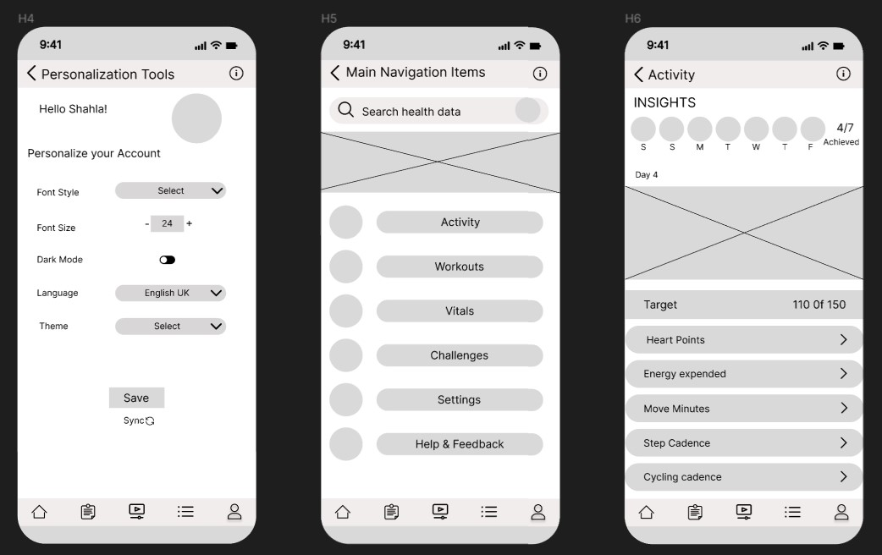
High Fidelity wireframes

Slide 38
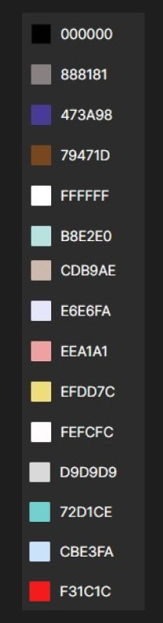
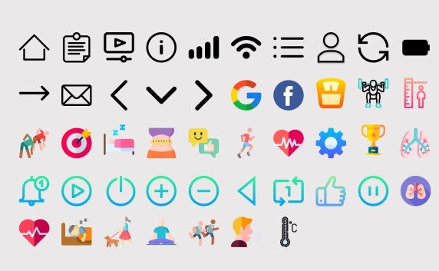
Style Guide
Colors
Icons
Font
Font: Regular and Medium.
Font sizes: 10, 14, 16, 20, 24 and 36

Slide 39
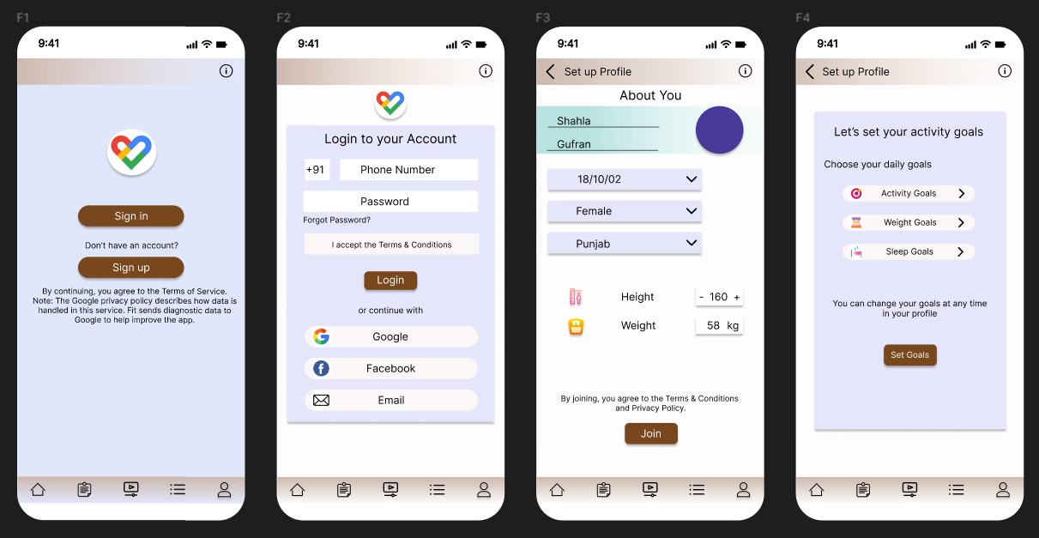
Final UI

Slide 40
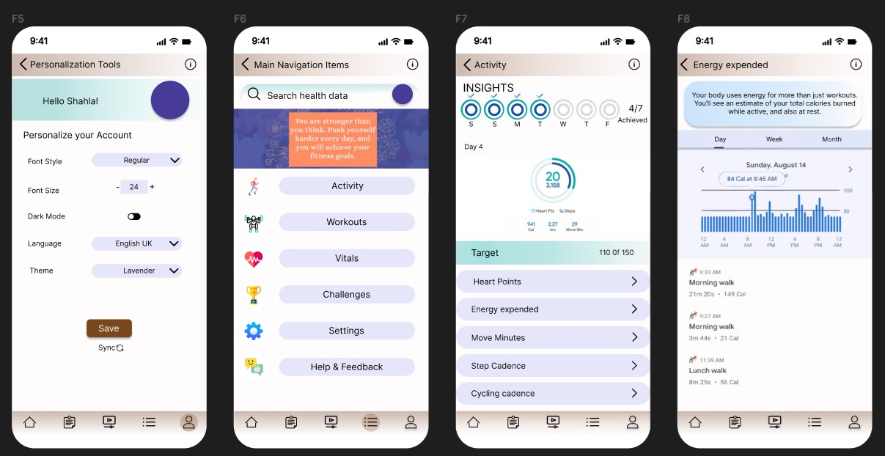
Final UI

Slide 41
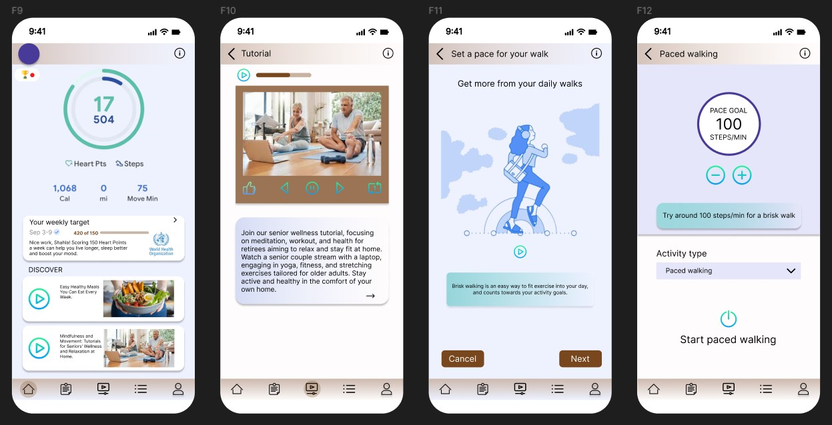
Final UI

Slide 42
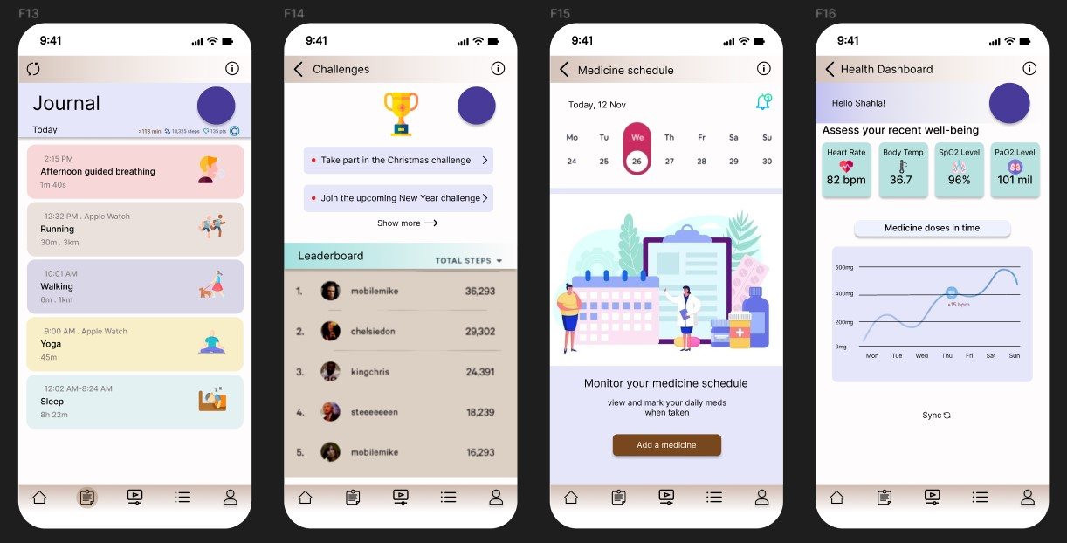
Final UI

Slide 43
Figma Link
https://www.figma.com/file/myyjMXeFYuUNz0IeLnUlWP/Redesigned-Google-Fit-App?type=design&node-id=0%3A1&mode=design&t=93hEGS39M3LiOBUc-1

Slide 44
THANK YOU
Shahla Gufran
12115794
KO364
B58

