Slide 1



Machine Learning LAB
Week 02

Slide 2
Lab Contents
Univariate Linear Regression
Multivariate Regression
Logistic Regression
Polynomial Regression
Linear Regression

Slide 3
Linear Regression
Load Data of Regression
Drop Sr# column
Split X,y
Train test split of 20%

Slide 4
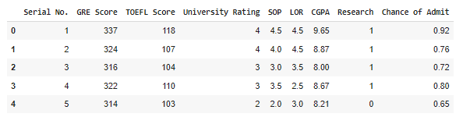
Load Data & Drop Sr
import pandas as pd
df=pd.read_csv("/content/Admission_Predict.csv")
coulumns=df.columns
df.drop("Serial No.",axis=1,inplace=True)
y = df['Chance of Admit ']
df.drop("Chance of Admit ",axis=1,inplace=True)
df.head()

Slide 5
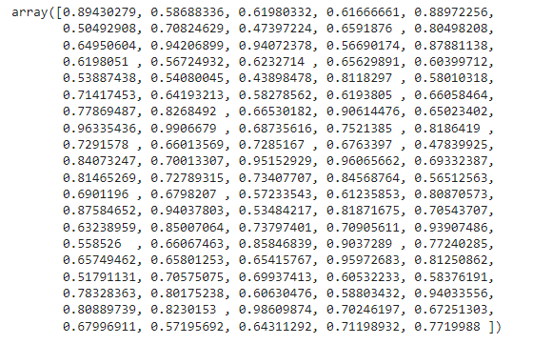
Split X,y Train Test Split 20%
from sklearn.model_selection import train_test_split
x_train,x_test,y_train,y_test = train_test_split(df,y,test_size=0.2)
from sklearn.linear_model import LinearRegression
lr = LinearRegression()
lr.fit(x_train,y_train)
pred = lr.predict(x_test)
pred

Slide 6

Linear Regression
from sklearn import metrics
import numpy as np
rmse = np.sqrt(metrics.mean_squared_error(y_test,pred))
rmse

Slide 7
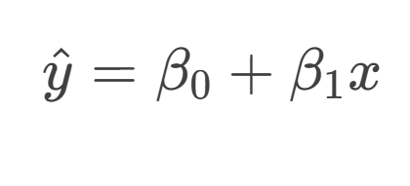
Univariate Linear Regression

Slide 8
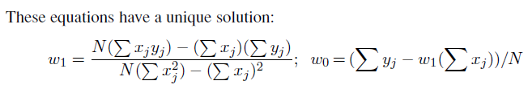
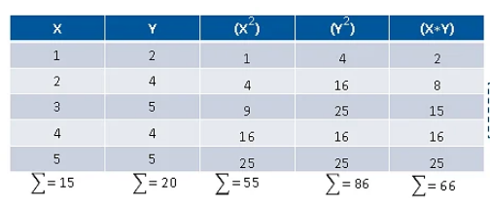
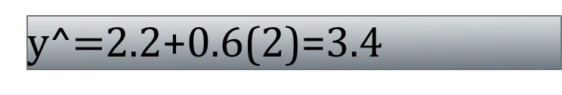
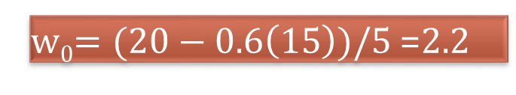
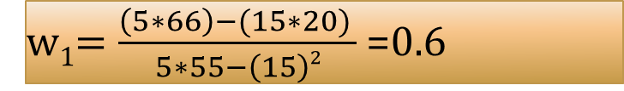
Solution
w₁$=\frac{\left(5∗66\right)−(15∗20) }{5∗55−\left(15\right)2}$ =0.6
w₀$=(20−0.6\left(15\right))/5$ =2.2
y^=2.2+0.6x
y^$=$2.2+0.6(2)=3.4

Slide 9
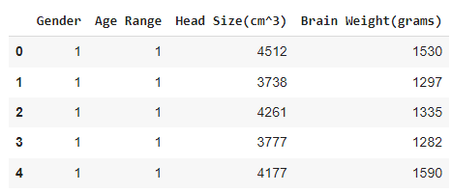
Load Dataset
import pandas as pd
df=pd.read_csv("/content/drive/My Drive/ML_Labs/DataSets/headbrain.csv")
df.head()

Slide 10
Load Dataset
# Computing X and Y
X = df['Head Size(cm^3)'].values
y = df['Brain Weight(grams)'].values

Slide 11

Calculate Parameters
import numpy as np
X_sum = np.sum(X)
X_squared_sum = np.sum(X * X)
n = len(X) print("Sum of X:", X_sum)
print("Sum of X squared:", X_squared_sum)
print("Length of X:", n)

Slide 12

Estimate Parameters
import numpy as np
# Total number of values
n = len(X)
# calculating cross-deviation and deviation about x
numer=n*np.sum(X*y)-np.sum(X)*np.sum(y)
denom=n*np.sum(X*X)-(np.sum(X))**2
w1=numer/denom
# calculating regression coefficients
w0=(np.sum(y)-w1*(np.sum(X)))/n
w1,w0

Slide 13
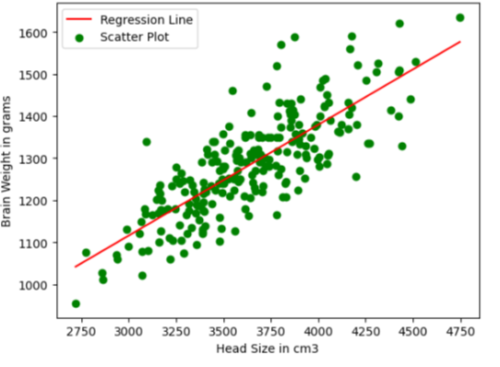
Plot Regression Line
import matplotlib.pyplot as plt
max_x = np.max(X)
min_x = np.min(X)
# Calculating line values x and y
x1 = np.linspace(min_x, max_x)
y1 = w0 + w1 * x1
# Ploting Line
plt.plot(x1, y1, color='red', label='Regression Line')
# Ploting Scatter Points
plt.scatter(X, y, c='green', label='Scatter Plot')
plt.xlabel('Head Size in cm3')
plt.ylabel('Brain Weight in grams')
plt.legend()
plt.show()

Slide 14
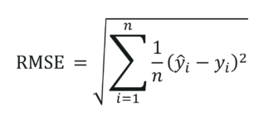

Calculate RMSE
# Calculating Root Mean Squares Error
rmse = 0
for i in range(n):
y_pred = w0 + w1 * X[i]
rmse += (y[i] - y_pred) ** 2
rmse = np.sqrt(rmse/n)
print("RMSE=",rmse)

Slide 15
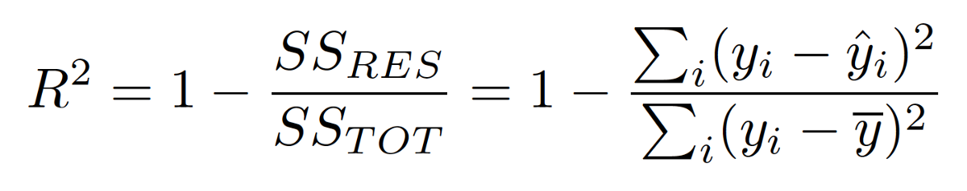

Calculating R2 Score
ss_tot = 0
ss_res = 0
y_mean=np.mean(y)
for i in range(n):
y_pred = w0 + w1 * X[i]
ss_tot += (y[i] -y_mean ) ** 2
ss_res += (y[i] - y_pred) ** 2
r2 = 1 - (ss_res/ss_tot)
print("R2 Score=",r2)

Slide 16

MULTIVARIATE LINEAR REGRESSION
We can easily extend to multivariate linear regression problems, in which each example x_{j} is an n-element vector.
Our hypothesis space is the set of functions of the form

Slide 17
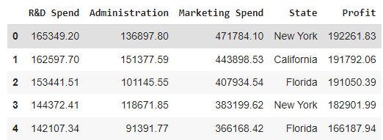
MULTIVARIATE LINEAR REGRESSION
# Importing the libraries
import pandas as pd
import numpy as np
import matplotlib.pyplot as plt
import pandas as pd
import seaborn as sns
companies=pd.read_csv("/content/drive/My Drive/ML_Labs/DataSets/MultipleRegression_1000_Companies.csv")
coulumns=companies.columns
companies.head()

Slide 18

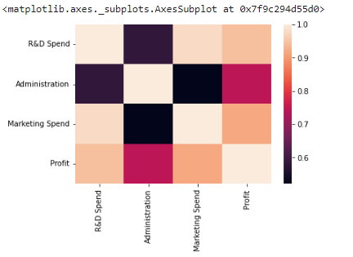
MULTIVARIATE LINEAR REGRESSION
X = companies.iloc[:, :-1].values
y = companies.iloc[:, 4].values
X[:5]
# Data Visualization
# Building the Correlation matrix
sns.heatmap(companies.corr())

Slide 19
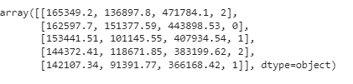
MULTIVARIATE LINEAR REGRESSION
# Encoding categorical data
from sklearn.preprocessing import LabelEncoder
labelencoder = LabelEncoder()
X[:, 3] = labelencoder.fit_transform(X[:, 3])
X[:5]

Slide 20
MULTIVARIATE LINEAR REGRESSION
# Splitting the dataset into the Training set and Test set
from sklearn.model_selection import train_test_split
X_train, X_test, y_train, y_test = train_test_split(X, y, test_size = 0.2, random_state = 0)
# Fitting Multiple Linear Regression to the Training set
from sklearn.linear_model import LinearRegression
regressor = LinearRegression()
regressor.fit(X_train, y_train)

Slide 21

# Predicting the Test set results
y_pred = regressor.predict(X_test)
print("Predicted:",y_pred[:5])
print("Actual:",y_test[:5])

Slide 22

MULTIVARIATE LINEAR REGRESSION
# Calculating the R squared value, # The mean squared error
from sklearn.metrics import r2_score,mean_squared_error
print("R squared value: %.2f" %r2_score(y_test, y_pred))
print("Mean squared error: %.2f" % mean_squared_error(y_test, y_pred))

Slide 23
Logistic Regression (Scratch)
Activity 1: Logistic Regression from scratch

Slide 24
Logistic Regression (Scratch)
it's also known as logit regression
Use for classification.
Help in decision making.
Where the situation is not clear you do not know the outcome results.
in regression dependent variable was continuous.
In this dependent variables is binary 0 or 1 or binomial.
Used in decision making so it support probability.
probability range is 0-1.
Binary classification it means that only two outcomes.
Multi class means different classes.

Slide 25
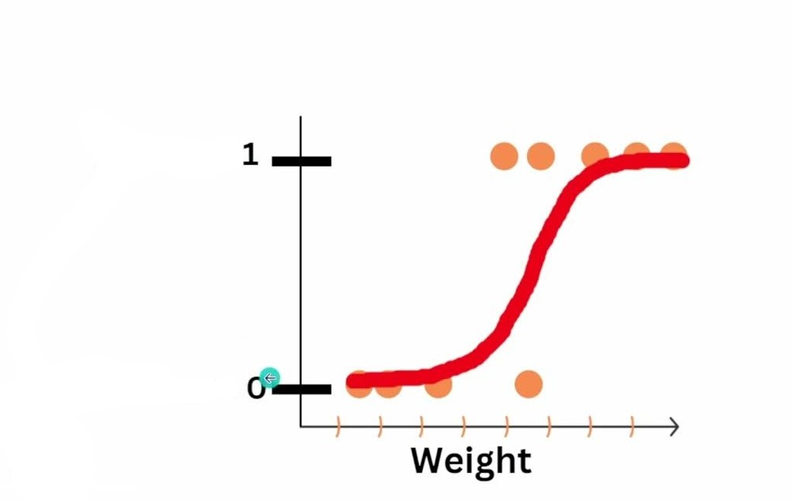
Logistic Regression (Scratch)
in linear relation we can draw straight line to classify but in this we can’t.
The outcome is form of s.
Backend working sigmoid or logit function
Sigmoid probability is equal to 1 / 1 + e^{-z}. So e Euler's number = 2.7
Z is equal to linear equation equation y= Mx+b...
it converts input into 0 1 range...

Slide 26
Logistic Regression (Scratch)
import numpy as np
import pandas as pd
from sklearn.model_selection import train_test_split
from sklearn.preprocessing import StandardScaler, LabelEncoder
from sklearn.metrics import accuracy_score, classification_report, confusion_matrix
# Load the dataset from a CSV file
data = pd.read_csv('/content/Social_Network_Ads.csv')

Slide 27
Logistic Regression (Scratch)
# Preprocessing
# Encode categorical variable 'Gender'
labelencoder = LabelEncoder()
data['Gender'] = labelencoder.fit_transform(data['Gender']) # Male=1, Female=0
# Define features and target variable
X = data[['Gender', 'Age', 'EstimatedSalary']].values # Select relevant columns
y = data['Purchased'].values # Target variable

Slide 28
Logistic Regression (Scratch)
# Split the dataset into training and testing sets
X_train, X_test, y_train, y_test = train_test_split(X, y, test_size=0.2, random_state=42)
# Scale the features
scaler = StandardScaler()
X_train = scaler.fit_transform(X_train)
X_test = scaler.transform(X_test)

Slide 29
Logistic Regression (Scratch)
# Logistic Regression Implementation
class LogisticRegression:
def __init__(self, learning_rate=0.01, num_iterations=1000):
self.lr = learning_rate
self.iterations = num_iterations
self.weights = None
self.bias = None
def sigmoid(self, z):
return 1 / (1 + np.exp(-z))
def fit(self, X, y):
num_samples, num_features = X.shape
self.weights = np.zeros(num_features)
self.bias = 0

Slide 30
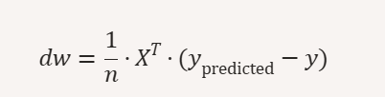
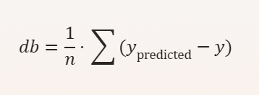
Logistic Regression (Scratch)
for i in range(self.iterations):
linear_model = np.dot(X, self.weights) + self.bias
y_predicted = self.sigmoid(linear_model)
# Update weights and bias by calculating Gradient
dw = (1 / num_samples) * np.dot(X.T, (y_predicted - y))
db = (1 / num_samples) * np.sum(y_predicted - y)
self.weights -= self.lr * dw
self.bias -= self.lr * db
def predict(self, X):
linear_model = np.dot(X, self.weights) + self.bias
return [1 if i > 0.5 else 0 for i in self.sigmoid(linear_model)]

Slide 31
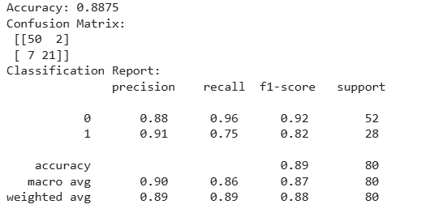
Logistic Regression (Scratch)
# Train the Model
model = LogisticRegression(learning_rate=0.1, num_iterations=1000)
model.fit(X_train, y_train)
# Evaluate the Model
predictions = model.predict(X_test)
print("Accuracy:", accuracy_score(y_test, predictions))
print("Confusion Matrix:\n", confusion_matrix(y_test, predictions))
print("Classification Report:\n", classification_report(y_test, predictions))

Slide 32
Logistic Regression (Sklearn)
import pandas as pd
from sklearn.model_selection import train_test_split
from sklearn.preprocessing import StandardScaler, LabelEncoder
from sklearn.linear_model import LogisticRegression
from sklearn.metrics import accuracy_score, confusion_matrix, classification_report
# Load dataset
data = pd.read_csv("/content/Social_Network_Ads.csv")
# Encode Gender (Male/Female → 1/0)
le = LabelEncoder()
data['Gender'] = le.fit_transform(data['Gender'])

Slide 33
Logistic Regression (Sklearn)
# Features & target
X = data[['Gender', 'Age', 'EstimatedSalary']].values
y = data['Purchased'].values
# Train-test split
X_train, X_test, y_train, y_test = train_test_split(X, y, test_size=0.2, random_state=42)
# Scale features
scaler = StandardScaler()
X_train = scaler.fit_transform(X_train)
X_test = scaler.transform(X_test)

Slide 34
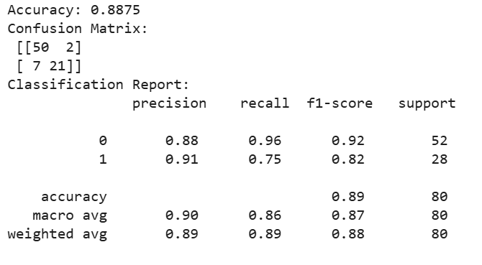
Logistic Regression (Sklearn)
# Logistic Regression
model = LogisticRegression()
model.fit(X_train, y_train)
# Predictions
y_pred = model.predict(X_test)
# Evaluation
print("Accuracy:", accuracy_score(y_test, y_pred))
print("Confusion Matrix:\n", confusion_matrix(y_test, y_pred))
print("Classification Report:\n", classification_report(y_test, y_pred))

Slide 35
Polynomial Regression
import pandas as pd
import numpy as np
import matplotlib.pyplot as plt
from sklearn.linear_model import LinearRegression
from sklearn.preprocessing import PolynomialFeatures
# Load dataset
data = pd.read_csv("Position_Salaries.csv")
# Independent variable (Level) and dependent variable (Salary)
X = data[["Level"]].values
y = data["Salary"].values

Slide 36
Polynomial Regression
# Polynomial transformation (degree=4 for better curve fitting)
poly = PolynomialFeatures(degree=4)
X_poly = poly.fit_transform(X)
# Train polynomial regression model
poly_model = LinearRegression()
poly_model.fit(X_poly, y)
# Predictions
y_pred = poly_model.predict(X_poly)

Slide 37
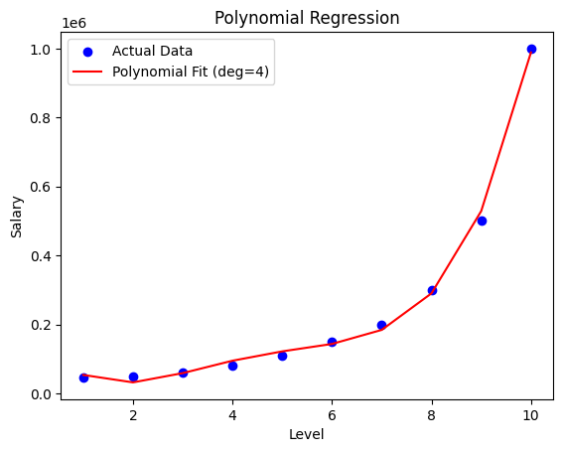
Draw the line….
# Plot results
plt.scatter(X, y, color="blue", label="Actual Data")
plt.plot(X, y_pred, color="red", label="Polynomial Fit (deg=4)")
plt.xlabel("Level")
plt.ylabel("Salary")
plt.title("Polynomial Regression")
plt.legend()
plt.show()

Slide 38
Activity 1
Predict a person’s medical insurance cost based on their personal details.
Dataset: Medical Cost Personal Dataset
Instructions
Load and explore the dataset.
Features include: age, bmi, children, smoker, region.
Target = charges (insurance cost).
Preprocess:
Apply Encoding to categorical features (region, smoker).
Scale numerical features.
Train a Linear Regression model to predict charges.
Evaluate using RMSE & R² score.
Plot Predicted vs Actual Costs.

Slide 39
Activity 2
Predict whether a customer will churn (leave the company) based on their behavior and usage patterns.
Dataset: Telco Customer Churn
Instructions:
Load dataset and preprocess categorical variables ( Encoding).
Train a Logistic Regression model with features like tenure, MonthlyCharges, Contract, InternetService.
Evaluate using Accuracy, Precision, Recall, F1-score.
Plot Confusion Matrix & ROC Curve.

Slide 40
Activity 3
Predict used car prices based on mileage, age, and horsepower.
Dataset: Car Price Prediction
Instructions:
Choose features like Kms_Driven, Year, Engine, Horsepower.
Apply Linear Regression and record performance.
Apply Polynomial Regression (degree=2,3,4) and compare results.
Plot fitted curves for different polynomial degrees.

