Slide 1
Analyzing British Airline Consumer Review From SKYTRAX
Shahnaj Ullah

Slide 2
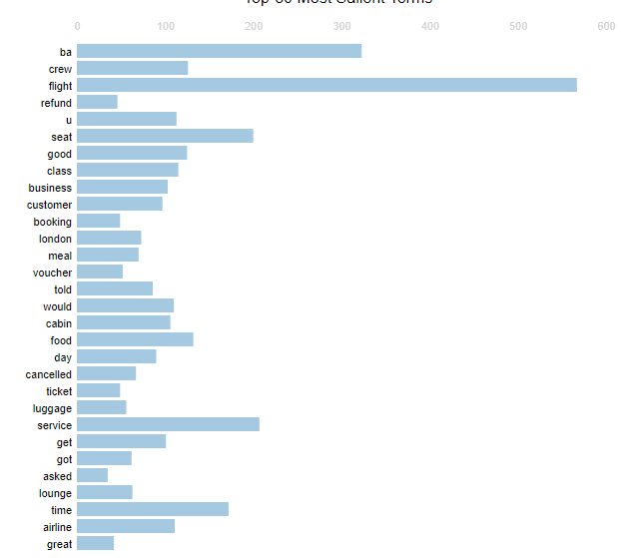
Topic Analysis:
From the word frequency chart, we can see the key topics discussed within the most recent 300 consumer reviews are about British Airline’s flight customer service experience with the cabin crew as well as the flight seatings.
Frequency
Sentiment Analysis:
A sentiment analysis study on the same 300 reviews
shows 52% of the reviews were negative, 29% positive
and 19% neutral.
Topics

