Slide 1

SMARTROOTS
SCRUM MASTER
SHAHNA S
MES24MCA2051
Department of Computer Applications
MES College of Engineering, Kuttippuram
21/08/2025

Slide 2
PRODUCT OWNER RESHMI K ASSISTANT PROFESSOR DEPARTMENT OF COMPUTER APPLICATIONS MES COLLEGE OF ENGINEERING, KUTTIPPURAM

Slide 3
TABLE OF CONTENTS
Introduction
Objective
Existing System
Proposed System
Motivation
Functionalities
Module Description
Developing Environment
Product Backlog
User Story
Project Plans
Sprint Backlog
Data Flow Diagrams
ER Diagram

Slide 4
SMARTROOTS
Mission: Reduce screen time and spark creativity through printable, hands-on activities
Audience: Children (3–12), parents, educators in underserved communities
Key Features:
Parent-led pre-activity rating system for personalized recommendations
Categorized activity types
Age/difficulty-based activity filtering
Printable worksheets & DIY offline tasks
Admin dashboard for content control
Playful, accessible frontend for children and parents

Slide 5
SMARTROOTS
Impact Goals:
Bridge the digital divide with low-tech solutions
Support community-led, offline education
Empower parents to guide learning through personalized input
Foster inclusive, screen-free environments
Vision:
Grow into a scalable ecosystem for families worldwide
Reframe simplicity as strategic strength with future-ready enhancements

Slide 6
OBJECTIVES
Promote Offline Learning Deliver printable, hands-on activities that reduce screen time and encourage real-world exploration.
Ensure Inclusive Accessibility Design content and interfaces usable by children, parents, and educators—regardless of technical background or internet access.
Empower Parent-Led Personalization Introduce a pre-activity rating system where parents assess their child’s skills to guide tailored activity recommendations.
Organize by Age, Skill & Activity Type Filter content by age and difficulty, and categorize tasks
Simplify Admin & Content Management Provide backend tools for uploading, organizing, and customizing content with ease for educators and admins.

Slide 7
EXISTING SYSTEM
.
Screen Dependency Relies heavily on devices and internet connectivity for learning.
Limited Offline Options Offers few printable or hands-on activities for real-world engagement.
Generic Content Delivery Lacks age-specific or skill-based customization for learners.
Complex Admin Interfaces Backend tools are not intuitive for parents or educators.
Minimal Parent-Child Interaction Learning activities do not actively involve parental input or collaboration

Slide 8
PROPOSED SYSTEM
.
Offline, Printable Learning Provides hands-on worksheets and DIY tasks to reduce screen time.
Parent-Led Personalization Uses a pre-activity rating system to tailor recommendations based on child’s skills.
Age & Skill-Based Filtering Filters content by age group, difficulty level, and learning domain.
Simple Admin Dashboard Offers user-friendly backend tools for easy content management.
Engaging, Inclusive Design Encourages parent-child interaction through playful, accessible interfaces and shared activity planning

Slide 9
MOTIVATIONS
.
To help parents support their child’s learning in a simple and easy way.
To reach families who don’t always have internet or digital tools.
To build strong skills like memory, behavior, and attention through fun activities.
To keep things simple, but still smart and useful for future growth.
To make learning fun for children with games, badges, and colorful progress.
To share progress clearly between parents and teachers or admins

Slide 10
FUNCTIONALITIES
.
Age & Difficulty Filtering Users can select activities based on the child’s age and skill level for personalized learning.
Printable Activities All learning content is designed to be printable, supporting offline, hands-on engagement.
Offline Accessibility Activities can be downloaded and used without internet—ideal for low-connectivity environments.
Parent-Led Rating System Parents assess their child’s skills (e.g., speaking, writing, reading) before each session to guide personalized activity recommendations.
Categorized Types Tasks are grouped to Behavioral, Memory, Attention, Language, Speaking, Writing, Creative etc..

Slide 11
FUNCTIONALITIES
.
Homepage with Child-Friendly Design Playful, responsive layout featuring rounded cards, gradients, and cartoon elements to engage kids.
Admin Dashboard Simple interface for uploading, editing, and organizing activities—designed for non-technical users.
User Authentication Secure login system for parents, educators, and admins to manage access and content.
Community Contribution (Planned) Future support for
educators and parents to share custom activities and ideas.

Slide 12
MODULE DESCRIPTION
Parent Module Enables parents to browse, rate, and download categorized learning activities. Tracks child progress and provides feedback to improve content. Supports offline access and personalized recommendations.
Child Module Offers a playful dashboard with printable activities and badge rewards. Tracks completion and progress visually. Designed for independent exploration and gamified learning.
Admin Module Manages user roles, content approval, and system oversight. Organizes activities by age and difficulty. Future-ready for educator and parent contribution

Slide 13
DEVELOPING ENVIRONMENT
.
.
Framework: Django (Python) for backend development, user authentication, and admin features.
Editor: Visual Studio Code for writing, debugging, and managing your project efficiently.
Frontend Stack: HTML, CSS, and JavaScript for building responsive, playful, and child-friendly interfaces.
Database: SQL to store user data and activity content.
Version Control: Git with GitHub for collaboration.

Slide 14
PRODUCT BACKLOG
ID | NAME | PRIORITY <high/medium/low> | ESTIMATE (Hours) | STATUS <Planned/In progress/Completed>
1 | PARENT REG& LOGIN | High | 5 | PLANNED
2 | ACTIVITY FILTERING | High | 5 | PLANNED
3 | PRE ACTIVITY RATING | High | 20 | PLANNED
4 | ADMIN LOGIN | High | 10 | PLANNED
5 | ACTIVITY UPLOAD | Medium | 10 | PLANNED

Slide 15
PRODUCT BACKLOG
ID | NAME | PRIORITY <high/medium/low> | ESTIMATE (Hours) | STATUS <Planned/In progress/Completed>
6 | FEEDBACK MONITORING | Medium | 5 | PLANNED
7 | CHILD LOGIN | High | 5 | PLANNED
8 | PROGRESS TRACKER | High | 20 | PLANNED
9 | BADGE SYSTEM | High | 10 | PLANNED
10 | CATEGORIZED ACTIVITY | High | 10 | PLANNED

Slide 16
USER STORY
User Story ID | As a type of User | I want to | So that i can
1 | PARENT | log in and register | access SmartRoots securely
2 | PARENT | browse activities | find what suits my child
3 | PARENT | rate activities | choose what excites my child
4 | PARENT | download printables | support offline learning
5 | PARENT | view activity history | track completed tasks
6 | CHILD | log in | access my dashboard

Slide 17
USER STORY
User Story ID | As a type of User | I want to | So that i can
7 | CHILD | do fun tasks | enjoy learning
8 | CHILD | track my progress | see how much I’ve completed
9 | CHILD | earn badges | feel proud of my progress
10 | ADMIN | manage users | keep the system secure
11 | ADMIN | approve content | Ensure quality for families
12 | ADMIN | View child progress | Monitor learning engagement

Slide 18
PROJECT PLAN
User StoryID | Task Name | Start Date | End Date | Days | Status
1 | Sprint 1 | 19/08/2025 | 20/08/2025 | 15 | Planned
6 |  | 21/08/2025 | 21/08/2025 |  | Planned
10 |  | 21/08/2025 | 22/08/2025 |  | Planned
2 | Sprint 2 | 11/09/2025 | 11/09/2025 | 15 | Planned
5 |  | 11/09/2025 | 11/09/2025 |  | Planned
11 |  | 11/09/2025 | 11/09/2025 |  | Planned

Slide 19
PROJECT PLAN
User StoryID | Task Name | Start Date | End Date | Days | Status
4 | Sprint 3 | 03/10/2025 | 05/10/2025 | 14 | Planned
9 |  | 07/10/2025 | 10/10/2025 |  | Planned
12 |  | 13/10/2025 | 17/10/2025 |  | Planned
3 | Sprint 4 | 23/10/2025 | 25/11/2025 | 10 | Planned
8 |  | 28/10/2025 | 28/10/2025 |  | Planned
7 |  | 30/10/2025 | 30/10/2025 |  | Planned

Slide 20
SPRINT BACKLOG
Backlog tem | Status And Completion Date | Original Estimation in Hours | Day 1 hrs | Day 2 hrs | Day 3 hrs | Day 4 hrs | Day 5 hrs | Day 6 hrs | Day 7 hrs | Day 8 hrs | Day 9 hrs | Day 10 hrs
SPRINT1
Parent login | 19/8/2025 | 2 | 1 | 1 | 0 | 0 | 0 | 0 | 0 | 0 | 0 | 0
Child login | 21/8/2025 | 3 | 1 | 1 | 1 | 0 | 0 | 0 | 0 | 0 | 0 | 0
Home page | 21/8/2025 | 3 | 1 | 1 | 1 | 0 | 0 | 0 | 0 | 0 | 0 | 0

Slide 21
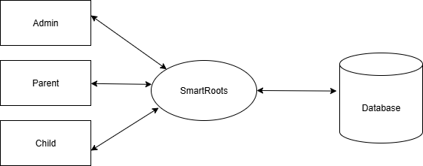
DATA FLOW DIAGRAM
LEVEL 0

Slide 22
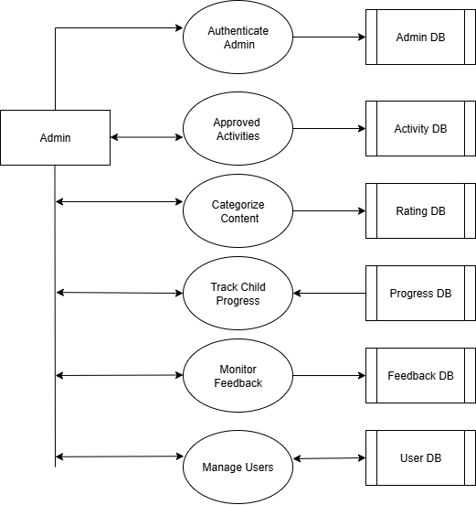
DATA FLOW DIAGRAM
Level 1

Slide 23
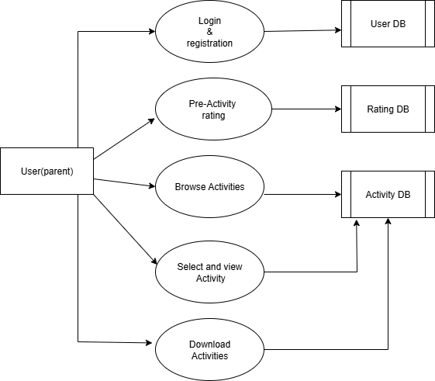
DATA FLOW DIAGRAM
Level 2

Slide 24
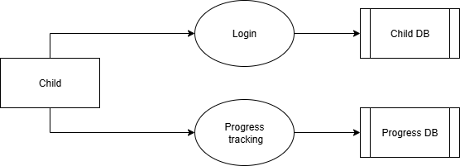
DATA FLOW DIAGRAM
Level 3

Slide 25
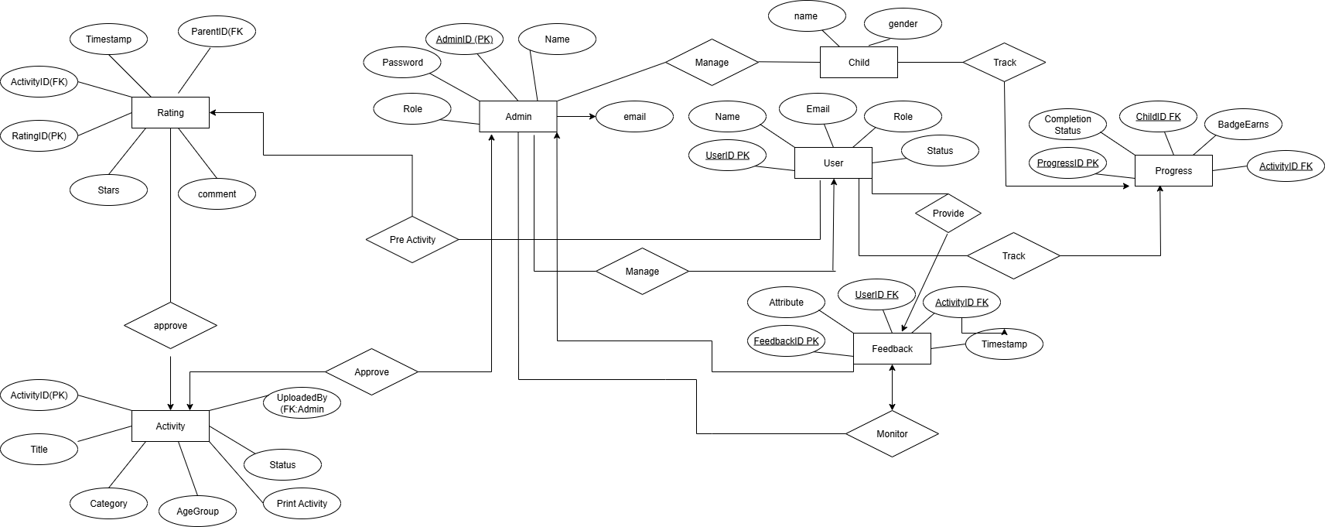
ER DIAGRAM

Slide 26
THANK YOU

