Slide 1
F26-060 · PROPOSAL DEFENSE · STREAM A — RESEARCH-DERIVED
Granite
A Self-Healing Multi-Agent System for Semantic Error Diagnosis, Verified Repair and Recovery
When a multi-agent AI system fails — including when the wrong answer looks completely right — no published method can reliably say which agent caused it, and none can verify a fix before trusting it.
Shahoud Shahid
23i-2515
Muhammad Noor
23i-2520
Saif Shahzad
23i-2634
Supervisor Dr. Adil Majeed
FAST School of Computing, NUCES Islamabad
Notes:
Say the one-line problem exactly as written — WHO (teams running multi-agent systems), WHAT fails (attribution + silent failures), WHY it matters (nobody can verify a fix), in one breath. Do not explain the title word-by-word — slide 6 does that. Three names, three distinct subsystems, said aloud here sets the ownership tone before the panel has to ask.

Slide 2
Problem & Users
CURRENT WORKFLOW — WITHOUT GRANITE
STAKEHOLDERS
Primary — an engineering team running a multi-agent AI system in or near production
Secondary — downstream product teams
Secondary — auditors needing traceable evidence
1
Trace captured
LangSmith / Langfuse / Braintrust / Arize
2
Human guesses the root cause
no published accuracy
SDG 9 Industry, Innovation & Infrastructure — reliability tooling, new industrial category
3
No silent-failure check
a confident, wrong answer passes unnoticed
CONSEQUENCE OF FAILURE
Ships a confident, wrong answer — no crash, no error, no signal anything went wrong.
4
No way to test a fix first
field baseline: 14.2% step accuracy (Who&When)
Stakeholder evidence today: literature + 7 commercial vendors
F26-060-GRANITE · PROPOSAL DEFENSE · STREAM A
2 / 10
Notes:
14.2% is the field's own measured baseline for 'a human reads the trace' — the number the whole project is trying to beat. On stakeholders: state plainly that this is Stream A, that the problem's reality rests on published evidence and a commercial market, and that live practitioner contact is scheduled in the Mid-2 acceptance study (C.13.1) — declared open, not claimed as done. Do not overclaim contact that has not happened — risk-register R33. Citations: plan §0.1 · §0.05 (SDG) · Full_Literature_Landscape_Analysis.md.

Slide 3
Existing Solutions & Prior FYP Comparison
 | Core approach | Step-level attribution (published accuracy) | Silent-failure detection | Counterfactual fix- testing, measured | Framework- agnostic
ErrorProbe (ACL 2026) | 3-stage LLM diagnosis + memory | 59.5% | ✘ admits it cannot | ✘ | ✘ 2 archs only
LangSmith Engine / Arize Alyx (2026) | Automated RCA + fix drafting | not published | ? | ? | ✘ stack-locked
Langfuse / Braintrust / Phoenix / Maxim / Opik | Trace capture + eval | human-driven | RAG only | ✘ | ✘
Closest prior FYP (S24-011-D-HDLM, Spring 2024) | hallucination detection in single-LLM text | — no attribution at all | partial — single-LLM text only | ✘ no repair / replay step | N/A — not a multi-agent system
Current manual workflow | human reads, guesses | 14.2% (Who&When) | ✘ | ✘ | N/A
Granite (proposed) | Constraint-based SED + verified repair loop | building on ErrorProbe | ✓ scoped & measured | ✓ recovery rate over N replays | ✓ CrewAI + LangGraph, unseen
PRIOR-FYP CHECK — CLOSED
THE REAL GAP
660 titles, 12 cohorts since 2019, checked structurally. Closest: S24-011-D-HDLM — hallucination detection in single-LLM text: same core problem, ~1 of our 4 stages.
No system combines attribution + silent-failure detection + verified repair + cross-arch generalization in one pipeline.
F26-060-GRANITE · PROPOSAL DEFENSE · STREAM A
3 / 10
Notes:
Volunteer the correction story: an early draft said 'nobody automates this' — direct vendor checks proved that stale, corrected on the record (R9). On prior FYPs, give the number unprompted: 660 titles across every published cohort back to 2019, checked structurally, not by title. Other analogs use 'multi-agent' only as an application pattern (PropPal, LawSphere, CampusHive); nearest detect-then-repair is AutoVulRepair (fuzzing/C++) — name it before a panelist finds it. The gap is the combination, not any single missing feature. Citations: plan §0.095 (full 660-title comparison) · Commercial_Product_Comparison.md · risk-register R9/R33.

Slide 4
Research & Technical Basis
DECISIONS THE LITERATURE ACTUALLY CHANGED
PUBLISHED STEP-ACCURACY LINEAGE
✓
ErrorProbe chosen as baseline
On performance (59.5%), not recency
✓
CrewAI + LangGraph committed
Unused by all 9 papers reviewed
✓
Constraint-based SED, not LLM-judge
LLM-judge AUROC ≤ 0.65 — barely above chance
Step-level accuracy on Who&When, % · AgenTracer-8B is a published 37–43% range — midpoint plotted.
40.5 points still wrong — misattributes 4 of 10 steps; cannot see silent failures at all.
✓
Single-framework narrowing rejected
Market survey's own advice, declined (R19)
BACKBONE-CONFOUND CAVEAT
Cross-paper backbones differ — controlled within our own experiments.
F26-060-GRANITE · PROPOSAL DEFENSE · STREAM A
4 / 10
Notes:
State the backbone-confound caveat before being asked. Name that credible unpublished preprints exist in adjacent territory and the team made a recorded decision not to chase every one — the strategy is beating a peer-reviewed baseline, not pre-empting unpublished work. If a win partly reflects backbone strength, report both numbers, declared in advance. Citations: Full_Literature_Landscape_Analysis.md · ErrorProbe_Baseline_Selection.md · plan §0.08.

Slide 5
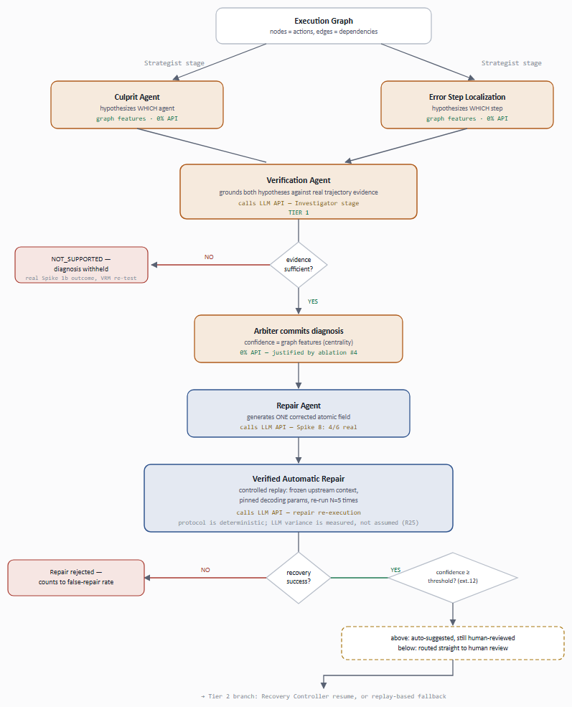
Complex Computing Challenge
CORE PIPELINE — HYPOTHESIS TO VERIFIED REPAIR
1
Conflicting requirements
2
No obvious solution
Depth vs. latency; privacy vs. completeness
Best published: 59.5% after 15 months, 7 papers
3
Depth of knowledge
4
Diverse stakeholders
Graph modeling, causal reasoning, tracing
Named; live contact scheduled Mid-2
5
Significant consequences
6
Ill-defined cause
A missed failure ships a wrong answer, undetected
3 unknowns: whether, which step, what's correct
F26-060-GRANITE · PROPOSAL DEFENSE · STREAM A
5 / 10
Notes:
This is the slide the panel uses to decide whether the project deserves capstone status. Concede up front that a trace-capture-plus-LLM-guess wrapper is a weekend's work, then name precisely what such a version would get wrong: no benchmark on unseen architectures, no way to tell a silent failure from a correct answer, no measured false-positive rate on clean controls, no evidence its fix works. NOTE — on-slide badges are renumbered 1-6 for readability; they are NOT the Seoul Accord characteristic numbers. Badge 4 on the slide = real characteristic 6 (Diverse stakeholders) — it's amber on purpose, say so before they spot it. Badge 6 on the slide = real characteristic 9 (Ill-defined cause) — read its resolution aloud if pressed on complexity; the diagram on the right is that resolution, drawn: hypothesis generation, evidence-grounding, and the controlled-replay loop that gates every fix. Real characteristics 4, 5 and 8 (Unfamiliar issues / Beyond standard practice / Interdependence) are off-slide entirely but still true and still fully argued in Granite_CCP_Justification_Seoul_Accord.docx and CCP_Characteristics_Not_On_Slide.md — cover them only if asked directly. Citations: 02_Panel_Defense_Question_Bank.md Q8a · plan §1 (three-tier CCP) · §2 (9-characteristic rating).

Slide 6
Proposed Solution & Contribution
Contribution. Best method: 59.5% — but it's untested on unseen architectures and misses silent failures. We build a cross-architecture benchmark and a diagnosis pipeline with constraint-based silent-failure verification, as a framework-agnostic SDK.
Target Multi-Agent System
GRANITE — SYSTEM BOUNDARY
LANE A — DATA / BENCHMARK
CrewAI / LangGraph
Framework Adapters
Fault Injection Operators
Benchmark Store
CrewAI + LangGraph hooks
rule-based · 0% API
LANE B — DIAGNOSIS
LLM API
core-assist only
~15–20% of components
Trace Normalizer
Execution Graph Builder
standard schema in
0% API
Semantic Error Diagnostic — runs in parallel, unconditionally
Backward Causal Tracer
LANE C — PLATFORM
Operator
Repair Agent
Verified Automatic Repair
Backend API
candidate fix
controlled replay, N runs
FastAPI
engineering team
Tier 2 (gated): Recovery Controller + Verified Repair Memory · Postgres · Dashboard — 3 screens
F26-060-GRANITE · PROPOSAL DEFENSE · STREAM A
6 / 10
Notes:
Say unprompted: 'controlled, not deterministic' — the replay protocol is deterministic, LLM-step variance is measured over N replays, never assumed away (R25). Say unprompted: the Semantic Error Diagnostic abstains where no checkable constraint exists, and the abstention rate is reported as a metric, not hidden. If asked about scope: in scope is 10 committed mechanisms; out of scope is message queues, Kubernetes, full RBAC, DR infra, multi-tenant billing; deployment target is Docker + a pip-installable SDK, operable by someone who didn't build it. Full traceable spec behind this diagram: Use Case Model + diagram, 3 System Sequence Diagrams, SRS, Test Plan, Software Development Plan, Traceability Matrix, 16-screen wireframes — architecture atlas, tab 'Requirements & Design'. Citations: Software_Design_Specification.md §2–§6 · plan §7.0 (frozen scope) · architecture-sketch.md.

Slide 7
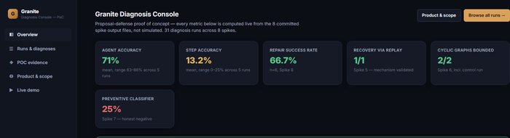
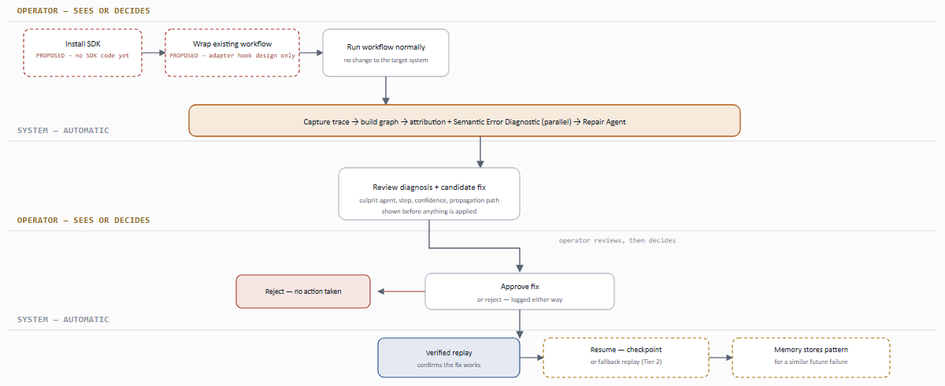
POC / Feasibility Evidence
71.4% agent accuracy (5 runs)
13.2% step accuracy (5 runs)
4 / 6 Repair Agent success
8 / 8 spikes with real evidence
# | Spike | Status | Result
1 | ErrorProbe reproduction (simplified) | DEMONSTRATED | agent 62.5–85.7%, step 0–25% — 5 real runs, a range
2 | CrewAI instrumentation | DEMONSTRATED | 3 nodes, 2 clean edges
3/3b | Fault injection | DEMONSTRATED | 1 case self-corrected — kept as a finding
4 | Semantic Error Diagnostic | DEMONSTRATED | Catches a near-miss ($20.00 vs $19.75), zero false positives
5 | Controlled counterfactual replay | DEMONSTRATED | 97.2 corrupted → 108.0 recovered, recovery_success = true
6 | Cyclic graph handling | DEMONSTRATED | Disabled → hits the 10,000-step safety cap
7 | Preventive classifier | HONEST NEGATIVE | precision / recall / F1 = 0.25, near-random — reported, not hidden
8 | Repair Agent | DEMONSTRATED | 4/6 success; both failures share one fixable cause
LIVE, CLICKABLE PROTOTYPE
OPERATOR WORKFLOW
F26-060-GRANITE · PROPOSAL DEFENSE · STREAM A
7 / 10
Notes:
Lead with Spike 7's negative result and Spike 8's failure analysis — quote the guide's own words on this directly: a POC that disproved an assumption is more valuable than one that confirmed it. Every number on this slide is real and recomputable from files in the repository; offer to open one. In progress: full 3-stage reproduction, top FYP-1 priority. Planned: Recovery Controller + Verified Repair Memory Tier-2 gates, pre-registered Mid-1 criteria, not yet run. Prototype: 5 screens, mocked backend, dist-static/index.html. Citations: dev/spikes/poc/ (8 scripts + output JSONs on disk) · markdowns/04-poc-evidence/POC_Spike_Outputs_Full.md.

Slide 8
Evaluation Plan & Risks
Pre-registered acceptance band. Reproduction accepted within ±10 points of ErrorProbe's published 59.5% on a comparable-class backbone.
METRICS
SUCCESS BANDS
TOP RISKS → STATED FALLBACK
Agent / step accuracy · propagation-path F1
SF precision/recall + abstention rate
False-positive rate on clean controls
Completion, recovery, repair success rates
Latency overhead — the NFR, target < 50%
Failure
Reproduction misses the ±10pt band
No measurable improvement anywhere
Report both numbers, declared in advance — expected, not a failure
Acceptable
Recovery Controller fails at Mid-1
Parity on Who&When + any cross-arch
Resume via controlled replay — Tier 1 delivers it
Strong
Verified Repair Memory fails again
DATA / DEPENDENCIES · PROTOCOL
Beats baseline, unseen archs, >70% SF
Data: Who&When (184 cases); our own benchmark, GSM8K + tau-bench, clean controls. Protocol: bootstrap CIs, fixed seeds, N=5 variance, ablation matrix, human baseline.
Ships as a memory-on/off ablation
Exceptional
Benchmark scale stalls below 500
Strong + >50% verified-repair recovery
Floor of 500; 300-with-stats beats 1,000-without
GenAI boundary: nothing we claim sits in core-replacement — the LLM is core-assist.
F26-060-GRANITE · PROPOSAL DEFENSE · STREAM A
8 / 10
Notes:
The false-positive-rate-on-clean-controls metric is absent from every paper in the reviewed corpus and every platform checked — say this is the field's gap, not just ours. Deliver the risk column as confidence, not confession: each decision rule was pre-registered before results exist. Outside the acceptance band, both numbers are reported transparently, declared before the run, not after. Full GenAI boundary line: every external component classified Support / Core-assist / Core-replacement; the contribution survives swapping the LLM. Citations: plan §11 (acceptance band, pre-registered) · risk-register.md (R4/R25/R37).

Slide 9
Work Division & Iteration Plan
Shahoud Shahid 23i-2515
Muhammad Noor 23i-2520
Saif Shahzad 23i-2634
DATA / BENCHMARK
DIAGNOSIS ENGINE
PLATFORM
Framework instrumentation (CrewAI, LangGraph)
Fault injection + labelling
Benchmark build & release
Graph construction + trace normalization
ErrorProbe reproduction and baseline
Semantic Error Diagnostic + causal tracing
Counterfactual replay + Recovery Controller
Framework-agnostic SDK, FastAPI, Postgres
Dashboard, containerized deployment
If removed: no cross-architecture benchmark — the core research claim is untestable
If removed: no attribution algorithm, no silent-failure detection — the contribution disappears
If removed: nothing is installable or operable outside the dev machine
FYP-1 → FYP-2 MILESTONES
M1
Scope locked
scope approved
M2
Baseline reproduced
reproduction + Tier-2 + baseline
M3
Core integrated
integrated core, end to end
M4
Benchmark released
benchmark ≥500 · release ready
M5
Full evaluation
full evaluation, deployed
F26-060-GRANITE · PROPOSAL DEFENSE · STREAM A
9 / 10
Notes:
Each member states their own subsystem in one sentence, aloud — the panel is applying the guide's four ownership questions (explain / justify against an alternative / predict what breaks / modify under questioning), and hearing three distinct voices here sets that tone early. The 'if removed' line under each card is the guide's own scope test, answered honestly rather than asserted. If pressed on effort/capacity: 490h (FYP-1) + 640h (FYP-2) = 1,130h against 1,130h capacity (3 × ~15h/wk × ~28 wks), balanced depth not identical tasks. Citations: plan §3 (ownership) · §7.0 (frozen scope) · §12 (effort) · cost-estimate.md · 06_Expanded_Scope_and_Feasibility_Plan.md.

Slide 10
DEI, Ethics & Legal
COMMITMENTS THE PANEL CAN HOLD US TO
DEI
ETHICAL
LEGAL / PROFESSIONAL
Open-source release widens access — SDG 9 access-equity
Colour + text + shape, never colour alone — WCAG owed by Final-1
Accuracy claims stated as English-only
Advisory only — every repair is human-gated
Consent for real trace data; injection only on consenting systems
Negative results published as found — Spike 7 not buried
Who&When · GSM8K · tau-bench — all MIT, confirmed against the LICENSE file
Released artefacts carry MIT / CC BY 4.0
AI usage logged per session and disclosed to the team throughout
F26-060-GRANITE · PROPOSAL DEFENSE · STREAM A
10 / 10
Notes:
The DEI line is a real, checkable commitment, not a decorative label — say the access-equity sentence in your own words. Ownership per lane and the FYP-1/FYP-2 milestone gates are both on slide 9; this slide is deliberately just the three compliance statements the guide names. Every CCP-relevant component has a member who can defend it live — offer to demonstrate that on any component they pick. Citations: plan §3 (ownership) · AI_Usage_Log.md · risk-register R30/R38.

