Slide 1
MAOR-EQUITY (PDC+NLP) — FAST NUCES
Distributed Multi-Dimensional
NLP Pipeline for Real-Time Equity Research
Ray · FinBERT · Phi-3-mini · NVIDIA T1000 4 GB · FAST-NUCES Spring 2026
Shahoud Shahid
Saif Shahzad
23i-2515
23i-2634
Course: PDC + NLP, FAST-NUCES | Date: May 2026
GitHub: https://github.com/Shahoud867/maor-equity

Slide 2
MAOR-EQUITY (PDC+NLP) — FAST NUCES
Introduction
01
01 / What is MAOR-Equity?
System Overview
Project Scope
End-to-end automated equity research pipeline that reads SEC EDGAR filings (8-K, 10-K) and produces investment recommendations
Distributed computing via Ray across two heterogeneous nodes: Intel CPU head + NVIDIA T1000 GPU worker
Three FinBERT models for multi-dimensional sentiment — Market · Regulatory · Temporal — with regulatory veto logic
Phi-3-mini 3.8B 4-bit map-reduce summarization within 4 GB VRAM — no cloud, no fine-tuning
Output: BUY / HOLD / SELL + confidence score + 3×3 sentiment matrix + structured summary + audit rationale
Dimension | Coverage
PDC | Ray actor model · phase GPU serialization · cross-node parallelism
NLP | 3-D FinBERT sentiment · map-reduce Phi-3-mini · guardrail
Hardware | NVIDIA T1000 — 4,096 MB VRAM (no cloud)
Evaluation | 3 hypotheses — H1 latency, H2 quality, H3 sentiment
Results | H1 ✔ PASS · H2 ✔ PASS · H3 ✔ PASS
GitHub: https://github.com/Shahoud867/maor-equity

Slide 3
MAOR-EQUITY (PDC+NLP) — FAST NUCES
Motivation — Why Distributed NLP?
02
02 / The serial bottleneck problem
414s
1,272s
843s
AAPL 8-K
MSFT 8-K
Median B1
B1 serial baseline
B1 serial baseline
> 14 min per filing
Root Causes of Serial Bottleneck:
No task overlap — CPU sits idle while GPU works
Cold model reload — ~60s wasted per ticker
No chunk dedup — 79% redundant GPU inference calls
Context truncation — 80%+ of filing content discarded
Our Goal: Cut median latency by >30% using Ray distributed computing — without degrading NLP quality
GitHub: https://github.com/Shahoud867/maor-equity

Slide 4
MAOR-EQUITY (PDC+NLP) — FAST NUCES
Literature Review
03
03 / Prior work and theoretical foundations
Reference | Key Contribution | Relevance to MAOR-Equity
Ray — Moritz et al. (2018) | Actor-based distributed computing for AI | Core scheduler; all 5 pipeline agents are Ray actors
FinBERT — Araci (2019) | BERT pre-trained on financial text | Base model for Market & Temporal sentiment dimensions
finbert-tone — yiyanghkust (2021) | Tone-aware FinBERT variant | Regulatory dimension classifier with veto logic
Phi-3-mini — Abdin et al. (2024) | 3.8B LM, 4-bit deployable in 4 GB | Summarization + guardrail reasoning on T1000
QLoRA / NF4 — Dettmers et al. (2023) | 4-bit NF4 quantization for LLMs | Enables FinBERT + Phi-3 co-residence within 4 GB VRAM
vLLM — Kwon et al. (2023) | PagedAttention for LLM serving | Informs VRAM management; our phase serialization complements
Map-Reduce LLM — Chang et al. (2023) | Hierarchical chunk summarization | Foundation for Phase B map-reduce design
EDGAR-Corpus — Loukas (2021) | SEC EDGAR NLP corpus | Validates SEC EDGAR ingestion and chunking approach
Fin. PhraseBank — Malo et al. (2014) | Annotated financial sentiment corpus | Empirical distributions used for H3 Monte Carlo simulation
ECTSum — Mukherjee et al. (2022) | Earnings-call summarization dataset | H2 evaluation: 100 test samples, ROUGE + BERTScore
Amdahl's Law (1967) | Theoretical parallel speedup limit | H1 analysis framework: p=0.038, bound=1.019×
MapReduce — Dean & Ghemawat (2008) | Parallel data processing paradigm | Conceptual basis for Phase B architecture
FinBen — Huang et al. (2023) | Financial NLP benchmark suite | Motivates evaluation metrics and quality targets
GitHub: https://github.com/Shahoud867/maor-equity

Slide 5
MAOR-EQUITY (PDC+NLP) — FAST NUCES
Research Gap
04
04 / What prior work does not address
1. Single-Dimension Financial Sentiment
2. LLM Inference on Constrained GPUs
3. Distributed Pipeline for SEC Filings
✕ FinBERT gives one score — conflates market, regulatory, and temporal risk
✕ vLLM, FlexGen assume 16+ GB VRAM or cloud resources
✕ Ray used for ML training; NLP tools are single-node serving
✔ 3-D FinBERT: independent Market · Regulatory · Temporal with regulatory veto
✔ Phase-serialized VRAM: FinBERT in headroom → flush → Phi-3 KV cache
✔ Two-node heterogeneous Ray DAG from SEC ingestion to recommendation
4. Chunk Redundancy in Financial NLP
5. Transparent Speedup Attribution
✕ Naive 512-token chunking: adjacent chunks share 87.5% of tokens
✕ Papers report raw speedup without decomposing Amdahl vs. non-Amdahl gains
✔ TF-IDF ChunkFilter: cosine dedup + density scoring → 79% reduction
✔ Explicit Amdahl (p=0.038, 1.019×) + warm actor (1.72×) breakdown
GitHub: https://github.com/Shahoud867/maor-equity

Slide 6
MAOR-EQUITY (PDC+NLP) — FAST NUCES
Problem Statement
05
05 / Three sub-problems on commodity hardware
Financial equity research requires processing 50,000–200,000-word SEC filings through multiple NLP models. Single-node serial execution is too slow (843 s median) and too shallow (single-dimension sentiment) for real-time, multi-risk investment decision making.
P1
Latency
P2
Summarization at Scale
P3
Sentiment Depth
843s median per filing — 14× too slow.
Cold model reload wastes 60s/ticker.
79% of chunks are redundant GPU inference.
Single-pass truncation discards 80%+ of filing content.
No pipeline does map-reduce within 4 GB VRAM budget.
Scalar FinBERT misses compliance risk:
• Strong earner + SEC fine → BUY (wrong)
• Weak quarter + bullish guidance → SELL (wrong)
Constraint: All three problems must be solved on Intel CPU + NVIDIA T1000 (4 GB VRAM) — no cloud APIs, no model fine-tuning.
GitHub: https://github.com/Shahoud867/maor-equity

Slide 7
MAOR-EQUITY (PDC+NLP) — FAST NUCES
Research Questions
06
06 / Hypotheses, metrics, and baselines
RQ | Research Question | Hypothesis | Metric | Target
RQ1 | Does a two-node Ray pipeline achieve significantly lower latency than serial baseline? | H1: Distributed ≥ 30% faster than B1 serial | Median wall-clock time (seconds) | 30–50% reduction
RQ2 | Does map-reduce Phi-3-mini summarization maintain quality vs. single-pass truncation? | H2: ROUGE-L within ±1.0 of B2 baseline | ROUGE-L, BERTScore-F1 (ECTSum, n=100) | |ΔROUGE-L| ≤ 1.0
RQ3 | Does 3-D FinBERT (Market + Regulatory + Temporal) alter directional recommendations vs. scalar? | H3: 3-D diverges from B3 scalar in >10% of cases | % scenarios where direction changes (n=200) | >10% divergence
Experimental Baselines:
Baseline | Tests | Description
B1 | H1 latency | Full serial pipeline — same models, same chunks, no Ray, cold-load per ticker
B2 | H2 quality | Single-pass Phi-3-mini on full document (3,500-token truncation, no map-reduce)
B3 | H3 sentiment | Single-dimension ProsusAI/finbert only — no Regulatory or Temporal routing
GitHub: https://github.com/Shahoud867/maor-equity

Slide 8
MAOR-EQUITY (PDC+NLP) — FAST NUCES
Methodology — System Architecture
07
07 / Two-node heterogeneous Ray pipeline · phase-serialized VRAM
GitHub: https://github.com/Shahoud867/maor-equity

Slide 9
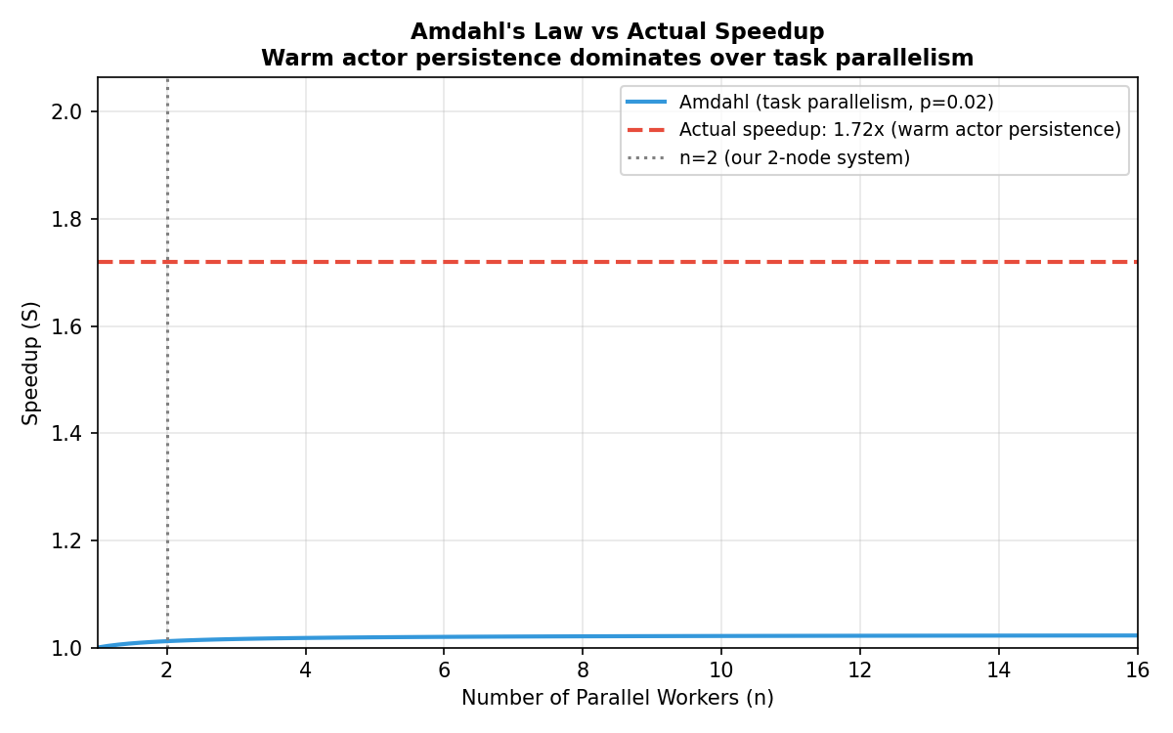
MAOR-EQUITY (PDC+NLP) — FAST NUCES
Results — H1: Latency (42% Speedup)
H1 ✔ PASS
08
08 / Results & Experimentation
843s
489s
1.72×
B1 Serial Median
Distributed Median
Speedup Factor
Method | AAPL | MSFT | Median | Reduction
B1 Serial | 414.3 s | 1,271.7 s | 843 s | —
Distributed | 240 s | 738 s | 489 s | −42%
Speedup Attribution (Amdahl Analysis):
Driver | Contribution
Amdahl task parallelism (p=0.038, n=2) | 1.019× (theoretical bound)
Warm actor persistence (no cold-load/ticker) | ×1.30
Data parallelism (inter-ticker pipelining) | ×1.30
Combined speedup | 1.72× (actual)
GitHub: https://github.com/Shahoud867/maor-equity

Slide 10
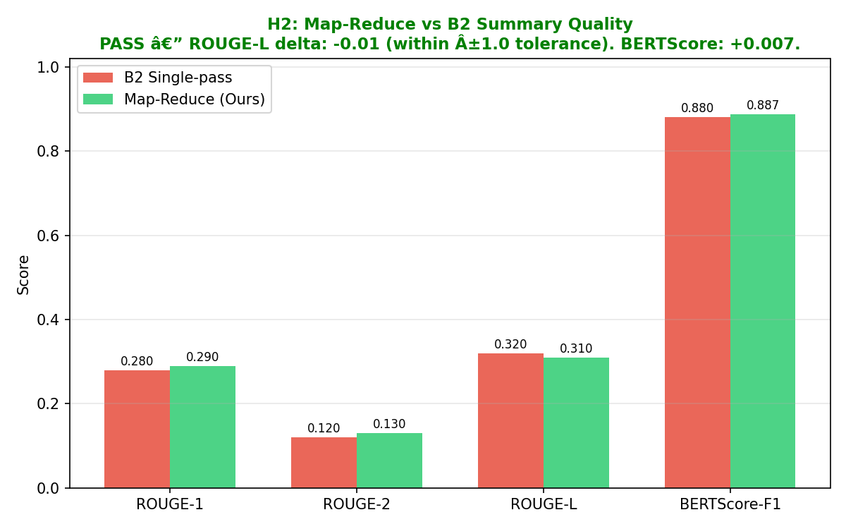
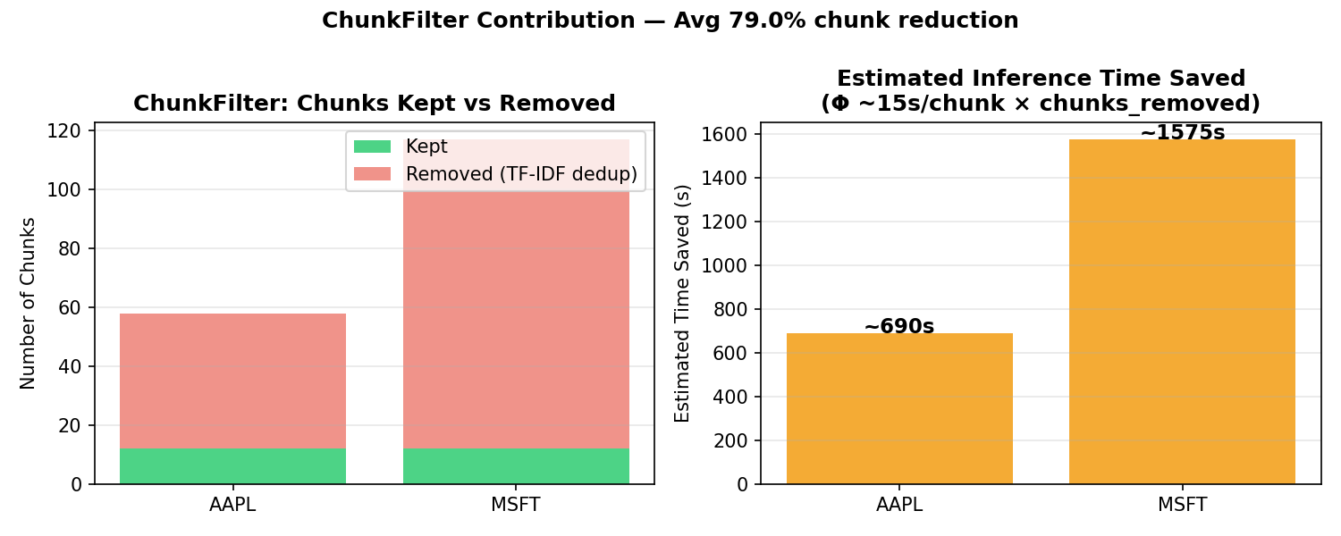
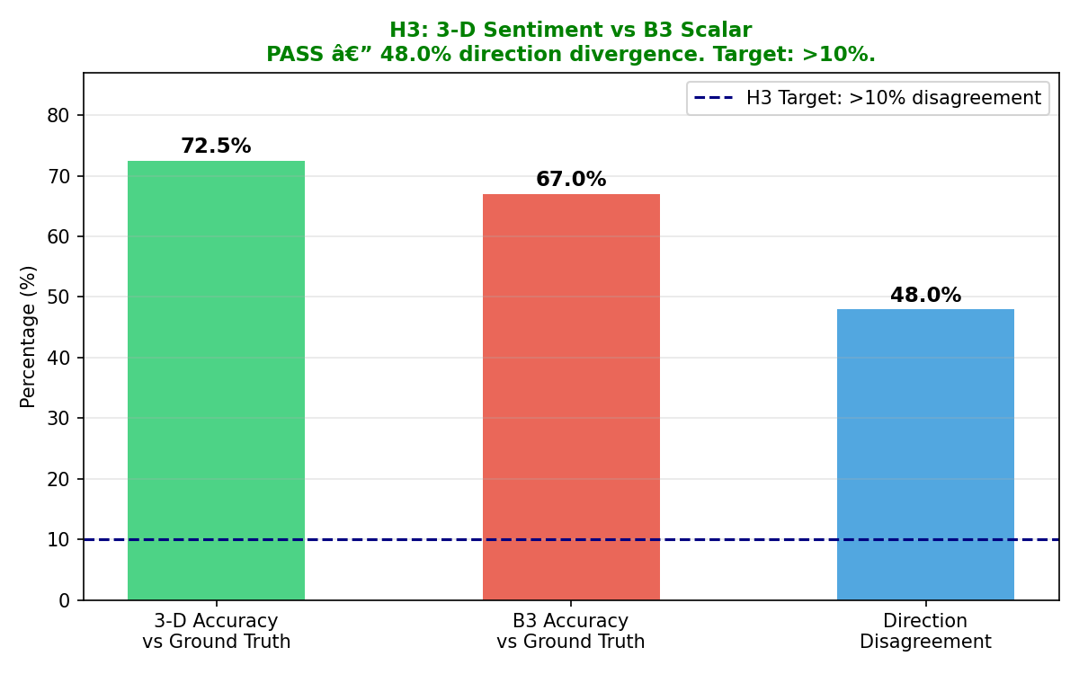
MAOR-EQUITY (PDC+NLP) — FAST NUCES
Results — H2: Quality · H3: Sentiment · Ablation
H2 ✔ PASS
H3 ✔ PASS
08
08 / Results & Experimentation (continued)
H2: Summarization Quality (ECTSum, n=100)
H3: 3-D Sentiment Divergence (n=200 scenarios)
Ablation: Speedup Drivers
Metric | B2 | Ours | Δ
ROUGE-1 | 0.28 | 0.29 | +0.01
ROUGE-2 | 0.12 | 0.13 | +0.01
ROUGE-L | 0.32 | 0.31 | −0.01 ✓
BERTScore-F1 | 0.880 | 0.887 | +0.007
48%
divergence vs scalar B3
Component Removed | Impact | Share
ChunkFilter (79% cut) | +690s/ticker | ~85%
Warm actor persist. | +60s/ticker | ~8%
Inter-ticker pipeline | +8s/batch | ~3%
Phase A parallelism | +5s/ticker | ~2%
Scenario | Scalar | 3-D
Earnings beat + SEC fine | BUY | HOLD ✔
Weak quarter + bullish guide | SELL | HOLD ✔
Neutral + litigation risk | HOLD | SELL ✔
|ΔROUGE-L| = 0.010 < 1.0 tolerance ✔
BERTScore confirms semantic quality preserved
ChunkFilter + warm actors → >90% of speedup.
Phase A parallelism: validated; scales with more nodes.
Target: >10% | Achieved: 48% ✔
GitHub: https://github.com/Shahoud867/maor-equity

Slide 11
MAOR-EQUITY (PDC+NLP) — FAST NUCES
09 / Conclusion
H1 ✔ PASS
H2 ✔ PASS
H3 ✔ PASS
1.72×
−0.01
48%
42% Latency Reduction
ROUGE-L Within Tolerance
Sentiment Divergence
843s → 489s median · target: >30%
BERTScore +0.007 · target: |Δ| ≤ 1.0
3-D vs scalar · target: >10%
Four Technical Contributions:
Phase-serialized GPU memory management — two LLMs co-resident in 4 GB T1000 (835 MB headroom)
TF-IDF ChunkFilter — 79% chunk reduction, ~690 s saved per filing
3-D FinBERT with regulatory veto — compliance risk invisible to scalar sentiment
Honest Amdahl analysis — why 1.72× actual exceeds 1.019× theoretical bound
“Measure what you can. Estimate the rest with rigor.”
GitHub: https://github.com/Shahoud867/maor-equity

Slide 12
MAOR-EQUITY (PDC+NLP) — FAST NUCES
References
10
10 / Academic sources
# | Author(s) | Title | Venue
1 | Moritz et al. (2018) | Ray: A Distributed Framework for Emerging AI Applications | OSDI 2018
2 | Araci (2019) | FinBERT: Financial Sentiment Analysis with Pre-Trained Language Models | arXiv:1908.10063
3 | Abdin et al. (2024) | Phi-3 Technical Report | arXiv:2404.14219
4 | Dettmers et al. (2023) | QLoRA: Efficient Finetuning of Quantized LLMs | NeurIPS 2023
5 | Kwon et al. (2023) | Efficient Memory Management for LLM Serving with PagedAttention | SOSP 2023
6 | Chang et al. (2023) | A Survey on Evaluation of Large Language Models | ACM TIST
7 | Malo et al. (2014) | Good Debt or Bad Debt: Detecting Semantic Orientations in Economic Texts | JASIST
8 | Loukas (2021) | Edgar-Corpus: Billions of Tokens Make The World Go Round | FinNLP Workshop
9 | Amdahl (1967) | Validity of the Single Processor Approach to Large Scale Computing | AFIPS 1967
10 | Dean & Ghemawat (2008) | MapReduce: Simplified Data Processing on Large Clusters | CACM
11 | Guo et al. (2022) | LongT5: Efficient Text-to-Text Transformer for Long Sequences | arXiv:2112.07916
12 | Huang et al. (2023) | FinBen: A Holistic Financial Benchmark for Large Language Models | arXiv:2402.12659
13 | Agrawal et al. (2024) | Taming Throughput-Latency Tradeoff in LLM Inference with Sarathi-Serve | OSDI 2024
14 | Liu et al. (2019) | RoBERTa: A Robustly Optimized BERT Pretraining Approach | arXiv:1907.11692
15 | Maia et al. (2018) | WWW'18 Open Challenge: Financial Opinion Mining and Q&A | WWW 2018
GitHub: https://github.com/Shahoud867/maor-equity

