Slide 2
Monopoly
Koutsoyianis says “Monopoly is that market in which there is one seller for a commodity and there is no any substitute of that product produced by that firm, and entry of firms is restricted”.
Pure monopoly-single firm produces a products for which there is no close substitutes and in which there is significant barriers to entry. Example: Indian Railways

Slide 3
Features of Monopoly
One seller and large number of buyers
Restriction on the entry of the new firms
No close substitutes
Price control
Possibility of price discrimination

Slide 4
Lerner Index Abba Lerner 1934
Competitive Firm: P = MC
Monopoly firm: P > MC
“the extent to which the profit maximising price exceeds Marginal Cost”
L= (P-MC)/P where P-price, MC-Marginal cost L-lerner Index
Lerner index value is always between Zero and One
L=0 indicates perfectly competitive firm
L=1 indicates pure or 100 percent monopoly

Slide 5
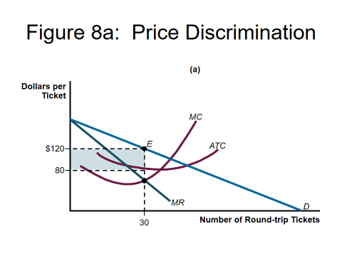
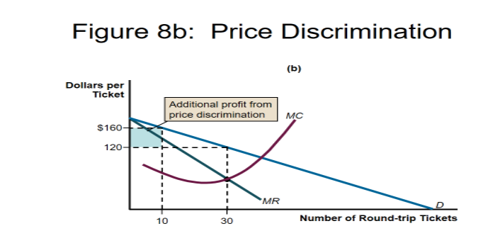
Price discrimination and dead weight loss

Slide 6
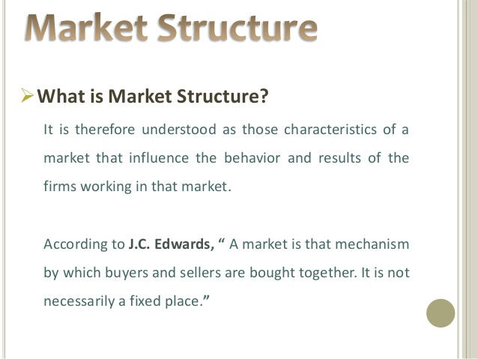

Slide 7
Price output determination
MR=MC Necessary condition
MC should cut the MR from below – sufficient condition

Slide 8
Monopolistic Competition
Leftwitch says- “ monopolistic competition is that situation of market where product of a seller is different in the mind of a customer from the product of another seller.”
Features
Large number of buyers and sellers
Product differentiation
Selling cost
More can be sell at lower cost

Slide 9
MR and AR in Monopoly

Slide 11
Price discrimination
When the firm sells it products to its customers of different profile at different price with no corresponding change in cost, the price discrimination is said to exist. Purchasing power, quantity brought, customers from different market conditions
Advantages
Helps to meet competition
Surplus production can be disposed off
Production cost decreases as volume increases
Long run profits

Slide 12


Slide 13
Is monopoly socially desirable?
No
Restrict the output
Exploitation of consumer
Wide gap between rich and poor
Unfair trade practices
Restricted scope to research and development

Slide 14
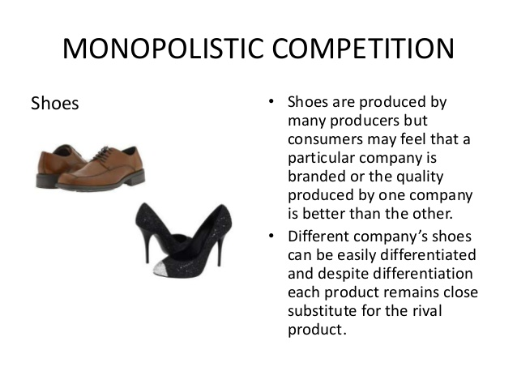

Slide 15
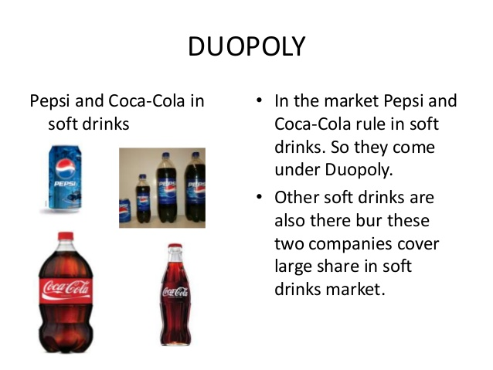

Slide 16
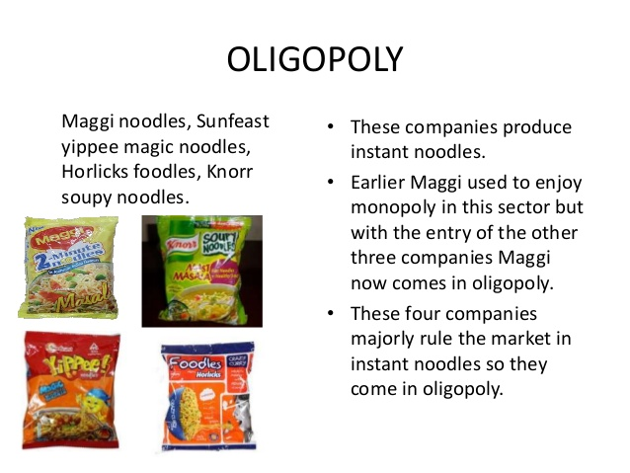

Slide 17
oligopoly
In this market the number of sellers are few and commodity may be homogenous or may not be homogenous. When some firms selling their products of homogeneous nature then is pure oligopoly, as industries of cement, Aluminum Iron and steel etc.
When there is difference in product in case of oligopoly, that is differentiated oligopoly.

