Slide 1


Slide 2

Deadlock
10

Slide 3
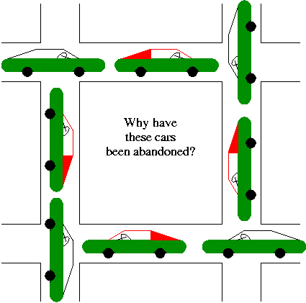
Automobile gridlock

Slide 4
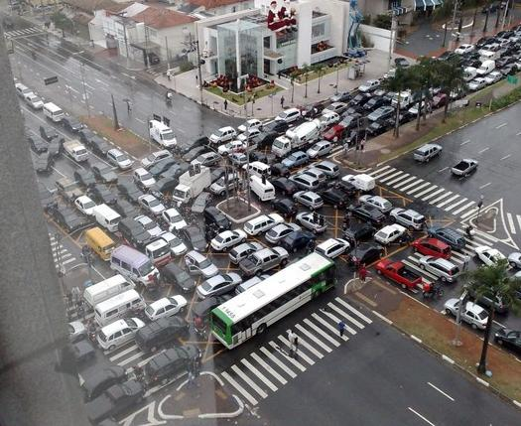
gridlock

Slide 5
Deadlock can arise in a community of cooperating processes.
A deadlock can occur among a group of two or more processes where by each process holds at least one resource while making a request on another.
The request can never be satisfied because the requested resource is being held by another process that is blocked waiting for that the first process is holding.

Slide 6
Example
Process 1
Process 2
Resource 1
Resource 2
Process holds the resource
Process requests the resource

Slide 7
Three Deadlocked Processes
Process 1
Process 2
Process 3
Resource 1
Resource 2
Resource 3
Process holds the resource
Process requests the resource

Slide 8
Addressing Deadlock
How come OS be constructed to ensure that a deadlock is handled properly ?
There are 3 general approaches and one adhoc approach
  Prevention: Design the system so that deadlock is impossible
  Avoidance: Construct a model of system states, then choose a strategy that will not allow the system to go to a deadlock state
  Detection & Recovery: Check for deadlock (periodically or sporadically), then recover
  Manual intervention: Have the operator reboot the machine if it seems too slow

Slide 9
Prevention
Necessary conditions for deadlock
  Mutual exclusion
  Hold and wait
  Circular waiting
  No preemption
Ensure that at least one of the necessary conditions is false at all times
  Mutual exclusion must hold at all times

Slide 10
Hold and Wait
Need to be sure a process does not hold one resource while requesting another
  Approach 1: Force a process to request all resources it needs at one time
  Approach 2: If a process needs to acquire a new resource, it must first release all resources it holds, then reacquire all it needs

Slide 11
Circular Wait
Have a situation in which there are K processes holding units of K resources
R
P
R_{i}
P holds R
P_{i}
P
R
P requests R

Slide 12
Circular Wait (cont)
There is a cycle in the graph of processes and resources
Choose a resource request strategy by which no cycle will be introduced
    Total order on all resources, then can only ask for R_{j} if R_{i} < R_{j} for all R_{i} the process is currently holding

Slide 13
Circular Wait (cont)
There is a cycle in the graph of processes and resources
Choose a resource request strategy by which no cycle will be introduced
  Total order on all resources, then can only ask for R_{j} if R_{i} < R_{j} for all R_{i} the process is currently holding
This is how we noticed the easy solution for the dining philosophers

Slide 14

Dining Philosophers
Is Semaphore Solution Correct?
philosopher(int i) {
while(TRUE) {
// Think
// Eat
P(fork[i]);
P(fork[(i+1) mod 5]);
eat();
V(fork[(i+1) mod 5]);
V(fork[i]);
}
}
semaphore fork[5]=(1,1,1,1,1);
fork(philosopher, 1, 0);
fork(philosopher, 1, 1);
fork(philosopher, 1, 2);
fork(philosopher, 1, 3);
fork(philosopher, 1, 4);

Slide 15
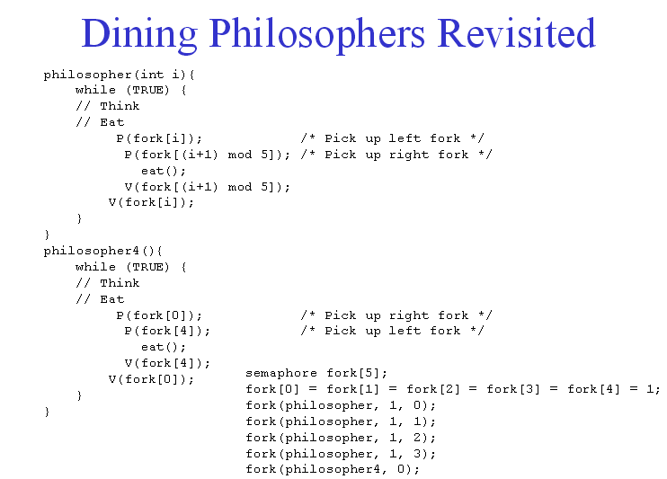

Slide 16
Avoidance
Define a model of system states, then choose a strategy that will guarantee that the system will not go to a deadlock state
Avoidance strategies are a conservative approach to resource allocation.
The strategy is to analyze a prospective state – before entering it – to guarantee that every process can still execute.

Slide 17
Avoidance
This strategy depends on additional information about the long-term resource needs of each process.
In particular, when a process is created, it must declare its maximum claim - the maximum number of units it will ever request – to every resource type.
The resource manager can honor the request if the resources are available

Slide 18
Safe vs Unsafe States
Safe state: one in which the system can assure that any sequence of subsequent transitions leads back to the initial state
  Even if all exercise their maximum claim, there is an allocation strategy by which all claims can be met
Unsafe state: one in which the system cannot guarantee that the system will transition back to the initial state
  Unsafe state can lead to a deadlock state if too many processes exercise their maximum claim at once

Slide 19
More on Safe & Unsafe States
I
Disallow
Safe States
Unsafe States
Deadlock States

Slide 20
Banker’s algorithm
The banker’s algorithm is the classic avoidance strategy.
It is modeled after the lending policies employed in banking systems
Working of a Bank
Line of maximum credit
Implicit assumption
  Additional money, they will have to render full after reception

Slide 21
Banker’s Algorithm
Let maxc[i, j] be the maximum claim for R_{j} by p_{i}
Let alloc[i, j] be the number of units of R_{j} held by p_{i}
Can always compute
  avail[j] = c_{j} - Σ_{0≤i< n}alloc[i,j]
  Then number of available units of R_{j}
Should be able to determine if the state is safe or not using this info

Slide 22
Banker’s Algorithm
Copy the alloc[i,j] table to alloc’[i,j]
Given C, maxc and alloc’, compute avail vector
Find p_{i}: maxc[i,j] - alloc’[i,j] ≤ avail[j] for 0 ≤ j < m and 0 ≤ i < n.
  If no such p_{i} exists, the state is unsafe
  If alloc’[i,j] is 0 for all i and j, the state is safe
Set alloc’[i,j] to 0; deallocate all resources held by p_{i}; go to Step 2

Slide 23
Example
Maximum Claim
C = <8, 5, 9, 7>
Process R₀ R₁ R₂ R₃
p₀ 3 2 1 4
p₁ 0 2 5 2
p₂ 5 1 0 5
p₃ 1 5 3 0
p₄ 3 0 3 3
Compute total allocated
Determine available units
avail = <8-7, 5-3, 9-7, 7-5>
= <1, 2, 2, 2>
Can anyone’s maxc be met?
Allocated Resources
maxc[2,0]-alloc’[2,0] = 5-4 = 1≤1 = avail[0]
maxc[2,1]-alloc’[2,1] = 1-0 = 1≤2 = avail[1]
maxc[2,2]-alloc’[2,2] = 0-0 = 0≤2 = avail[2]
maxc[2,3]-alloc’[2,3] = 5-3 = 2≤2 = avail[3]
Process R₀ R₁ R₂ R₃
p₀ 2 0 1 1
p₁ 0 1 2 1
p₂ 4 0 0 3
p₃ 0 2 1 0
p₄ 1 0 3 0
Sum 7 3 7 5
P₂ can exercise max claim
avail[0] = avail[0]+alloc’[2,0] = 1+4 = 5
avail[1] = avail[1]+alloc’[2,1] = 2+0 = 2
avail[2] = avail[2]+alloc’[2,2] = 2+0 = 2
avail[3] = avail[3]+alloc’[2,3] = 2+3 = 5

Slide 24
Example
Maximum Claim
C = <8, 5, 9, 7>
Process R₀ R₁ R₂ R₃
p₀ 3 2 1 4
p₁ 0 2 5 2
p₂ 5 1 0 5
p₃ 1 5 3 0
p₄ 3 0 3 3
Compute total allocated
Determine available units
avail = <8-7, 5-3, 9-7, 7-5>
= <5, 2, 2, 5>
Can anyone’s maxc be met?
Allocated Resources
maxc[4,0]-alloc’[4,0] = 5-1 = 4≤5 = avail[0]
maxc[4,1]-alloc’[4,1] = 0-0 = 0≤2 = avail[1]
maxc[4,2]-alloc’[4,2] = 3-3 = 0≤2 = avail[2]
maxc[4,3]-alloc’[4,3] = 3-0 = 3≤5 = avail[3]
Process R₀ R₁ R₂ R₃
p₀ 2 0 1 1
p₁ 0 1 2 1
p₂ 0 0 0 0
p₃ 0 2 1 0
p₄ 1 0 3 0
Sum 3 3 7 2
P₄ can exercise max claim
avail[0] = avail[0]+alloc’[4,0] = 5+1 = 6
avail[1] = avail[1]+alloc’[4,1] = 2+0 = 2
avail[2] = avail[2]+alloc’[4,2] = 2+3 = 5
avail[3] = avail[3]+alloc’[4,3] = 5+0 = 5

Slide 25
Example
Maximum Claim
C = <8, 5, 9, 7>
Process R₀ R₁ R₂ R₃
p₀ 3 2 1 4
p₁ 0 2 5 2
p₂ 5 1 0 5
p₃ 1 5 3 0
p₄ 3 0 3 3
Compute total allocated
Determine available units
avail = <8-2, 5-3, 9-4, 7-2>
= <6, 2, 5, 5>
Can anyone’s maxc be met? (Yes, any of them can)
Allocated Resources
Process R₀ R₁ R₂ R₃
p₀ 2 0 1 1
p₁ 0 1 2 1
p₂ 0 0 0 0
p₃ 0 2 1 0
p₄ 0 0 0 0
Sum 2 3 4 2

Slide 26
Detection & Recovery
Check for deadlock (periodically or sporadically), then recover
Can be far more aggressive with allocation
No maximum claim, no safe/unsafe states

Slide 27
Recovery
No magic here
  Choose a blocked resource
  Preempt it (releasing its resources)
  Run the detection algorithm
  Iterate if until the state is not a deadlock state

