Slide 1
Game Theory
It is a mathematical model which is used for decision making in the case of Oligopolistic Market situations. The decision making situation can be classified as 1) Deterministic situation 2) Probabilistic situation 3)Uncertain situation.
Introduced by Von Newman and Morgenstern in “Theory of games and Economic behaviour” published in 1944.
A game theory in any situation in which the players (participants) make strategic decisions. That is a decision that takes into account each other actions and responses. Example of games include firms competing each other by setting prices. It is concerned with choice of optimal strategy in a conflict situations.
“Game theory shows how an Oligopolistic firm can make strategic decision
1) To gain a competitive advantage over its rival
2) How it can minimise the potential harm from a strategic move by a rival”

Slide 2
A game consists of
a set of players
a set of strategies for each player
the payoffs to each player for every possible list of strategy choices by the players.
Players are the decision makers (manager of the oligopolistic firm)
Strategies are the potential choices. This include whether to change price? Whether to develop a new or differentiated products? Whether to introduce a new or different advertising campaign?
Pay off: It is the outcome or consequences of each strategy. It is often expressed in terms of profits or losses
Pay off Matrix: A table that gives the payoff from all the strategies open to a firm and its rival’s response
Optimal Strategy: A strategy that maximises the players expected payoff.

Slide 3
Zero sum game and Non Zero sum game
A zero sum game is a game in which the gain of one player comes at the expenses of the other and is exactly equal to the loss of the other player. Ex. Market Share
Non-Zero sum game
If gain or loss of one firm do not come at the expenses of other firms or it provide equal benefits to both firms. A non-Zero sum game can be positive or negative

Slide 4
Pure strategies and Mixed strategies
Pure strategy is a strategy in which a player makes a specific choice or takes a specific action. Eg. Advertise or not, whether to introduce new product or not etc. Eg. Among the different strategies firm is taking only once strategy and ignoring all other remaining strategies, But some of these probabilities is one. Eg. If there are P1, P2 and P3 Strategies Firm I is taking P2 Strategy ignores the other. The probability will be zero for P1 and P3 and one for P2. Hence, the sum is One.
Mixed strategies are in which players make random choices among possible actions, based on a set of chosen probabilities. If player follows more than one strategy then the player is said to follow mixed strategy. Here, the probability of the selecting an individual strategy is les than one and sum of all the strategies together is one. Say firm one is following P1, P2 and P3 strategies together , the probabilities can be P1=0.65 P2=0.35 and P3=0. Then sum of Probabilities is=1

Slide 5
Dominant strategy
If both firms advertise, firm A will earn a profit of 10 and Firm B will earn a profit of 5. If firm A advertise and firm B don’t, firm A will get a profit of 15 and firm B will get a profit of 0.
Dominant Strategy of firm A-It should clearly advertise because no matter what firm B does, firm A gets the best by advertising. Firm A earns 10 by advertising
Dominant Strategy of firm B-It should clearly advertise because no matter what firm A does, firm A gets the best by advertising. Firm B gets 10 by advertising
When both the firms have a dominant strategy , we call the outcome of the game “An equilibrium in dominant strategies”

Slide 6
Nash Equilibrium
Now, firm A has no dominant strategy. His optimal decision depends on what firm B does. Why? To answer this problem Firm A must put itself in firm B’s shoes.
But here, Firm B have a dominant strategy –to advertise, no matter what firm A does. There for Firm A can conclude that firm B will advertise and firm A will follow B and go for Advertising and there by earns a profit of 10 and 5.Hence, the outcome of the game is that both firms will advertise. Here A’s strategy is depend on what B does. This is “Nash Equilibrium”.

Slide 7
Dominant strategy
Dominant strategy is a course of action that results in the highest payoff for a player regardless of what the other player is doing
I am doing the best that I can, no matter what you do
You are doing the best you can no matter what I do
Nash Equilibrium
It is a course of action that results in the highest payoff for a player given the strategy of the other player. It is a stable equilibrium where there is no incentive to deviate from the present action
I am doing the best I can given what you are doing
You are doing the best given what I am doing.

Slide 8
Prisoner’s Dilemma
Two suspects arrested for a crime
Prisoners decide whether to confess or not to confess
If both confess, both sentenced to 3 months of jail
If both do not confess, then both will be sentenced to 1 month of jail
If one confesses and the other does not, then the confessor gets freed (0 months of jail) and the non-confessor sentenced to 9 months of jail
What should each prisoner do?

Slide 9
Prisoner’s Dilemma
Payoff Matrix
Prisoner 2
 | Confess | Not Confess
Confess | -3,-3 | 0,-9
Not Confess | -9,0 | -1,-1
Prisoner 1

Slide 10
Solution
Both will confess, though both have a dominant strategy of not to confess, because of uncertainty and asymmetric information. They choose the less payoff.
Each player’s predicted strategy is the best response to the predicted strategies of other players
No incentive to deviate unilaterally
Strategically stable or self-enforcing

Slide 11
P & G and Uniliver-Prisoner’s dilemma
1) They started to enter into the Japanese Market for the production of
Gypsy Moth tape in Japan at the same time
2) Both face same cost and demand conditions
3) Both are rival and there is no collusion
4) Each firm has to decide on price that took its competitor into account
How will they arrive at a feasible solution?

Slide 12
Payoff Matrix
Uniliver
 | Charges 1.40 US $ | Charges 1.5 US $
Charges 1.40 US $ | $12, $12 | $29, $11
Charges 1.5 US $ | $3, $21 | $20, $20
P & G

Slide 13
Product choice problem
Two breakfast cereals companies faces a market in which two new varieties of cereals can be successfully introduced- Sweet and Crispy
Each variation can be introduced by only one firm
Both sweet and crispy cereals have a market
But each firm has the resources to produce only one new product
How will they arrive at a solution?

Slide 14
Payoff Matrix
Firm II
 | Crispy | Sweet
Crispy | -5, -5 | 10, 10
Sweet | 10, 10 | -5, -5
Firm I

Slide 15
Solution
If Firm I announces through a press release that it is going to introduce sweet cereals
Given the firm I ‘s action Firm II will introduce Crispy cereals
Neither the firm has to deviate from its proposed action
If one deviate and given the opponent’s action remain unchanged its pay off will be -5.
There for the strategy given at the bottom left hand corner of the payoff matrix is stable and this constitute Nash Equilibrium. i.e. given the strategy of the opponent, each firm is doing the best it can and has no incentive to deviate
The upper right hand corner of the payoff matrix is also a Nash equilibrium and is stable too.

Slide 16
Matching Pennies
Each player choose head or tail and the players reveals their coins at the same time. If the coins match (i.e. both are either head or both are tail) Player A wins and receives 1 $ from B. If the coin do not match, the player B wins and receives a dollar from firm A. The payoff matrix
Solution: No Nash Equilibrium in pure strategies for this game
Although there is no Nash Equilibrium in pure strategies, there is a Nash equilibrium in mixed strategy in which players make random choices, among the two or more possible actions, based on a set of certain possibilities.

Slide 17
Matching Pennies
Payoff Matrix
Player B
Player A
 | Head | Tail
Head | 1, -1 | -1, 1
Tail | -1, 1 | 1, -1

Slide 18
Battle of Sexes- Mixed Strategy
Two friends –a girl and a boy- is deciding how to spend the evening together-then only their utility is maximized
Girl would like to go for a movie
Boy would like to go for a cricket match
Both however want to spend the time together
Scope for strategic interaction

Slide 19
Battle of Sexes
Payoff Matrix
Boy
girl
 | Movie | Cricket
Movie | 2,1 | 0,0
Cricket | 0,0 | 1,2

Slide 20
Solution to “Battle of sexes”
There are two Nash Equilibrium in pure strategies for the game
Both watch movie
Both will watch cricket
Both the outcomes are Nash equilibrium (stable) because neither the boy or girl would want to change his or her decision given the decisions of the other.
This game is also have equilibrium in Mixed strategies also
The boy choose cricket with 2/3 probability and movie with 1/3 probability
If the boy is choosing this strategy the boy cannot do better with any other strategy
Like wise the girl is choosing the movie with 2/3 probability and cricket with 1/3 probability and the girl cannot do better with any other strategy.

Slide 21
Rock-paper-scissors
Column player aka. player 2 (simultaneously) chooses a column
0, 0 | -1, 1 | 1, -1
1, -1 | 0, 0 | -1, 1
-1, 1 | 1, -1 | 0, 0
Row player aka. player 1 chooses a row
A row or column is called an action or (pure) strategy
Row player’s utility is always listed first, column player’s second
Zero-sum game: the utilities in each entry sum to 0 (or a constant)
Three-player game would be a 3D table with 3 utilities per entry, etc.

Slide 22
Solution
A probability distribution over the pure strategies of the game
No pure strategy Nash equilibrium
One mixed strategy Nash equilibrium – each player plays rock, paper and scissors each with 1/3 probability

Slide 23
PAY OFF MATRICS OF FIRM I
 | STRATEGIES OF FIRM TWO
STRATEGIES OF FIRM ONE |  | B1 | B2 | B3 | B4 | B5
 | A1 | 0.10 | 0.20 | 0.15 | 0.30 | 0.25
 | A2 | 0.40 | 0.3 | 0.50 | 0.55 | 0.45
 | A3 | 0.35 | 0.25 | 0.20 | 0.40 | 0.5
 | A4 | 0.25 | 0.15 | 0.35 | 0.6 | 0.20
PAY OFF MATRICS OF FIRM II
 | STRATEGIES OF FIRM TWO
STRATEGIES OF FIRM ONE |  | B1 | B2 | B3 | B4 | B5
 | A1 | 0.9 | 0.80 | 0.85 | 0.70 | 0.75
 | A2 | 0.6 | 0.70 | 0.50 | 0.45 | 0.55
 | A3 | 0.65 | 0.75 | 0.80 | 0.60 | 0.50
 | A4 | 0.75 | 0.85 | 0.65 | 0.40 | 0.80

Slide 24
Maximin and Minimax Strategies
PAY OFF MATRICS OF FIRM I
 | STRATEGIES OF FIRM TWO
STRATEGIES OF FIRM ONE |  | B1 | B2 | B3 | B4 | B5
 | A1 | 0.10 | 0.20 | 0.15 | 0.30 | 0.25
 | A2 | 0.40 | 0.3 | 0.50 | 0.55 | 0.45
 | A3 | 0.35 | 0.25 | 0.20 | 0.40 | 0.5
 | A4 | 0.25 | 0.15 | 0.35 | 0.6 | 0.20
Maximin Strategy –Maximise the minimum guaranteed gain to A.
Among all these minima (worst outcomes) Firm I chooses the Maximum (the best of the worst)
Hence, the Maximin strategy for Firm I is A2 i.e. the strategy that yields the share of .30. (30 % of Market share)

Slide 25
Minimax Strategy
PAY OFF MATRICS OF FIRM I
 | STRATEGIES OF FIRM TWO
STRATEGIES OF FIRM ONE |  | B1 | B2 | B3 | B4 | B5
 | A1 | 0.10 | 0.20 | 0.15 | 0.30 | 0.25
 | A2 | 0.40 | 0.3 | 0.50 | 0.55 | 0.45
 | A3 | 0.35 | 0.25 | 0.20 | 0.40 | 0.5
 | A4 | 0.25 | 0.15 | 0.35 | 0.6 | 0.20
Minimax Strategy –Minimise the Maximum loss
Among all these maximum payoffs (best outcomes) Firm II chooses the Minimum (the worst of the best) Hence, the Minimax strategy for Firm II is B2 i.e. the strategy that yields the share of .70. (70 % of Market share). This involves the choice of a minimum among the maximum payoff table.

Slide 26
Equilibrium
PAY OFF MATRICS OF FIRM I&II
 | STRATEGIES OF FIRM TWO
STRATEGIES OF FIRM ONE |  | B1 | B2 | B3 | B4 | B5
 | A1 | 0.10 | 0.20 | 0.15 | 0.30 | 0.25
 | A2 | 0.40 | 0.3 | 0.50 | 0.55 | 0.45
 | A3 | 0.35 | 0.25 | 0.20 | 0.40 | 0.5
 | A4 | 0.25 | 0.15 | 0.35 | 0.6 | 0.20

Slide 27
Equilibrium
Equilibrium solution is
Strategy A2 for Firm I (30 % Market share)
Strategy B2 for Firm II (70 % Market share)
It is an equilibrium solution because it is the preferred one by both the firms.
This solution has a saddle points.[That is A payoff that is simultaneously a Maxmin and a Minimax strategies]
The value of the game is .3. the value of the cell where both raw minimum and a column Maximum meets.
This preferred strategies of A2 and B2 are called Dominant Strategies is the optimal choice of a player no matter what an opponent does.

Slide 28
Problem: find the optimum strategies for the player in the following games
 |  | Player B
 |  | 1 | 2 | 3 | Raw Minimum
Player A | 1 | 25 | 20 | 35
 | 2 | 50 | 45 | 55
 | 3 | 58 | 40 | 42
 | Column Maxima

Slide 29
Problem: Consider the following payoff matrix with respect to the player A &B and solve it optimally
 | Player B
Player A | 9 | 7 | Row Minimum
 | 5 | 11
Column Maxima

Slide 30
Solution
This game has no pure strategy equilibrium since it does not have a saddle point
So we have to find out whether it has a mixed strategy equilibrium
Find the probability for each cell (Make sure the probability of the selection of strategy is less than one and total it is one)
P1=3/4
P2=1/4
Q1=1/2
Q2=1/2
Then find the value of the game.
Hence, the strategies of the player A is ¾ and ¼
Player B is ½ and ½
And the value of the game is 8

Slide 31
Repeated games
Game in which action is taken and payoffs received over and over again
Tit for tat strategy
Repeated game strategy in which a player responds in kind to an opponents previous play, cooperatively with cooperative opponents and retaliating against uncooperative ones.
There are infinity repeated games
Finite number of repeated games

Slide 32
Sequential games
In sequential games players move in turn. Example. Advertising decision of the firm and its responses by the competitor. In sequential games, the key is to think through the possible actions and the rational reactions of each player

Slide 33
Product choice problem revisited
Payoff Matrix
Firm II
 | Crispy | Sweet
Crispy | -5, -5 | 10, 20
Sweet | 20, 10 | -5, -5
Firm I

Slide 34
Extensive form of a game
Sequential game are sometimes easier to visualise if we represent the possible moves in the form of a decision tree. When a sequential game is represented in the form of a decision tree, it is called extensive form of game. To find a an easy solution for this extensive form of game is better to work backward from the end. This is called backward induction.
Crispy
-5, -5
crispy
Firm 2
10, 20
sweet
Firm I
Crispy
20, 10
sweet
Firm 2
sweet
-5, -5

Slide 35
Macro Economics
Micro economics, supply creates its own demand
the publication of Keynes “General Theory of Employment Interest an Money” The need for separate study of macro economics was felt by Keynes while understanding and analyzing the Great Depression of 1929
, the distinction between Micro & Macro economic issues did not arise at all.
the study of the economy as a whole
it deals with broad aggregates

Slide 36
Difference between Micro and Macro Economics
Micro Economis
Study the individual units
Macro economics
Study aggregates, Policy related questions
Definition
Boulding says, “Macro economic theory is that part of economics which studies the over all averages and aggregates of the system.”
According to Shapiro, “ Macro economics deals with the functioning of the economy as a whole.”

Slide 37
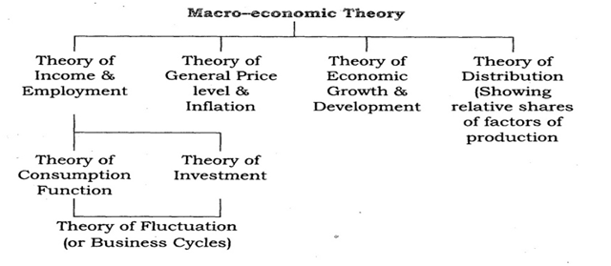
Subject matter of Macro Economics
Theory of National Income
Theory of Employment
Theory of Money
Theory of general price level
Theory of economic growth
Theory of international trade

Slide 38
Importance of Macro Economics Helpful in knowing the functioning of the economy Study national Income Formulation of economic policy study trade cycles changes in general price level Economic growth Helpful in study of Micro Economics International Comparisons Economic planning Inter relation among different sectors

Slide 39
Circular flow of Income
A model to understand the functioning of a macro economic system or the economy as a whole is called the ‘Circular Flow of Income Model’
Real Flow
Normal flow

Slide 40
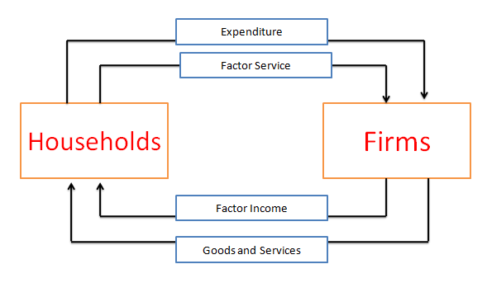
Circular flow of Income-Two sector model

Slide 41
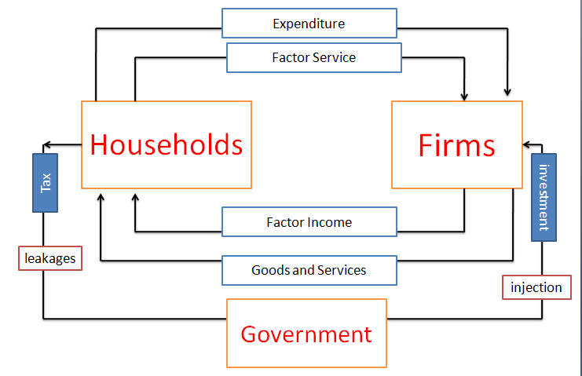
Circular flow of Income-Three sector model

Slide 42
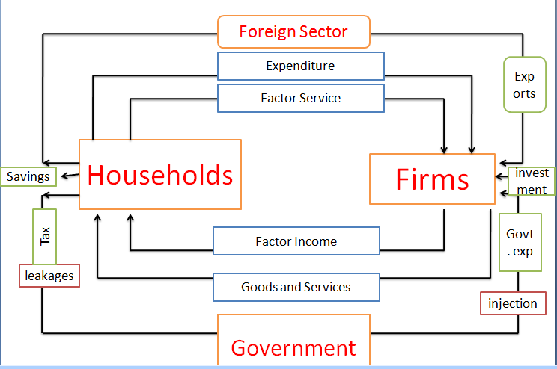
Circular flow of Income-Four sector model

