Slide 1
Inter process Communication Mechanisms
Operating system CS3003

Slide 2
Inter process communication (IPC) is the transfer of data among processes. Some of the examples are
    A Web browser may request a Web page from a Web server, which then sends HTML data.This transfer of data usually uses sockets in a telephone-like connection.
    one may want to print the filenames in a directory using a command such as ls | lpr. The shell creates an ls process and a separate lpr process, connects two with a pipe, represented by the “|” symbol. A pipe permits one-way communication between two related processes. The ls process writes data into the pipe, and the lpr process reads data from the pipe

Slide 3
IPC Mechanisms
Info copy
Message
Info to be
shared
OS IPC
Mechanism
Address Space for p₀
Address Space for p₁
Sharing of Information can be in
  User space
  Kernel space

Slide 4
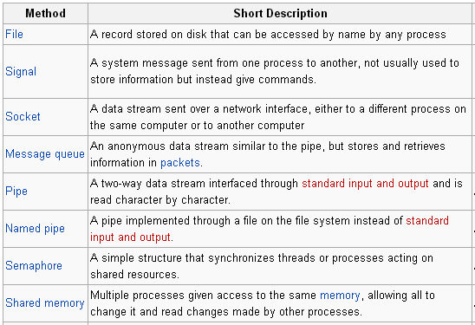
Main IPC methods

Slide 5
IPC mechanisms
System V IPC
  Shared memory
  Semaphore
  Message queue
Signals
Pipes (named pipe also)
Sockets

Slide 6
System V IPC
System V IPC was first introduced in SVR2, but is available now in most versions of unix
  Message Queues represent linked lists of messages, which can be written to and read from
  Shared memory allows two or more processes to share a region of memory, so that they may each read from and write to that memory region
  Semaphores synchronize access to shared resources by providing synchronized access among multiple processes trying to access those critical resources.

Slide 7
SYS V IPC
Each mechanism contains
  Table
    Table entries describe all occurrences of the mechanism
  Key
    User chosen name
  Get
    To create a new entry or to retrieve an existing one.

Slide 8
Identifiers and Keys
  Each IPC structure (message queue, semaphore, or share memory segment) is identified by a nonnegative integer identifier.
    Similar to a file descriptor, but can be a large value.
  A key must be specified when creating an IPC structure.
    Kernel convert the key to the identifier.
    All process access to an IPC structure must have a way to specify the same key

Slide 9

Shares the memory in user space
Shared memory is the special address range in the address range of a process
Provides efficient access to large areas of memory .
Other process can attach this shared memory segment into their own address space (Virtual address space)
Notes:
Shared memory is one among the three SYS V IPC mechanism. Any number of unrelated processes can communicate using this concept. The shared memory shared by all the unrelated processes lies in the user space ( as a segment in the address space of one of the processes). As many processes try to share the same piece of memory, this shared piece of memory becomes the critical section. So, we require an external synchronization mechanism to manage the access to the shared resource (shared memory). Shared memory is specially useful, when processes want to share large data i.e., this provides an efficient access to large areas of memory.

Slide 10
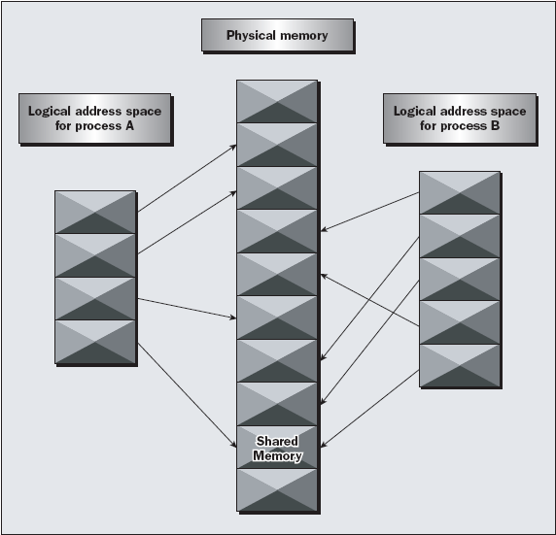
Notes:
Shared memory is a special range of address that is there in one processes address space and all the processes that are interested in making the IPC, attaches themselves to this memory segment. By this, this shared segment of memory is there in all the processes addresses space.
Out of all the processes, one process gets this special ranged address space, and all other processes including the first, will attach this memory segment in their address space.

Slide 11

shmget
  Create / retrieve
shmat
  Attach to the virtual address space
shmdt
  Detach form virtual address space
shmctl
  Manipulation of various parameters
Notes:
Now let us look at using the shared memory concept.
The API’s associated with the shared memory are shmget, shmat, shmdt, shmctl
Shmget is the API used to create a new shared memory region or it is used to retrieve the existing shared memory region with the requirements. The existing shared memory can be retrieved by the key associated with it.
shmat API logically attaches the shared memory to its virtual memory address space. After attaching the region to its process address space, we can share the data by writing and reading to and from the shared memory.
Shmdt is the API used to detach the shared address space from its process address space.
Shmctl is the API to control the shared memory. It is used to get the properties of the shared memory segment. A special command IPC_RMID passed to shmctl, that particular shared memory segment with the key is destroyed.

Slide 12
debugging
ipcs –shm
------ Shared Memory Segments --------
key shmid owner perms bytes nattch status
0x00000000 1627649 user 640 25600 0
If this memory segment was erroneously left behind by a program, you can use the ipcrm command to remove it.
ipcrm shm 1627649

Slide 13

Pros
  Easy to access as it is in user space
  Fastest IPC mechanism
Cons
  Synchronization mechanism is not there.
Notes:
Coming to advantages and disadvantages of shared memory –
Lets discuss about the advantages first.
As it is in the user space, it is very easy and fast to access it. Also, the data in the shared memory is persistent.
But coming to the disadvantages, mainly there is no synchronization between the processes.
Think of a scenario, process-1 is supposed to collect a message after process-2 posts it.
If process-2 comes first and posts it, process-1 collects it easily. But if process -1 comes first, it cannot find the data so it comes out.

Slide 14

For synchronization
Different from posix semaphores
Between two unrelated processes
A number with post and signal operations
Notes:
These semaphores are used for the synchronization purpose. These are different from the posix semaphores in implementation. They run for related processes and these sys V semaphores are used between unrelated processes.
Semaphore is a typically a number. This is used as a flag to indicate that the critical section is already being accessed by other process. So, the process waits till the flag is made down. It then acquires the flag and enters the critical region. Wait and signal are the two typical words used in semaphores for P and V operations.

Slide 15
Operations
P(), V() . P and V stand for Dutch words "Proberen", to test, and "Verhogen", to increment.
function V(semaphore S)
{ S ← S +1 }
function P(semaphore S)
{
While (S= =0){ wait};
S=S-1;
}

Slide 16

semget
  Create / retrieve
semop
  Wait and signal operations use the same call with different arguments
semctl
  Manipulation of various parameters, controlling the semaphore
Notes:
Semaphores uses 3 API’s
Semget, semop and semctl.
We will see more about these functions in the next slides.

Slide 17
Message Queue
Message queue.
  A linked list of messages stored within the kernel and identified by a message queue identifier.
    Every message has a type field, and a nonnegative length, and the actual data bytes.
    Msgsnd puts a message at the end of the queue
    Msgrcv gets a message, may not follow FIFO order (can be based on type)

Slide 18
Refined IPC Mechanism
OS manages the mailbox space
More secure message system
Address Space for p₀
Address Space for p₁
Info to be
shared
Info copy
send(… p₁, …);
receive(…);
OS Interface
Mailbox for p₁
Message
Message
send function
Message
receive function

Slide 19

msgget
  Returns a message descriptor to be used by other system calls
msgsnd
  Sends a message
msgrcv
  Receives a message
msgctl
  Controls the message queue

Slide 20

int main() {
int msgid, retval ;
struct msgbuf mbuf ;
if(msgid = msgget((key_t)5678,IPC_CREAT | IPC_EXCL) ) < 0); {
printf("msgget already created\n") ;
msgid = msgget((key_t)5678,0666) ; }
mbuf.mtype =1 ;
strcpy(mbuf.mtext,"hello") ; // trying to send hello
If( (retval = msgsnd(msgid,&mbuf,5,0)) <0){
perror("msgsnd: ") ; }
return 0 ;
}

Slide 21

int main() {
int msgid, retval ;
struct msgbuf mbuf ;
If((msgid = msgget((key_t)5678,IPC_CREAT | IPC_EXCL))<0) {
printf("msgget already created\n") ;
msgid = msgget((key_t)5678,0666) ;
}
if((retval = msgrcv(msgid,&mbuf,5,1,0)) < 0){
perror("msgrcv: ") ;
}
printf("message from process 1 is %s\n",mbuf.mtext) ;
return 0 ;
}

Slide 22

Pros
  Lies in the kernel space
  Doesn’t require any external synchronization.
Cons
  Limit in the size of data to be sent
  Over all size limit in the complete system
Notes:
Message queues provide a reasonably easy and efficient way of passing data between two unrelated processes. we can almost totally avoid the synchronization and blocking problems in sending messages. Even better, we can “look ahead” for messages that are urgent in some way.
Looking at the disadvantages, there’s a maximum size limit imposed on each block of data and also a limit on the maximum total size of all blocks on all queues throughout the system. Linux does have two defines, MSGMAX and MSGMNB, which define the maximum size in bytes of an individual message and the maximum size of a queue, respectively.

