Slide 1
Threads, Thread management

Slide 2
Algorithms, Programs, and Processes
Idea
Execution Engine
Files
Files
Algorithm
Files
Status
Stack
Source
Program
Binary
Program
Data
Other
Resources
Process

Slide 3
Implementing the Process Abstraction
P_{i} CPU
P_{j} CPU
P_{k} CPU
Ideal Abstraction:
As if using an
Actual machine
…
P_{i} Executable
Memory
P_{j} Executable
Memory
P_{k} Executable
Memory
OS interface
OS Address
Space
CPU
ALU
P_{i} Address
Space
P_{k} Address
Space
Machine Executable Memory
Control
Unit
…
P_{j} Address
Space
Notes:
Classic process vs modern process
Modern process - process supplies the execution framework in which thread execute
Modern process - several musicians (threads) share a single studio to work together on a piece

Slide 4
Processes and Threads
Thrd_{j} in P_{i}
Thrd_{k} in P_{i}
…
P_{i} CPU
…
…
OS interface
…
Notes:
Classic process case: base thread is running/abstract machine is running & abstract machine quits/base thread stops

Slide 5
Thread
A thread is a basic unit of CPU utilization, consisting of a program counter, a stack, and a set of registers
Thread is a light weight process
Traditional ( heavyweight ) processes have a single thread of control - There is one program counter, and one sequence of instructions that can be carried out at any given time.

Slide 6
Processes and Threads
Threads Threads are schedulable activities attached to processes. The aim of having multiple threads of execution is : To maximize degree of concurrent execution between operations Threads are faster to create and destroy than processes Natural fit for multiple cores

Slide 7
Process and Thread
Process is an infrastructure in which execution takes place – address space + resources
Thread is a program in execution within a process context – each thread has its own stack
Stack
Data
Thread
Thread
Stack
Process
…
Program
Stack
Thread
Operating System

Slide 8
A Process with Multiple Threads
Thread (Execution Engine)
Status
Stack
Files
Files
Files
Status
Stack
Data
Status
Stack
Binary
Program
Other
Resources
Process

Slide 9
Multi thread application - example
For example in a word processor, a background thread may check spelling and grammar while a foreground thread processes user input ( keystrokes ), while yet a third thread loads images from the hard drive, and a fourth does periodic automatic backups of the file being edited.

Slide 10
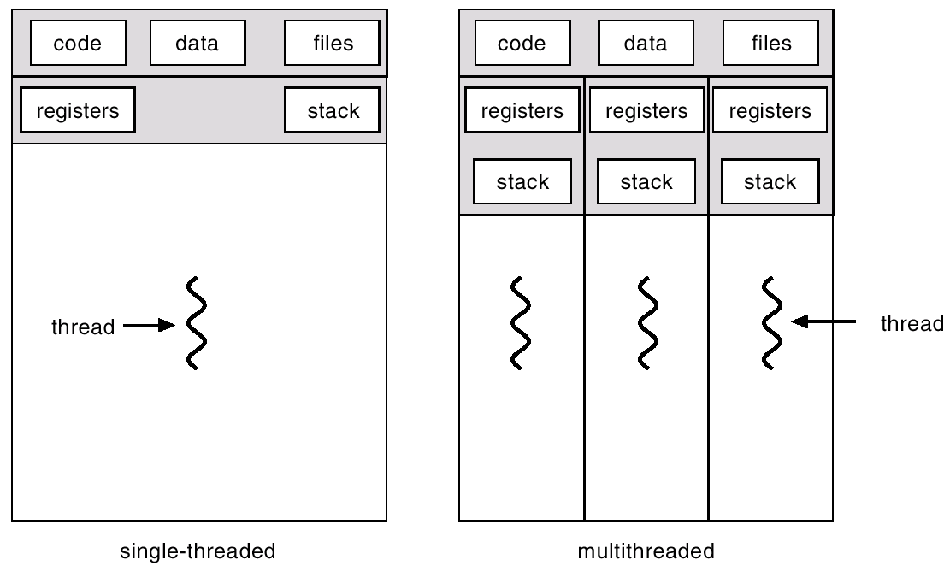
Single Thread Vs Multi Thread

Slide 11
Thread Abstraction
Process Manager has algorithms to control threads and thread descriptor (data structure) to keep track of threads.
Management Tasks
- Create/destroy thread
- Allocate thread-specific resources
- Manage thread context switching
Thread Descriptor
- state
- execution stats
- process (reference to associated process)
- list of related threads
- stack (reference to stack)
- thread-specific resources
Notes:
Context switching includes the task of scheduling
Mosr resources are allocated to associated process - however some are specific to thread

Slide 12
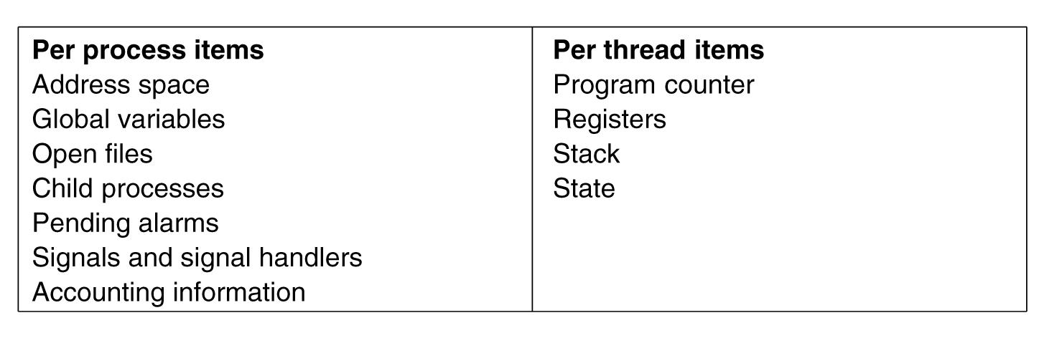
Threads are lightweight
Tanenbaum, Modern Operating Systems 3 e, (c) 2008 Prentice-Hall, Inc. All rights reserved. 0-13-6006639

Slide 13
Threads are like processes
Have same states
Running
Ready
Blocked
Have their own stacks –same as processes
Tanenbaum, Modern Operating Systems 3 e, (c) 2008 Prentice-Hall, Inc. All rights reserved. 0-13-6006639

Slide 14
Process & Thread
Modern operating system
Unit of resource ownership is usually referred to as process
The unit of dispatching is usually referred to as a thread. Thus a thread
Has an execution state
Saves thread context when not running
Has access to memory address space & its resources

Slide 15
Advantage of using threads
It takes less time to create a new thread than a process
It takes less time to terminate a thread than a process
Context switch between two threads within the same process involves lesser time.
Communication overhead is minimized.

Slide 16
Thread implementation
There are two broad categories of thread implementation
User Level Threads – thread libraries
Kernel Level Threads – system calls
In ULT, kernel is not aware of the existence of threads
In KLT, all thread management is done by kernel. There is no thread library

Slide 17
How Linux actually implemented user level threads!
In the kernel, fork is actually implemented by a clone() system call.
Clone allows you to explicitly specify which parts of the new process are copied into the new process, and which parts are shared between the two processes.
This may seem a bit strange at first, but allows us to easily implement threads with one very simple interface.

Slide 18
Clone ( ) System Call
Thread
clone(CLONE_VM | CLONE_FS | CLONE_FILES |
CLONE_SIGHAND, 0);
• Process with fork( )
clone(SIGCHLD, 0);
Process with vfork( )
clone(CLONE_VFORK | CLONE_VM | SIGCHLD, 0);

Slide 19
Pthreads
a POSIX standard (IEEE 1003.1c) API for thread creation and synchronization.
API specifies behavior of the thread library, implementation is up to development of the library.
Common in UNIX operating systems.

Slide 20
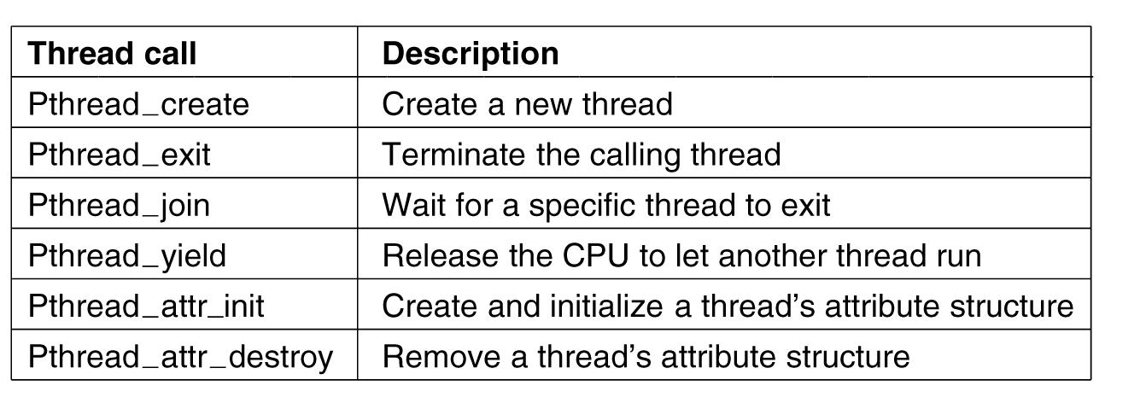
POSIX Threads (Pthreads)
Pthreads are IEEE Unix standard library calls
Tanenbaum, Modern Operating Systems 3 e, (c) 2008 Prentice-Hall, Inc. All rights reserved. 0-13-6006639

Slide 21
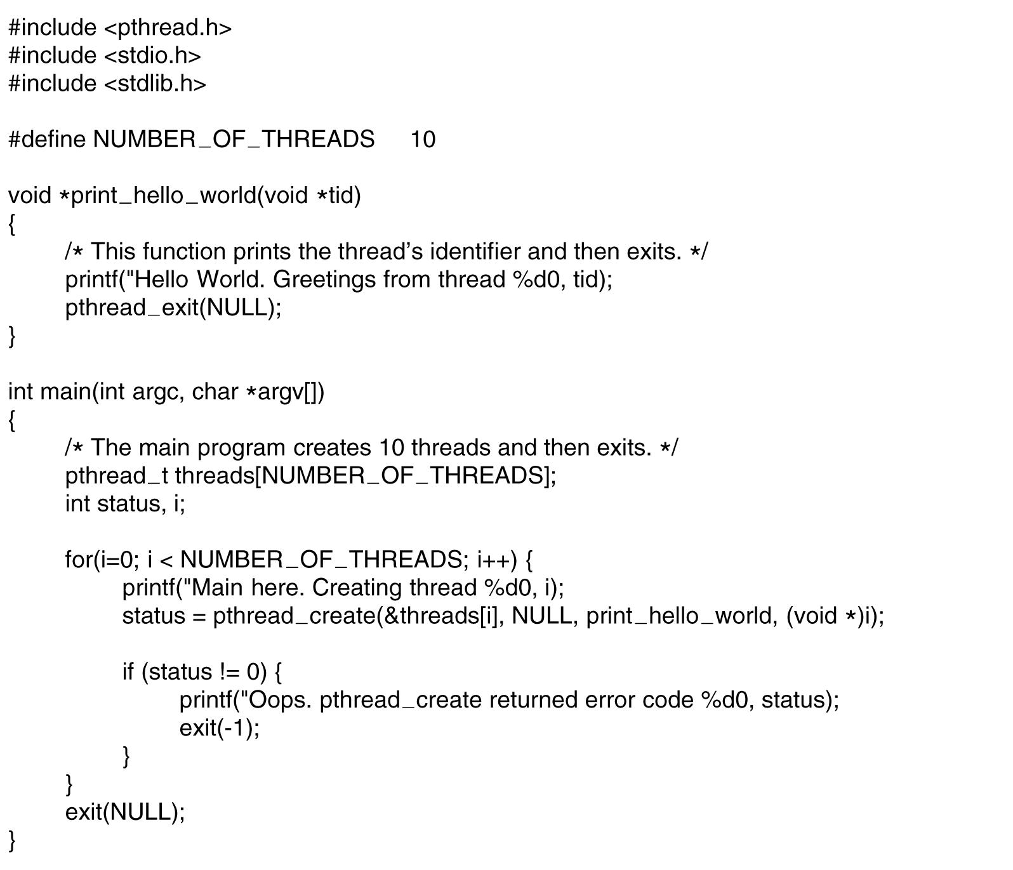
A Pthreads example-”Hello,world”
. . .
.
Tanenbaum, Modern Operating Systems 3 e, (c) 2008 Prentice-Hall, Inc. All rights reserved. 0-13-6006639

Slide 22
Summary : Process and Threads
Process: encompasses
Unit of dispatching: process is an execution path through one or more programs set of threads (computational entities)
execution may be interleaved with other processes
Unit of resource ownership: process is allocated a virtual address space to hold the process image
Thread: Dynamic object representing an execution path and computational state.
threads have their own computational state: PC, stack, user registers and private data
Remaining resources are shared amongst threads in a process

