Slide 1
Example Software EMEA Ltd
Month-end pack: August 2026
Simulated company data for a portfolio project. Exchange rates: ECB monthly averages.

Slide 2
Summary
Revenue, year to date
Operating profit, year to date
Operating profit, full-year outlook
€12.27m
€4.06m
€6.66m
€+225k vs budget
€+28k vs budget
€+344k vs budget
• In August, operating profit was €620k, €76k ahead of budget.
• Year to date to August 2026, operating profit is €4.06m, €28k (0.7%) ahead of budget.
• Revenue is +€225k against budget: volume +€255k, price −€41k, exchange rates +€11k.
• EUR revenue: volume +€118k, price −€79k.
• GBP revenue: volume −€80k.
• USD revenue: volume +€217k, price +€39k.
• Cost of revenue is €82k (7%) over budget.
• Marketing programmes is €34k (6%) over budget.
• Professional fees is €30k (37%) over budget.
• R&D: 3 heads under budget (+€142k year to date).
• Sales: 1 head over budget (−€47k year to date).
• Pay per head is running above budget across departments (−€109k year to date).
• Full-year outlook: operating profit €6.66m against a budget of €6.31m (+€344k), using actuals to August and the rolling forecast after.
Example Software EMEA Ltd · simulated data for a portfolio project

Slide 3
Profit and loss, year to date to August 2026 (€k)
€k | Actual | Budget | Variance | Variance %
Revenue | 12,268 | 12,043 | 225 | +1.9%
Cost of revenue | (1,232) | (1,150) | (82) | -7.1%
Gross profit | 11,036 | 10,892 | 144 | +1.3%
Payroll | (5,553) | (5,540) | (14) | -0.2%
Marketing programmes | (652) | (618) | (34) | -5.5%
Software and tools | (152) | (138) | (14) | -10.0%
Travel | (144) | (120) | (24) | -19.9%
Rent and facilities | (360) | (360) | 0 | +0.0%
Professional fees | (110) | (80) | (30) | -37.4%
Operating expenses | (6,971) | (6,856) | (116) | -1.7%
Operating profit | 4,065 | 4,037 | 28 | +0.7%
Positive variance = favourable.
Costs are shown in brackets.
Actuals at ECB monthly average rates; budget at budget rates.
Example Software EMEA Ltd · simulated data for a portfolio project

Slide 4
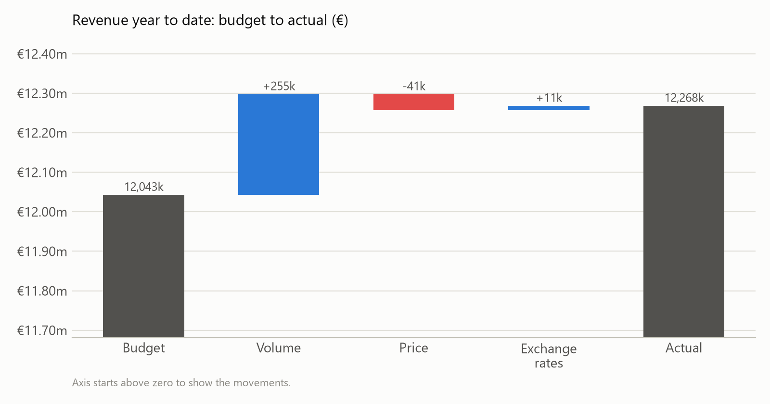
Revenue: volume, price and exchange rates
€k | Budget | Volume | Price | FX | Actual
EUR | 6,609 | 118 | (79) | 0 | 6,648
GBP | 2,326 | (80) | 0 | 15 | 2,261
USD | 3,108 | 217 | 39 | (4) | 3,359
Volume: extra seats at budget price and rate.
Price: price change on actual seats at budget rate.
Exchange rates: actual revenue at actual vs budget rate.
Example Software EMEA Ltd · simulated data for a portfolio project

Slide 5
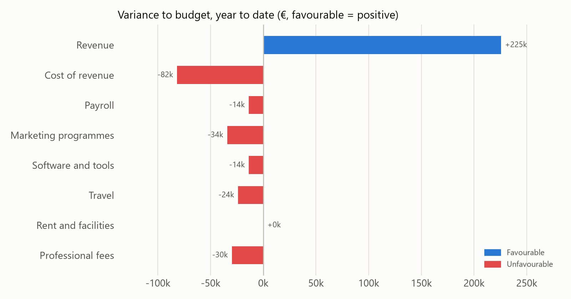
Costs and headcount
Payroll (€k) | Budget heads | Actual heads | Headcount effect | Cost per head effect | Variance
Customer Success | 14 | 14 | 0 | (12) | (12)
G&A | 11 | 11 | 0 | (12) | (12)
Marketing | 9 | 9 | 0 | (9) | (9)
R&D | 36 | 33 | 142 | (47) | 94
Sales | 24 | 25 | (47) | (28) | (75)
Heads at the latest month; effects are year to date.
Headcount effect: extra or missing heads at budget cost per head.
Cost per head effect: actual heads at actual vs budget cost per head.
Example Software EMEA Ltd · simulated data for a portfolio project

Slide 6
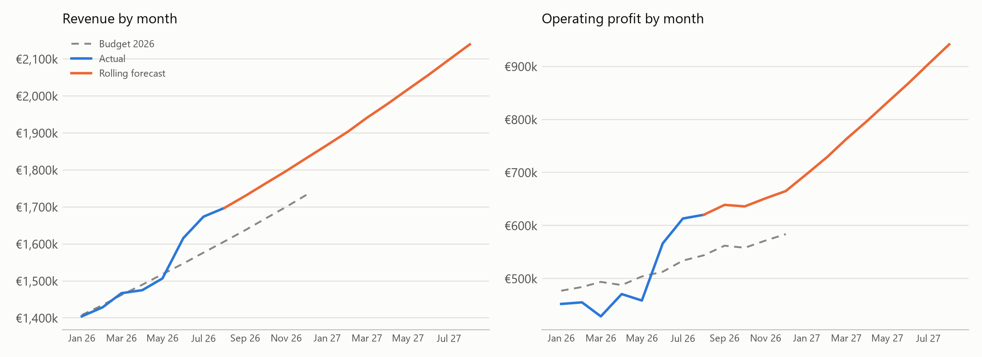
Rolling 12-month forecast
Full year (€k) | Latest estimate | Budget | Variance
Revenue | 19,390 | 18,781 | 609
Cost of revenue | (1,945) | (1,794) | (151)
Payroll | (8,694) | (8,701) | 7
Marketing programmes | (961) | (927) | (34)
Software and tools | (229) | (207) | (22)
Travel | (216) | (180) | (36)
Rent and facilities | (540) | (540) | 0
Professional fees | (150) | (120) | (30)
Operating profit | 6,656 | 6,312 | 344
Revenue: seats grow at the median of the last three monthly growth rates; price and FX held at the latest month. Payroll: latest heads plus budgeted hires, employer PRSI 11.40% from October. Other costs: last three months' average.
Example Software EMEA Ltd · simulated data for a portfolio project

Slide 7
Data checks
WARNING: Duplicate postings. 1 repeated posting removed: JE100157
WARNING: Missing cost centre. 1 line posted to UNALLOCATED: JE100156
Checks run before any numbers are reported:
• Duplicate transaction IDs (removed, warning)
• Missing cost centre (posted to UNALLOCATED, warning)
• Unknown cost centre, unmapped account, missing exchange rate (errors: the run stops)
Example Software EMEA Ltd · simulated data for a portfolio project

