Slide 1

MINESWEEPER
MINESWEEPER
A full-stack browser game with scoring, leaderboards, and player accounts
WEB
APPLICATION
Mohammad Shahria Faysal 242002056
Naeem Islam 242002069

Slide 2
INTRODUCTION
OVERVIEW
Minesweeper is a full-stack web application that reimagines the classic puzzle as a competitive, timed challenge. Players race a two-minute countdown to clear cells, avoid mines, and post the highest score possible.
Aa
FRONTEND
React + Vite single-page app
BACKEND
PHP REST-style API
DATABASE
MySQL
ACCOUNTS
Session-based authentication

Slide 3
HOW IT WORKS
CORE GAMEPLAY
01
02
03
REVEAL & FLAG
RACE THE CLOCK
CHOOSE DIFFICULTY
Uncover hidden cells or flag suspected mines. Numbered cells show how many mines are adjacent.
A two-minute countdown drives every round, keeping each game fast-paced and tense.
Beginner and advanced boards, plus optional hints when a player gets stuck.
GAME END CONDITIONS
The game ends when a mine is triggered or the timer reaches zero — all mines are then revealed automatically, and the game is recorded.
03

Slide 4
RULES OF THE GAME
SCORING SYSTEM
Scores reward both progress and survival — every completed game is recorded, with no separate win condition.
+10
+2
-50
PER CELL REVEALED
PER SECOND SURVIVED
PER HINT USED
04

Slide 5
ACCOUNTS
USER FEATURES
1
ACCOUNT REGISTRATION
4
PERSONAL PROFILE
New players sign up with a secure, dedicated account.
Each player has a profile showing their gameplay information.
2
SECURE LOGIN
5
LOGOUT
Session-based authentication with securely hashed passwords.
Players can safely end their session at any time.
3
PROTECTED PAGES
Gameplay and account pages are restricted to authenticated users.
05

Slide 6
TRACK YOUR PROGRESS
STATISTICS &
COMPETITION
DASHBOARD STATISTICS
A global leaderboard ranks the top scores, while every player keeps a personal game history broken out by difficulty.
HIGHEST SCORE
AVERAGE SCORE
LONGEST SURVIVAL TIME
MOST CELLS REVEALED
GLOBAL LEADERBOARD · PERSONAL HISTORY · DIFFICULTY TRACKING

Slide 7
INTERFACE
USER EXPERIENCE
RESPONSIVE INTERFACE
LIGHT & DARK THEMES
TOAST NOTIFICATIONS
Built with React for a smooth experience across screen sizes.
Players can switch between light and dark appearance.
Instant feedback for actions and errors as they happen.
RESULT MODAL
FULL NAVIGATION
A summary of the final score and game details after each round.
Move freely between game, dashboard, history, leaderboard, and profile.
07

Slide 8
UNDER THE HOOD
TECHNOLOGY
FRONTEND
React, Vite, React Router, CSS
BACKEND
PHP REST-style API
DATABASE
MySQL
AUTHENTICATION
PHP sessions with securely hashed passwords
DEVELOPMENT ENVIRONMENT
XAMPP-compatible PHP and MySQL setup
08

Slide 9
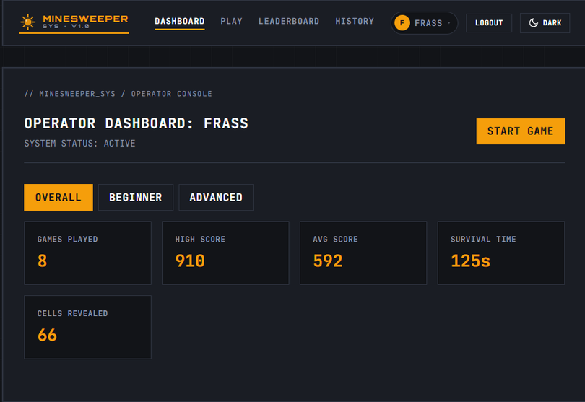
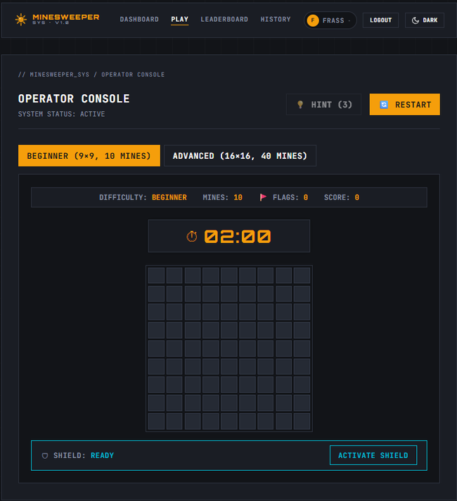
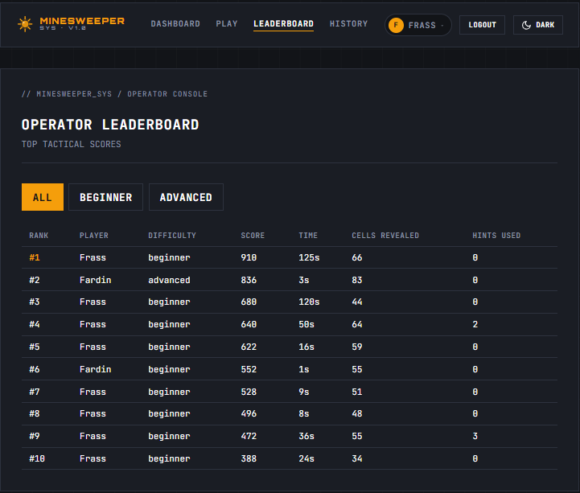
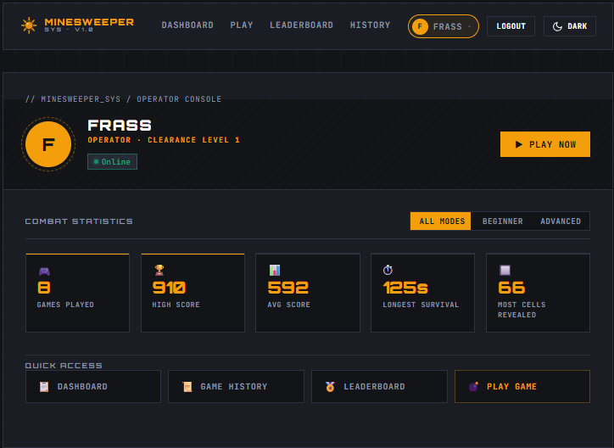
MINESWEEPER
GAMEPLAY

Slide 10
LET'S PLAY.
THANK YOU
Minesweeper — a full-stack game built with React, PHP, and MySQL.

