Slide 1
eGP: A Blockchain-based Tendering Technique
Presented By
Mahfujur Rahman
1607036
MD. Shahriar karim
1607051
Supervised by
Dr. M.m.a. hashem
Professor
Dept. of computer science and engineering
Khulna university of engineering & technology

Slide 2
Outline
Introduction
Objectives
Related Works
Proposed System
Implementation and Analysis
Limitations and Future Works
Conclusion
References

Slide 3
Introduction
Tenders are key parts of procurements for govt. projects and institutions.
Tendering system of Bangladesh is riddled with corruption and political influence.
Favoritism and lack of transparency and accountability main reasons for the situation.

Slide 4
Introduction : Problems
Data security is not guaranteed in the current system. Data leaks about the tendering process is common incident.
Sometimes tender specifications are changed midway to favor certain candidates.
Bid evaluation process is not transparent, so no way to be sure of its fairness.

Slide 5
Introduction : e-GP
e-GP is a govt. initiative for electronic tender system to facilitate simpler tendering using an electronic medium.
Provides a one stop web portal for all procurement related activities
Makes the tendering process much simpler from a user perspective
Does not provide guarantees for security of data or transactions
Can be improved by integrating concepts like blockchain

Slide 6
Introduction : Blockchain
Secure trustless transaction system based on distributed ledgers
Basis of cryptocurrencies and NFTs
Immutable, uses hash values and consensus system to keep free from tampering

Slide 7
Introduction : Ethereum
Application-based blockchain platform [1]
Uses concepts of smart contracts to facilitate application development in the blockchain
Smart contracts are pieces of self-running codes that can keep storage as well

Slide 8
Introduction
Objectives
Related Works
Proposed System
Implementation and Analysis
Limitations and Future Works
Conclusion
References

Slide 9
Objectives
To propose a blockchain-based tendering model
Data should be secure throughout the whole bidding process
Tender data cannot be changed midway
The tender evaluation process has to be transparent and visible
The proposed model has to comply with the laws

Slide 10
Introduction
Objectives
Related Works
Proposed System
Implementation and Analysis
Limitations and Future Works
Conclusion
References

Slide 11
Related Works
[2] Introduced blockchain based procurement system for the Open Government Partnership.
[3] Proposes a framework employing the concept of smart contracts to the public procurement process in South Africa.
[4] Presented about a blockchain-based smart contract prototype for a specific benefit process from the Syddjurs Municipality government in Denmark about the deployment of blockchain-based smart contracts for municipal government processes.

Slide 12
Introduction
Objectives
Related Works
Proposed System
Implementation and Analysis
Limitations and Future Works
Conclusion
References

Slide 13



Proposed System: Entities
Tendering Authority
Bidder
Evaluation Committee

Slide 14
Proposed System: Design
The tendering authority will open the tender by circulating the tender and adding the first block on the blockchain.
Bidders will see the specifications and submit appropriate bids for the tender through smart contracts.
The bids will be added as additional blocks of the blockchain.
Bidding will continue until meeting deadline.

Slide 15
Proposed System: Design
No one will be able to view data before deadline.
After deadline, the evaluation committee will receive access.
They will evaluate the bids according to the criteria.
They will select the best bid and add the best bid information to the blockchain.
The overall information of all the bids will be open for public viewing for transparency.

Slide 16

Initiation of the blockchain with the tender circular
Block 1
Addition of blocks by bid submissions
Block 2
Tendering
Authority
Bidder
Additional blocks keep adding until bidding deadline
Block n

Slide 17

Block 1
After deadline, evaluation committee gets access to the blockchain and evaluates the tender bids
And decides the winning bid
Block 2
Evaluation Committee
Winning bid
Block n
The winning bid gets added to the blockchain
Block n+1

Slide 18
Introduction
Objectives
Related Works
Proposed System
Implementation and Analysis
Limitations and Future Works
Conclusion
References

Slide 19
Implementation and Analysis
Prototyping of the proposed system was done in Ethereum platform
Smart contracts take input and keep storage
Tender circular as well as bid submissions are done through smart contracts
The prototype was tested in Rinkeby Ethereum Test Network
The simulation of the prototype was visualized using Remix platform

Slide 20
Implementation and Analysis (cont.)
Bidder Account
Deadline
Bid Value(s)
Maximum Bid
Submit Bid
Tender Smart Contract
Bid Smart Contract

Slide 21
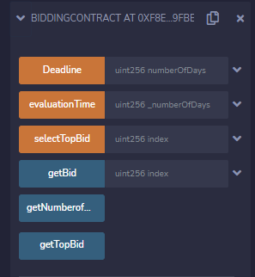
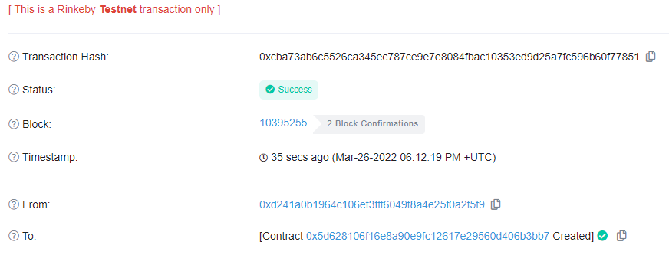
Implementation and Analysis (cont.)
Fig. 1: Tendering authority interface
Fig. 2: Deployment transaction details in Etherscan

Slide 22
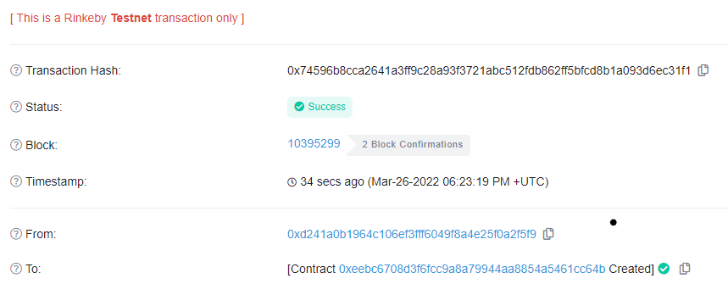
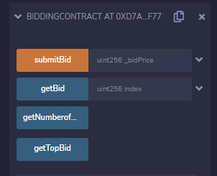
Implementation and Analysis (cont.)
Fig. 3: Bidder interface
Fig. 4: Bid submission transaction details in Etherscan

Slide 23
Implementation and Analysis (cont.)
Operation | Data Bits Used | Transaction Fee (Ether) | GAS Price (Ether)
Smart Contract Deployment | 768 | 0.001271492521869671 | 0.000000002500000043
Bid Submission | 512 | 0.00092981500371926 | 0.00000000250000001
Table 1: Ethereum cost analysis for key operations

Slide 24
Introduction
Objectives
Related Works
Proposed System
Implementation and Analysis
Limitations and Future Works
Conclusion
References

Slide 25
Limitations and Future Works
We prototyped the system but large scale integration for use with e-GP is a future potential development.
Future works can be done to optimize the Ethereum GAS cost analyzing it in larger implemantations.
The proposed system can be reformed in Ethereum 2.0 in the future for even better performance and functionalities.

Slide 26
Introduction
Objectives
Related Works
Proposed System
Implementation and Analysis
Limitations and Future Works
Conclusion
References

Slide 27
Conclusion
Devised a blockchain-based tendering technique for use in Bangladeshi context with e-GP
Prototyped and simulated a functional prototype based on the proposed system
This tendering system can prevent data tampering, provide security and ensure transparency

Slide 28
Introduction
Objectives
Related Works
Proposed System
Implementation and Analysis
Limitations and Future Works
Conclusion
References

Slide 29
References
[1] V. Buterin, Ethereum: A Next-Generation Smart Contract and Decentralized Application Platform, 2014.
[2] Fair and Transparent Blockchain based Tendering Framework - A Step Towards Open Governance Freya Sheer Hardwick, Raja Naeem Akram, and Konstantinos Markantonakis ISG-SCC, Royal Holloway, University of London, Egham, United Kingdom.
[3] Hardwick, F.S.; Akram, R.N.; Markantonakis, K. Fair and Transparent Blockchain based Tendering Framework—A Step Towards Open Governance. In Proceedings of the 17th IEEE International Conference onTrust, Security and Privacy in Computing and Communications (TrustCom), New York, NY, USA, 1–3 August 2018.
[4] Krogsboll, M.; Borre, L.H.; Slaats, T.; Debois, S. Smart Contracts for Government Processes: Case Study and Prototype Implementation. In Financial Cryptography and Data Security; Springer: Kota Kinabalu, Malaysia, 2020; pp. 676–684.

Slide 30
Thank you
Feel free to ask any questions

