Slide 1


American International University-Bangladesh
Machine Learning
Section: B
“A hybrid deep learning lung cancer detection model.”
Presented To:
DR. MOHAMMAD SAEF ULLAH MIAH
Associate Professor, Computer Science(AIUB)

Slide 2
1
Presented By
Serial No. | Name | ID
1 | MD. ALAMIN HOSSEN | 21-44943-2
2 | MD. SAD BIN SIDDIQUE | 21-45005-2
3 | SHAHRIAR HOSSEN | 22-46525-1
4 | F. M SHARIAR | 22-46532-1
AIUB | 2024

Slide 3
2
OVERVIEW
Introduction
Model Architecture
Literature Review
Model Implementation
Used Data Type
Model Optimization
Data Preparation
Result and Discussion
Model Algorithm Used
Conclusion
AIUB | 2024

Slide 4
3
INTRODUCTION
Lung cancer leads in global cancer-related deaths (~1.8M annually).
Late-stage diagnoses hinder treatment effectiveness.
Traditional methods (biopsy, CT scans) are invasive and prone to errors.
Develop and evaluate a hybrid deep learning model for lung cancer detection using CT scans.
Early and accurate detection improves treatment outcomes and reduces mortality.
Integrate CNNs with other architectures (RNNs, attention mechanisms) to enhance feature extraction and pattern identification.
Potential to enhance medical imaging and cancer diagnosis accuracy.
AIUB | 2024

Slide 5
4
LITERATURE REVIEW
1
Sreeprada & Vedavathi (OCNN-SVM): This model combines CNN for feature extraction with SVM for classification, achieving 98.7% accuracy on chest X-rays, and suggests using larger datasets for further improvement.
AIUB | 2024
Hegde et al.: A hybrid model using VGG-16 CNN and MSVM, along with NLM filtering, K-Means Clustering, and Genetic Algorithms, achieving 95% accuracy in lung cancer detection using CT scans.
2
3
Venkatesh et al.: The study combines CNN with K-Means Clustering and PSO to enhance segmentation and feature extraction, improving detection accuracy but facing computational challenges.

Slide 6
5
LITERATURE REVIEW
4
Tandon et al. (VCNet): VCNet integrates VGG-16 with CapsNet to address limitations in lung carcinoma detection, demonstrating superior accuracy and potential for early diagnosis.
AIUB | 2024
Sobur et al.: This hybrid model combines CNN with PCA for dimensionality reduction, achieving 99% accuracy by extracting fine and global features, improving diagnostic outcomes.
5
6
Bharati et al. (VDSNet): VDSNet combines VGG, data augmentation, and a spatial transformer network to tackle data imbalance and image variations, showing superior lung disease detection performance.

Slide 7
6
USED DATA
For our study on lung cancer detection and classification, we utilized a publicly available Chest CT Scan Dataset from Kaggle, created by Mohamed Hany. This dataset is structured to support machine learning models, particularly Convolutional Neural Networks (CNNs)
Key Details :
Cancer Types:
Adenocarcinoma (30% of lung cancers): Found in the outer lung regions.
Large Cell Carcinoma (10-15%): A fast-growing cancer spread across the lung.
Squamous Cell Carcinoma (30%): Located centrally in the lung, strongly linked to smoking.
Normal Scans: Included for comparison and training of the model.
Dataset Structure: Training Set (70%)Testing Set (20%)Validation Set (10%)
Image Format : PNG files (not DICOM).
AIUB | 2024

Slide 8
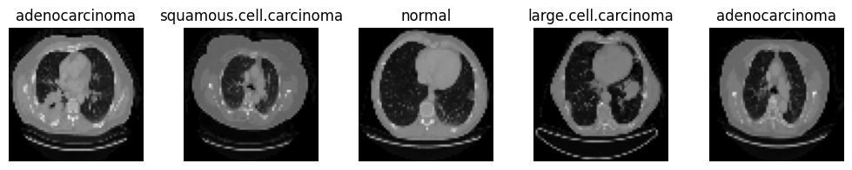
7
USED DATA TYPE
The dataset is preprocessed and cleaned to be compatible with CNN models, providing a reliable basis for classification and diagnostic model training. This structured setup facilitates efficient training, testing, and validation in lung cancer detection.
AIUB | 2024
Figure 1: CT scan images

Slide 9
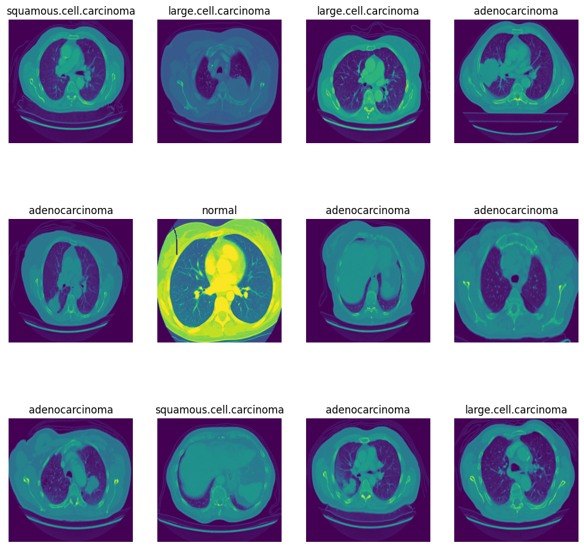
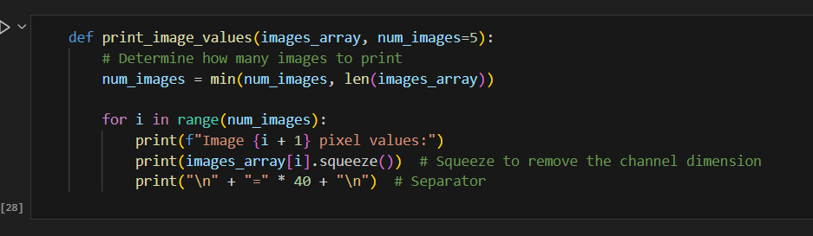
8
Data

Slide 10
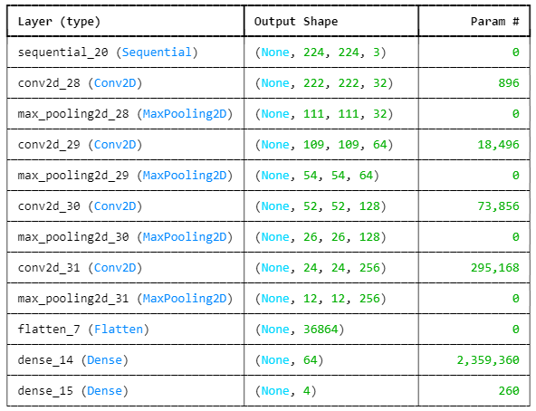
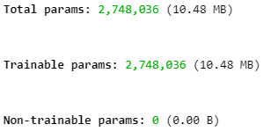
9
CNN Model for Bounding Box Regression on CT Scans
CNN model used:
CNNs (Convolutional Neural Networks) are designed for image data processing.
This model is used for bounding box regression, which identifies the location of a cancer in an image by predicting coordinates (xmin, ymin, xmax, ymax).
AIUB | 2024
Model Structure

Slide 11
10
CNN Architecture Overview
Layer Architecture Key Points:
Input Layer: The input is a grayscale CT scan image, resized to (224, 224, 1).
Convolutional Layers: The main feature extraction mechanism.
Conv2D Layer 1: 32 filters of size (3,3), ReLU activation function.
MaxPooling Layer 1: Reduces dimensions by pooling.
Conv2D Layer 2: 64 filters of size (3,3), ReLU activation function.
MaxPooling Layer 2: Reduces dimensions further.
Conv2D Layer 3: 128 filters of size (3,3), ReLU activation function.
MaxPooling Layer 3: Final reduction in dimensions.
Dense Layers: Fully connected layers to finalize bounding box predictions.
Flatten Layer: Converts the output of the convolution layers to a 1D vector.
Dense Layer: 512 neurons with ReLU activation.
Bounding Box Output Layer: Dense layer with 4 neurons to predict xmin, ymin, xmax, ymax.
AIUB | 2024

Slide 12
11
Data Preparation for model
Data Preparation:
Key Points:
X, y: Contains the image data and bounding box annotations.
Resizing Images: CT scan images are resized to (224, 224, 1) using TensorFlow's tf.image.resize().
Train-Test Split:
Data is split into training and testing sets using train_test_split().
80% for training and 20% for testing.
AIUB | 2024

Slide 13
12
Training Process
Key Points:
Optimizer: Adam optimizer is used for its adaptive learning rate.
Loss Function: Mean Squared Error (MSE) measures the difference between predicted and true bounding boxes.
Metrics: Mean Absolute Error (MAE) is also tracked during training to assess the model's performance.
Training Details:
Epochs: 10
Batch Size: 16 images per batch
Validation Data: The testing set is used to validate model performance after each epoch
AIUB | 2024

Slide 14
13
Model Summary
Key Points:
Input Layer: (None, 224, 224, 1)
Conv2D Layers: 32, 64, and 128 filters for extracting features.
MaxPooling Layers: Downsamples the feature maps.
Dense Layer: 512 neurons to process the flattened features.
Output Layer: Predicts the 4 bounding box coordinates.
AIUB | 2024

Slide 15
14
Loss and Accuracy
Key Points:
Loss Calculation:
MSE is used to calculate how far off the predicted bounding box coordinates are from the actual ones.
MAE (Mean Absolute Error):
Tracks how much the model's predictions deviate from the ground truth on average, a useful metric for evaluating performance during training.
AIUB | 2024

Slide 16
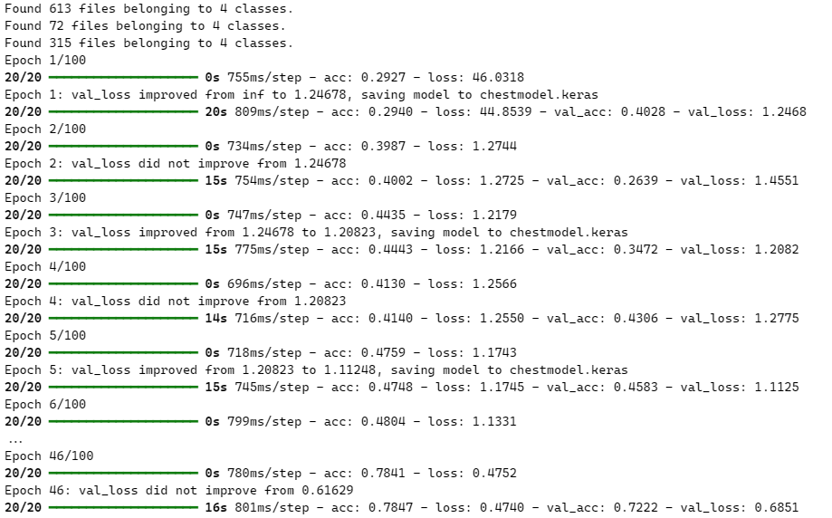
﻿RESULT & DISCUSSION
15
Training Finding
AIUB | 2024

Slide 17
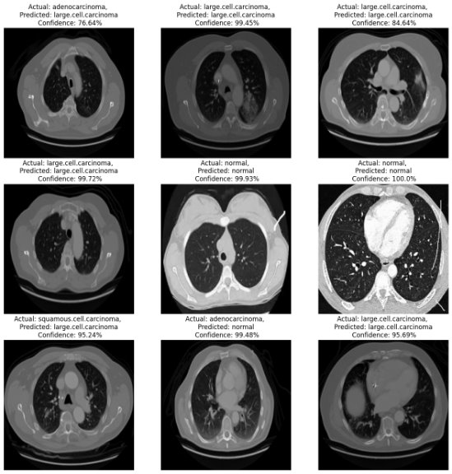
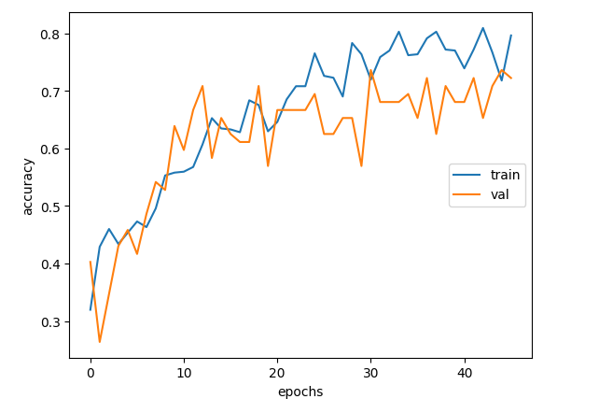
﻿RESULT & DISCUSSION
16
AIUB | 2024

Slide 18

17
CONCLUSION
In this study we developed a hybrid deep learning model that improves lung cancer detection using CT scans, combining CNNs with other architectures for better accuracy. The model shows potential for enhancing early diagnosis and reducing errors in medical imaging.
AIUB | 2024

Slide 19
THANK YOU

