Slide 1
Offensive Comment Detection from Bangla Text
Presented by
Tasmiyah Tisha – 170104033
Sadia Tasnim – 170104037
Shahriar Hasan Chowdhury – 170104030
Date: 30. 09. 2021

Slide 2
01
Introduction
02
Problem Statement
03
Literature Review
Overview
04
Strategy
05
Experimental Process
06
Result Analysis
07
Conclusion
08
Reference
2

Slide 3
introduction
Offensive comments in Social Media take place by attacking people based on their region, race, disability, gender, and so on.
Classifying the offensive comments can help out in detecting this bullying and monitor the whole process in preventing cyberbullying.
Our proposed approach is to build a classification model where the comments will be categorized by which proper action can be taken accordingly.
3

Slide 4
Problem Statement
The unfortunate consequences of Cyberbullying are enormous. So, it has to be prevented before the spreading of any kind of bullying is occurred.
Machine learning algorithm would enable us to develop effective detection of cyberbullying.
4

Slide 5
Literature Review
Reference Work | Training Data | Output Classes | Classification Algorithm | Performance/ Success
Social Media Bullying detection using machine learning on Bangla text[1] | 2400 Bangla text collected from Facebook and Twitter | 2 Classes: Bullied, non-bullied | 4 algorithms: SVM, NB, Decision Tree, KNN | Maximum accuracy : 97.27% (SVM)
An application of Machine Learning to Detect Abusive Bengali Text[2] | 2500 Facebook Comments | 2 classes : abusive and non-abusive | 6 Algorithms: RF, MNB, SVM (Linear), SVM(Polynomial), SVM (RBF), SVM (Sigmoid) | TF-IDF Vectorizer features with SVM linear kernel performs the best
5

Slide 6
Reference Work | Training Data | Output Classes | Classification Algorithm | Performance/ Success
Hateful Speech Detection in Public Facebook Pages for the Bengali Language [3] | 5126 comments from Facebook pages | 7 Classes : slang, religious hatred, personal attack, politically violated, antifeminism, positive and neutral | 6 algorithms: SVC, Linear SVC, NB, RF, Adaptive Boost, GRU Based Model | Maximum Accuracy: 70.10% with GRU based deep neural network.
Cyberbullying Classification using Text Mining[4] | 1600 conversation, and a total of 12,729 text data from www.kaggle.com | 2 classes, 4 classes, 11 classes | 5 algorithms: NB , SVM Linear, SVM Poly, SVM RBF, SVM Sigmoid, | For 2 classes: SVM-poly 99.41% For 4 classes: SVM-poly 97.81% For 11 classes: SVM-poly 94.12%
6

Slide 7
Reference Work | Training Data | Output Classes | Classification Algorithm | Performance/ Success
An Approach to Detect Abusive Bangla Text[5] | 300 comments from Facebook pages | 2 classes: abusive and not abusive | Root level algorithm (proposed) | Accuracy increases with data.
Bangla hate speech detection on social media using attention-based recurrent neural network [6] | 7425 Bengali comments from Facebook pages | Binary Class: abusive and non-abusive Multiclass: Five Classes | Three encoder–decoder-based models: LSTM, GRU | Maximum accuracy: 77% with attention-based decoder
7

Slide 8
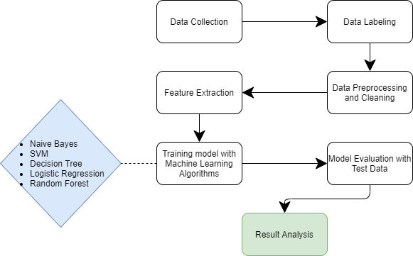
Strategy
8
Figure: Work Flow Diagram

Slide 9
Dataset
Data Collection:
- from GitHub [7]
Data Labeling:
- labeled 10219 comments
- divided them into two classes
- 2 classes: abusive,
and non-abusive
9

Slide 10
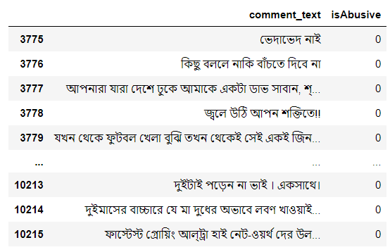
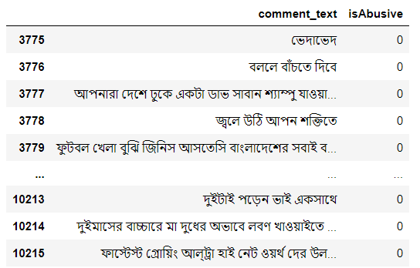
Data Preprocessing and Cleaning:
- tag, mention and link
removal
- stop word and punctuation
removal
- tokenization
Feature Extraction:
Processed the text to feature vector,
- Document Frequency (TF-IDF)
- Count Vectorizer
10
Fig: Before Preprocessing
Fig: After Preprocessing

Slide 11
Experimental Process
Training the Machine Learning models
11

Slide 12
Support Vector Machine
A supervised machine learning model that uses classification algorithms for two group classification problems.
We used SVC RBF Kernel function to train our model that represents the similarity of training samples in a feature.
Using SVC RBF kernel we got 83.099% accuracy and the f1-score was 88.997%.
12

Slide 13
Decision tree
Decision tree creates a training model that predicts class or value of the target variable.
It builds a classification model in the form of a tree structure by breaking down the dataset into smaller and smaller subsets.
This classifier gave 75.005% accuracy and the f1-score was 83.489%.
13

Slide 14
Naïve Bayes
A probabilistic classifier that helps in building the fast machine learning models which can make quick predictions.
We used Multinomial Naïve Bayes classifier to train our model as it is suitable for classification with word counts for text classification.
We got 76.112% accuracy for Binary classification and the f1-score was 82.793%.
14

Slide 15
Random Forest
A machine learning technique that utilizes ensemble learning, that combines many classifiers to provide solutions to complex problems.
It consists of many decision trees and we used 100 depth for our model.
Using this algorithm, we got 79.086% accuracy and the f1-score was 86.154%.
15

Slide 16
Logistic Regression
A classification algorithm which is used when the value of the target variable is categorical in nature.
We used logistic regression as the output of our model gives discrete values for given set of inputs.
This classifier gave 79.135% accuracy and f1-score was 86.463%.
16

Slide 17
Result Analysis
Performances of different model
17

Slide 18
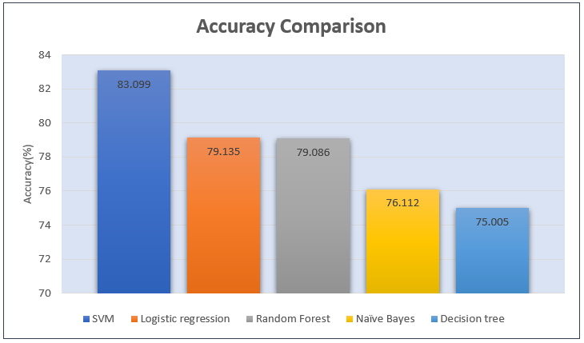
Accuracy Comparison of the models
Comparison of different ML models where SVM gives the highest accuracy for the binary classification.
18

Slide 19
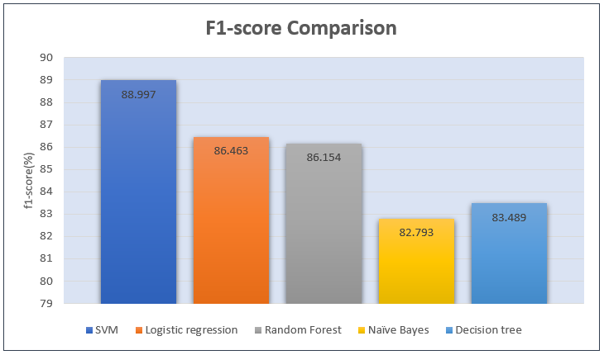
F1-Score Comparison of the models
Comparison of different ML models where SVM has the highest f1-score for the binary classification.
19

Slide 20
Overall Model Performance
 | Accuracy | Precision | Recall | F1-score
SVC (RBF) | 83.099% | 96.776% | 83.099% | 88.997%
Decision Tree | 75.005% | 95.416% | 75.005% | 83.489%
Random Forest | 79.086% | 96.013% | 79.086% | 86.154%
Naïve Bayes | 76.112% | 96.049% | 76.112% | 82.793%
Logistic Regression | 79.135% | 96.51% | 79.135% | 86.463%
20

Slide 21
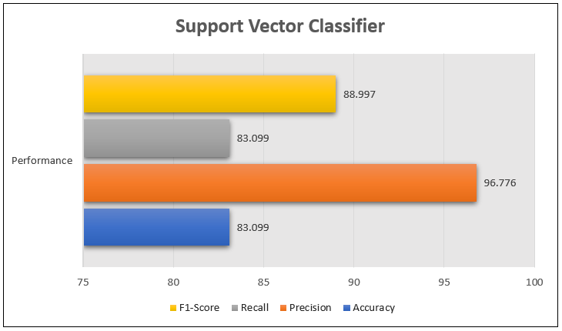
Performance of SVM
Graphical representation of the percentages of Accuracy, Precision,
F1-score, and Recall for Long Short-term Memory.
21

Slide 22
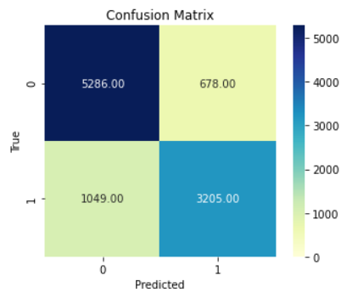
Confusion Matrix of SVM
22

Slide 23

Future Work
Applying multiclass classification.
Also, we are pointing our target to severity measurement for offensive comments.
With the high performing model, we would try to develop an application.
23

Slide 24
Conclusion
Classification of offensive Bangla comments can help to categorize the bullying occurrence and monitor the process to prevent cyberbullying.
24

Slide 25
References
AKHTER, S., ET AL. Social media bullying detection using machine learning on bangla text. In 2018 10th International Conference on Electrical and Computer Engineering(ICECE) (2018), IEEE, pp. 385–388.
ESHAN, S. C., AND HASAN, M. S. An application of machine learning to detect abusive bengali text. In 2017 20th International Conference of Computer and Information Technology (ICCIT) (2017), IEEE, pp. 1–6.
ISHMAM, A. M., AND SHARMIN, S. Hateful speech detection in public facebook pages for the bengali language. In 2019 18th IEEE International Conference On Machine Learning and Applications (ICMLA) (2019), IEEE, pp. 555–560.
ISA, S. M., ASHIANTI, L., ET AL. Cyberbullying classification using text mining. In 2017 1st International Conference on Informatics and Computational Sciences (ICICoS) (2017), IEEE, pp. 241–246.
25

Slide 26
References
HUSSAIN, M. G., AL MAHMUD, T., AND AKTHAR, W. An approach to detect abusive bangla text. In 2018 International Conference on Innovation in Engineering and Technology (ICIET) (2018), IEEE, pp. 1–5.
DAS, A. K., AL ASIF, A., PAUL, A., AND HOSSAIN, M. N. Bangla hate speech detection on social media using attention-based recurrent neural network. Journal of Intelligent Systems 30, 1 (2021), 578–591.
GitHub-aimansnigdha/Bangla-Abusive-Comment-Dataset. https://github.com/aimansnigdha/Bangla-Abusive-Comment-Dataset. Accessed: Feb 22, 2021.
26

Slide 27
Thank You

