Slide 1
CHARLES
DARWIN
UNIVERSITY
FIFA WORLD CUP 2026 — DATA SCIENCE PROJECT
Objective 1 & Objective 2 — Key Findings
Presented By — Md Shahriar Islam
Student ID — S400228
Campus —Sydney
Assessment 2 — Group Project Presentation · Data source: CC0 FIFA World Cup 2026 dataset (GitHub)
Notes:
(~10s) Hi, I'm [Name], student ID [XXXXXXX], CDU Sydney. This is my part of the group's Objective 1 and Objective 2 analysis on the FIFA World Cup 2026 dataset.

Slide 2
CHARLES
DARWIN
UNIVERSITY
METHODOLOGY
1. Approach & Data
Six analyses, one CC0-licensed public dataset: four hypothesis tests (Objective 1) and two pre-match linear regression models (Objective 2). Every sample uses a fixed seed (random_state = 42) for full reproducibility.
# | Task | Method
1 | Market value — FWD vs DEF | Two-sample t-test
2 | Experience — UEFA vs benchmark | One-sample t-test
3 | Possession — Win vs Loss | Two-sample t-test
4 | Age — GK vs Outfield | Two-sample t-test
5 | Regression — Goal difference | OLS, 8 pre-match features
6 | Regression — Team goals | OLS, 8 pre-match features
Data: teams (48×8), players (1248×10), matches (104×17), team-match stats (208×12).
2
Notes:
(~20s) All six analyses share one wrangling-sampling-testing pipeline on the CC0 FIFA World Cup 2026 dataset — four hypothesis tests and two pre-match regression models.

Slide 3
CHARLES
DARWIN
UNIVERSITY
FROM THE NOTEBOOK
2. The Six Questions We Answered
1
On average, do forwards (FWD) have a significantly different market value than defenders (DEF)?
5
Can a match's goal difference be predicted from 8 pre-match-only variables (rankings, squad value, host status, stage)?
TWO-SAMPLE T-TEST
OLS REGRESSION
2
Do UEFA (European) players average significantly more international caps than the non-UEFA benchmark?
6
Can a team's goals scored in a match be predicted from 8 pre-match-only variables?
ONE-SAMPLE T-TEST
OLS REGRESSION
Did teams that won their match have significantly higher ball possession than teams that lost?
Every variable used in Objective 2 is known before kickoff — no in-match data (shots, possession, cards) ever enters the regression.
3
TWO-SAMPLE T-TEST
4
Are goalkeepers significantly older, on average, than outfield players?
TWO-SAMPLE T-TEST
3
Notes:
(~25s) These are the exact six questions solved in the notebook: four hypothesis tests on player and match data, and two regressions predicting match outcomes from pre-match information only.

Slide 4
CHARLES
DARWIN
UNIVERSITY
OBJECTIVE 1 — RESULTS
3. Four Hypothesis Tests, One Real Signal
Task | Comparison | p-value | Verdict
1 | Market value: FWD vs DEF | p = 0.3356 | Not significant
2 | UEFA caps vs benchmark | p = 0.2304 | Not significant
3 | Possession: Win vs Loss | p < 0.0001 | Significant
4 | GK age vs outfield age | p = 0.3503 | Not significant
ONLY ONE SIGNIFICANT RESULT
Task 3 — possession vs match outcome — was the only rejected H0. A well-formed question doesn't guarantee significance, and that's honest science.
Welch's t-test (unequal variances) was used throughout, since none of the compared groups had equal variances.
One-tailed tests were used only where domain knowledge gave a specific expected direction (Tasks 3 & 4).
4
Notes:
(~25s) Of the four Objective 1 tests, only possession vs match outcome came back significant. The other three — market value, caps, age — showed no significant difference, which is still a valid finding.

Slide 5
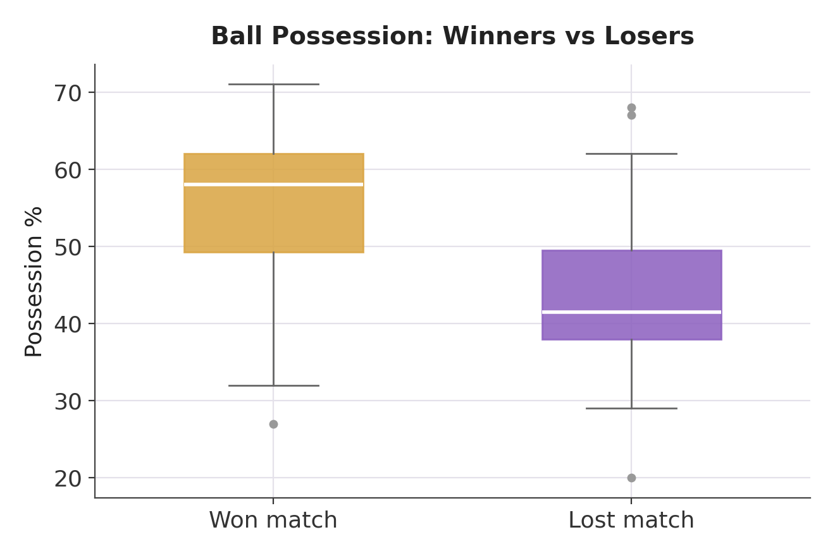
CHARLES
DARWIN
UNIVERSITY
HEADLINE FINDING — TASK 3
4. Possession Wins Matches
TWO-SAMPLE WELCH T-TEST (ONE-TAILED)
t = 4.400 p < 0.0001
Winning teams: 55.27% possession (n = 30) vs losing teams: 43.27% (n = 30)
95% CI for winners' mean possession: 51.33% – 59.21%
H1: μWin > μLoss — winning teams have higher mean possession
REJECT H0 — SIGNIFICANT
TAKEAWAY: Winning teams averaged 12.0 possession points more than losing teams — the one Objective 1 result with statistically significant evidence.
5
Notes:
(~30s) Winning teams averaged 55.3% possession vs 43.3% for losing teams — a statistically significant gap with p under 0.0001. This is the strongest, most defensible finding in Objective 1.

Slide 6
CHARLES
DARWIN
UNIVERSITY
OBJECTIVE 2 — REGRESSION MODELS
5. Predicting Outcomes From Pre-Match Data Only
Both models use only information known before kickoff — Elo/FIFA rankings, squad value, caps, age, host status, and stage. Never anything derived from in-match events.
Regression 2.1 — Goal Difference
Regression 2.2 — Team Goals
n = 104 · 8 pre-match features · OLS
n = 208 · 8 pre-match features · OLS
R² = 0.491
Adjusted R² = 0.448
R² = 0.268
Adjusted R² = 0.239
5-fold CV R² = 0.328 · MAE = 1.23 goals
Strongest predictor: elo_diff
5-fold CV R² = 0.163 · MAE = 0.95 goals
Strongest predictor: opponent_elo_rating
Cross-validated R² is realistically modest — sporting outcomes are genuinely uncertain, and this model never leaks in-match information.
6
Notes:
(~30s) Both regressions used only pre-match features. Goal difference reached a cross-validated R² of about 0.33; team goals about 0.16 — modest but honest, since football outcomes are inherently noisy.

Slide 7
CHARLES
DARWIN
UNIVERSITY
Conclusion & Limitations
Of four Objective 1 hypotheses, only possession vs match outcome was statistically significant — a legitimate, honest mixed result.
Both Objective 2 models achieved a moderate, defensible fit using only pre-match information (goal difference CV R² ≈ 0.33; team goals CV R² ≈ 0.16).
Limitations: samples of 30–50 per group cannot capture every outlier; single-match goals are a noisy, discrete outcome that a linear model can only approximate.
7
Notes:
(~25s) In short: one honest significant finding, two realistic regression models, and full reproducibility from one CC0-licensed dataset.

Slide 8
CHARLES
DARWIN
UNIVERSITY
Thank You
Questions & Discussion
FIFA World Cup 2026 — Objective 1 & Objective 2 · Assessment 2 — Group Project Presentation
Notes:
(~5s) Thank you — happy to take questions.

