Slide 1
Can we identify
customers likely
to leave?
Predicting telecommunications customer churn
Logistic Regression vs Random Forest
IBM sample dataset • 7,043 customers • 21 raw columns
Shahriar Kamal | October 2026
Primary evaluation metric: churn-class F1-score
RESEARCH PRACTICE / ASSIGNMENT 2
PROBLEM 01 / 07

Slide 2
WHY THIS RESEARCH MATTERS
Predicting churn is not the same as preventing it
Prior research motivates a fair comparison of a simple model and an ensemble.
The challenge
What research suggests
Our question
Only 26.54% of the customers churned. An accuracy-only metric can conceal failure to identify those customers.
Random Forest and feature engineering can capture complex patterns; handling class imbalance and business costs also matters.
Does Random Forest improve F1-score and ROC-AUC compared with Logistic Regression on the same dataset and hold-out test?
Literature: Ullah et al. (2019) • Wu et al. (2021) • Xu et al. (2021) • Manzoor et al. (2024)
RESEARCH PRACTICE / ASSIGNMENT 2
PROBLEM 02 / 07

Slide 3
EXPERIMENTAL DESIGN
One held-out test. Two classifiers.
A comparable pipeline based on the original methodology and notebook.
01
02
03
04
Raw data
Prepare data
Engineer features
Fit & compare
→
→
→
7,043 customers
Churn: Yes / No
11 blank charges → 0
One-hot categories
Tenure cohort
Services count
Charge difference
Stratified 80/20
Balanced classes
Logistic Regression • baseline
Random Forest • 300 trees
Training n = 5,634 • Test n = 1,409 • Stratified split, random_state = 42
RESEARCH PRACTICE / ASSIGNMENT 2
METHOD 03 / 07

Slide 4
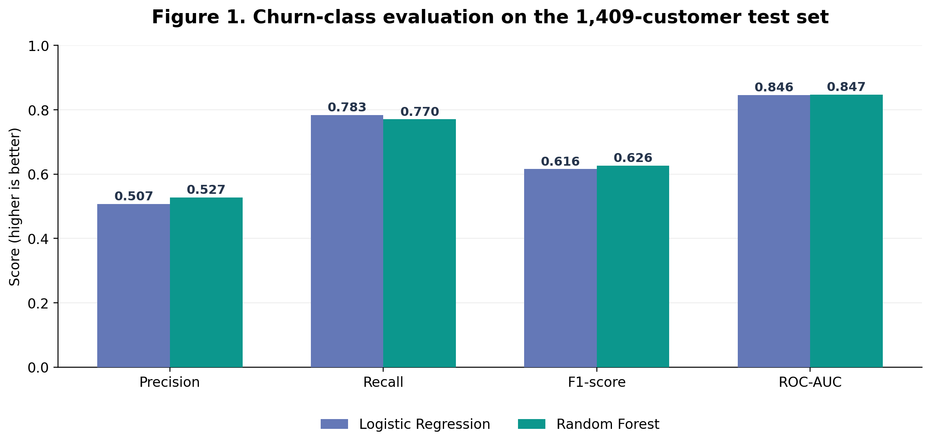
MODEL COMPARISON
Random Forest has a small edge in F1
Test-set metrics for the positive class: Churn = 1
+0.0106
F1 gain
+0.0010
ROC-AUC gain
RESEARCH PRACTICE / ASSIGNMENT 2
RESULTS 04 / 07

Slide 5
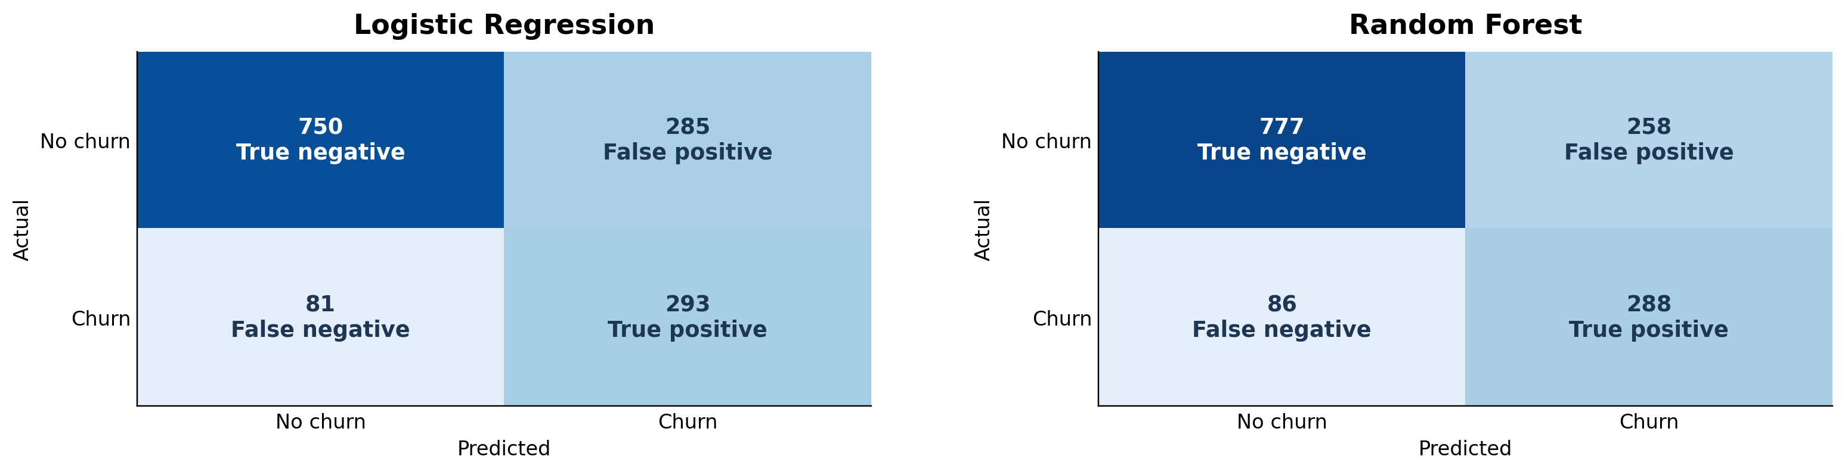
CONFUSION MATRICES
Fewer false alarms, but more churners missed
Comparing what each model actually classified at the default threshold.
Random Forest: 27 fewer false positives (258 vs 285), but 5 more false negatives (86 vs 81).
RESEARCH PRACTICE / ASSIGNMENT 2
RESULTS 05 / 07

Slide 6
INTERPRETATION
The best model depends on the cost of mistakes
A 0.0106 F1 gain is useful to report, but not grounds for deployment by itself.
Business takeaway
Limits of this result
Random Forest flags fewer customers unnecessarily. Logistic Regression catches more actual churners.
One train/test split, fictional sample data, no cross-validation, and no cost-aware threshold study.
NEXT STEP
Validate on repeated splits • test feature ablations • optimize thresholds using retention costs
RESEARCH PRACTICE / ASSIGNMENT 2
TAKEAWAY 06 / 07

Slide 7
EVIDENCE BASE
Peer-reviewed sources and project files
The cited literature is consistent with the original literature-review topics.
Ullah et al. (2019), IEEE Access. DOI: 10.1109/ACCESS.2019.2914999
Wu et al. (2021), IEEE Access. DOI: 10.1109/ACCESS.2021.3073776
Xu et al. (2021), Applied Sciences. DOI: 10.3390/app11114742
Alotaibi & Haq (2024), ETASR. DOI: 10.48084/etasr.7480
Manzoor et al. (2024), IEEE Access. DOI: 10.1109/ACCESS.2024.3402092
Full APA 7 reference list: paper.md | Zotero import: references.ris
RESEARCH PRACTICE / ASSIGNMENT 2
REFERENCES 07 / 07

