Slide 1
DELTA AIR LINES | FP&A CASE STUDY
Revenue, Cost &
Operating Margin Forecasting
FY2021–FY2025 reported actuals · FY2026–FY2028 illustrative scenarios
Shahriar Molhem
BBA Finance Student | University of Georgia
Source: publicly filed SEC financial statements
Independent undergraduate finance portfolio
UNIVERSITY OF GEORGIA · BBA FINANCE
01
Notes:
Hi, I'm Shahriar Molhem, a finance student at the University of Georgia. In this project, I analyzed Delta Air Lines using publicly reported financial statements and operating statistics. My goal was to understand how passenger demand, airline capacity, fuel, and labor costs influence operating profitability. I then used a simplified Excel planning model to test hypothetical outcomes. This is an undergraduate case study—not Delta's internal budget or a professional forecast.

Slide 2
Three Questions for an FP&A Analyst
01 PERFORMANCE
What changed in revenue, GAAP costs, and operating profit from 2021 to 2025?
02 DRIVERS
Which reported revenue and expense line items explain the 2024 to 2025 EBIT bridge?
03 SCENARIOS
How could capacity, passenger yield, fuel price, and unit costs change illustrative 2026–2028 EBIT?
Actuals: SEC 10-Ks | Forecasts: independent student assumptions, not Delta guidance
Research objective
UNIVERSITY OF GEORGIA · BBA FINANCE
02
Notes:
I organized my work around three questions. First, how did Delta's revenue and operating profit change across five years? Second, which reported cost categories contributed to the change in operating income from 2024 to 2025? Third, how might changes in capacity, passenger revenue per available seat mile, fuel prices, and unit costs affect a hypothetical future operating plan? I used public SEC filings for the historical facts, then labeled all future scenarios as independent assumptions.

Slide 3
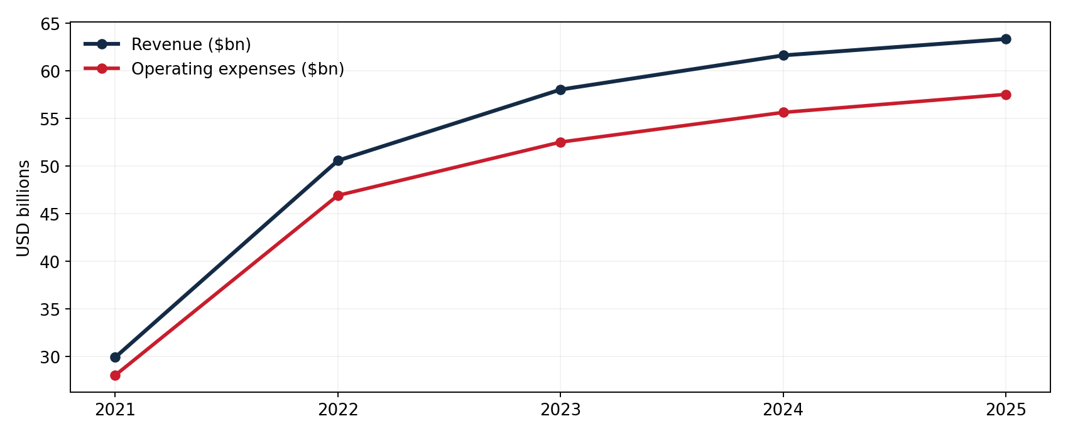
Five Years of Reported Financial Performance
2025 REVENUE
$63.36B
FY2021: $29.90B
2025 EXPENSES
$57.54B
FY2021: $28.01B
Source: Delta FY2023 10-K p.59 and FY2025 10-K p.56; 2021 includes pandemic-era government grant credits
SEC GAAP actuals · USD billions
UNIVERSITY OF GEORGIA · BBA FINANCE
03
Notes:
The first chart shows consolidated revenue and operating expenses between 2021 and 2025. Revenue increased from about 29.9 billion dollars in 2021 to 63.4 billion in 2025. However, I would be cautious with a straight five-year comparison because 2021 was heavily affected by the pandemic and Delta recognized government grant support as a reduction to operating expenses. For a more relevant operating discussion, I place extra emphasis on the 2024-to-2025 change.

Slide 4
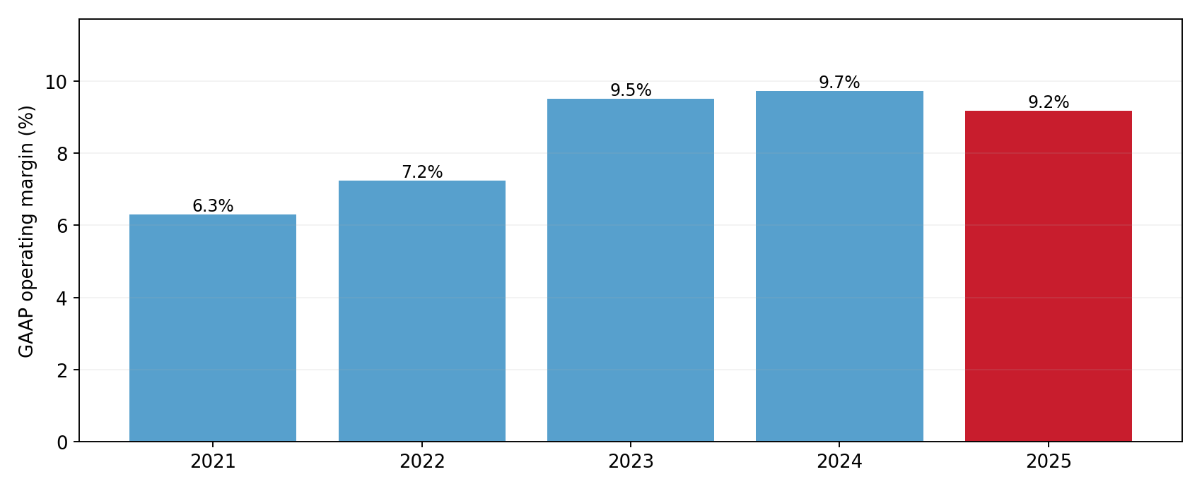
Revenue Increased; Operating Margin Softened
2024 MARGIN
9.73%
2025 MARGIN
9.19%
Margin = GAAP operating income / GAAP revenue; source: 2025 SEC 10-K p.56
Comparative GAAP margins
UNIVERSITY OF GEORGIA · BBA FINANCE
04
Notes:
Delta's operating revenue increased by about 2.8 percent in 2025, but GAAP operating income declined by 173 million dollars. Its operating margin decreased from 9.7 percent to 9.2 percent. This tells me that revenue growth alone isn't sufficient evidence of improved performance. In a real FP&A role, I would want to understand whether the cost structure is changing faster than revenue, and which cost categories management should monitor most closely.

Slide 5
Operating Income Bridge | FY2024 → FY2025
2024 EBIT
Passenger revenue
Cargo + other revenue
Salaries
Fuel cost savings
Other costs
2025 EBIT
$5,995m
$874m
$847m
−$1,359m
$747m
−$1,282m
$5,822m
GAAP RECONCILIATION
FY2024 operating income + revenue changes − expense changes = FY2025 operating income. Check difference = $0m.
Sources: FY2025 10-K Consolidated Statements of Operations, p.56; units $ million
Arithmetic reconciliation, not causal attribution
UNIVERSITY OF GEORGIA · BBA FINANCE
05
Notes:
This operating-profit bridge reconciles reported figures directly. We start with 5 billion, 995 million dollars in 2024 operating income. Passenger revenue contributed 874 million dollars of growth, cargo added 78 million, and other revenue increased by 769 million. On the cost side, higher salaries and related costs reduced operating income by 1 billion, 359 million. Lower fuel expenses added 747 million back, while other operating costs rose by 1 billion, 282 million. The bridge arrives at 5 billion, 822 million in 2025, exactly matching the 10-K. These are accounting contributions, not proof of the underlying causes.

Slide 6
Fuel Expense: Price and Volume Matter Separately
FUEL GALLONS
REPORTED FUEL COST
REPORTED PRICE
4,114m → 4,269m
+3.8% volume
$10.57B → $9.82B
$747m decrease
~$2.57 → ~$2.30
per gallon, rounded
Price effect + volume effect = −$747 million
Calculated using implied unrounded cost per gallon = GAAP fuel expense / gallons consumed.
Source: Delta FY2025 SEC 10-K pp.11 and 56; decomposition is mathematical, not proof of causation
FY2024 → FY2025 source-backed decomposition
UNIVERSITY OF GEORGIA · BBA FINANCE
06
Notes:
Fuel is a major operating driver. In 2025 Delta's gallons consumed actually increased, from 4.114 billion to 4.269 billion gallons. But total fuel expense fell by 747 million dollars. I separated this change into a price effect and a volume effect using fuel expense divided by reported gallons, rather than the rounded price disclosed in the report. The lower implied cost per gallon more than offset increased fuel consumption. This decomposition is useful for planning, though it doesn't fully explain refinery, hedging, or market conditions.

Slide 7
Build an Operating Plan From Drivers
Driver
2026E
2027E
2028E
Capacity (ASM)
3.0%
3.0%
2.8%
Passenger yield / ASM
0.5%
1.0%
1.0%
Cargo revenue growth
3.0%
3.0%
3.0%
Other revenue growth
4.0%
4.0%
4.0%
Fuel efficiency gain
0.5%
0.5%
0.5%
Fuel price inflation
0.0%
2.0%
2.0%
Labor cost/ASM inflation
3.0%
3.0%
3.0%
Other cost/ASM inflation
2.0%
2.0%
2.0%
All figures shown above are independent student assumptions, not official Delta guidance or internal budget
2026–2028 illustrative planning assumptions
UNIVERSITY OF GEORGIA · BBA FINANCE
07
Notes:
After reviewing actual results, I built a three-year student planning scenario. Starting from 2025, the model separately forecasts available seat miles, passenger revenue per seat mile, cargo and other revenue, fuel gallons, fuel cost per gallon, and operating costs per available seat mile. For example, the 2026 assumptions include three percent capacity growth, half a percent growth in passenger yield, and three percent growth in unit labor costs. These are my hypothetical inputs. They're not management guidance, and I'm not claiming this reflects actual developments in 2026.

Slide 8
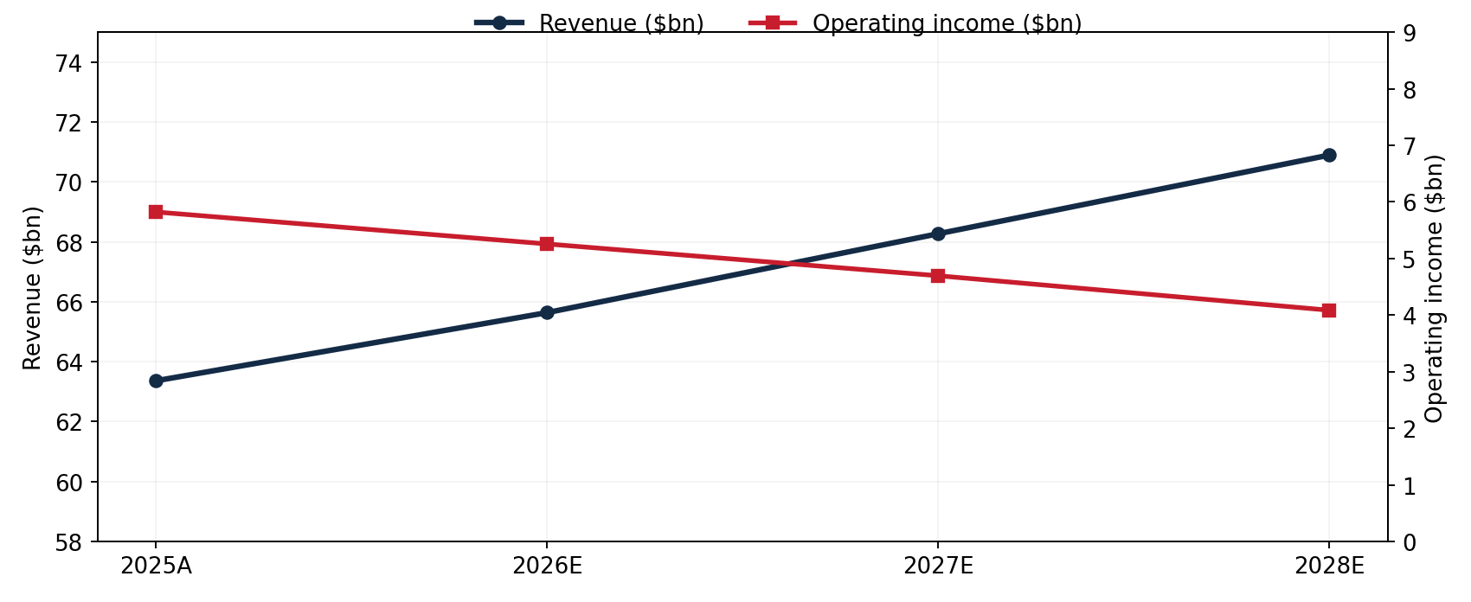
Hypothetical Scenario: Revenues Grow, EBIT Falls
2026E EBIT
$5.26B
8.0% operating margin
MAIN QUESTION
Can passenger yield cover unit-cost inflation?
FY2025 actual from SEC Form 10-K; 2026E–2028E hypothetical what-if calculations, NOT guidance
FY2025 actual → FY2026–FY2028 student planning case
UNIVERSITY OF GEORGIA · BBA FINANCE
08
Notes:
Under this particular set of assumptions, 2026 operating revenue reaches about 65.6 billion dollars, while projected operating income is approximately 5.26 billion, representing an 8.0 percent operating margin. Revenue continues growing in the later forecast years, but labor and other unit-cost inflation outpace passenger yield improvements, so the model's operating margin declines. This isn't a claim about Delta's actual financial outlook. It is a cost-pressure stress case showing why FP&A should monitor revenue and unit economics together.

Slide 9
2026 EBIT Sensitivity | Fuel Price × Yield
Column: passenger-yield shock
-4%
-2%
0%
+2%
+4%
-20% fuel
5,126
6,198
7,270
8,342
9,413
-10% fuel
4,120
5,192
6,264
7,335
8,407
0% fuel
3,114
4,185
5,257
6,329
7,401
+10% fuel
2,107
3,179
4,251
5,323
6,394
+20% fuel
1,101
2,173
3,245
4,316
5,388
Center = $5,257m EBIT · +10% fuel ≈ −$1.0B · +1% passenger yield ≈ +$536m
Source: student financial model, hold all other operating drivers constant; no probabilistic interpretation
Standalone one-year profit what-if · USD millions
UNIVERSITY OF GEORGIA · BBA FINANCE
09
Notes:
For sensitivity analysis I changed two variables independently: passenger yield and fuel price. Holding all other assumptions constant, a ten percent increase in modeled fuel price reduces 2026 EBIT by roughly 1.01 billion dollars. A one percent improvement in passenger revenue per available seat mile adds approximately 536 million dollars of operating income. The point isn't that the company can simply increase ticket prices without consequences. In reality, demand, competition, and capacity responses matter. This is a what-if tool to make financial exposure visible.

Slide 10
Takeaways for a Finance / FP&A Internship
01 SOURCE DISCIPLINE
Five years of GAAP data reconciled; key airline KPIs linked to SEC filings.
02 DRIVER THINKING
Capacity, passenger yield, labor, and fuel must be modeled separately.
03 REASONED LIMITATIONS
2021 pandemic grants; refinery mix; forecast assumptions; no internal data.
Thank you. I would be glad to walk through the assumptions and Excel model.
Independent BBA Finance student work · No audit assurance or Delta endorsement
Lessons, integrity and limitations
UNIVERSITY OF GEORGIA · BBA FINANCE
10
Notes:
My main takeaway is that airline profitability depends on the relationship between capacity, passenger yield, fuel costs, and other unit expenses. I used SEC data to build a reconciled operating-profit bridge and an Excel model with editable assumptions. I also learned to be careful about historical comparisons, particularly 2021 government support and Delta's refinery and other businesses. This analysis doesn't use internal budget data or estimate a current stock price. It demonstrates the operating and financial reasoning I want to build on in a finance or FP&A internship. Thank you.

