Slide 1
Machine Learning Presentation FACULTY: DR. M M MANJURUL ISLAM SEC: [B] Topic: Bangla Text Sentiment Analysis Using Supervised Machine Learning
Group Members ID
Syeda Faiza Karima 20-43073-1
Abdullah Al Mahdi 20-43084-1
Muhammad Shahriar Zaman 20-41840-1
Muhammad Rafid Rahman 20-42801-1

Slide 2
Introduction
PROBLEM DEFINITION: A rule-based algorithm of Bangla Text Sentiment Score (BTSC) is developed for detecting sentence polarity which provides the better sentiment extraction by giving a score from a chunk of Bangla text.
To determine these data with sentiment as a polarity, i.e., positive, negative, or neutral class, machine learning framework has acquired significant interest with the help of N-grams model.
Sentiment analysis (SA), also called opinion mining is a field of
study that predicts polarity in public opinion or textual data from
microblogging sites [1] on a well-publicized topic by extracting people emotions, attitudes, emotions, etc.

Slide 3
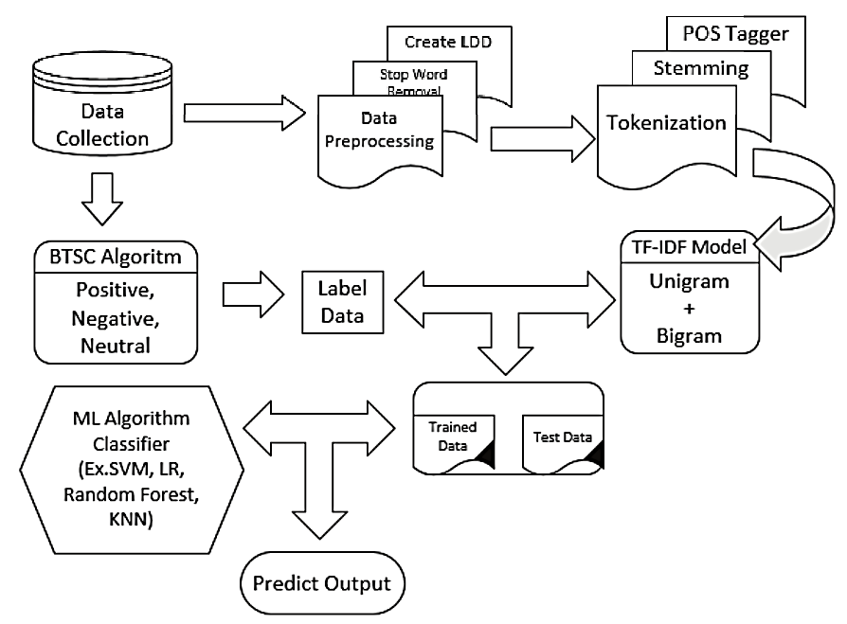
Methodology
PROPOSED SYSTEM ARCHITECTURE
Constructing a specific domain-based categorical weighted LDD
Develop a novel and effective rule-based algorithm for detecting sentence polarity classification
Investigate the feature matrix with the target dataset and evaluate

Slide 4
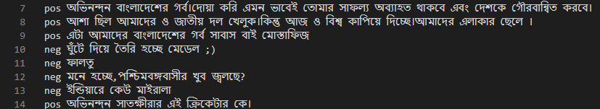
Data Preprocessing
Fig: Target Dataset
We can notice that our raw dataset is poorly arranged and the columns aren’t clearly separated, so we shall perform preprocessing on this to make it suitable for usage.
DATASET PREPROCESSING

Slide 5
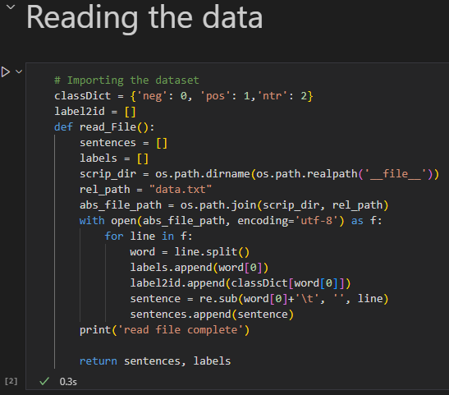
Data Preprocessing (Reading from file)
Fig: Reading the dataset by a user defined function
Here the function will read labels and sentences as separate arrays and then return them which will later be used to create the data frame.

Slide 6
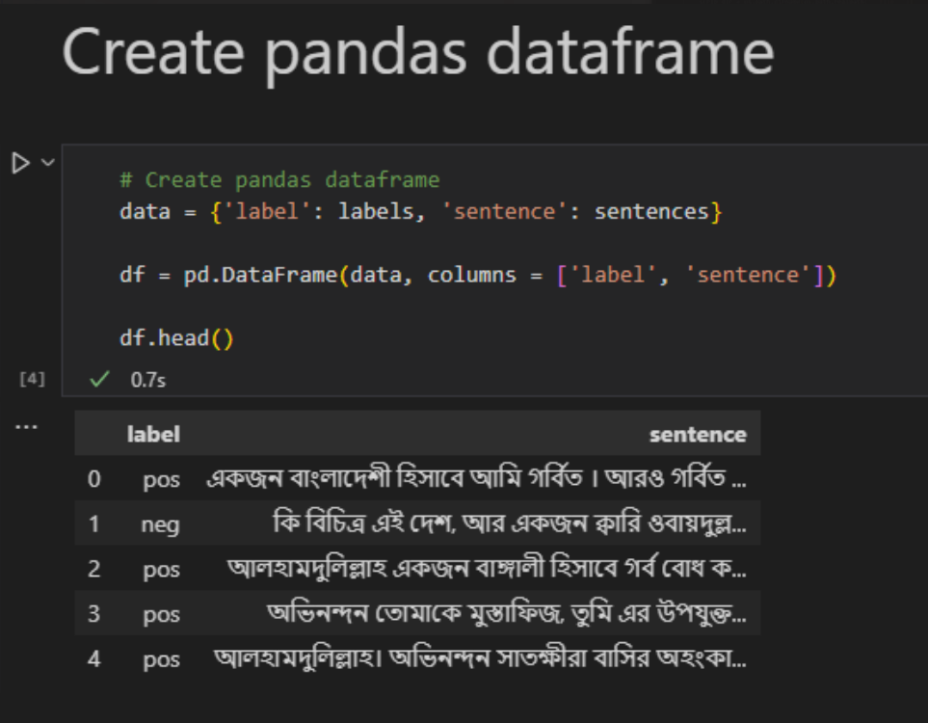
Data Preprocessing(Creating Data frame)
Fig: Creating a pandas data frame to store data

Slide 7
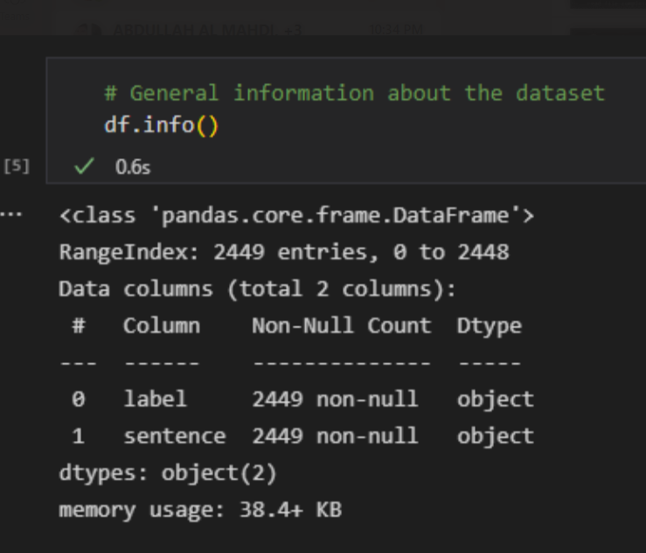
Data Preprocessing (showing Data frame)
Fig: Info of our data frame

Slide 8
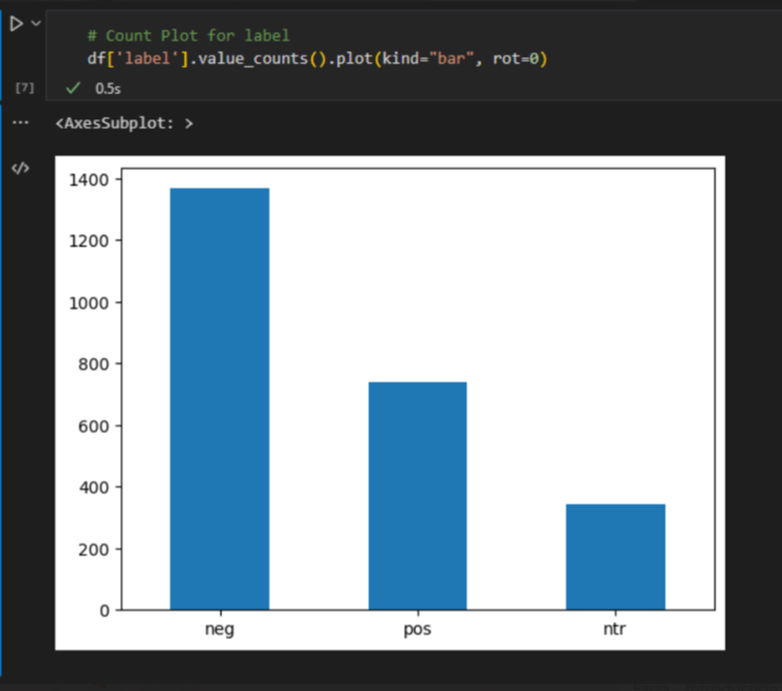
Data Preprocessing (barchart)
Fig: Types of labels and their frequency in our data frame

Slide 9
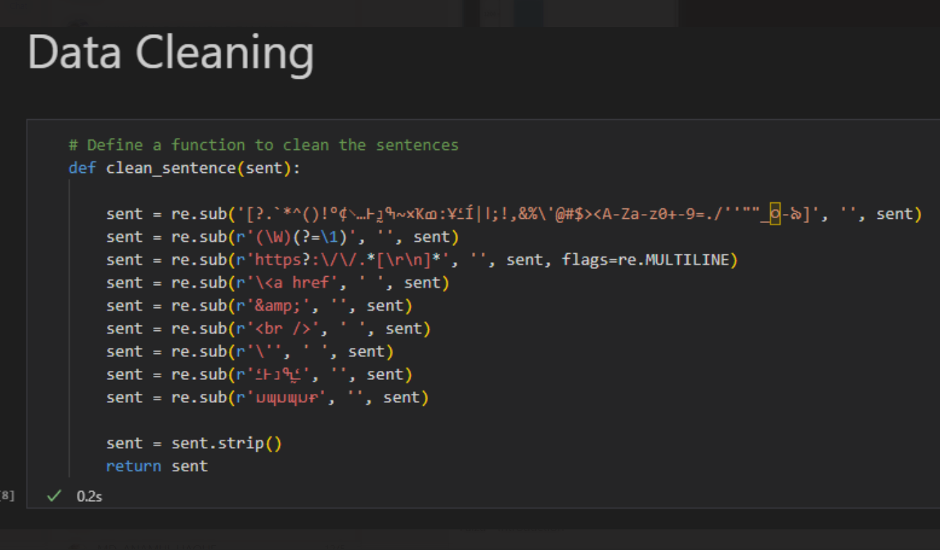
Data Preprocessing (cleaning)
Fig: User defined function to clean our data frame from unnecessary characters

Slide 10
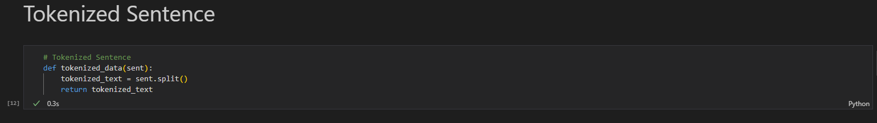
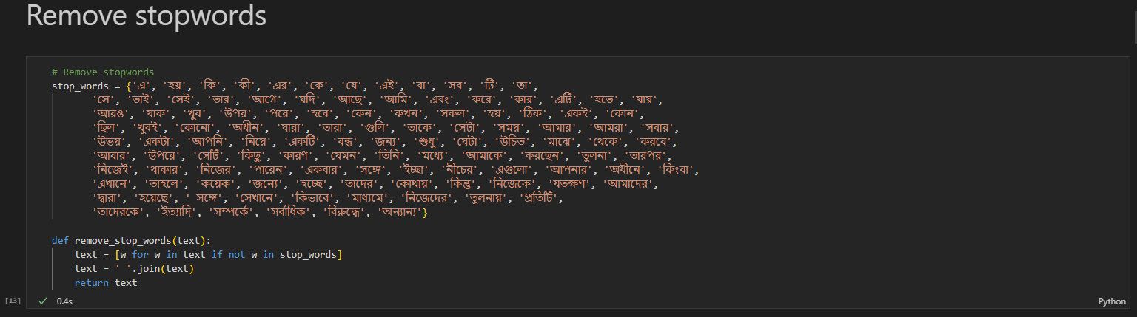
Data Preprocessing
Fig.: Tokenized Sentence
Fig.: Remove Stop words

Slide 11
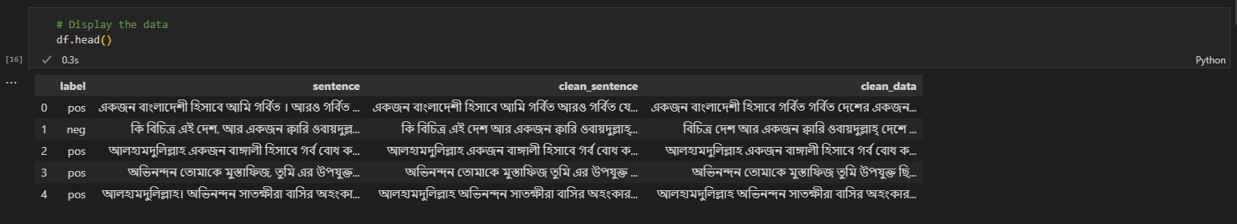
Data Preprocessing
Fig.: Transferring to CSV file
Fig.: Display Data

Slide 12
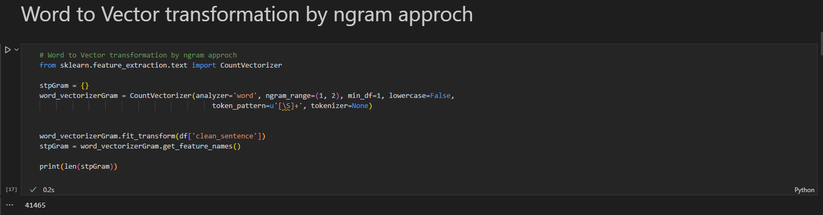
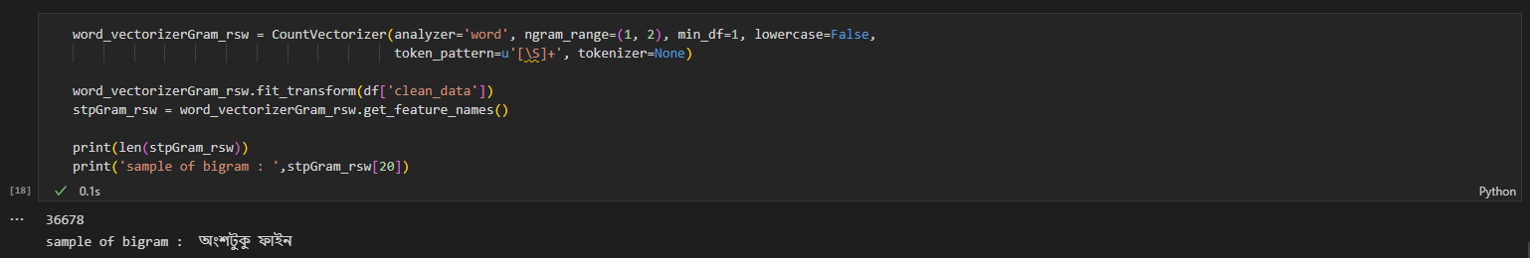
Data Preprocessing
Fig.: Word to Vector Transformation

Slide 13
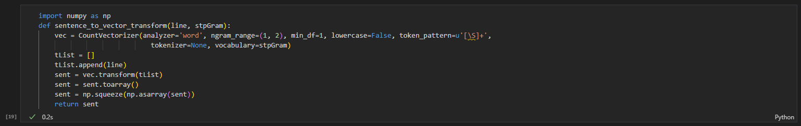
Data Preprocessing
Fig.: Sentence to Vector Transformation

Slide 14
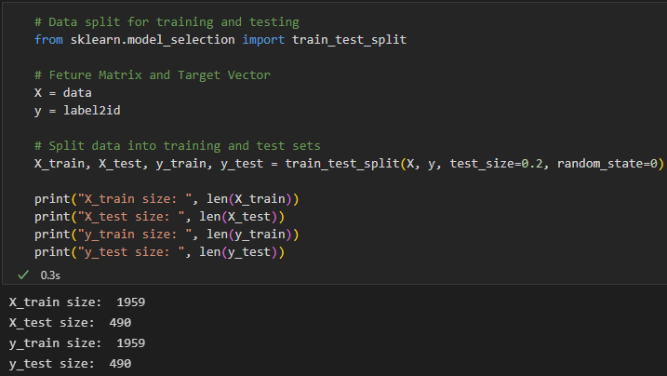
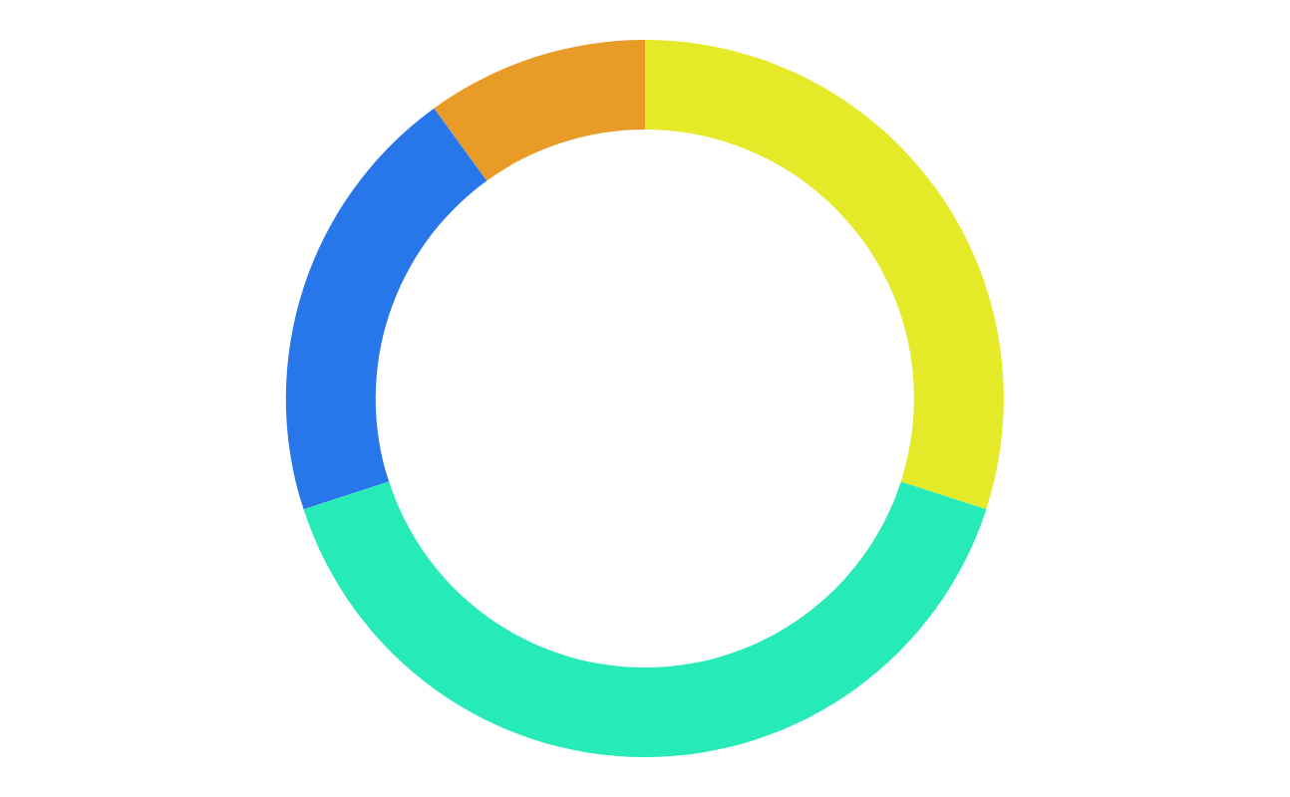
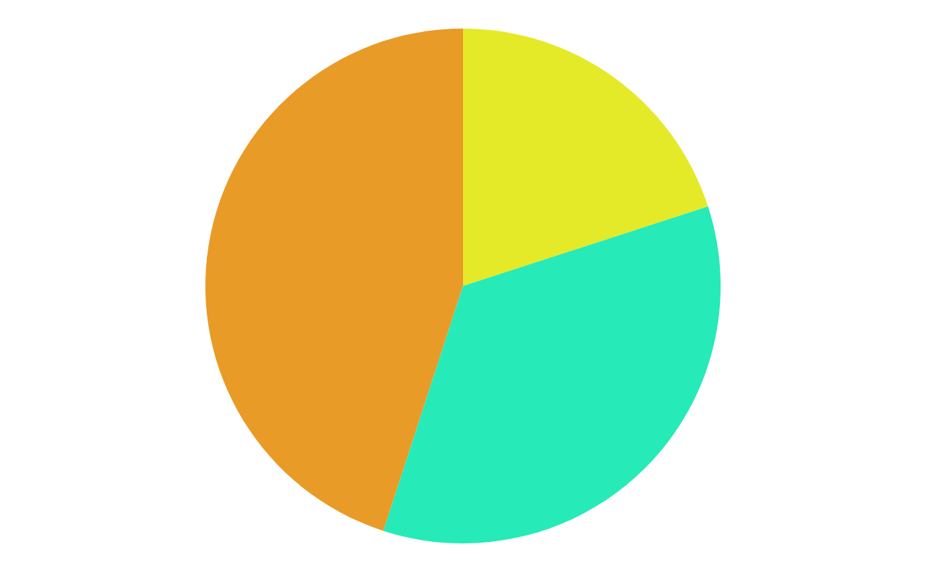
Data Split For Training And Testing
The Dataset is divided into training and testing
Eighty percent of the data is in the training set and twenty percent of the data is in the testing set
Training size is 1959 and Testing size is 490
Data Split For Training And Testing

Slide 15
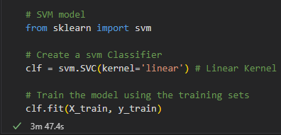
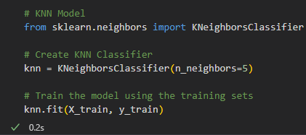
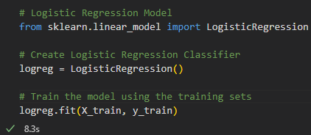
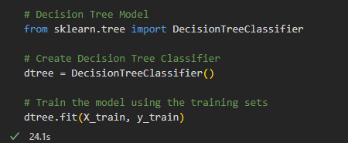
Training Model
Support Vector Machine (SVM)
K Nearest Neighbors (KNN)
Logistic Regression
Decision Tree
Model building and training

Slide 16
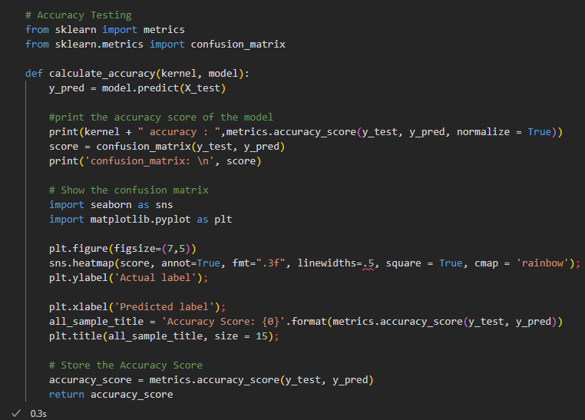

Accuracy Testing
A function to calculate the accuracy of the developed model
The function would show an accuracy score and confusion matrix
Also plots the confusion matrix
Function for accuracy testing

Slide 17
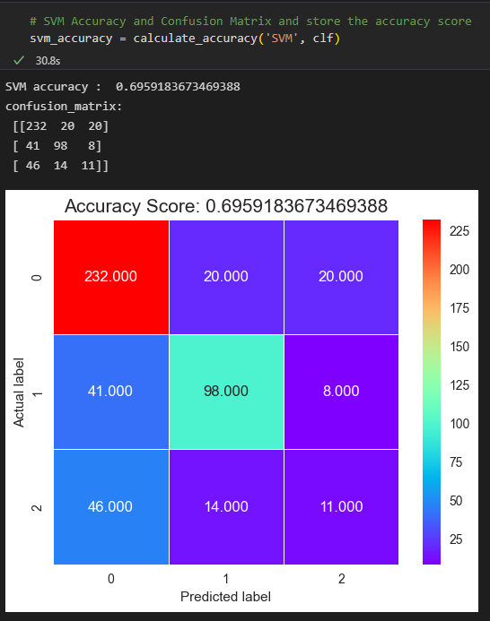
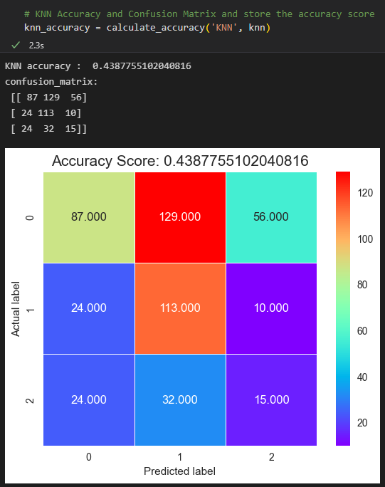
Accuracy Testing
SVM Accuracy and Confusion Matrix
KNN Accuracy and Confusion Matrix

Slide 18
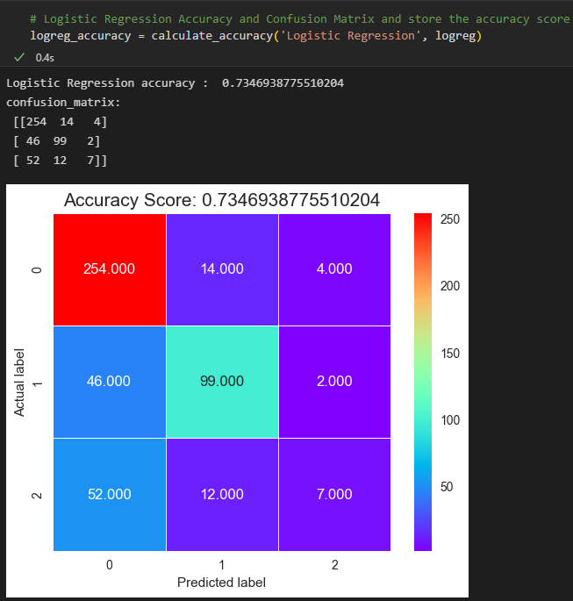
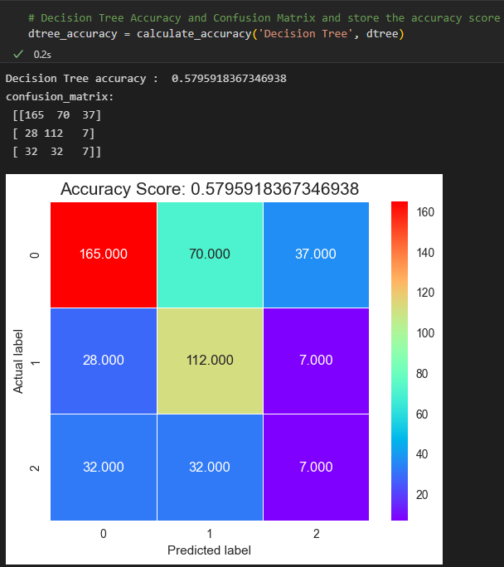
Accuracy Testing
Logistic regression Accuracy and Confusion Matrix
Decision Tree Accuracy and Confusion Matrix

Slide 19
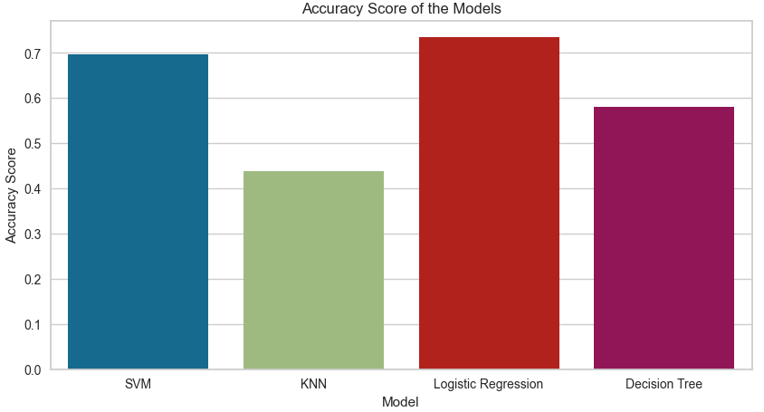
Accuracy Comparison
Accuracy Comparison amongst models

Slide 20
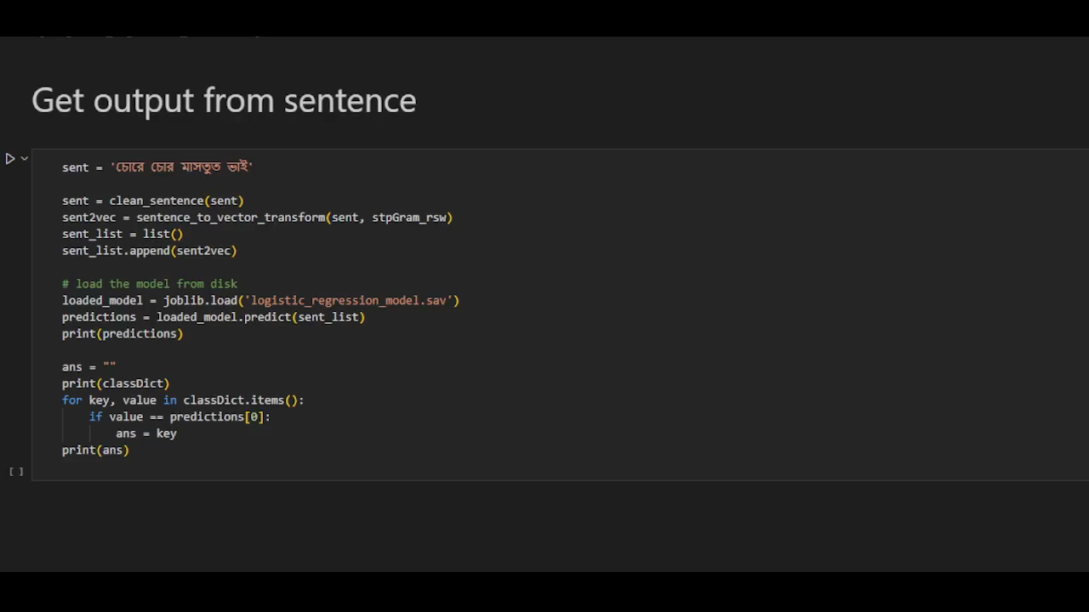
Get output from sentence
Get output from a sentence (Video)

Slide 21
Conclusion
The highest accuracy was achieved from the logistic Regression which is nearly 73% of the time accurately predicts
Precise observation of the data will give more accurate results in classifying polarity.
Adding a POS tagger could increase the performance.
Removing more unique stop words could increase performance
If we use more datasets in the machine learning process, the result will predict more accuracy than the obtained accuracy with the current dataset.

Slide 22
References
[1] A. Pak, P. Paroubek, Twitter as a corpus for sentiment analysis and opinion mining, in Proceedings of the International Conference on Language Resources and Evaluation (LREc), Valletta, Malta, 2010, vol. 10, pp. 1320–1326.
[2] S. Chowdhury, W. Chowdhury, Performing sentiment analysis in Bangla microblog posts, in 2014 International Conference on Informatics, Electronics & Vision (ICIEV), IEEE, Dhaka, Bangladesh, 2014, p. 1–6.
[3] R.A. Tuhin, B.K. Paul, F. Nawrine, M. Akter, A.K. Das, An automated system of sentiment analysis from Bangla text using supervised learning techniques, in 2019 IEEE 4th International Conference on Computer and Communication Systems (ICCCS), IEEE, Singapore, 2019, pp. 360–364.
[4] N. Tabassum, M.I. Khan, Design an empirical framework for sentiment analysis from Bangla text using machine learning, in 2019 International Conference on Electrical, Computer and Communication Engineering (ECCE), IEEE, Cox’sBazar, Bangladesh, 2019, pp. 1–5.

Slide 23
Thank you
Very much

