Slide 1
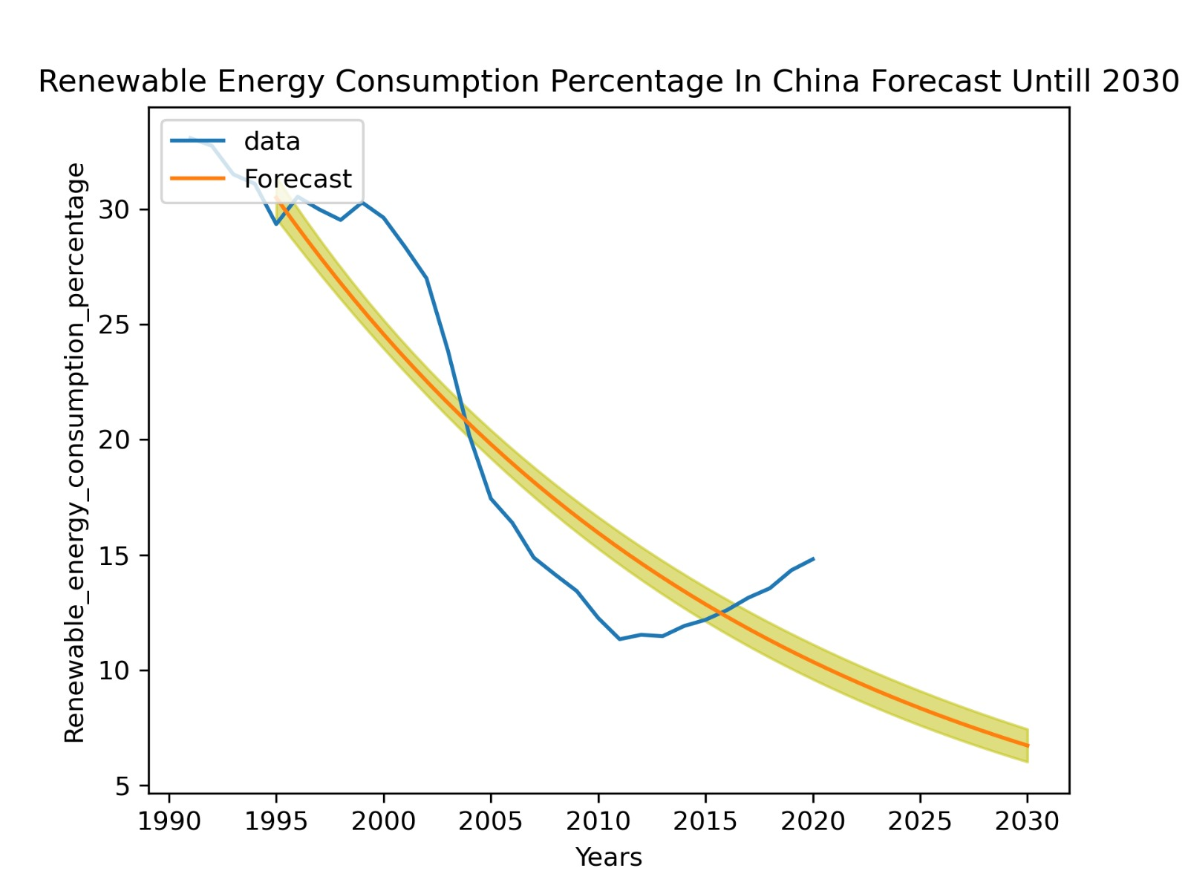
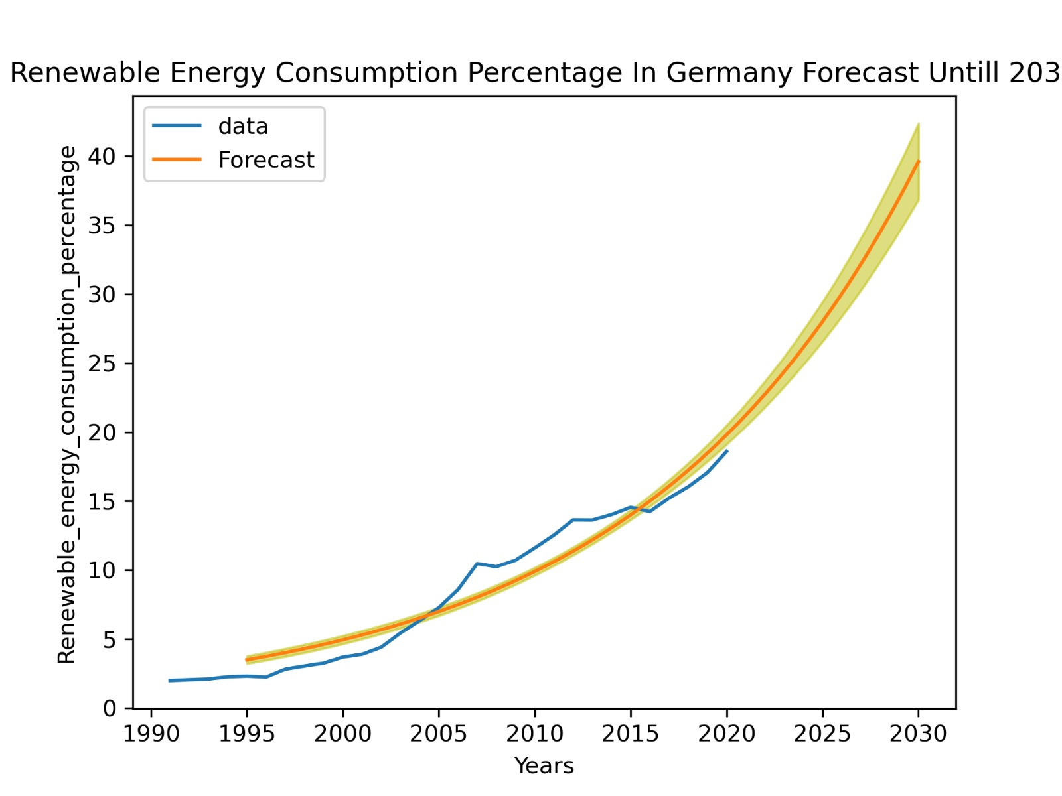
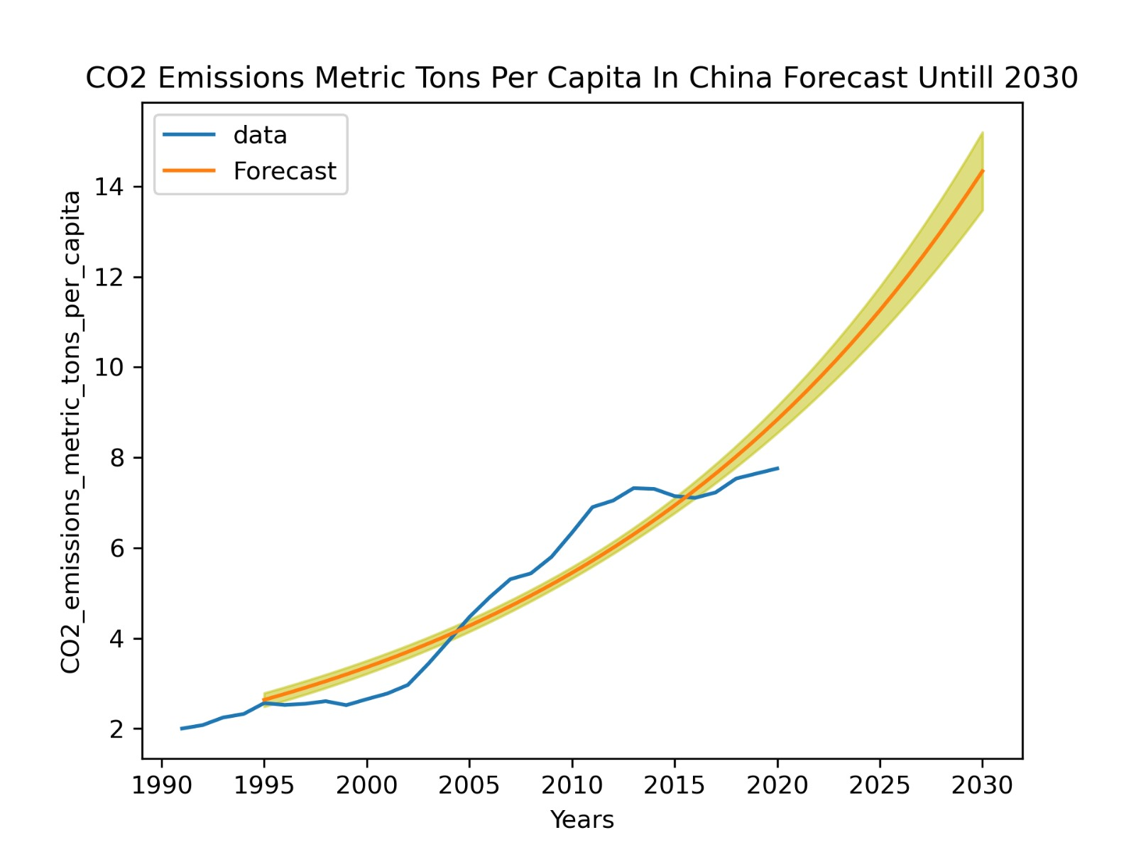
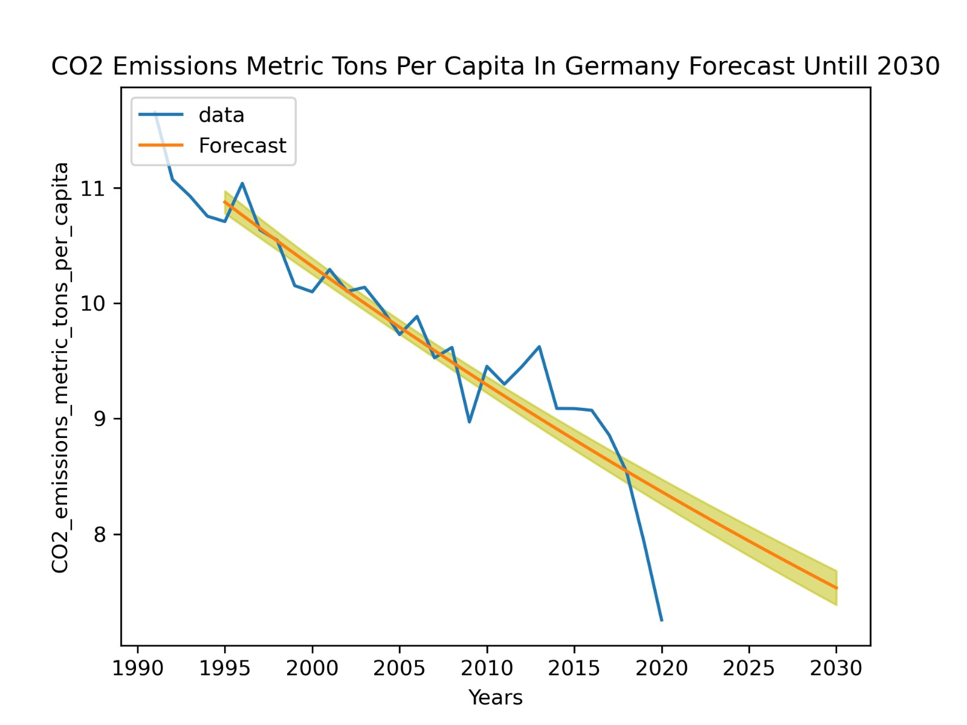
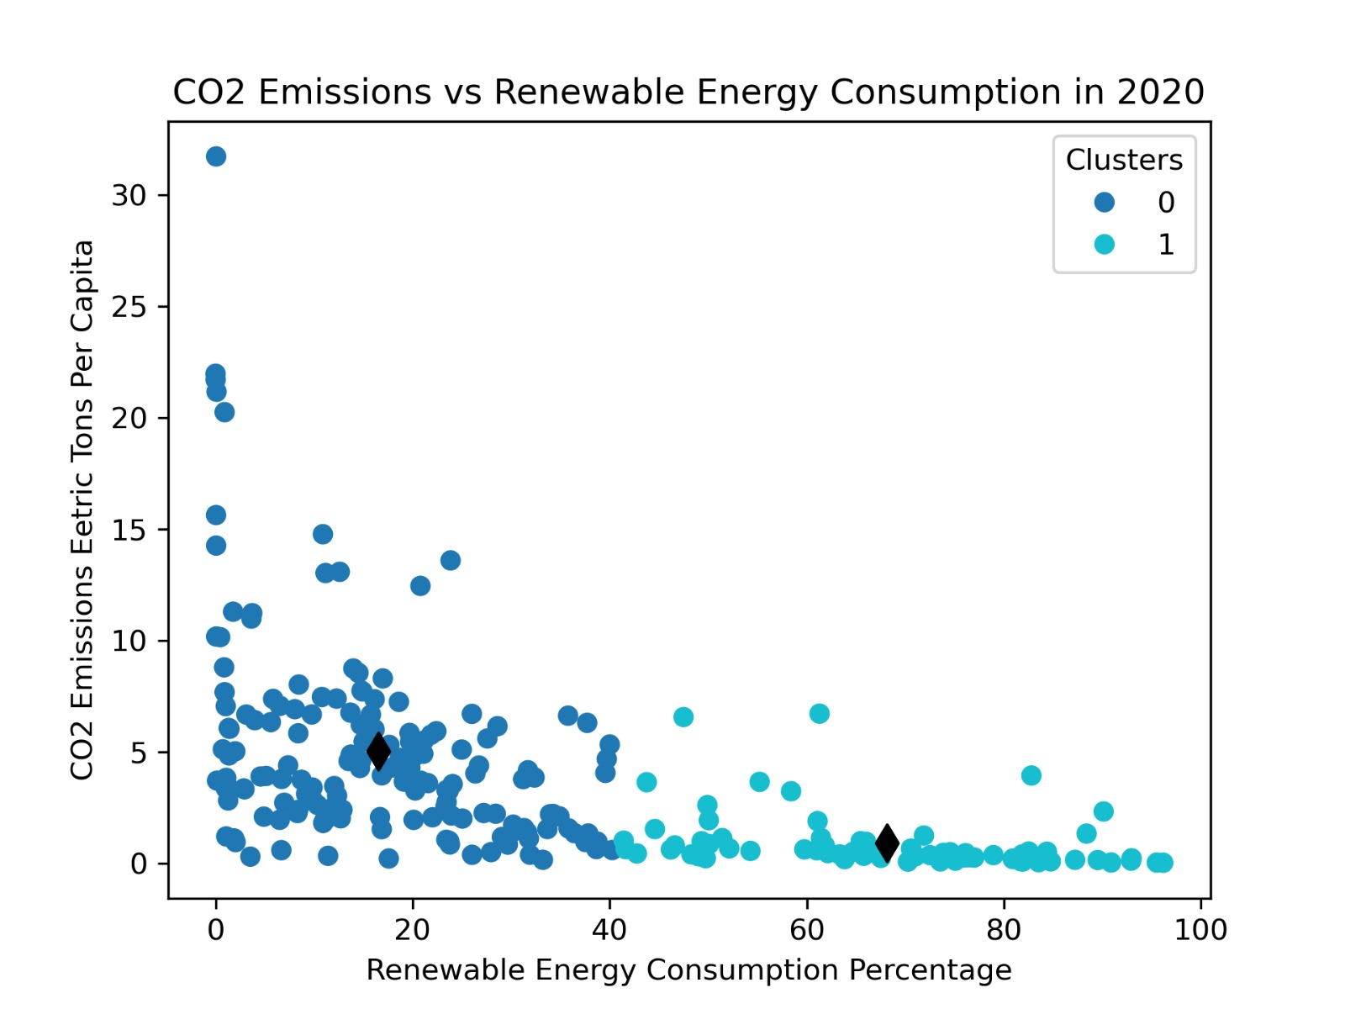
Comparative Analysis of CO2 Emission and Renewable Energy of Germany and China.
Shahroze_Hassan_Gondal(22098543)
https://github.com/Shahroze-Gondal/Clustering-and-fitting.git
Abstract:
This analysis displays the connection between CO2 emission and renewable energy consumption for the environmental sustainability in the world by examining these factors in China and Germany. Using advanced analytical tools, we reveal the divergent paths these global powerhouses navigate in balancing industrial growth and ecological responsibility. This study offers crucial insights for decision-makers, emphasizing the imperative of harmonizing economic success with sustainable practices to guarantee a robust and environmentally conscious future on a global scale
Introduction:
In this extensive analysis, we delve into the intricate relationship between carbon dioxide (CO2) emissions and the utilization of renewable energy in two global powerhouses: China and Germany. Utilizing K-Means clustering as a robust analytical tool, we leverage extensive data from the World Bank dataset to identify distinctive global patterns in CO2 emissions and the consumption of renewable energy. Our objective is to unravel the complex interplay between economic growth and environmental sustainability, shedding light on the divergent trajectories of these two nations.
Our attention now turns to China, a rapidly expanding economy, and Germany, a developed industrialized nation. Examining the impact of large factories and dynamic businesses, we aim to assess their influence on climate by quantifying CO2 emissions. Concurrently, our investigation extends to comprehending the role of renewable energy consumption in alleviating environmental impacts, providing a comprehensive perspective on each country's commitment to sustainable practices.
Through thorough predictive modeling techniques, we endeavor to anticipate future values for CO2 emissions per capita and renewable energy consumption in China and Germany.
Forecast regarding Renewable Energy Consumption in China and Germany
According to this graph the use of renewable energy is on least priority in China, it is continuously decreasing with rise and fall since 1990 to 2020 and will continue till 2030
Germany is conscious about the environmental challenges and that's why the renewable energy consumption is increasing since 1990 to 2020 and will continue till 2030.
Forecast about the CO2 Emission Per Capita in China and Germany
With the increase of industries, CO2 emission in China is increasing since 1990 to 2020 and graph forecasts that it will increase till 2030
Due to the combatting environmental challenges, CO2 emission in Germany is decreasing since 1990 to 2020 and the graph predicts that it will continue till 2030.
Clustering
Conclusion
In conclusion, our in-depth analysis of CO2 emissions, economic development, and renewable energy consumption in China and Germany underscores the intricate relationship between increase in industries and environmental sustainability. Through the lens of K-Means clustering and predictive modeling, we have unveiled the contrasting trajectories of these global powerhouses. This study not only enriches our understanding of China and Germany but also contributes valuable insights to the broader global discourse on environmental sustainability. Moving forward, strategic decision-makers can leverage these findings to foster a harmonious synergy between economic prosperity and ecological well-being, fostering a more sustainable future for our planet
This Graph shows the negative correlation between the CO2 emission and the renewable energy consumption in different Countries in 2020

