Slide 1

ESE 4009
IoT based Cradle system using SIDS monitor

Slide 2
Web-server Interface with Raspberry Pi
INSTRUCTOR: Prof. Mike Aleshams
Group 6

Slide 3
IoT in Raspberry Pi
Introduction to the concepts of network programming, the IoT, and the connection of sensors to the Internet.
We will configure the RPi to be a web server that uses various server-side scripting techniques to display sensor data.
Custom C/C++ code is described that can push sensor data to the Internet

Slide 4
IoT in Raspberry Pi
The terms Internet of Things (IoT) and cyber-physical systems (CPS) are broadly used to describe the extension of the web and the Internet into the physical realm, by the connection of distributed embedded devices.
IoT concept envisions that if physical sensors and actuators can be linked to the Internet, then a whole new range of applications and services are possible.
IoT also has broad application to many large-scale industries, such as energy management, healthcare, transport, and logistics.

Slide 5
IoT in Raspberry Pi
IoT devices should be able to :
automate laborious tasks;
manage security;
improve :
energy efficiency,
accessibility,
convenience

Slide 6
IoT in Raspberry Pi
In this ppt, the implementation of several software communication architectures that can be used to realize IoT or CPS is described.
There are mainly 4 IoT architectures to implement iot in raspberry pi.
We will use raspberry pi as a webserver to publish data over internet.

Slide 7
IoT Architecture
1. The RPi web server:
An RPi that is connected to a sensor and running a web server can be used to present information to the web when it is requested to do so by a web browser. Communications take place using the Hypertext Transfer Protocol (HTTP).

Slide 8
IoT Architecture
2. The RPi web client:
An RPi can initiate contact with a web server using HTTP requests to send and receive data. A C/C++ program is written that uses TCP sockets to build a basic web browser, which can communicate over HTTP, or if necessary, securely over secure HTTP (HTTPS).

Slide 9
IoT Architecture
3. The RPi TCP client/server:
A custom C++ client and server are presented that can intercommunicate at high speeds with a user-defi ned communications protocol.

Slide 10
IoT Architecture
4. The RPi web sensor using a PaaS:
Code is written to enable the RPi to use HTTP and MQTT to send data to, and receive data from, web services such as ThingSpeak and IBM Bluemix IoT. This code enables you to build large arrays of sensors that can intercommunicate and store data on remote servers. In addition, these web services can be used to visualize the data that is stored.

Slide 11
The raspberry-pi as webserver
One significant advantage of an embedded Linux device over more traditional embedded systems is the vast amount of open source software that is available.
a web server is installed and configured on the RPi. It is a straightforward process compared to the steps involved for a typical non-Linux embedded platform
Fun-fact: In fact, one of the more diffi cult challenges is choosing which Linux web server to use! There are low-overhead servers available such as lighttpd, Boa, Monkey, and Nginx, and there are full-featured web servers such as the popular Apache server.

Slide 12
Nginx server
The Nginx web server is a lightweight server that has an overhead that is suitable for running on the RPi. Running a web server on the RPi provides you with a number of application possibilities, including the following:
Present general web content to the world.
Integrate sensors and display their values to the world.
Integrate sensors and use it to intercommunicate between devices.
Provide web-based interfaces to tools that are running on the RPi.

Slide 13
Azure vs Nginx
What is Azure Websites?
Deploy and scale modern websites and web apps in seconds.
Azure Websites is a fully managed Platform-as-a-Service (PaaS) that enables you to build, deploy and scale enterprise-grade web Apps in seconds.
Focus on your application code, and let Azure take care of the infrastructure to scale and securely run it for you.

Slide 14
Azure vs Nginx
What is nginx?
A high performance free open source web server powering busiest sites on the Internet.
nginx [engine x] is an HTTP and reverse proxy server, as well as a mail proxy server, written by Igor Sysoev.
According to Netcraft nginx served or proxied 30.46% of the top million busiest sites in Jan 2018.

Slide 15
Azure vs Nginx
Azure Websites belongs to "Platform as a Service" category of the tech stack, while nginx can be primarily classified under "Web Servers".
"Ease of deployment" is the top reason why over 14 developers like Azure Websites, while over 1437 developers mention "High-performance http server" as the leading cause for choosing nginx.

Slide 16
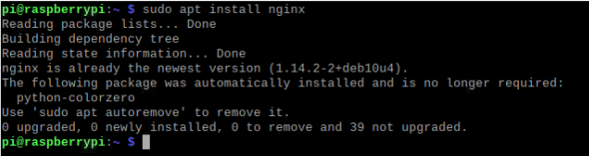
Nginx configuration on raspberry-pi
The Nginx server is currently available through the Raspbian distribution. You can use the following commands to install it:
pi@erpi ~ $ sudo apt update
pi@erpi ~ $ sudo apt install nginx
pi@erpi ~ $ sudo reboot

Slide 17
Nginx configuration on raspberry-pi
On some RPi Nginx versions you must edit the /etc/nginx/sitesavailable/default configuration file and comment out the entry "listen[::]:80 default_server;" using a # character.
Also, if you have installed Apache on your RPi then you must stop it before installing Nginx; for example, by using sudo service apache2 stop.
The Nginx web server runs on port number 80 by default. A port number is an identifi er that can be combined with an IP address to provide an endpoint for a communications session.

Slide 18
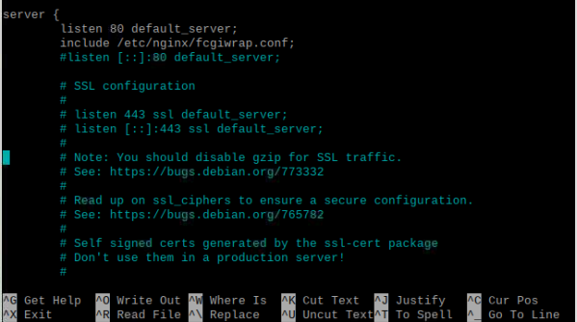
Nginx configuration on raspberry-pi

Slide 19
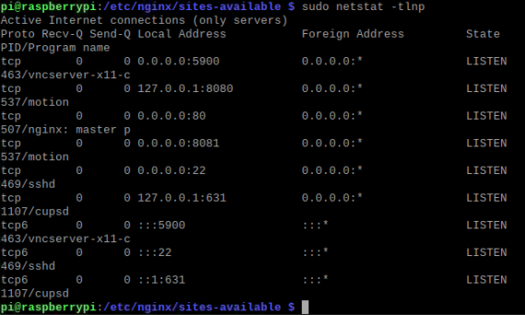
Nginx configuration on raspberry-pi
It is effectively used to identify the software service that is required by a client. For example, you can find out the IP address of your RPi, and the list of services that are listening to ports on the RPi by using the network statistics (netstat) command:
pi@erpi ~ $ hostname -I
192.168.1.116
pi@erpi ~ $ sudo netstat -tlpn

Slide 20

Nginx configuration on raspberry-pi
Therefore, when a network request is received for port 80, it is directed to the Nginx web server application. The usual port number for unsecured web traffic is 80; this is assumed when you enter a URL in your web browser.
You can also see that traffi c for port 22 is directed to the Secure Shell (SSH) server. You can test the configuration of your Nginx server using the following:
pi@erpi ~ $ sudo nginx -t

Slide 21
Nginx configuration on raspberry-pi
You can also get information about changes that you make to the server configuration before you perform a server restart, as follows:
pi@erpi ~ $ sudo service nginx configtest
[ ok ] Testing nginx configuration:.
pi@erpi ~ $ sudo service nginx restart
[ ok ] Restarting nginx: nginx.
Both of these tests are particularly useful in identifying confi guration problems.

Slide 22
Programming on server
Nginx can be configured using the files in /etc/nginx/ where the core configuration files are as follows:
nginx.conf is the main confi guration fi le for the server. The sites-available directory contains the confi guration files for any virtual sites, and the sites-enabled directory should contain a symbolic link to a confi guration fi le in the sites-available directory, to activate a site.
Most of the configuration changes are performed on the default file entry in the sites-available directory.

Slide 23
Creating webpages and webscripts
To create a simple web page for the RPi web server, you can use the nano editor and some basic HTML syntax as follows:
pi@erpi /var/www/html $ sudo nano index.html
pi@erpi /var/www/html $ more index.html
<HTML><TITLE>RPi First Web Page</TITLE>
<BODY><H1>RPi First Page</H1>
The Raspberry Pi test web page.
</BODY></HTML>

Slide 24
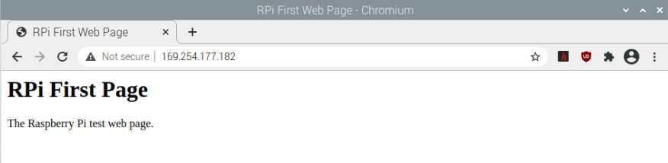
Creating webpages and webscripts

Slide 25
Creating webpages and webscripts
Web pages are ideal for the presentation of static web content, and by using an editor like KompoZer, CoffeeCup, or Notepad++ you can quickly build HTML content for a personal web server.
You could then use the port forwarding functionality of your home router, and a dynamic DNS service, to share your static web content with the world.
More advanced dynamic web content can also be developed for the RPi that interfaces to the physical environment for such tasks as reading sensor data or actuating motors. One relatively straightforward method of doing this is to use Common Gateway Interface (CGI) scripts

Slide 26
Creating webpages and webscripts
Unlike Apache, Nginx does not have support for simple CGI scripts by default. Therefore, to install them, use the following steps:
1. Install fcgiwrap and a sample confi guration fi le:
pi@erpi ~ $ sudo apt install fcgiwrap
pi@erpi ~ $ sudo cp /usr/share/doc/fcgiwrap/examples/nginx.conf →
/etc/nginx/fcgiwrap.conf
pi@erpi ~ $ cd /etc/nginx/sites-available
pi@erpi /etc/nginx/sites-available $ sudo nano default

Slide 27
Creating webpages and webscripts
2. Add the following highlighted line to the Nginx default fi le (note the use of a semicolon to delimit lines):
server {
listen 80 default_server;
include /etc/nginx/fcgiwrap.conf;
...
3. Then restart the server (should errors arise, use sudo nginx -t):
pi@erpi /etc/nginx/sites-available $ sudo service nginx configtest
[ ok ] Testing nginx configuration:.
pi@erpi /etc/nginx/sites-available $ sudo service nginx restart
[ ok ] Restarting nginx: nginx.

Slide 28

Creating webpages and webscripts
As well as calling Linux system commands, you can also execute programs that have been written in C/C++
To demonstrate this capability, the AM2301/2302 (DHT) one-wire sensor circuit can be connected to the RPi as in Figure 6-19. The dht.c program that is adapted for this chapter so that it only outputs the temperature and humidity values in an HTML format when it is executed:
pi@erpi $ sudo ./dht

Slide 29
Creating webpages and webscripts
This new dht binary executable can then be copied to the /usr/local/bin directory so that it is “permanently” installed on the RPi:
pi@erpi ~/exploringrpi/chp12/dht $ sudo cp dht /usr/local/bin
pi@erpi ~/exploringrpi/chp12/dht $ cd /usr/local/bin/
pi@erpi /usr/local/bin $ sudo chown root:root dht
pi@erpi /usr/local/bin $ sudo chmod ugo+s dht
pi@erpi /usr/local/bin $ ls -l dht
-rwsr-sr-x 1 root root 9360 Oct 11 15:36 dht

Slide 30
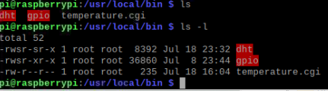
Creating webpages and webscripts

Slide 31
Creating webpages and webscripts
The CGI script can then be modified to output the temperature value directly from the sensor as follows:
pi@erpi /usr/lib/cgi-bin $ more temperature.cgi
#!/bin/bash
echo "Content-type: text/html"
echo ""
echo '<html><head>'
echo '<meta charset="UTF-8">'
echo '<title>Pi Weather Sensor</title></head>'
echo '<body><h1>Pi Weather Sensor</h1><para>'
/usr/local/bin/dht
echo '</para></html>'

Slide 32
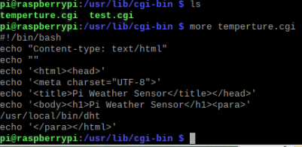
Creating webpages and webscripts

Slide 33
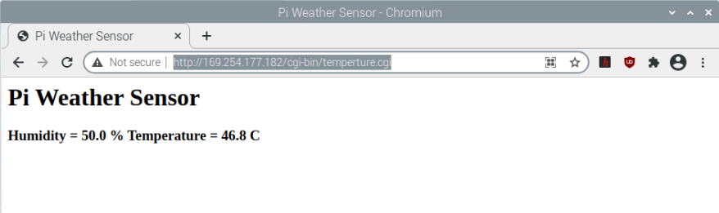
Creating webpages and webscripts
Type URL: http://169.254.177.182/cgi-bin/temperture.cgi

Slide 34
References:
Derek Molloy, (2016). Exploring Raspberry Pi: Interfacing to the Real World with Embedded Linux, New York: Wiley.
Stackshare, Azure websites vs NGINX, retrieved from: https://stackshare.io/stackups/azure-websites-vs-nginx
Setting up an NGINX web server on a Raspberry Pi, Retrived from: https://www.raspberrypi.org/documentation/remote-access/web-server/nginx.md

