Slide 1

ESE 4009 IoT based Cradle system using SIDS monitor
Pulse oximeter interface with Raspberry Pi
INSTRUCTOR: Prof. Mike Aleshams
Group 6

Slide 2
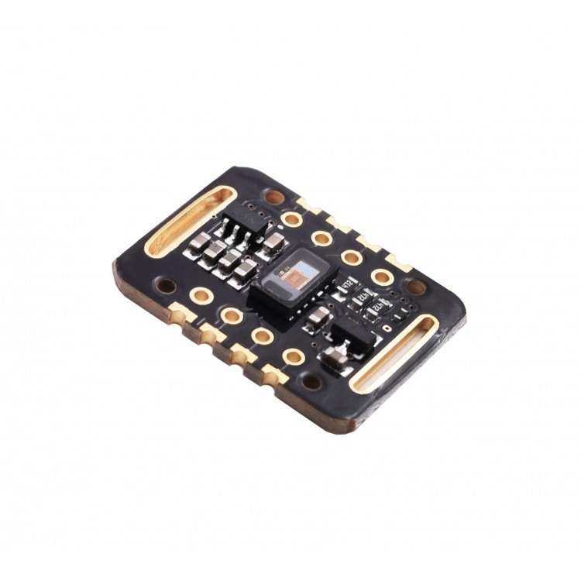
Pulse Oximeter sensor MAX30102
It includes internal LEDs, photodetectors, optical elements, and low-noise electronics
with ambient light rejection. The MAX30102 provides a complete system solution to ease the design-in process for mobile and wearable devices.

Slide 3
Pulse Oximeter sensor MAX30102
The MAX30102 operates on a single 1.8V power supply and a separate 3.3V power supply for the internal LEDs.
Communication is through a standard I2C-compatible interface. The module can be shut down through software with zero standby current, allowing the power rails to remain powered at all times.
Link for datasheet:https://www.smart-prototyping.com/image/data/2020/10/102090%20Pulse%20Oximeter%20and%20Heart%20Rate%20Sensor%20(MAX30102)/MAX30102.pdf

Slide 4
Specifications
LED Peak Wavelength: 660nm/880nm
LED Supply Voltage: 3.3~5V
Interface: I2C Interface
Operating Temperature Range: -40°C to +85°C
Dimension: 20.3 x 15.2mm
Weight: 1.1g

Slide 5
Connections with pi
Raspberry pi : Sensor
3.3v (PIN 1) : Vin
GND(PIN39) : GND
I2c-SDA(PIN 3): SDA
i2c-SCL(PIN 5): SCL

Slide 6
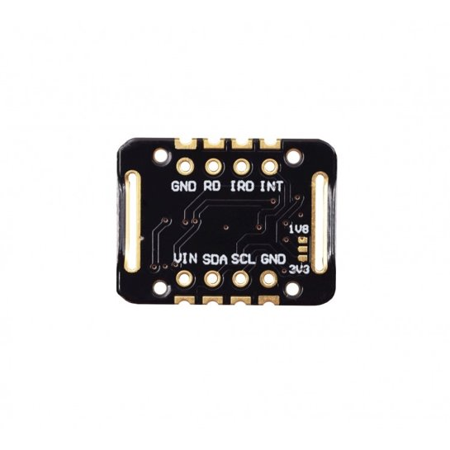
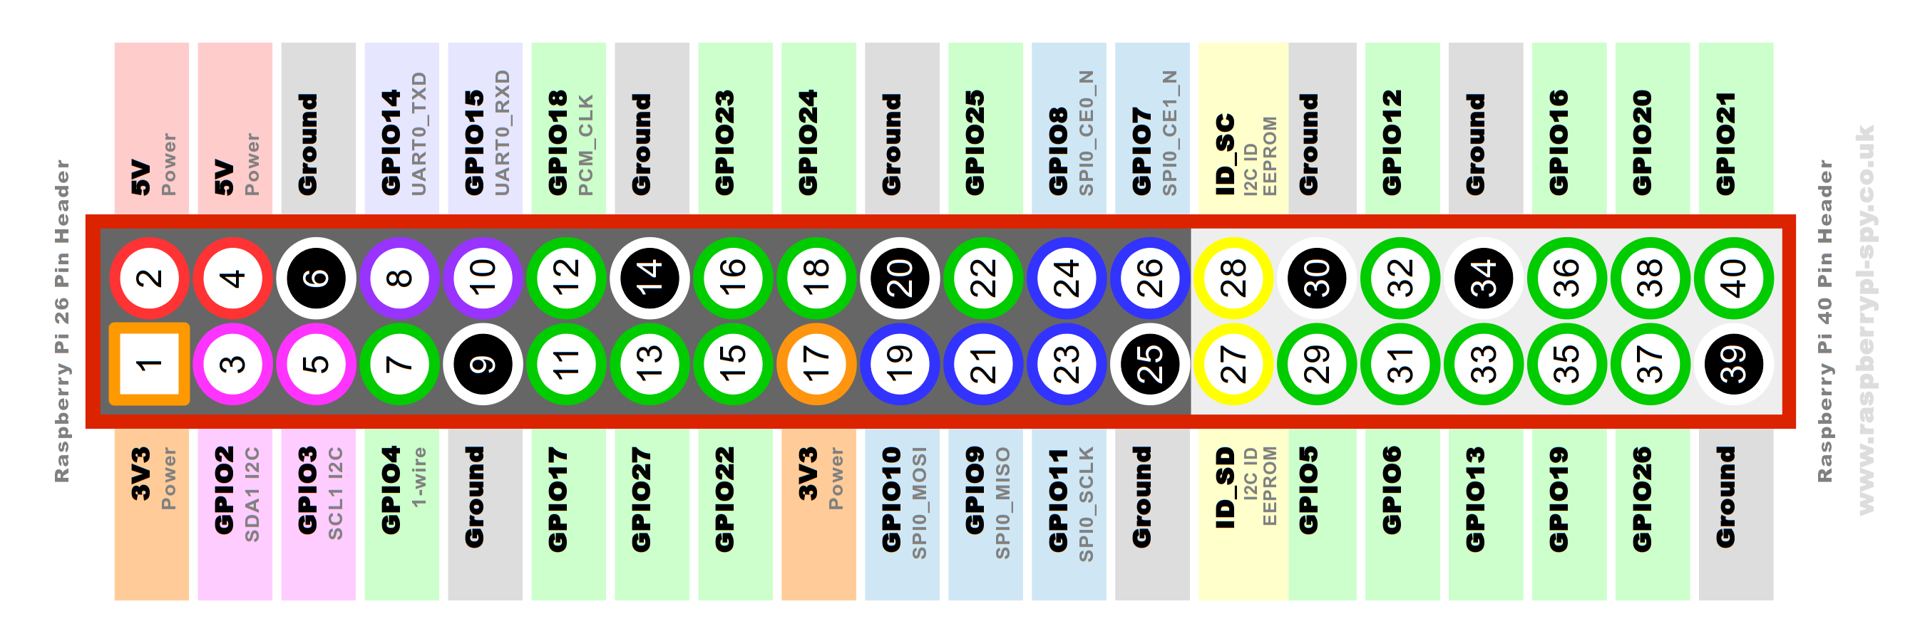
Pinout

Slide 7
Communication Protocol
Here we have used i2c communication protocol to communicates with MAX30102.
I2C combines the best features of SPI and UARTs. With I2C, you can connect multiple slaves to a single master (like SPI) and you can have multiple masters controlling single, or multiple slaves.

Slide 8
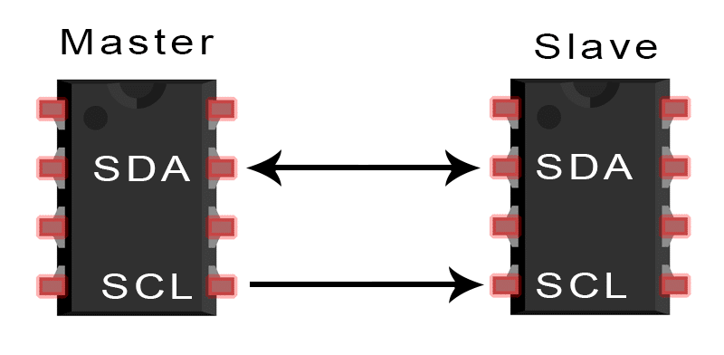
Communication protocol
I2C only uses two wires to transmit data between devices:
SDA (Serial Data) – The line for the master and slave to send and receive data.
SCL (Serial Clock) – The line that carries the clock signal.

Slide 9
How I2C Works?
With I2C, data is transferred in messages. Messages are broken up into frames of data.
Each message has an address frame that contains the binary address of the slave, and one or more data frames that contain the data being transmitted.

Slide 10
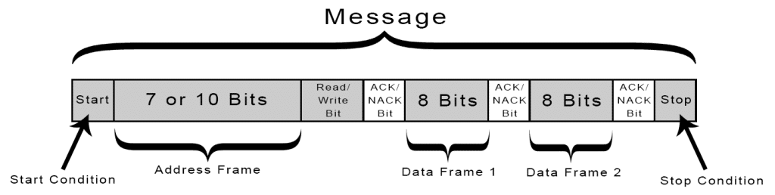
How I2C Works?
The message also includes start and stop conditions, read/write bits, and ACK/NACK bits between each data frame:
Start Condition: The SDA line switches from a high voltage level to a low voltage level before the SCL line switches from high to low.

Slide 11
How I2C Works?
Stop Condition: The SDA line switches from a low voltage level to a high voltage level after the SCL line switches from low to high.
Address Frame: A 7 or 10 bit sequence unique to each slave that identifies the slave when the master wants to talk to it.

Slide 12
How I2C Works?
Read/Write Bit: A single bit specifying whether the master is sending data to the slave (low voltage level) or requesting data from it (high voltage level).
ACK/NACK Bit: Each frame in a message is followed by an acknowledge/no-acknowledge bit. If an address frame or data frame was successfully received, an ACK bit is returned to the sender from the receiving device.

Slide 13
Configure i2c on pi
Enable I2C Interface:
The default Raspbian image disables I2C by default so before you can use it the interface must be enabled.
Raspberry pi has two i2c bus enable based on your connection
Here, I have used i2c-1 bus.

Slide 14
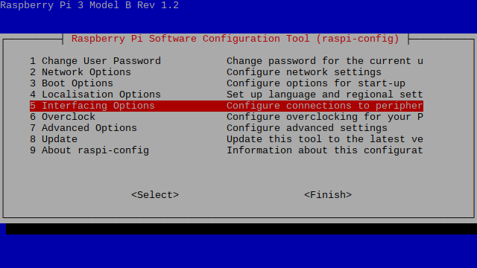
Configure i2c on pi
Command: sudo raspi-config
This will launch the raspi-config utility. Select “Interfacing Options” :

Slide 15
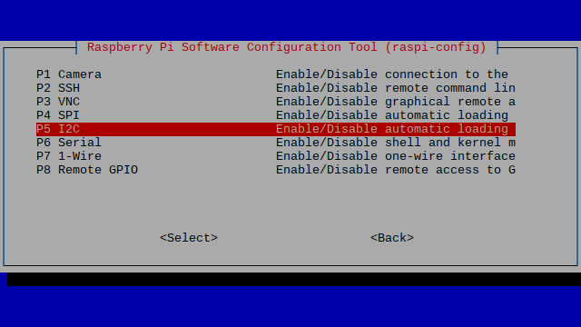
Configure i2c on pi
Highlight the “I2C” option and activate “<Select>”.

Slide 16
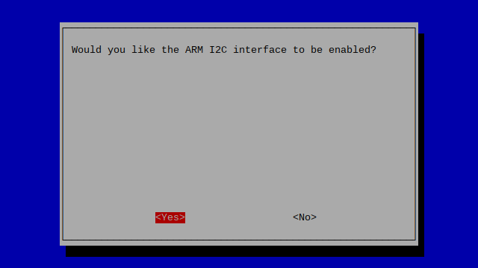
Configure i2c on pi
Select and activate “<Yes>” :

Slide 17
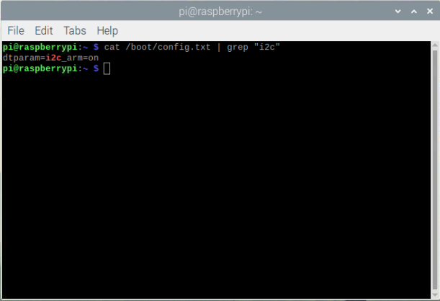
Configure i2c on pi
Command: cat /boot/config.txt | grep "i2c"
Here, we can see that i2c is enabled now.

Slide 18
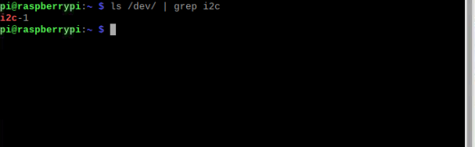
Configure i2c on pi
Command: ls /dev/ | grep i2c
This command let us know which bus is connected to device.

Slide 19
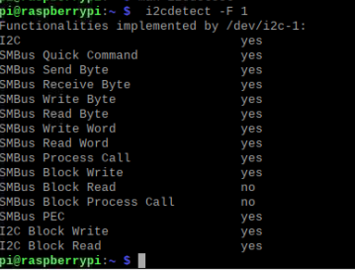
Configure i2c on pi
Now, we will check fuctionality of i2c-1 bus by following command:
I2cdetect –F 1

Slide 20
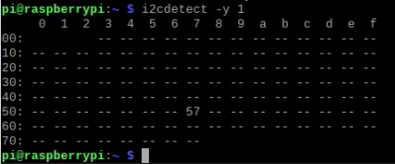
Configure i2c on pi
Command: i2cdetect –y 1
This command display address at where our device is connected.

Slide 21

Configure i2c on pi
Command: i2cget 1 0x57 0xff b
This command will get part id that is resides in register 0xff of sensor.

Slide 22
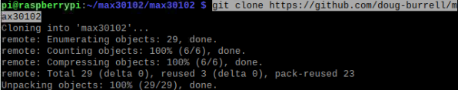
Programming for MAX30102
Command: git clone https://github.com/doug-burrell/max30102
This command will copy github repository which has code for max30102 sensor.

Slide 23
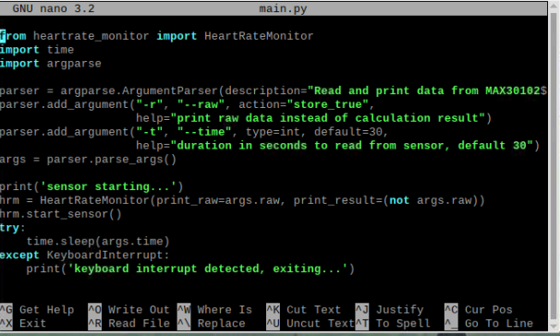
Code for MAX30102
Command: nano main.py

Slide 24
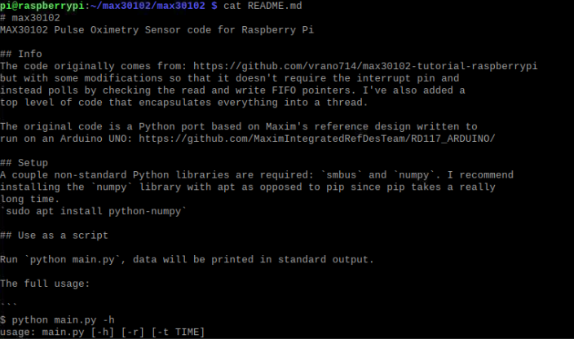
Code for MAX30102
Tips: this is compicated program with 4 source code file.
Use command: cat README.md for help

Slide 25
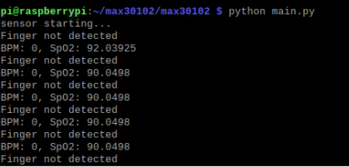
Code for MAX30102
Command: python main.py

Slide 26
Code for MAX30102
To use the code, instantiate the HeartRateMonitor class found in heartrate_monitor.py. The thread is used by running start_sensor and stop_sensor. While the thread is running you can read bpm to get the active beats per minute. Note that a few seconds are required to get a reliable BPM value and the sensor is very sensitive to movement so a steady finger is required!

Slide 27
Code for MAX30102
from heartrate_monitor import HeartRateMonitor
import time
import argparse
parser = argparse.ArgumentParser(description="Read and print data from MAX30102")
parser.add_argument("-r", "--raw", action="store_true",
help="print raw data instead of calculation result")
parser.add_argument("-t", "--time", type=int, default=30,
help="duration in seconds to read from sensor, default 30")
args = parser.parse_args()

Slide 28
Code for MAX30102
print('sensor starting...')
hrm = HeartRateMonitor(print_raw=args.raw, print_result=(not args.raw))
hrm.start_sensor()
try:
time.sleep(args.time)
except KeyboardInterrupt:
print('keyboard interrupt detected, exiting...')
hrm.stop_sensor()
print('sensor stoped!')

Slide 29
Code for MAX30102
Run python main.py, data will be printed in standard output.
The full usage:
$ python main.py -h usage: main.py [-h] [-r] [-t TIME] Read and print data from MAX30102 optional arguments: -h, --help show this help message and exit -r, --raw print raw data instead of calculation result -t TIME, --time TIME duration in seconds to read from sensor, default 30

Slide 30
Run Arduino code on raspberry pi
Go to this link and download windows zip file for arduino
https://www.arduino.cc/en/software
Download hardware board for conerting arduino code into pi-executable code from here:
https://github.com/me-no-dev/RasPiArduino
Youtube link:https://www.youtube.com/watch?v=lZvhtfUlY8Y&list=PLj7-greLdfN-UVMi9nn5MkLTkW3xkBGLo&index=8&t=7s

Slide 31
Run Arduino code on raspberry pi
Now go to C:/Programfilex86/Arduino/hardware/ and copy past Piduno folder which you have downloaded from github.
Next step is to download tool chain for raspberry pi arm based binary on windows.
http://gnutoolchains.com/raspberry/
Goto link and install latest version.
Leave directories as default, no change.

Slide 32
Run Arduino code on raspberry pi
Now open Arduino folder, go to hardware/piduino/platform.txt
And change line number 5 as following.
This will be path to cross tool chain for raspberry pi that we have already installed.

Slide 33
Run Arduino code on raspberry pi
Go to arduino IDE ->Tools-> board -> select raspberry pi.
Open code of pulse oximeter.
Click sketch->export compiled binary.
It will take time to compile code.

Slide 34
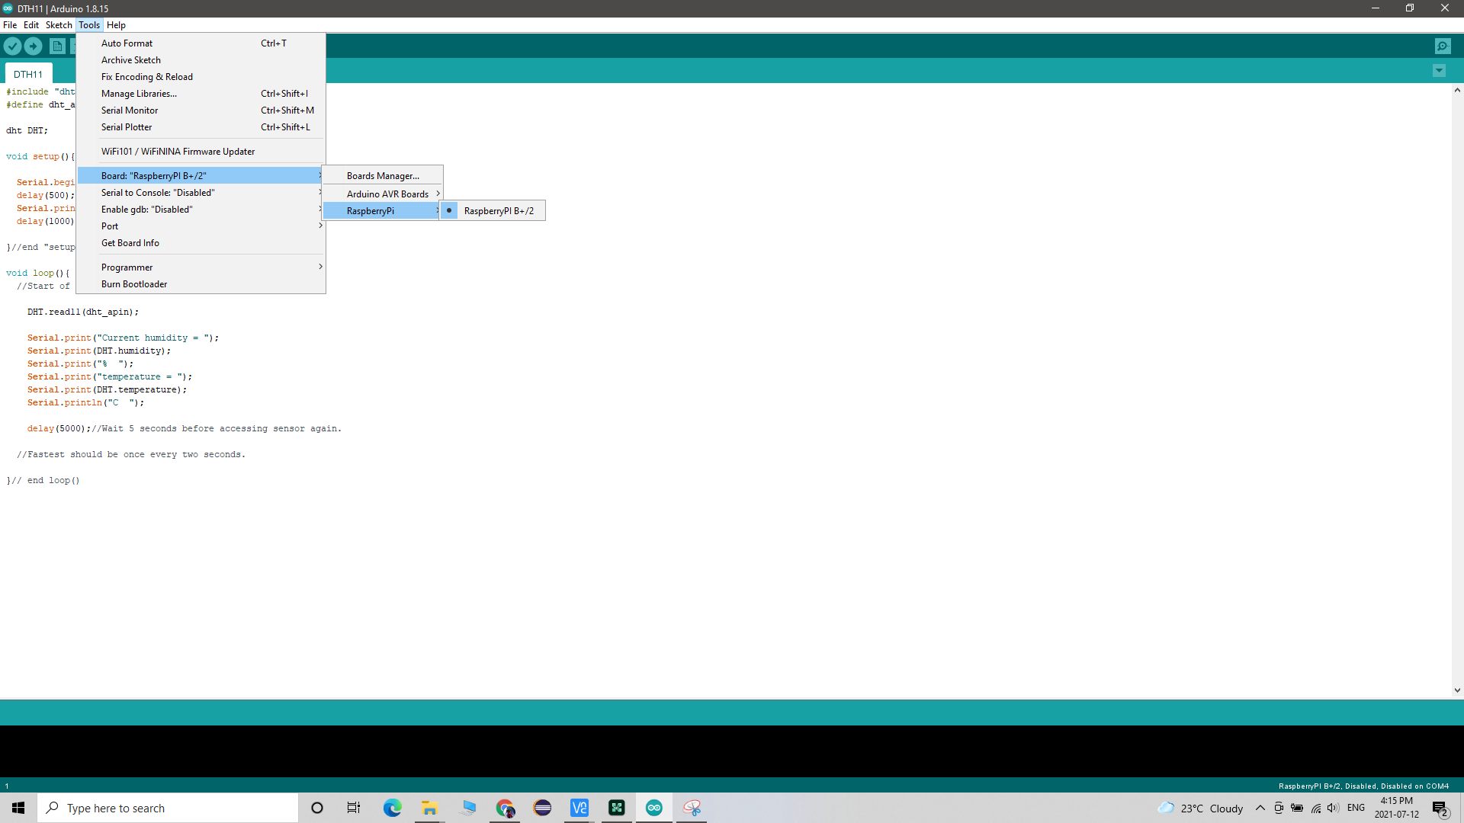
Run Arduino code on raspberry pi

Slide 35
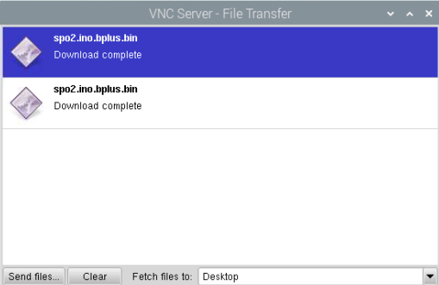
Run Arduino code on raspberry pi
Transport compiled binary to raspberry file through vnc viewer.

Slide 36
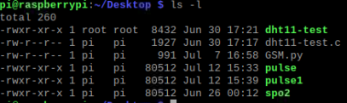
Run Arduino code on raspberry pi
Now, we need to give execution functionality to our binary file
Command: sudo chmod +x pulse

Slide 37
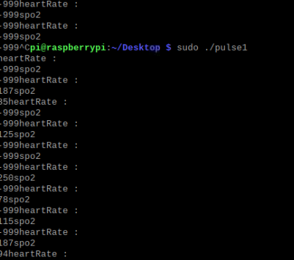
Execute program : sudo ./pulse ans see the results.

Slide 38
References:
Doug borrel, June 9,2020, MAX30102 Pulse Oximetry Sensor code for Raspberry Pi, https://github.com/doug-burrell/max30102
Scott Campbell,BASICS OF THE I2C COMMUNICATION PROTOCOL, https://www.smart-prototyping.com/Pulse-Oximeter-and-Heart-Rate-Sensor-MAX30102
Dmitry Grigoryev, Oct 20, 20202,How can Rpi read the MAX30100 / MAX30102 Oximeter?, https://raspberrypi.stackexchange.com/questions/111955/how-can-rpi-read-the-max30100-max30102-oximeter
Youtube link:https://www.youtube.com/watch?v=lZvhtfUlY8Y&list=PLj7-greLdfN-UVMi9nn5MkLTkW3xkBGLo&index=8&t=7s

Slide 39
Thank you

