Slide 1

ESE 4009
IoT based Cradle system using SIDS monitor

Slide 2
Webdesigning with HTML
INSTRUCTOR: Prof. Mike Aleshams
Group 6

Slide 3
What is an HTML Element?
An HTML element is defined by a start tag, some content, and an end tag:
<tagname>Content goes here...</tagname>
The HTML element is everything from the start tag to the end tag:
<h1>My First Heading</h1>

Slide 4
Understanding with Example
<!DOCTYPE html> <html> <head> <title>Page Title</title> </head> <body> <h1>My First Heading</h1> <p>My first paragraph.</p> </body> </html>

Slide 5
Understanding with Example
The <!DOCTYPE html> declaration defines that this document is an HTML5 document
The <html> element is the root element of an HTML page
The <head> element contains meta information about the HTML page
The <title> element specifies a title for the HTML page (which is shown in the browser's title bar or in the page's tab)

Slide 6
Understanding with Example
The <body> element defines the document's body, and is a container for all the visible contents, such as headings, paragraphs, images, hyperlinks, tables, lists, etc.
The <h1> element defines a large heading
The <p> element defines a paragraph

Slide 7
Steps for creating HTML file
Step 1: Open Notepad (PC)
Windows 8 or later:
Open the Start Screen (the window symbol at the bottom left on your screen). Type Notepad.
Windows 7 or earlier:
Open Start > Programs > Accessories > Notepad

Slide 8
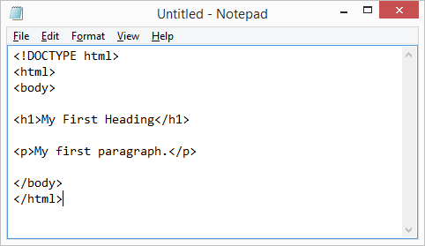
Steps for creating HTML file
Step 2: Write Some HTML

Slide 9
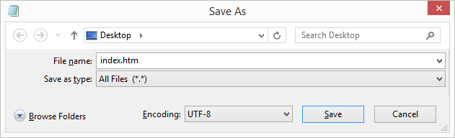
Steps for creating HTML file
Step 3: Save the HTML Page
Save the file on your computer. Select File > Save as in the Notepad menu.
Name the file "index.htm" and set the encoding to UTF-8 (which is the preferred encoding for HTML files).

Slide 10
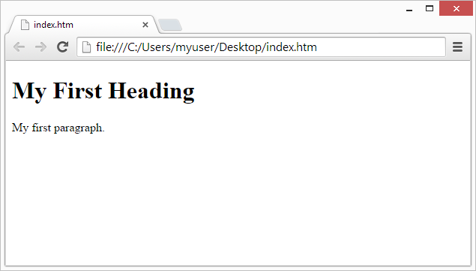
Steps for creating HTML file
Step 4: View the HTML Page in Your Browser
Open the saved HTML file in your favorite browser (double click on the file, or right-click - and choose "Open with").
The result will look much like this:

Slide 11
Nested HTML Elements
HTML elements can be nested (this means that elements can contain other elements).
All HTML documents consist of nested HTML elements.
The <html> element is the root element and it defines the whole HTML document.
It has a start tag <html> and an end tag </html>.
Then, inside the <html> element there is a <body> element:

Slide 12
Nested HTML Elements
The <body> element defines the document's body.
It has a start tag <body> and an end tag </body>.
Never Skip the End Tag
Some HTML elements will display correctly, even if you forget the end tag:
HTML tags are not case sensitive: <P> means the same as <p>.

Slide 13
HTML Attributes
All HTML elements can have attributes
Attributes provide additional information about elements
Attributes are always specified in the start tag
Attributes usually come in name/value pairs like: name="value"

Slide 14
Nested HTML Elements
The href Attribute
The <a> tag defines a hyperlink. The href attribute specifies the URL of the page the link goes to
Example
<a href="https://www.w3schools.com">Visit W3Schools</a>

Slide 15
Nested HTML Elements
The src Attribute
The <img> tag is used to embed an image in an HTML page. The src attribute specifies the path to the image to be displayed:
<img src="img_girl.jpg">
There are two ways to specify the URL in the src attribute:
1. Absolute URL - Links to an external image that is hosted on another website. Example: src="https://www.w3schools.com/images/img_girl.jpg".

Slide 16
Nested HTML Elements
2. Relative URL - Links to an image that is hosted within the website. Here, the URL does not include the domain name.
If the URL begins without a slash, it will be relative to the current page. Example: src="img_girl.jpg".
If the URL begins with a slash, it will be relative to the domain. Example: src="/images/img_girl.jpg".

Slide 17
HTML <button> Tag
A clickable button is marked up as follows:
<button type="button">Click Me!</button>
The <button> tag defines a clickable button.
Inside a <button> element you can put text (and tags like <i>, <b>, <strong>, <br>, <img>, etc.). That is not possible with a button created with the <input> element!
Tip: Always specify the type attribute for a <button> element, to tell browsers what type of button it is.

Slide 18
HTML Styles - CSS
CSS stands for Cascading Style Sheets.
CSS saves a lot of work. It can control the layout of multiple web pages all at once.
What is CSS?
Cascading Style Sheets (CSS) is used to format the layout of a webpage.

Slide 19
HTML Styles - CSS
With CSS, you can control the color, font, the size of text, the spacing between elements, how elements are positioned and laid out, what background images or background colors are to be used, different displays for different devices and screen sizes, and much more!
The word cascading means that a style applied to a parent element will also apply to all children elements within the parent. So, if you set the color of the body text to "blue", all headings, paragraphs, and other text elements within the body will also get the same color (unless you specify something else)!

Slide 20
Using CSS
CSS can be added to HTML documents in 3 ways:
Inline - by using the style attribute inside HTML elements
Internal - by using a <style> element in the <head> section
External - by using a <link> element to link to an external CSS file.
The most common way to add CSS, is to keep the styles in external CSS files.

Slide 21
Inline CSS
An inline CSS is used to apply a unique style to a single HTML element.
An inline CSS uses the style attribute of an HTML element.
The following example sets the text color of the <h1> element to blue, and the text color of the <p> element to red:

Slide 22
Inline CSS
<h1 style="color:blue;">A Blue Heading</h1> <p style="color:red;">A red paragraph.</p>
A Blue Heading
A red paragraph.

Slide 23
Internal CSS
An internal CSS is used to define a style for a single HTML page.
An internal CSS is defined in the <head> section of an HTML page, within a <style> element.
The following example sets the text color of ALL the <h1> elements (on that page) to blue, and the text color of ALL the <p> elements to red. In addition, the page will be displayed with a "powderblue" background color:

Slide 24

Internal CSS
<!DOCTYPE html>
<html>
<head>
<style>
body {background-color: powderblue;}
h1 {color: blue;}
p {color: red;}
</style>
</head>
<body>
<h1>This is a heading</h1>
<p>This is a paragraph.</p>
</body>
</html>

Slide 25
CSS Colors, Fonts and Sizes
Here, we will demonstrate some commonly used CSS properties.
The CSS color property defines the text color to be used.
The CSS font-family property defines the font to be used.
The CSS font-size property defines the text size to be used.

Slide 26
CSS Border
The CSS border property defines a border around an HTML element.
Tip: You can define a border for nearly all HTML elements.
p { border: 2px solid powderblue; }

Slide 27
CSS Padding
The CSS padding property defines a padding (space) between the text and the border.
Use of CSS border and padding properties:
p {
border: 2px solid powderblue;
padding: 30px;
}

Slide 28
CSS Margin
The CSS margin property defines a margin (space) outside the border.
Use of CSS border and margin properties:
p { border: 2px solid powderblue; margin: 50px; }

Slide 29
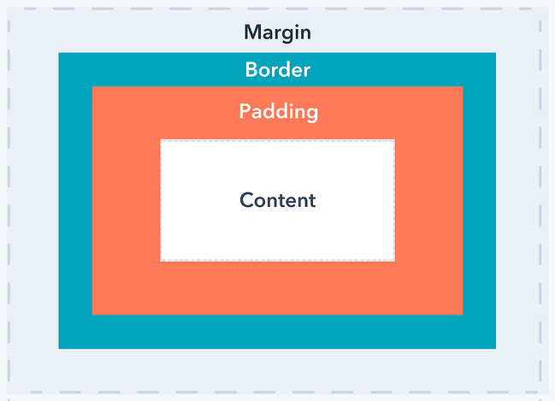
Padding vs Border vs Margin

Slide 30
HTML <script> Tag
The <script> tag is used to embed a client-side script (JavaScript).
The <script> element either contains scripting statements, or it points to an external script file through the src attribute.
Common uses for JavaScript are image manipulation, form validation, and dynamic changes of content.
JavaScript makes HTML pages more dynamic and interactive.

Slide 31
HTML <script> Tag
Common uses for JavaScript are image manipulation, form validation, and dynamic changes of content.
To select an HTML element, JavaScript most often uses the document.getElementById() method.

Slide 32
HTML <script> Tag
<!DOCTYPE html>
<html>
<body>
<h1>My First JavaScript</h1>
<button type="button"
onclick="document.getElementById('demo').innerHTML = Date()">
Click me to display Date and Time.</button>
<p id="demo"></p>
</body>
</html>

Slide 33
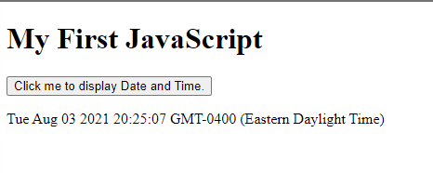
Output

Slide 34
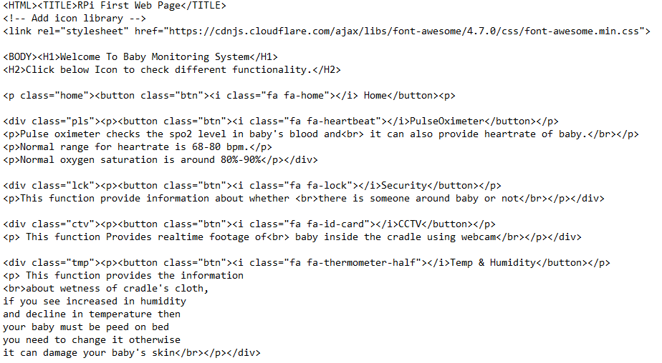
Website Homepage:
Code:

Slide 35
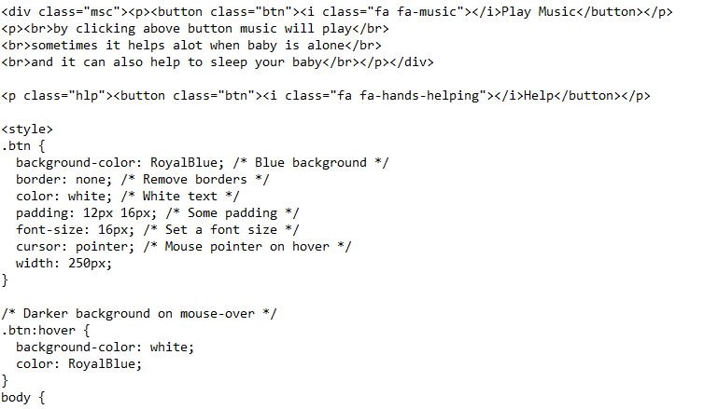
Website Homepage:

Slide 36
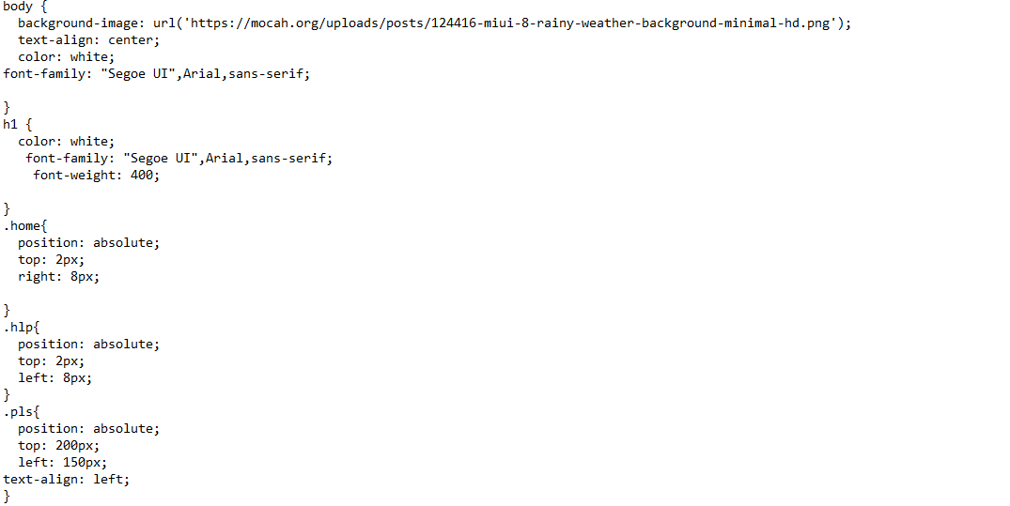
Website Homepage:

Slide 37
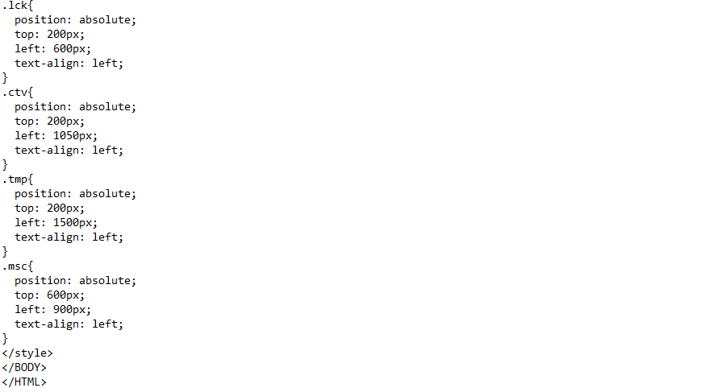
Website Homepage:

Slide 38
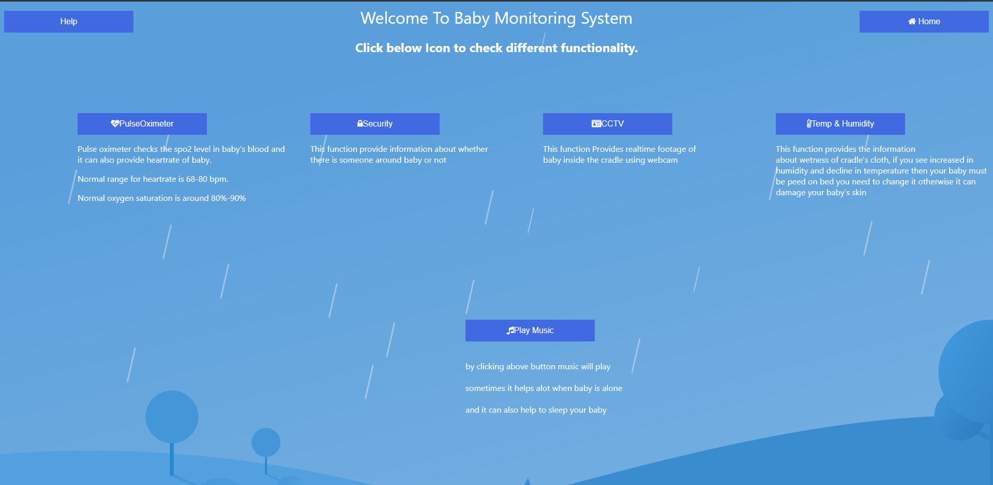
Homepage:

Slide 39
References:
HTML Tutorial by w3schools.com, https://www.w3schools.com/html/default.asp

