Slide 1

ESE 4009 IoT based Cradle system using SIDS monitor
Schematic Capture design
INSTRUCTOR: Prof. Mike Aleshams
Group 6

Slide 2
Group 6
Group members:-
Presented by:-
Rohan Yadav | C0773871
Shahrukh Padaniya | C0769542
Swapnil Sevak | C0777195
Vandana Eaga | C0777215
Shahrukh Padaniya​ | C0769542​

Slide 3
What is schematics capture?
Schematic capture is the process of creating a schematic diagram for an electronic circuit using various tools designed for the job. This can be done from as simple as using a pen and paper to using schematic capture software, including highly expensive electronic design automation suites or packages that can do everything from schematic capture, layout and simulation.

Slide 4
What is schematics capture?
Schematic capture is part of circuit analysis and design; it is the process of "taking" the schematic design from an engineer's head and entering it into a computer or putting it into a piece of paper. In simpler terms, it means that an engineer is designing a circuit that will serve a specific purpose by making use of industry standards and conventions to put the design into a visual state, either via hand drawing or by entering it into a software made for the purpose. It can be seen in the same manner as a digital artist might draw using a tool like Photoshop or a writer using a word processor.

Slide 5
What is schematics capture?
The result of schematic capture is a schematic design or layout that can be used for the following purposes:
Informational -- The final output of schematic capture is more of an informational piece than of an outright physical design of a circuit. It shows what is connected to where and gives a good overview of the inner workings of the circuit. This simply shows the various components of the circuit drawn using industry standard symbols and conventions.

Slide 6
What is schematics capture?
Layout -- When an actual physical circuit design needs to be created, the schematic can be fed into a layout tool that will systematically place and route connections that can be placed directly on a printer circuit board.
Simulation -- A simulation tool can be used to determine whether the schematic design does what is expected or shows flaws in the design.

Slide 7
Top 10 PCB Design Software :-
Altium Designer
Fusion 360
NI Multisim
KiCad EDA
Autodesk EAGLE
DipTrace
Ultiboard
ExpressPCB Plus
CAM350
SolidWorks PCB

Slide 8
What is KiCad ?
KiCad is an open-source software suite for Electronic Design Automation (EDA). The programs handle Schematic Capture, and PCB Layout with Gerber output. The suite runs on Windows, Linux and macOS and is licensed under GNU GPL v3.
The goal of the KiCad project is to provide the best possible cross platform electronics design application for professional electronics designers. Every effort is made to hide the complexity of advanced design features so that KiCad remains approachable by new and inexperienced users, but when determining the direction of the project and the priority of new features, the needs of professional users take precedence

Slide 9
KiCad Schematic Capture
KiCad’s schematic capture is efficient, with all the tools you can expect for such a task. The interface focuses on productivity. There are no complexity limits, as large designs can be divided into hierarchical sub sheets. Various export options are available (PDF, SVG, HPGL, Postscript).

Slide 10
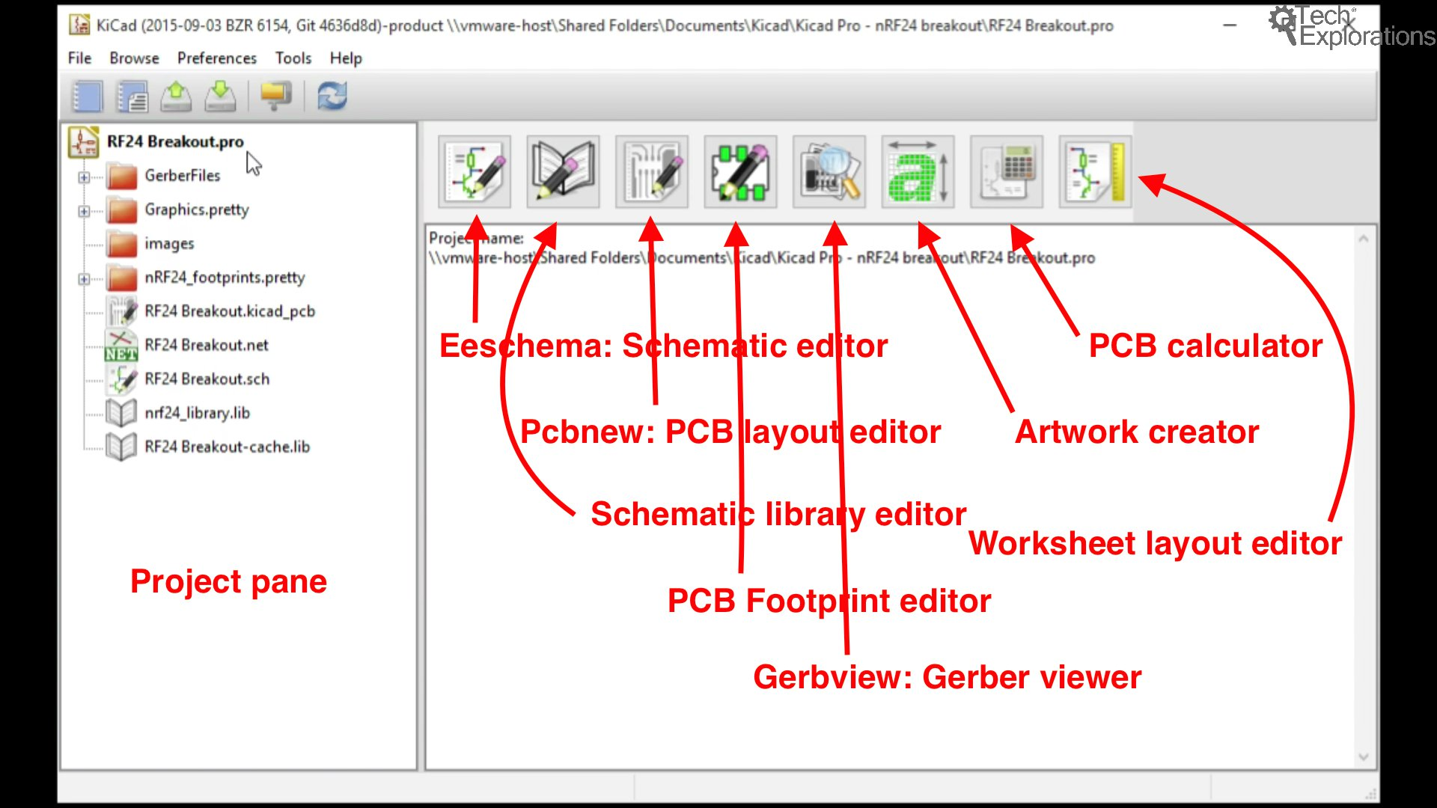
KiCad

Slide 11
Creating a Project
A KiCad project is a combination of multiple files that describe your printed circuit board (PCB). There will be at least one schematic file that describes the function of the PCB. It uses symbols , wires and labels to achieve this. This file is used to generate the connectivity information for the layout as well as defining which footprints will be used.

Slide 12
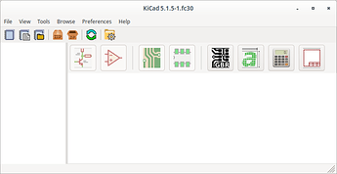
Creating a Project
To create a project, we need to start KiCad like you would any other program. The main window of KiCad will open. It is used to handle tasks at the project level. Use it to create or open projects and to open the tools responsible to edit project files.

Slide 13
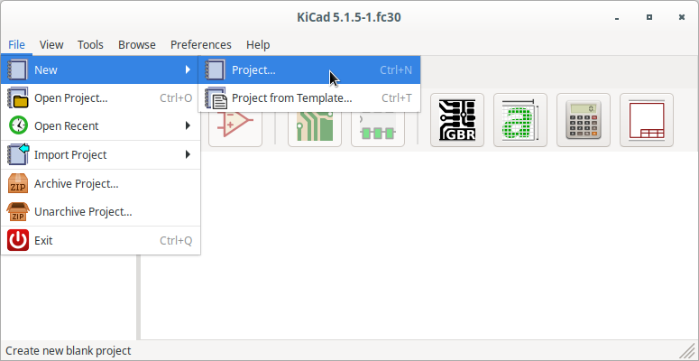
Creating a Project
Create a new project using File->New->Project (or shortcut crtl+n).

Slide 14
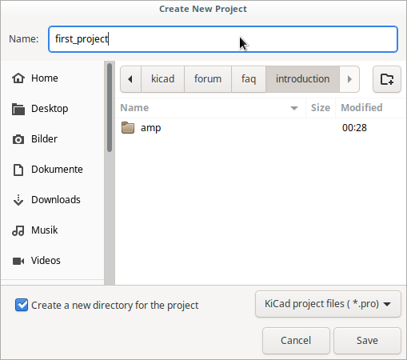
Creating a Project
An operating system dependent file browser like tool will open. With this tool navigate to some place to store your project and enter the project name (example: first_pcb) in the input field. Create the project by selecting “save” (or the equivalent for your operating system).

Slide 15
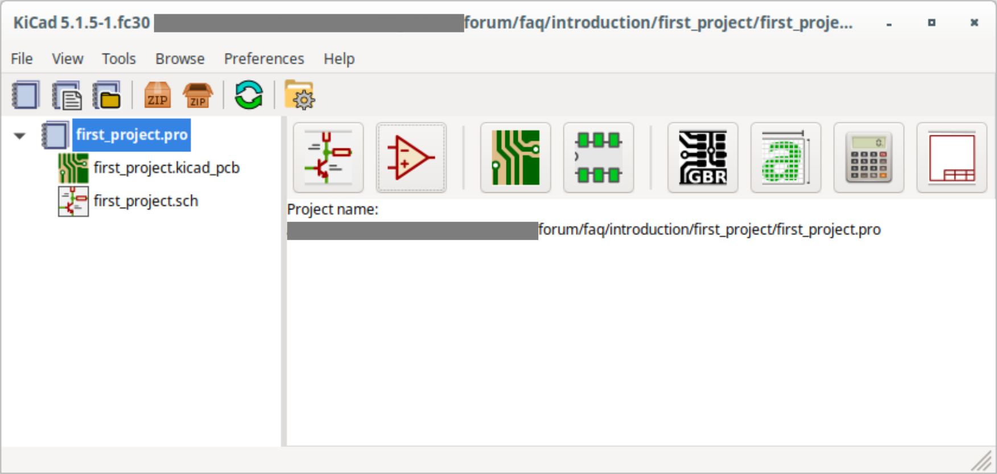
Creating a project
The result will look something like this.

Slide 16
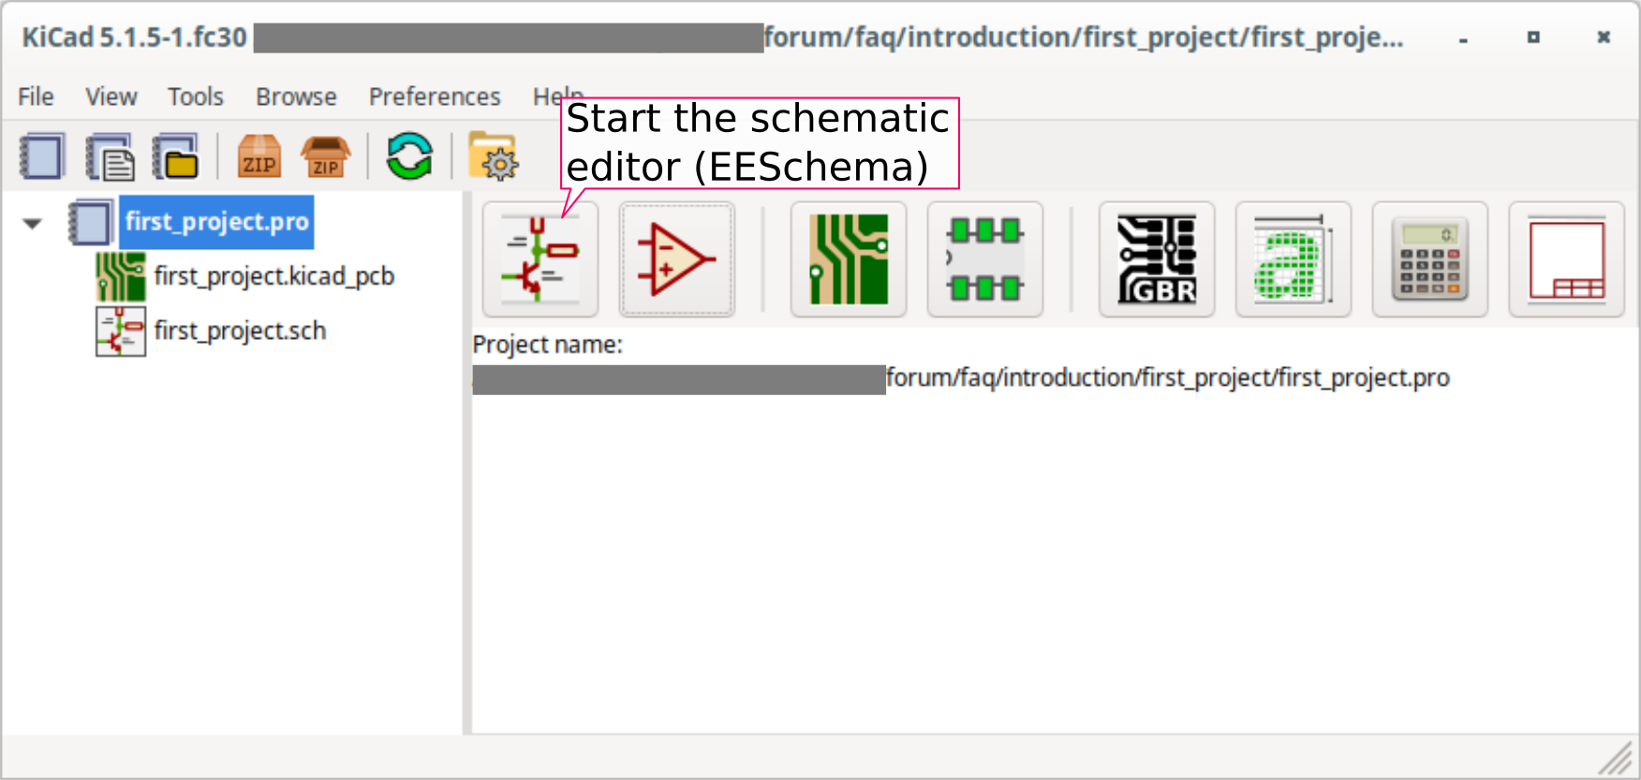
Starting the editor
Open the schematic editor (EESchema) by clicking on the button for the schematic layout editor (leftmost of the large buttons. See screenshot)

Slide 17
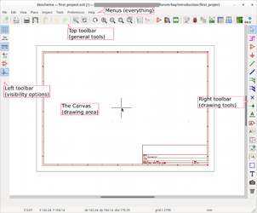
Starting the editor
If this is the first time you open EESchema then a window will pop up asking you how you want your libraries setup. Accept the default option. If the default option is not available, then you somehow did not install libraries with KiCad.
An empty schematic will open for you. I have annotated the important parts of EESchema in the screenshot which shows different parts of EESchema.

Slide 18
Adding symbol in KiCad
Use the add symbol button in the right toolbar (or “place->symbol”) to start the symbol mode. A similar button is in the top toolbar but that one opens the symbol editor.
After that click somewhere on the canvas and the add symbol dialog will come up. Enter part name into the filter field and select the symbol from the result by single clicking. You will now see a preview of the symbol and symbol details in the dialog. Double click on the symbol name or click ok to add the symbol to the schematic.

Slide 19
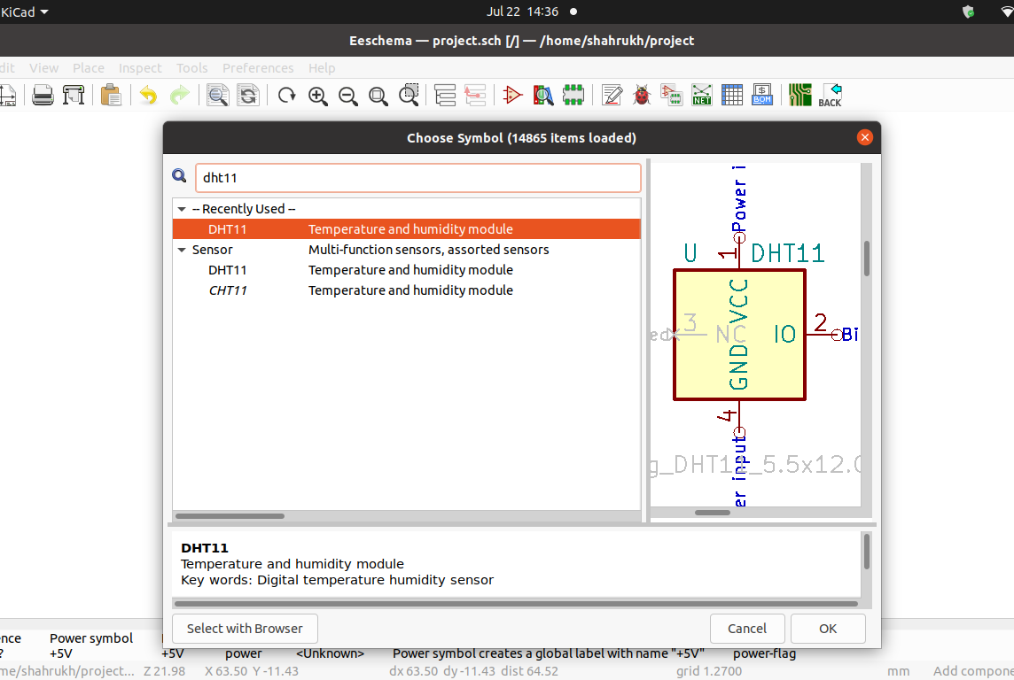
Adding symbol in KiCad - DHT11

Slide 20
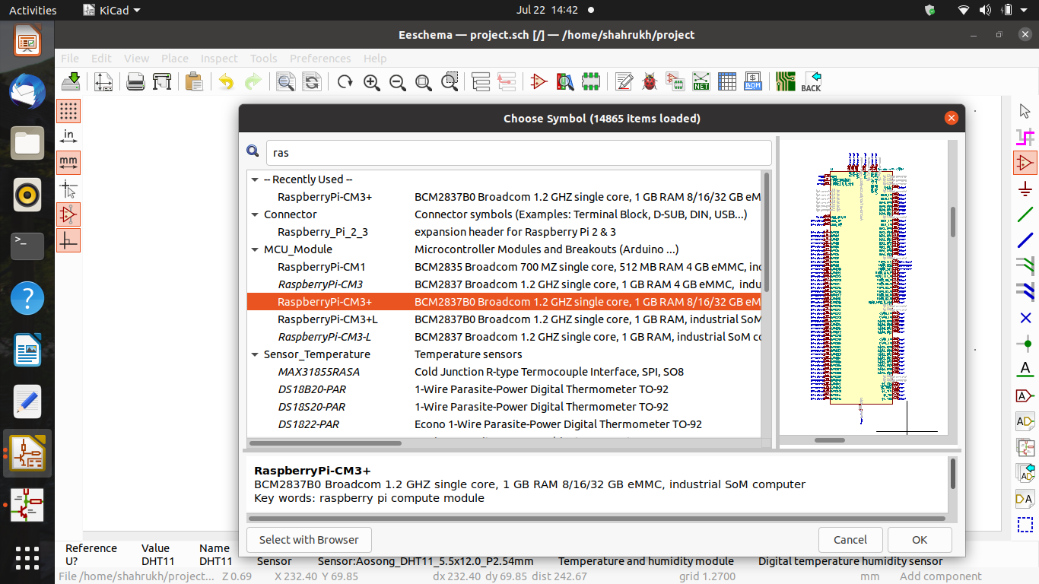
Adding symbol in KiCad – raspberry pi

Slide 21
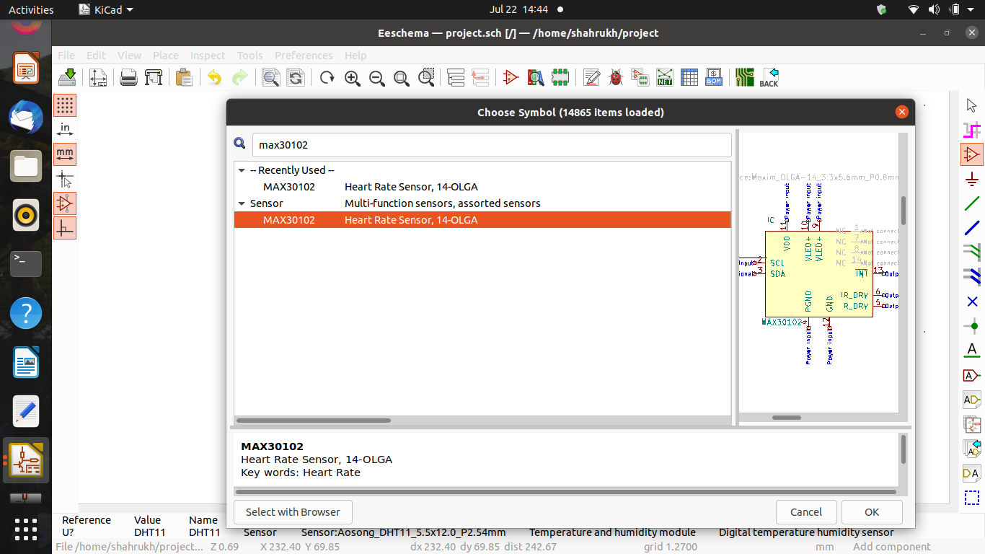
Adding symbol in KiCad – pulse oximeter

Slide 22
Make the Connections
If you look at your symbols you will see that they have lines sticking out of them with a small circle at the end. The lines are called pins and the circle indicates that this pin is not connected. We will use wires to create the connections required. For that start the wire tool found in the right toolbar .
Like with the add symbol tool nothing happens at this point in time. Use left click to start the wire. If you now move the mouse around then you will discover that a green line is following you.

Slide 23
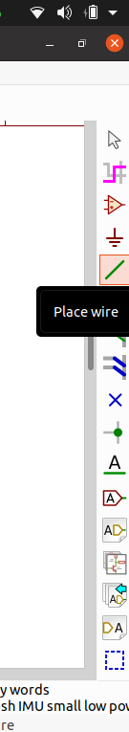
Make the connections:-
To make the connection, click on place area and then on wire.
Now connect the component with another component.
After this click on end wire.

Slide 24
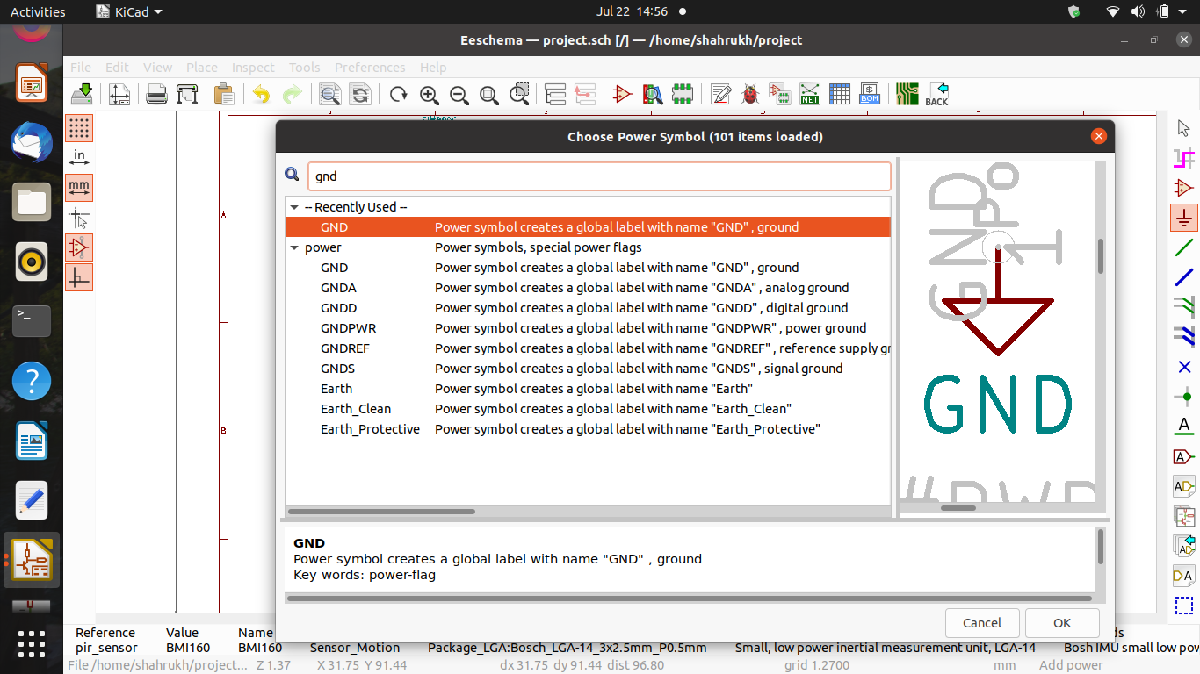
Placing power components:-
To place power components goto place and then power point and then search for the power component which we need like ground or Vcc.

Slide 25
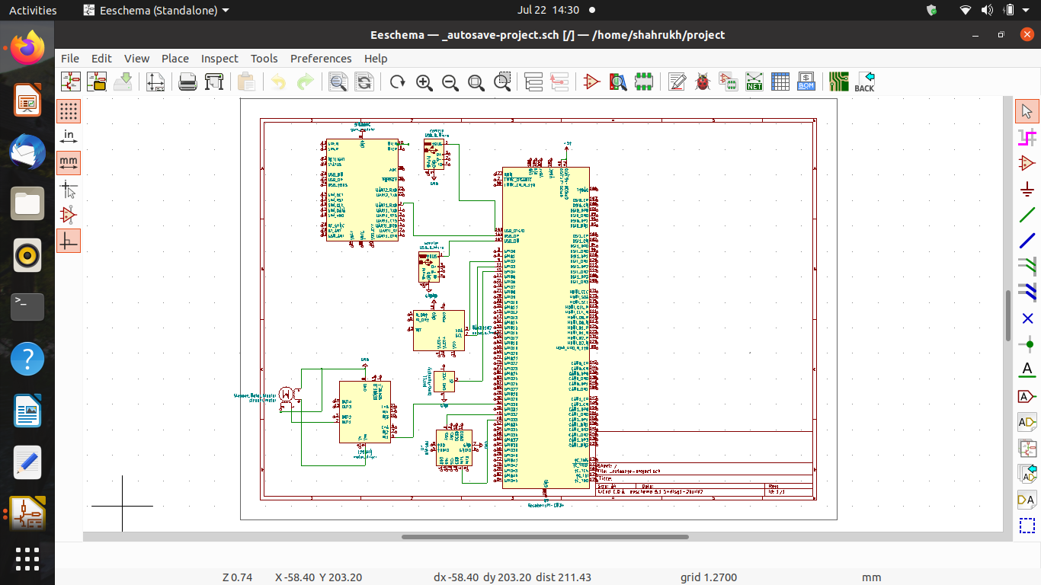
KiCad schematics

Slide 26

Thank you

Slide 27
References
Techopedia. (2015, August 16). What is Schematic Capture? - Definition from Techopedia. Techopedia.com. https://www.techopedia.com/definition/21935/schematic-capture.
Proto-Electronics. (n.d.). Our Top 10 printed circuit design software programmes. Proto. https://www.proto-electronics.com/blog/our-top-10-printed-circuit-design-software-programmes.
KiCad EDA Reviews & Product Details (n.d.)
https://www.g2.com/products/kicad-eda/reviews#details

