Slide 1

ESE 4009 IoT based Cradle system using SIDS monitor
Servo Motor Interface with Raspberry pi
INSTRUCTOR: Prof. Mike Aleshams
Group 6

Slide 2
Content
Overview
Description
Technical Details
Controlling Servo Motor

Slide 3
Overview
In this project, we will learn about Servo Motors, Raspberry Pi Servo Motor Interface and How to Control a Servo Motor using Raspberry Pi.
Here is link of servo motor
https://www.digikey.ca/en/products/detail/adafruit-industries-llc/2442/5774227

Slide 4
Servo Motor
Interfacing a Servo Motor with Raspberry Pi is an interesting topic as Servo Motors are the main components of a Robot.
Manufacturer | Adafruit Industries LLC
Manufacturer Product Number | 2442
Supplier | Adafruit Industries LLC
Description | SERVOMOTOR RC 130 RPM 5V

Slide 5
Description
This little micro servo rotates 360 degrees fully forward or backwards, instead of moving to a single position.
We can use any servo code, hardware or library to control these servos. Good for making simple moving robots. Comes with five horns and attachment screws.

Slide 6
Technical Details
No load speed: 110RPM (4.8v) / 130RPM (6v)
Running Current (at no load): 100mA (4.8v) / 120mA (6v)
Peak Stall Torque (4.8v): 1.3 kg/cm / 18.09 oz/in
Peak Stall Torque (6v): 1.5 kg/cm / 20.86 oz/in
Stall Current: 550mA (4.8v) / 650mA (6v)
Dimensions: 32mm x 30mm x 12mm / 1.3" x 1.2" x 0.5" Wire Length: 240mm / 9.4" Weight: 10g Spline Count: 21

Slide 7
Controlling Servo-Motor
In order to control a Servo Motor, We need to use a technique called Pulse Width Modulation or PWM.
In PWM technique, there will be sending a pulse of variable width and the position of the Servo Motor’s shaft will be set by the width or length of the Pulse.

Slide 8
Controlling Servomotor
The frequency of the PWM Signal is a fixed value and is dependent on the type of the Servo Motor. In our case, both SG90 and MG90S Servo Motors have a PWM Frequency of 50Hz.
At 50Hz i.e. a period of 20ms, the minimum pulse width is 1ms and the maximum pulse width is 2ms.
Most servo motors can have a sweep area of 180 degrees i.e. 90 degrees on either side of the neutral position.

Slide 9
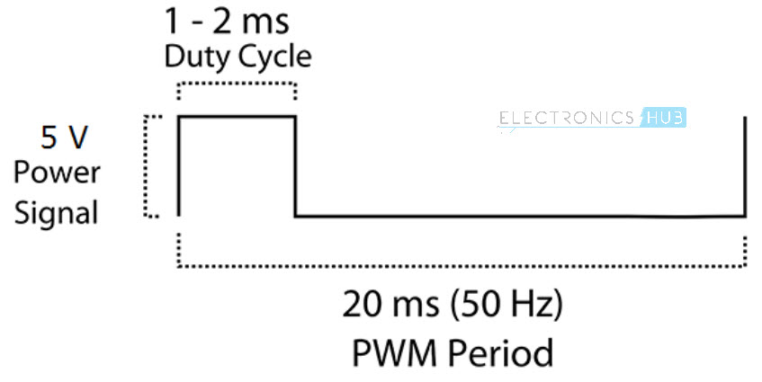
Controlling Servomotor

Slide 10
Controlling Servomotor
When the pulse width of the PWM Signal is 1ms, the position of the servo is all the way to the LEFT. The Duty Cycle of this position is (1ms/20ms) x 100 = 5%.
Similarly, for pulse widths of 1.5ms and 2ms, the position of the servo is MIDDLE (with duty cycle of 7.5%) and far RIGHT (with duty cycle of 10%).

Slide 11
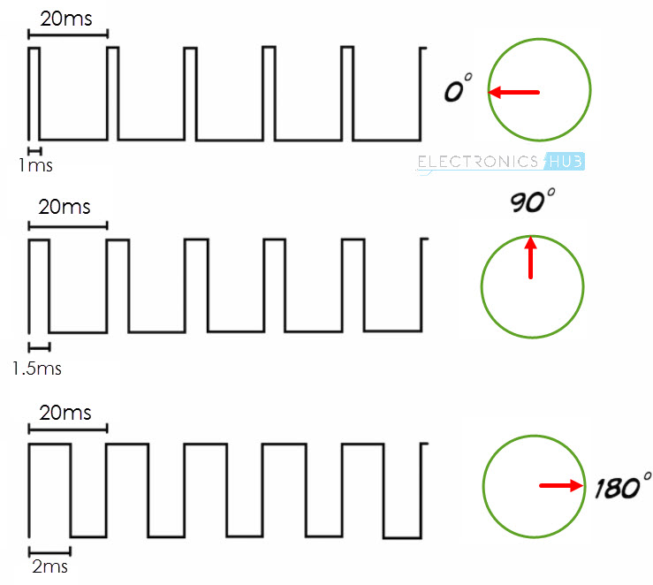
Controlling Servomotor

Slide 12
L298N DC Motor Driver
It can control both speed and spinning direction of two DC motors.
And as a bonus, it can even control a bipolar stepper motor like NEMA 17 and servo motor also.

Slide 13
Controlling a Servo Motor
In order to have a complete control over Servo motor, we have to control its speed and rotation direction. This can be achieved by combining these two techniques.
PWM – For controlling speed
H-Bridge – For controlling rotation direction

Slide 14
H-Bridge – For controlling rotation direction
The DC motor’s spinning direction can be controlled by changing polarity of its input voltage. A common technique for doing this is to use an H-Bridge.
An H-Bridge circuit contains four switches with the motor at the center forming an H-like arrangement.

Slide 15
H-Bridge – For controlling rotation direction
Closing two particular switches at the same time reverses the polarity of the voltage applied to the motor. This causes change in spinning direction of the motor.
Below animation illustrates H-Bridge circuit working.

Slide 16
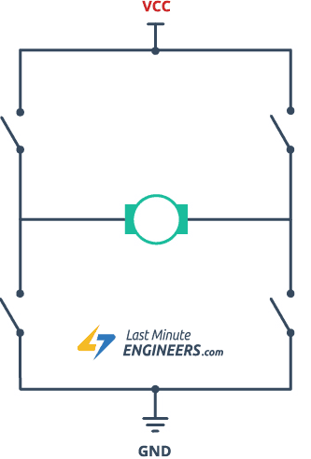
H-Bridge – For controlling rotation direction

Slide 17
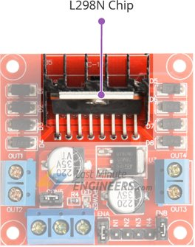
L298N Motor Driver IC

Slide 18
L298N Motor Driver IC
At the heart of the module is the big, black chip with chunky heat sink is an L298N.
The L298N is a dual-channel H-Bridge motor driver capable of driving a pair of DC motors. That means it can individually drive up to two motors making it ideal for building two-wheel robot platforms.

Slide 19
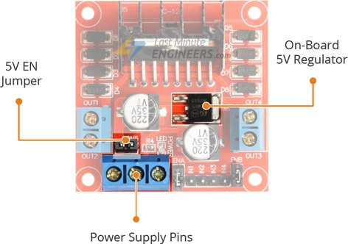
Power Supply

Slide 20
Power Supply
The L298N motor driver module is powered through 3-pin 3.5mm-pitch screw terminals. It consists of pins for motor power supply(Vs), ground and 5V logic power supply(Vss).
The module has an on-board 78M05 5V regulator from STMicroelectronics. It can be enabled or disabled through a jumper.

Slide 21
Power Supply
When this jumper is in place, the 5V regulator is enabled, supplying logic power supply(Vss) from the motor power supply(Vs). In this case, 5V input terminal acts as an output pin and delivers 5V 0.5A.
You can use it to power up the Raspberry or other circuitry that requires 5V power supply.

Slide 22
Output Pins
The L298N motor driver’s output channels for the motor A and B are broken out to the edge of the module with two 3.5mm-pitch screw terminals.
You can connect two DC motors having voltages between 5 to 35V to these terminals.

Slide 23
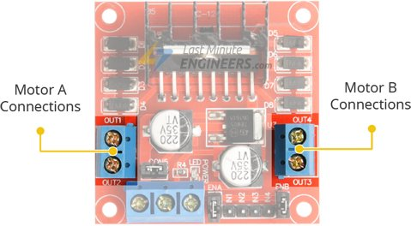
Output Pins
Each channel on the module can deliver up to 2A to the DC motor. However, the amount of current supplied to the motor depends on system’s power supply.

Slide 24
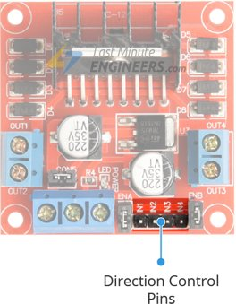
Direction Control Pins
Input1 | Input2 | Spinning Direction
Low(0) | Low(0) | Motor OFF
High(1) | Low(0) | Forward
Low(0) | High(1) | Backward
High(1) | High(1) | Motor OFF

Slide 25
Components Required
Raspberry Pi
Servo Motor
Connecting Wires
Power Supply
Computer

Slide 26
Connection guide
Connect the V_{CC} and GND of the Tower Pro SG90 Servo Motor to +5V and GND pins of the power supply. Then connect the PWM Pin of the Servo Motor to Physical Pin 22 of Raspberry Pi i.e. GPIO25.
Make the ground common between Raspberry Pi and the Power Supply of the Servo Motor.

Slide 27
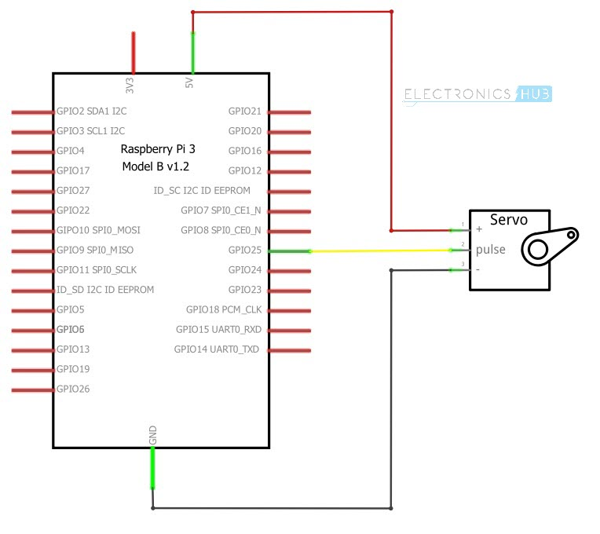
Circuit Diagram

Slide 28
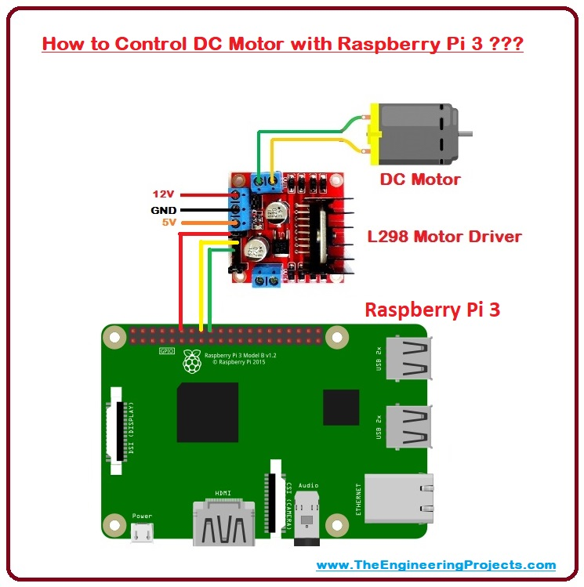
Circuit Diagram

Slide 29
Code
#include <wiringPi.h> #include <stdio.h> int main (void) { printf ("Raspberry Pi wiringPi test program\n"); wiringPiSetupGpio(); pinMode (18, PWM_OUTPUT) ; pwmSetMode (PWM_MODE_MS); pwmSetRange (2000); pwmSetClock (192); pwmWrite(18,150); delay(1000); pwmWrite(18,200); return 0; }

Slide 30
Commands for linux
gpio -g mode 18 pwm
gpio pwm-ms
gpio pwmc 192
gpio pwmr 2000
gpio -g pwm 18 150
gpio -g pwm 18 200

Slide 31
References
Datasheet of servo motor
Interface L298N DC Motor Driver Module with Arduino, Retrived from https://lastminuteengineers.com/l298n-dc-stepper-driver-arduino-tutorial/
Electronics Hub,February 14, 2018, Raspberry Pi Servo Motor Interface, Retrived from https://www.electronicshub.org/raspberry-pi-servo-motor-interface-tutorial/
Jim blom, May 8,2019, Raspberry pi GPIO, retrived from https://learn.sparkfun.com/tutorials/raspberry-gpio/c-wiringpi-api

