Slide 1
CodeQuest: An Immersive Coding Adventure
CodeQuest is an engaging web-based game that lets players embark on a captivating journey, mastering programming concepts through interactive storytelling and dynamic animations.

Slide 2



Heroic Characters
Kalpya Shah
A brilliant young coder with a thirst for knowledge and a knack for problem- solving.
Jaydev Prajapati A creative technologist who weaves intricate
narratives and brings them to life through code.
Sharanam Shah
A versatile developer with a keen eye for design, committed to crafting an unforgettable user experience.
Bhumi Shah
A brilliant designer with lots of creativity, which makes the user experience mind blowing.

Slide 3

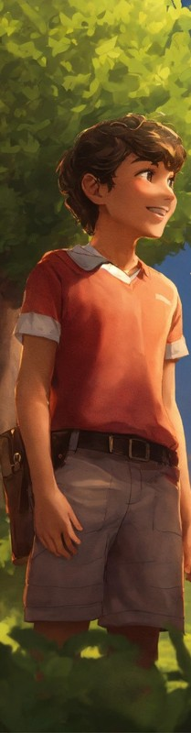

Captivating Narrative
1
Chapter 1: The Awakening
Players are introduced to the world of CodeQuest and embark on a quest to solve their first coding challenge.
2
Chapter 2: The Enchanted Forest
As the story progresses, players navigate through a lush, mystical forest, unlocking new coding skills along the way.
3
Chapter 3: The Haunted Castle
In the final chapter, players must confront their greatest challenge yet, using their programming prowess to overcome the obstacles within a haunted castle.

Slide 4

Engaging Storytelling
1
Immersive Narrative The game's captivating story draws players in, making them feel like
they're part of the adventure.
2
Relatable Characters Players can connect with the game's diverse cast of characters, each with their
own unique personalities and motivations.
3
Branching Paths
The story offers multiple branching paths, allowing players to make choices that impact the outcome of the game.

Slide 5

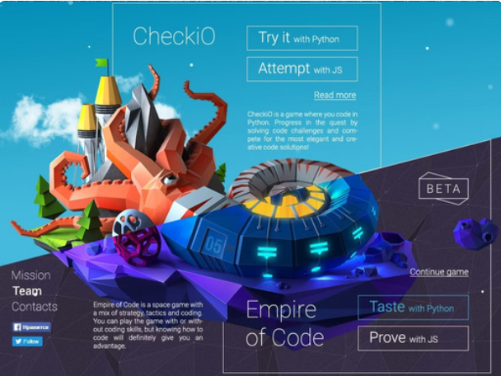
Gamified Concepts
Adaptive Difficulty The game adjusts the complexity of the challenges
based on the player's skill level, ensuring a tailored learning
experience.
Coding challenges are seamlessly integrated into the
game's narrative, learning feel natural and engaging.
making
Instant Feedback Players receive immediate feedback on their code, allowing them to quickly
identify and correct any errors.
Rewarding Progression Successful completion of
challenges unlocks new story elements and features, motivating players to keep
learning and improving.

Slide 6



Dynamic Animations
Expressive Characters
The game's characters come to life through fluid, emotive animations, enhancing the overall immersive experience.
Captivating Visuals Magical spells, enchanted environments, and other visually stunning effects are seamlessly integrated into the game's world.
Responsive Environments The game's environments react dynamically to the player's actions, creating a sense of interactivity and immersion.

Slide 7


TOOLS
ELEVENLAB.IO
ADOBE EXPRESS
CANVA
XAMPP
VS CODE
LOTTIE FILES
FIGMA

Slide 8
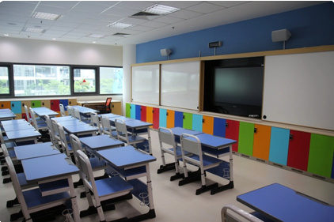
Immersive Learning Experience
Innovative Pedagogy CodeQuest leverages cutting-edge educational techniques to make learning programming concepts engaging and effective.
Gamified Approach
The game seamlessly blends educational content with entertaining gameplay, fostering a love for coding and problem-solving.
Collaborative Learning Players can engage with a community of fellow coders, sharing insights and solutions to enhance their learning experience.

Slide 9


Target Audience
Young Learners
CodeQuest is designed to captivate and inspire the next
1
generation of coders, cultivating their passion for technology from an early age.
Hobbyists
The game appeals to coding enthusiasts who want to enhance their skills in a fun and immersive way, beyond traditional learning methods.
2
Educators
CodeQuest offers a unique, engaging platform for teachers to incorporate coding education into their classrooms, fostering problem-solving and computational thinking.
3

Slide 10



Key Features
Captivating Narrative
Immersive, story-driven gameplay that hooks players and makes learning feel natural.
Gamified coding exercises that adapt to player skill levels, providing instant feedback and a sense of progression.
Visually stunning effects and responsive environments that enhance the overall learning experience.
Opportunities for players to engage with a community of fellow coders, sharing insights and solutions.
Interactive Coding Challenges
Dynamic Animations
Collaborative Learning

Slide 11


Potential Impact
Fostering Coding Literacy
CodeQuest aims to make
coding education more accessible and engaging, empowering a new generation of problem-solvers and digital innovators.
Promoting STEM Education
The game's immersive
approach to teaching programming concepts can inspire young learners to pursue careers in the STEM fields.
Enhancing Computational Thinking
By solving interactive coding challenges, players develop critical- thinking and problem-solving skills that are valuable in any field.

Slide 12


THANK YOU
$$≫$$
$$≫$$

