Slide 1


XENIA’26
HACKATHON
BUILD. INNOVATE. COMPETE
Secure Content Distribution Platform
Problem Statement ID: NMA2
Problem Statement Title : Secure Content Distribution Platform
Domain: NeuraMach.AI
Team Name : Code:201

Slide 2
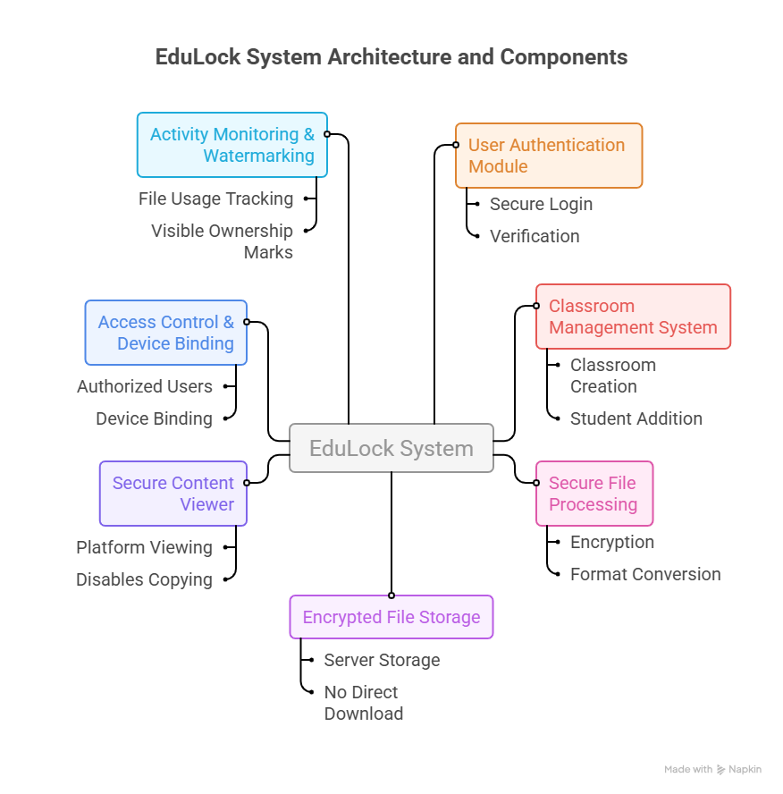
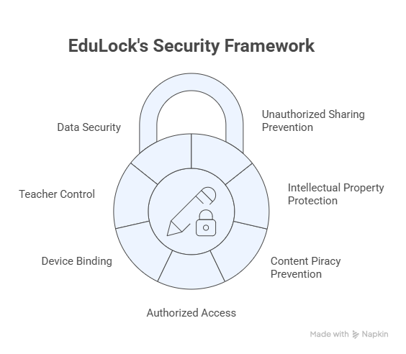
IDEA TITLE

Slide 3
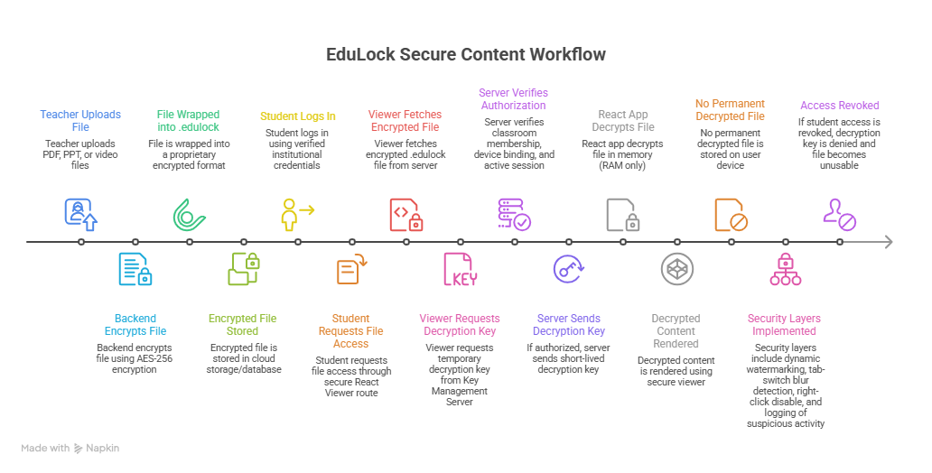
TECHNICAL APPROACH
The detailed explanation for the Workflow ,Technical details and Output is given in the below document:
https://drive.google.com/drive/folders/1hZdtjAiEIL90T_qnfr3kyXPDsdnsff3i?usp=sharing

Slide 4
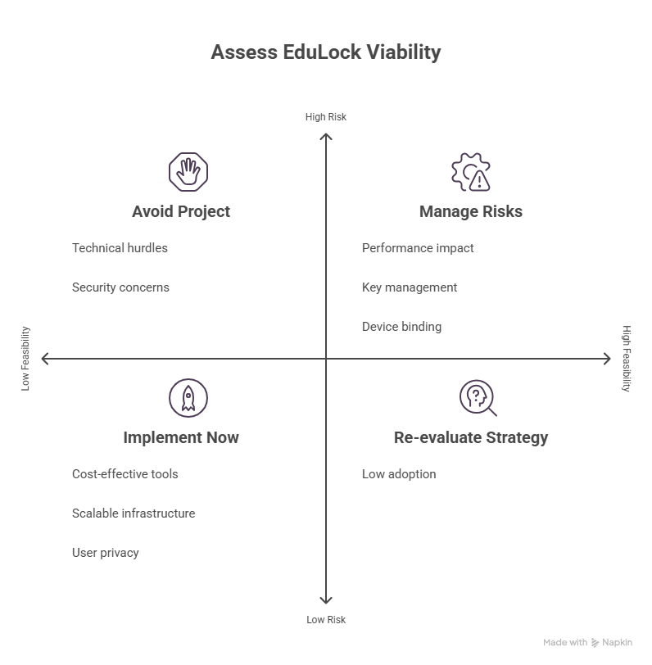
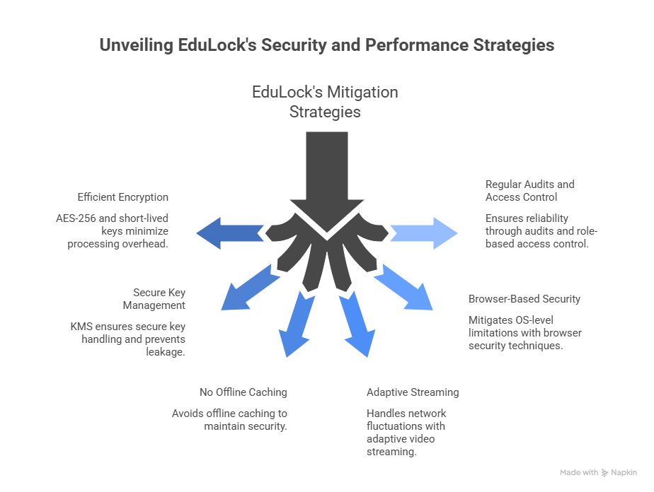
FEASIBILITY AND VIABILITY

Slide 5
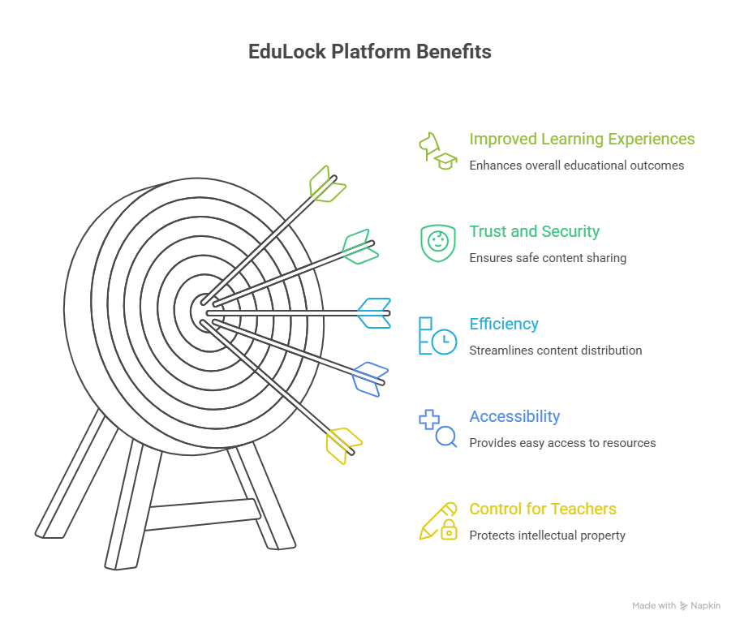
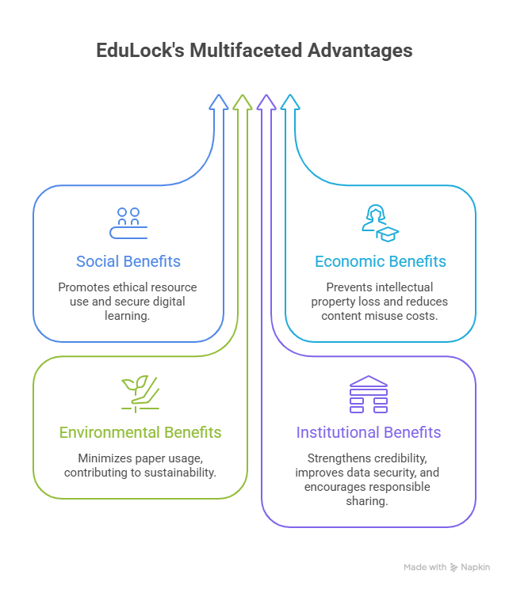
IMPACT AND BENEFITS

Slide 6
RESEARCH AND REFERENCES
GitHub Repository : https://github.com/Shahu1906/Secure_Content_Distribution.git
Drive Link: https://drive.google.com/drive/folders/1hZdtjAiEIL90T_qnfr3kyXPDsdnsff3i?usp=sharing

