Slide 1
PIP4004 - INTERNSHIP Review-3 Presentation DataInsightAI: An Intelligent Natural Language to SQL Query Generation System
Student Details
Name | SHAHUL HAMEED
Roll No | 20211CIT0125
Section | 8CIT-02
Batch No.
Under the Supervision of,
Mr.Tanveer Ahmed
Assistant Professor
School of Computer Science and Engineering
Presidency University
Name of the Program: CSE-IOT
Name of the HoD: Dr. S P ANANDRAJ
Name of the Program Project Coordinator: Dr.Sharmasth Vali Y
Name of the School Internship/Project Coordinators: Mr. Md Ziaur Rahman /
Dr. Sampath A K / Dr. Abdul Khadar A

Slide 2
Content
Title
Abstract
Review of literature
Problem Identification, and formulation of problem
Internship Roadmap
Impact and advantages of the proposed work
References

Slide 3
Abstract
The DataInsights project is a Natural Language Interface to Database (NLIDB) system designed to simplify data access and analysis for non-technical users. Built using FastAPI, it integrates OpenAI's Assistants API to convert user-provided natural language queries into structured SQL queries, which are then executed on a MySQL database. The system supports real-time, interactive conversations by managing session-based threads and provides contextual follow-ups to enhance the querying experience.
This project demonstrates the potential of Generative AI to bridge the gap between complex data systems and everyday users, enabling quick decision-making and insightful business analysis through an intuitive web interface.

Slide 4
Review of Literature
” Next-Generation Database Interfaces: A Survey of LLM-based Text-to-SQL”
– Zijin Hong , Zheng Yuan, Qinggang Zhang, Hao Chen, Junnan Don, Feiran Huang, Xiao Huang
provides a comprehensive overview of recent advancements in leveraging large language models (LLMs) for translating natural language into SQL queries. It effectively categorizes existing approaches, highlights key challenges like schema linking and generalization, and discusses future research directions in building robust NLIDB systems.

Slide 5
“Text2SQL is Not Enough: Unifying AI and Databases with TAG”
– Asim Biswal, Liana Patel, Siddarth Jha, Amog Kamsetty, Shu Liu, Joseph E. Gonzalez, Carlos Guestrin, and Matei Zaharia
The paper introduces TAG (Text-to-Anything with Guided execution), a novel framework that goes beyond traditional Text2SQL by supporting complex analytical workflows. It combines LLMs with database systems to generate executable code for diverse tasks, including visualization and multi-step reasoning.

Slide 6
Objectives
Enable Natural Language Querying of Databases
Integrate Generative AI for Text-to-SQL Translation
Develop a FastAPI-Based Interface for Real-Time.
Ensure Data Integrity and Query Safety

Slide 7
Problem Identification and Formulation
Challenges in Traditional database query System
SQL Expertise Requirement
Poor User Experience
Limited Flexibility in Querying
Scalability and Personalization Issues
Problem Statement
How can Generative AI and fine-tuned language models be utilized to enable users to query databases using natural language, generating accurate and context-aware SQL responses—thereby improving accessibility, reducing reliance on technical skills, and streamlining data-driven decision-making?

Slide 8
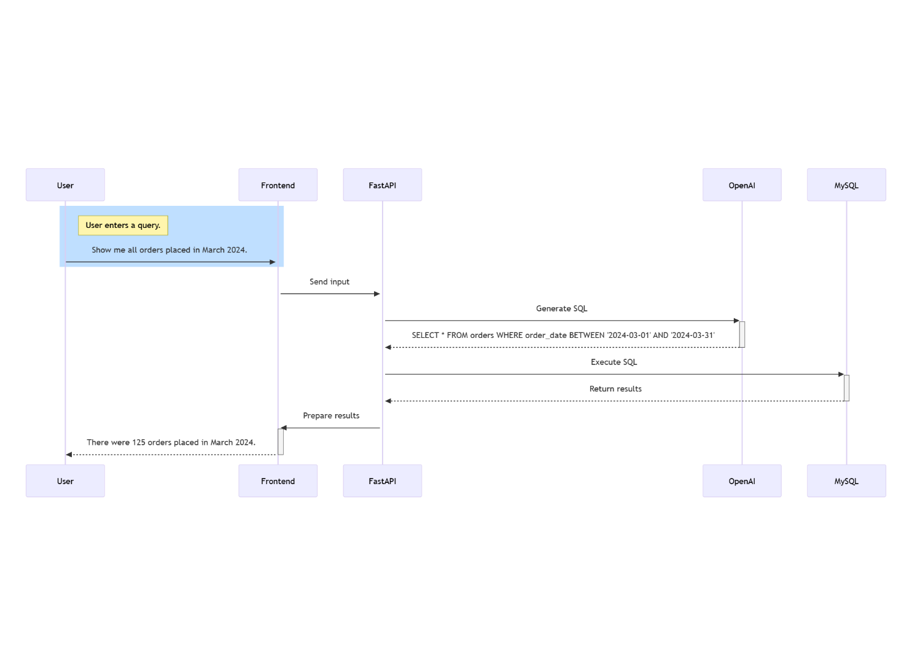
Architecture

Slide 9
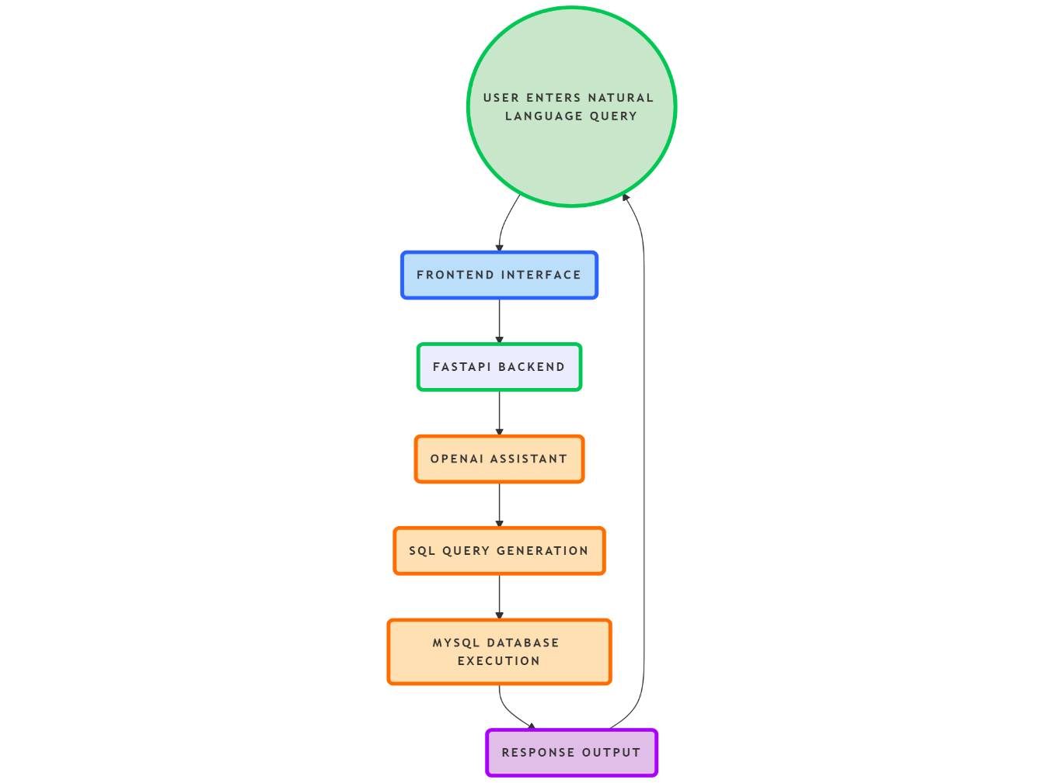
Workflow Diagram

Slide 10
Roadmap and Proposed Work
ARTIFICIAL INTELLIGENCE AND MACHINE LEARNING
Technology Stack
Frontend
HTML
JavaSCript
Backend
FastAPI
OpenAI Assistants API
Database
MySQL
Development Tools – Python,Uvicorn,JSOn

Slide 11
Development Phases
Requirement Gathering & System Design
Dataset Creation & Setup
API Development with FastAPI
Integration with OpenAI’s Assistants API
Frontend Development
Testing & Validation
Deployment & Hosting

Slide 12
Impact and Advantages of Proposed Work
Impact
Enhanced Accessibility for Non-Technical Users – By enabling natural language queries, your project democratizes access to data, allowing non-technical users to extract insights without needing SQL expertise.
Increased Efficiency and SpeedWith real-time natural language querying and automated SQL generation, the system streamlines the process of data retrieval.
Advantages
User-Friendly InterfaceThe system enables non-technical users to interact with complex databases using simple, natural language.
Real-Time Data Access:– y leveraging FastAPI and integrating with OpenAI’s Assistants API, the system provides real-time responses, allowing users to quickly access and analyze data as queries are made.
Increased Productivity:– Automating the SQL query generation process removes the need for manual query writing, saving time and reducing the risk of errors.

Slide 13
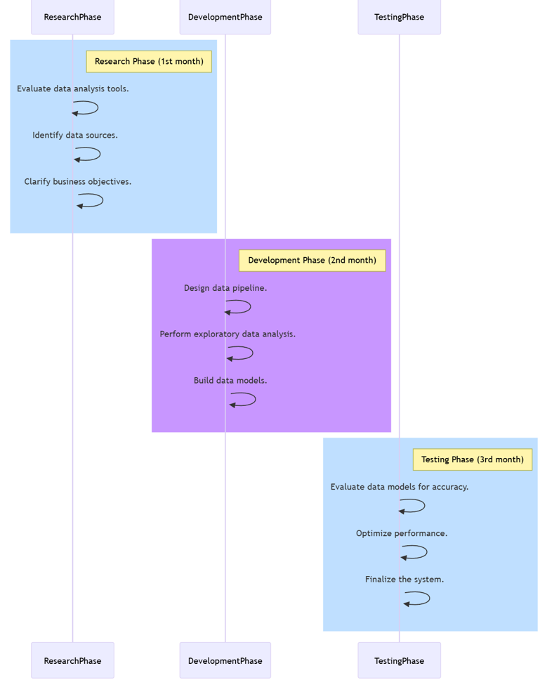
Timeline Gantt Chart

Slide 14
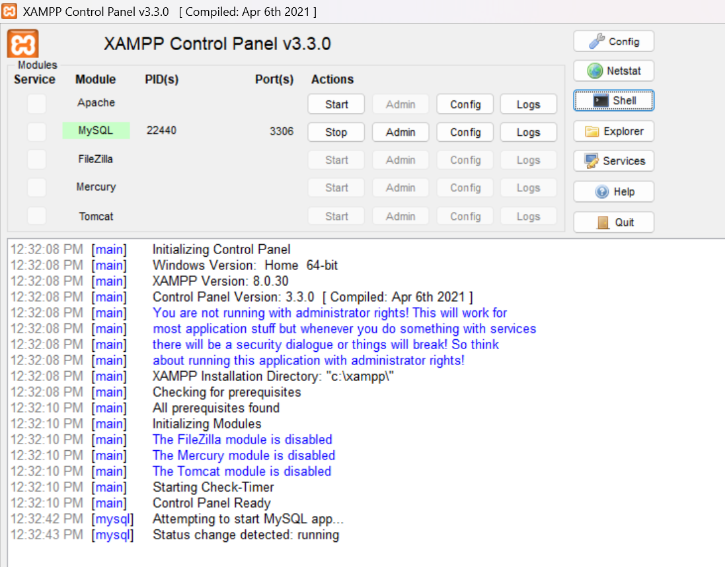
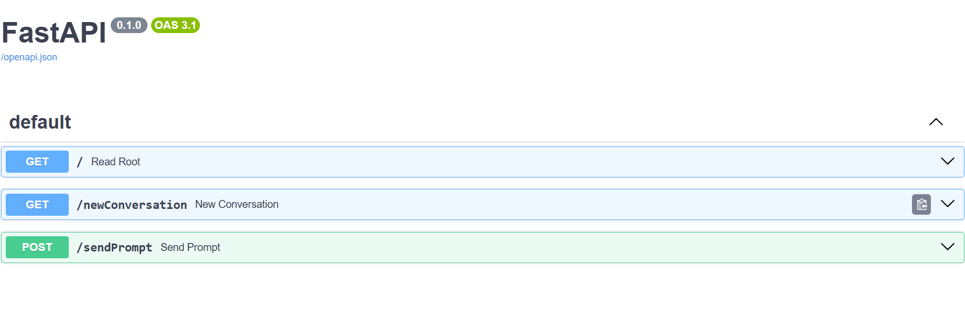
OUTCOMES
FastAPI Backend
XAMPP Control Panel

Slide 15
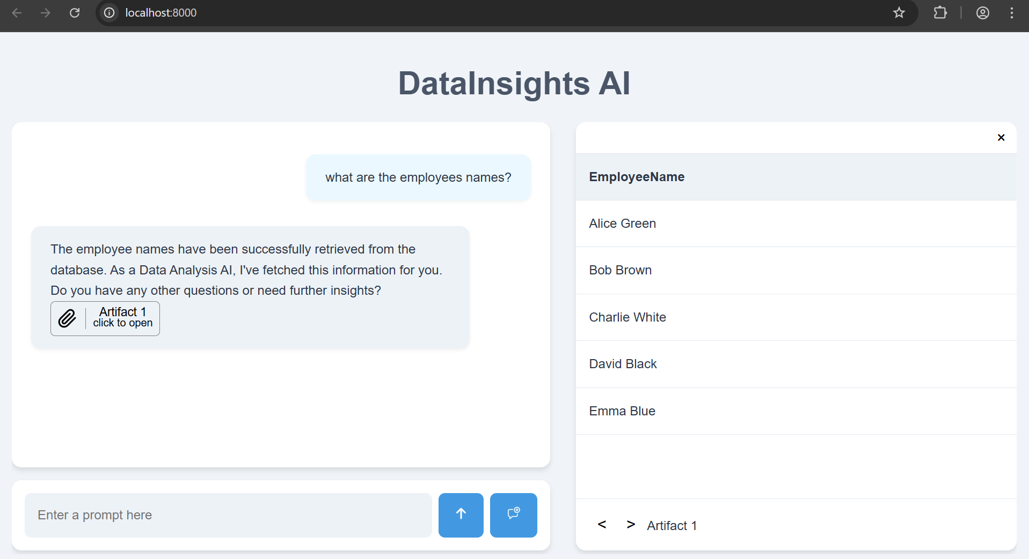
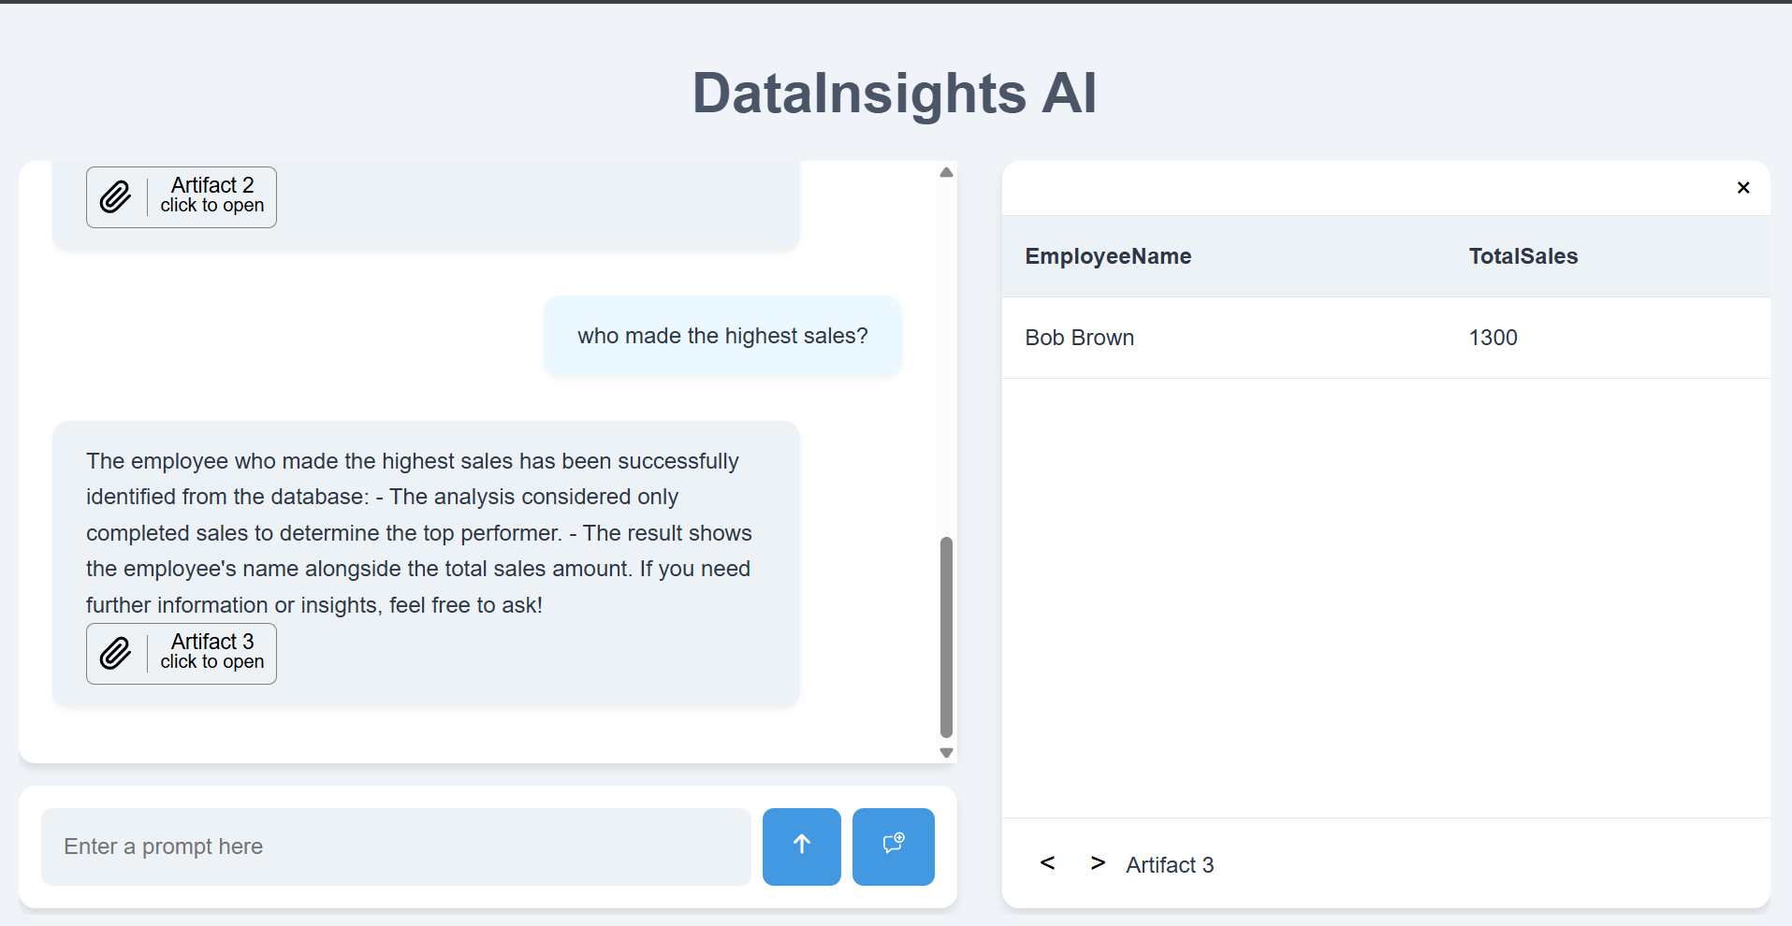
OUTCOMES
Text2Sql Generation

Slide 16

SUSTAINABLE DEVELOPMENT GOALS
The project work carried out here is mapped to SDG-9 Industry
Innovation and Infrastructure
The project plays a key role in reaching SDG- 9 by boosting innovation through the use of AI, which simplifies SQL generation from natural language. This makes data systems not only smarter but also more user-friendly. Additionally, it improves digital infrastructure by streamlining data interactions, making them quicker and more efficient across various industries.

Slide 17
REFERENCES
Next-Generation Database Interfaces: A Survey of LLM-based Text-to-SQL by Zijin Hong , ,Zheng Yuan, Qinggang Zhang, Hao Chen, Junnan Don, Feiran Huang, Xiao Huang
Text2SQL is Not Enough: Unifying AI and Databases with TAG by Asim Biswal, Liana Patel, Siddarth Jha, Amog Kamsetty, Shu Liu, Joseph E. Gonzalez, Carlos Guestrin, and Matei Zaharia
Text2SQL Generation Based on Inverse Normalized Schema Linking by Jun Tie, Ziqi Fan ,Chong Sun, Boer Zhu, Lu Zheng
Enhancing Text2SQL Generation with Syntactic Information and Multi-task Learning by Haochen Li and Minghua Nuo
http://arxiv.org/abs/1906.07348

Slide 18
Github Link
https://github.com/Shahul0912/Text2Sql

Slide 19
Q&A

Slide 20
Thank you !!

