Slide 1
Healthcare Analytics for Doctor Visits
Major Project: Factors Influencing Doctor Visits
Shahul Hameed
Sathyabama Institute Of Science and Technology
APPLY_172719625266f2ec5ce0098
INTERNSHIP_172663295366ea53f910591

Slide 2
TABLE OF CONTENTS
01
02
03
04
05
PROBLEM STATEMENT
PROJECT DESCRIPTION
WHO ARE THE END USERS?
TECHNOLOGY USED
CONCLUSION

Slide 3
01
PROBLEM STATEMENT

Slide 4
PROBLEM STATEMENT
Identify duplicate records.
Analyze illness count based on individuals.
Study gender-wise illness distribution.
Income distribution analysis.
Reduced activity due to illness by gender.
Check missing values in dataset.
Variable correlation in dataset.

Slide 5
02
PROJECT DESCRIPTION

Slide 6
PROJECT DESCRIPTION
This project analyzes data on doctor visits, illness rates, income, and insurance coverage.
It focuses on the impact of income, gender, and health status on hospital visits and reduced activity due to illness.

Slide 7
03
END USERS

Slide 8
END USERS
Healthcare providers, insurance companies, and public health policymakers can use this analysis to understand healthcare access, illness frequency, and income impact on health.

Slide 9
04
TECHNOLOGY USED

Slide 10
TECHNOLOGY USED
Data Analysis: Python (Pandas, NumPy)
Data Visualization: Matplotlib, Seaborn
Presentation: Microsoft PowerPoint or Google Slides
Jupyter Notebook: For initial data exploration and analysis.

Slide 11
05
CONCLUSION

Slide 12
RESULTS
Chart 1: Income vs Average Number of Hospital Visits
Chart 2: Chronic Illnesses vs Average Number of Hospital Visits
Chart 3: Health Status vs Total Number of Visits

Slide 13
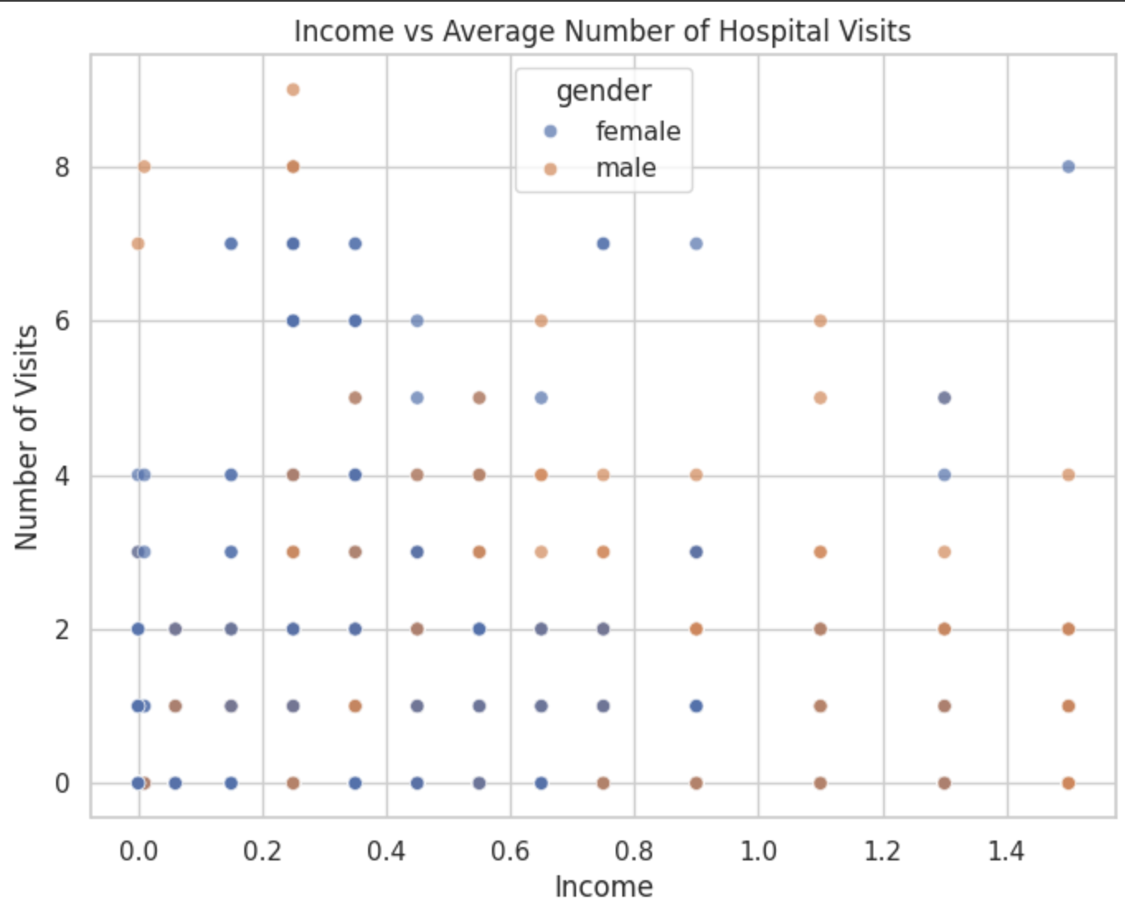
Income vs Average Number of Hospital Visits - Chart

Slide 14
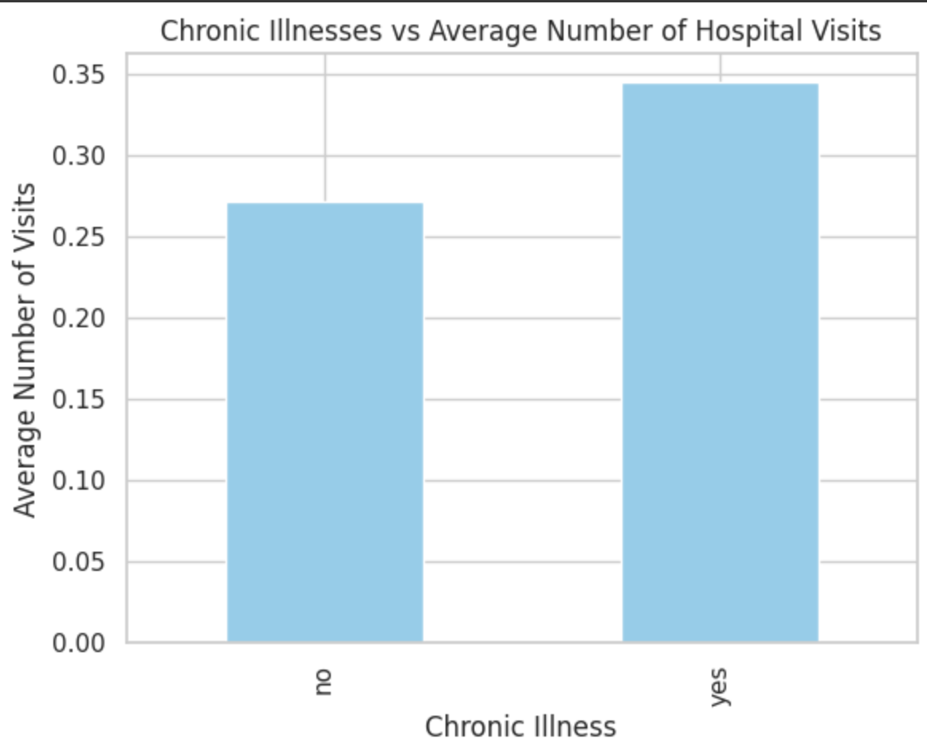
Chronic Illnesses vs Average Number of Hospital Visits - Chart

Slide 15
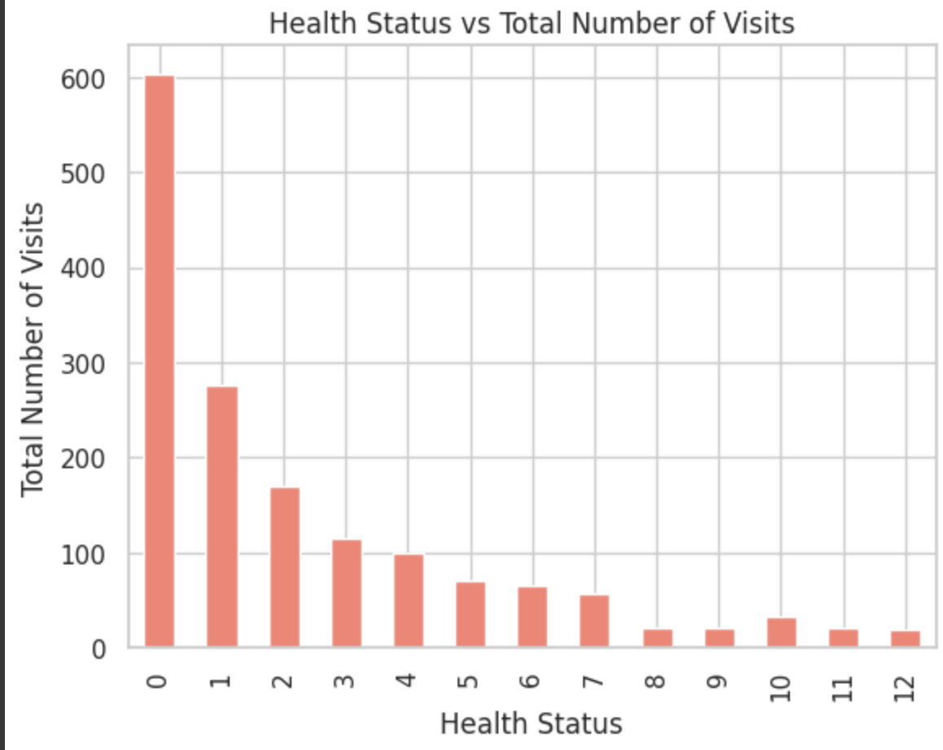
Health Status vs Total Number of Visits - Chart

Slide 16
THANKS
Thank you for reviewing the Doctor's Visit project.
Do you have any questions?
Shahulofficial16@gmail.com
+91 98949 18026
Linkedin

