Slide 1

PROJECT HURRICANIX eLEARNING

Slide 2


Meet the presenters
SYED SHAH HUSSAIN​​
​
MAHAD WAJID

Slide 3

Introduction
Our HURRICANIX eLEARNING platform is designed to make learning accessible and convenient for everyone. With our online platform, you can access a wide range of courses and materials on various subjects, all in one place. Whether you're a student looking to supplement your education, a working professional looking to upgrade your skills, or simply someone who wants to learn something new, our app has something for you. With interactive features, quizzes, attempting assignment in real-time with integrated applications and progress tracking, our app makes it easy to stay engaged and motivated as you learn.
​

Slide 4

Purpose
Providing a diverse range of courses and materials accessible from anywhere, catering to students, professionals, and lifelong learners.
Fostering interactive and engaging learning experiences through quizzes, real-time assignments, and integrated applications.
Tracking individual progress to personalize learning journeys and enhance motivation.
Offering a seamless learning experience that transcends geographical limitations, making education convenient and adaptable to varying schedules.
Empowering learners by simplifying the learning process, thereby promoting continuous personal and professional development."

Slide 5
Vision
Empowering Learners, Transforming Education: Our vision is to create an inclusive, accessible, and dynamic e-learning platform that revolutionizes education. We aim to break down barriers to learning by providing a diverse range of high-quality courses and resources, fostering interactive and engaging learning experiences for students, professionals, and lifelong learners worldwide. Through innovation, personalized learning, and a commitment to excellence, we strive to empower individuals to achieve their full potential, facilitating continuous growth and success in an ever-evolving world.

Slide 6
Project Scope
Objective: "Develop an E-Learning Platform for Accessibility and Engagement"
Features:
Centralized repository for courses and materials
User-centric interface for students, professionals, and lifelong learners
Offline learning functionality for video lecture downloads
Interactive tools like real-time assignments, quizzes, and progress tracking
Personalized user profiles for tailored experiences
Out of Scope: Hardware development, content creation
Constraints: Stringent security, compatibility, compliance
Deliverables: Fully functional platform, user documentation, testing reports
Milestones: Development phase, implementation phase
Success Criteria: High engagement, minimal post-launch issues, positive adoption metrics

Slide 7


Malcolm Forbes​
Education's purpose is to replace an empty mind with an open one.

Slide 8

Overall Description
Product Perspective:
E-Learning Platform as a centralized system
User Classes:
Students, professionals, lifelong learners
Operating Environment:
Online accessibility across devices
Design and Implementation Constraints:
Security, compatibility, standards
Assumptions and Dependencies:
User engagement, reliable internet​

Slide 9
System features:
Feature | Description | Requirements
User Profile Management | Manage user accounts and store information securely. | 1. Allow users to create, update, and delete profiles. 2. Ensure secure storage of user information.
Course Catalog | Display available courses with descriptions and categorization. | 1. List courses with details, objectives, and prerequisites. 2. Categorize courses for easy navigation.
Content Management System (CMS) | Upload, organize, and manage course materials (lectures, quizzes, resources). | 1. Support multiple formats for content. 2. Enable organization and easy access.
Learning Management System (LMS) | Track student progress, grading, feedback, and performance analytics. | 1. Record student progress and grades. 2. Provide performance insights and analytics.
Discussion Forums | Facilitate communication between students and instructors. | 1. Enable forums, chats, or messaging systems. 2. Support collaboration tools for group discussions.
Assessment and Evaluation | Create quizzes, exams, and assessments; automate grading and feedback. | 1. Develop various types of assessments. 2. Implement automated grading and feedback mechanisms.
Progress Tracking and Reporting | Allow students to monitor their progress; provide analytics for administrators. | 1. Provide progress tracking tools for students. 2. Generate reports for platform usage and course effectiveness.
Certification and Credentials | Issue certificates or badges upon course completion; maintain credential records. | 1. Generate and issue completion certificates. 2. Store earned credentials securely.
Mobile Compatibility | Ensure platform accessibility and functionality across devices. | 1. Develop a responsive design for different screen sizes. 2. Optimize usability on mobile devices.

Slide 10
Logical Data Model:
Entity | Attributes | Relationships
User | user_id (PK), usertype, username, email, password, other_user_attributes | -
Course | course_id (PK), title, description, other_course_attributes | -
Enrollment | enrollment_id (PK), user_id (FK - User), course_id (FK - Course), enrollment_date, other_enrollment_attributes | User (One-to-Many), Course (One-to-Many)
Video | video_id (PK), course_id (FK - Course), title, video_url, other_video_attributes | Course (One-to-Many)
Quiz | quiz_id (PK), course_id (FK - Course), title, questions, other_quiz_attributes | Course (One-to-Many)
Assignment | assignment_id (PK), course_id (FK - Course), title, description, other_assignment_attributes | Course (One-to-Many)
Project | project_id (PK), course_id (FK - Course), title, description, other_project_attributes | Course (One-to-Many)
Certificate | certificate_id (PK), user_id (FK - User), course_id (FK - Course), issue_date, other_certificate_attributes | User (One-to-Many), Course (One-to-Many)

Slide 11
Data dictionary
Attribute | Description | Data Type
course_id | Unique course identifier | Integer
title | Course title | String
description | Course description | String
instructor_id | Unique instructor identifier | Integer
category | Course category or subject area | String
price | Course price | Decimal
duration | Course duration (in hours) | Integer
level | Difficulty level (e.g., beginner, intermediate) | String

Slide 12

Reports
Course Enrollment and Completion
Instructor Performance
Student Progress and Engagement
Course Category Analysis
Revenue and Profitability
Customer Demographics and Behavior
Course Feedback and Ratings

Slide 13

External interface Requirements:
User interfaces​
User-Friendly Interface
Visual Appeal
Responsiveness
Clear Instructions and Feedback

Slide 14

External interface Requirements:
Software interfaces
Database Connectivity
Secure Payment Processing
Order Fulfillment and Tracking

Slide 15
External interface Requirements:
Hardware interfaces
Compatibility with Hardware Devices
Printer Connectivity
Communications interfaces
Push Notifications
Email Communication
Analytics and Tracking

Slide 16
Quality Attributes
1: Usability
Ease of Use
User-friendly design with easy navigation and clear layouts.
Ensuring usability for users with diverse technical abilities.
Search Functionality
Effective search options by course title, category, or keywords.
Facilitating filtering by price, duration, level, or popularity.
Information
Detailed course descriptions, objectives, and prerequisites.
Engaging multimedia content supplemented with additional resources.

Slide 17
Quality Attributes
2: Performance
Speed
Fast loading times for pages and course materials.
Efficient resource utilization for a seamless user experience
Reliability
Ensuring the platform's stability without frequent downtime or technical glitches.
Maintaining consistent performance across different devices and browsers.
Scalability
Ability to handle increased user traffic and growing content demands.

Slide 18
Quality Attributes
3: Data Protection
Protection of user data from unauthorized access or breaches.
Payment Security
Implementing secure payment gateways for financial transactions.
Content Access Control
Ensuring authorized access to paid or restricted content.
4: Safety
Content Reliability
Ensuring educational content adheres to factual accuracy and reliability.
Privacy Compliance
Compliance with data protection laws to safeguard user privacy.

Slide 19
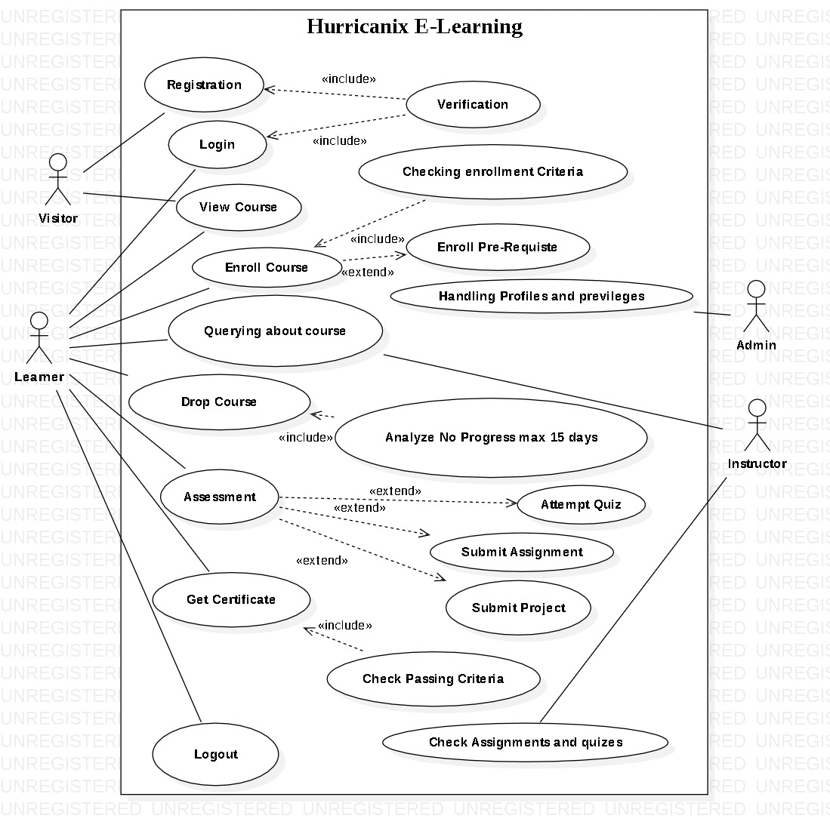
USE CASE DIAGRAM

Slide 20
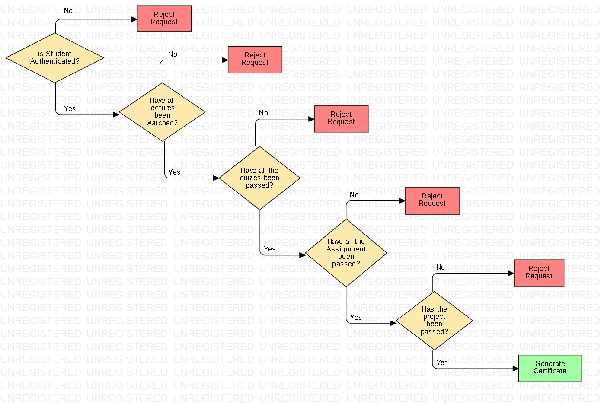
Decision Tree (Generate Certificate)
Decision Table
(Generate Certificate)
Condition | 1 | 2 | 3 | 4 | 5
Student is Authenticated | True | True | True | True | True
All lectures watched | True | False | True | True | True
All quizzes are passed | True | False | True | True | True
All Assignments are passed | True | True | False | True | True
Project passed | True | False | False | True | True
Action
Generate Certificate | Yes |  |  | Yes | Yes
Criteria not Met |  | Yes | Yes

Slide 21
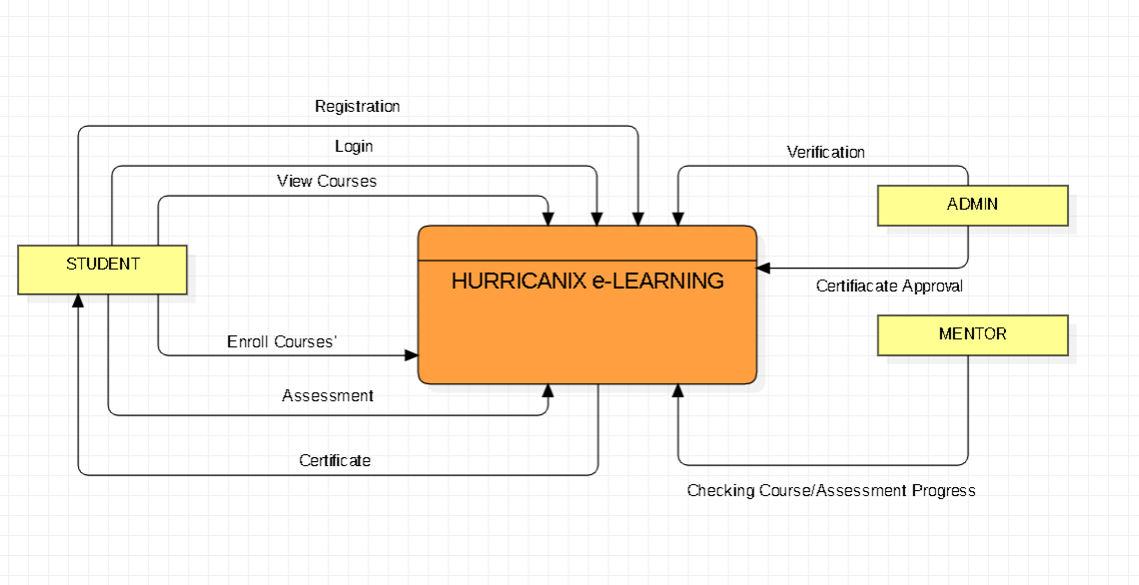
DFD (Level 0)

Slide 22
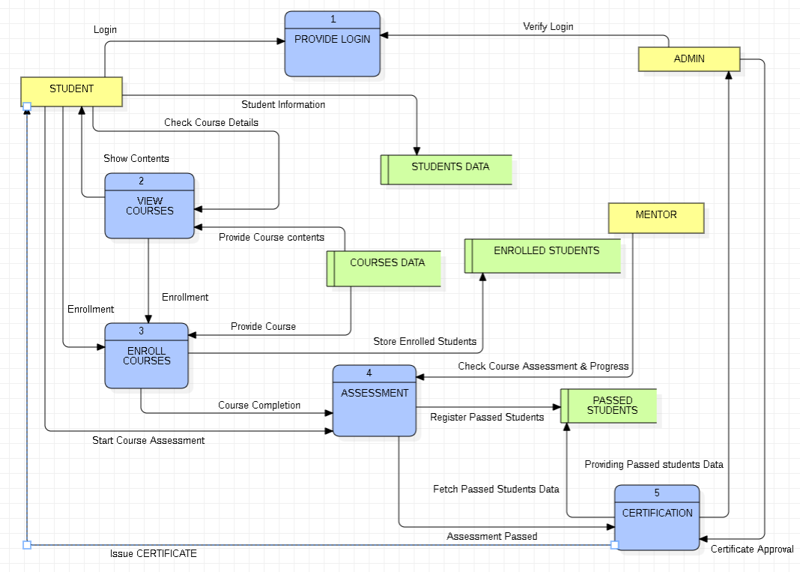
DFD (Level 1)

Slide 23
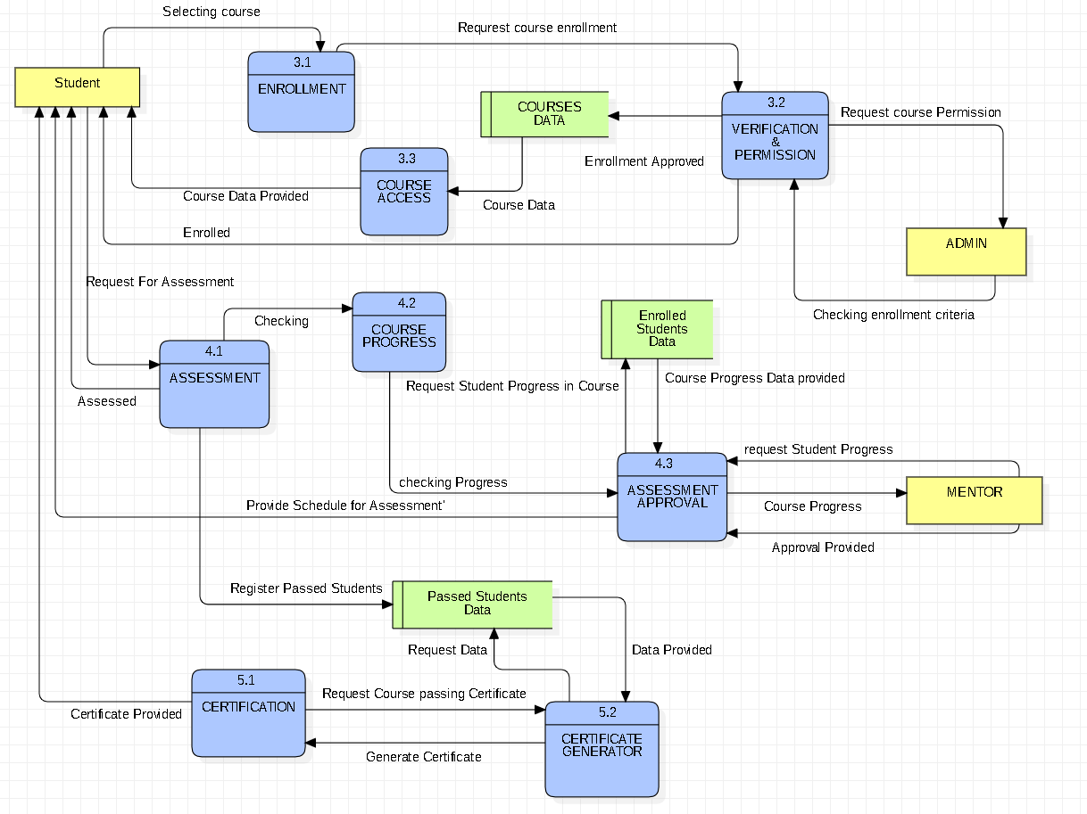
DFD (Level 2)

Slide 24
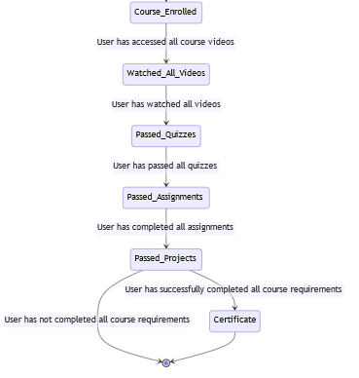
STATE TRANSITION DIAGRAM (Generate Certificate)

Slide 25
STATE TRANSITION MATRIX; (Course Selection)
Current State | Select Course | Enroll Request | Confirm Enrollment | Enrollment Rejected | Cancel Enrollment
Initial State | Course Selection | - | - | - | -
Course Selection | - | Enrollment Pending | - | - | -
Enrollment Pending | - | - | Enrolled | Enrollment Failed | Cancelled
Enrolled | - | - | - | - | Cancelled
Enrollment Failed | - | - | - | - | -
Cancelled | - | - | - | - | -

Slide 26
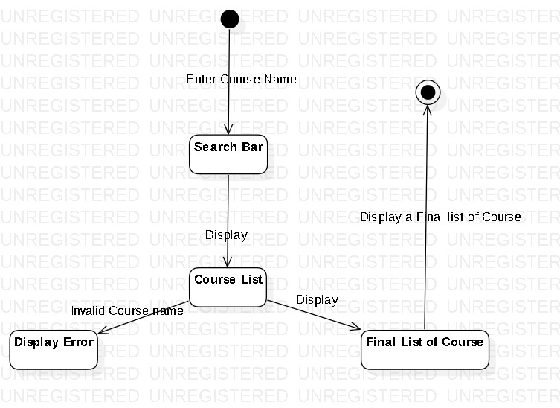
Dialogue Map

Slide 27

USE CASE DIAGRAM

