Slide 1
SMU Data Science Project 1
George Sapp, Shazaad Ansari, Matthew Lopez, Ken Ho

Slide 2
Objective
Given the current state of the world we wanted to use publicly accessible data sources to answer some questions about how the COVID -19 virus spreads and who is the most vulnerable.

Slide 3
The Questions:
Is there any correlation between races and infection rate? Which races are more likely to get infected?
Is there a correlation between income and how many people of a given race are infected?
Is there a correlation of sex, race or age group in regards to contracting covid?
Is there a correlation between profession in regards to contracting covid?

Slide 4
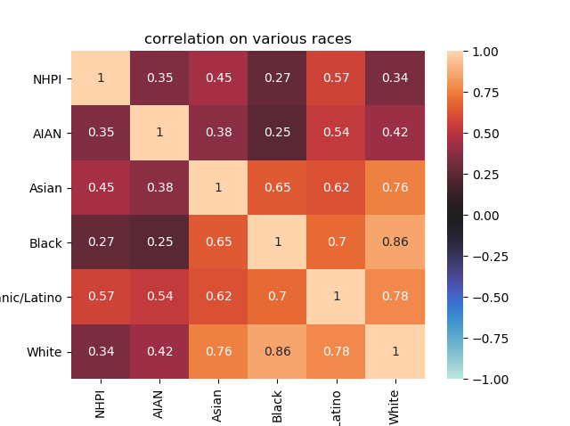
Question 1
A correlation heat map performed on the cases of covid per race by day show that there is a correlation between one race getting covid and another.

Slide 5
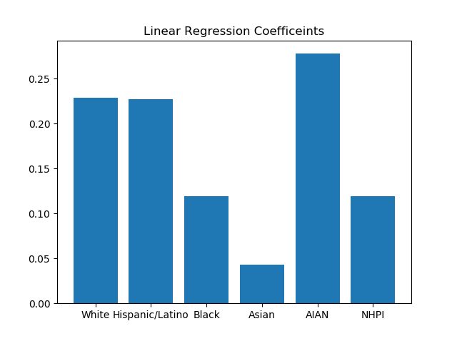
Question 1
Linear Coefficients from the regression analysis describing predicted growth rates

Slide 6
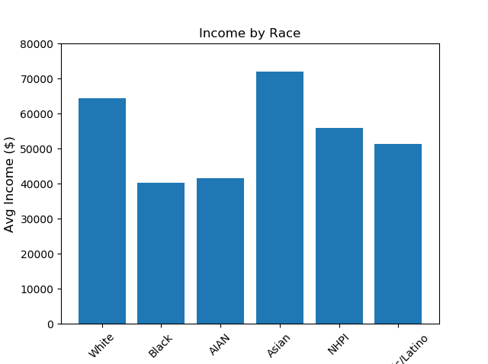
Question 2
Census data indicates that African American & Indian & Alaska Native Americans have the lowest average income of race/ethnicities in the U.S.
Income strong predictor of:
  Housing (adequate v. inadequate
  Access to nutritious food
  Comorbidities
  How well one can socially distance

Slide 7
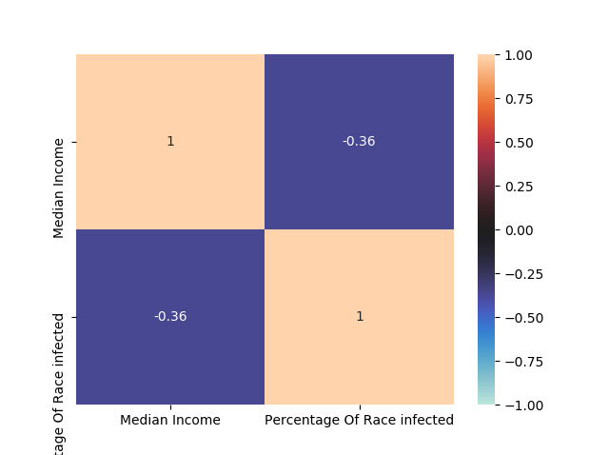
Question 2
Correlation b/w median income level and a races or ethnic groups susceptibility to COVID exposure

Slide 8
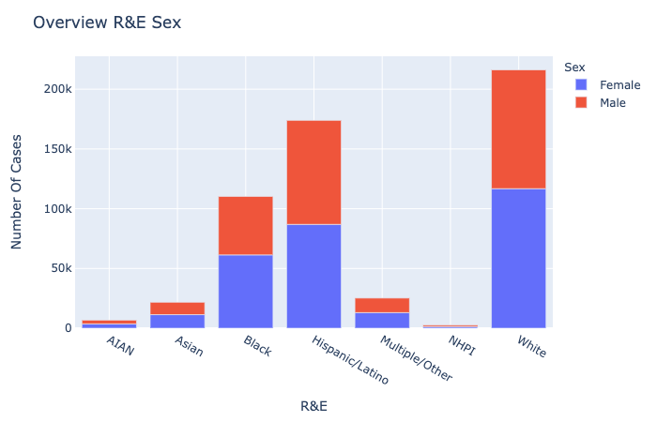
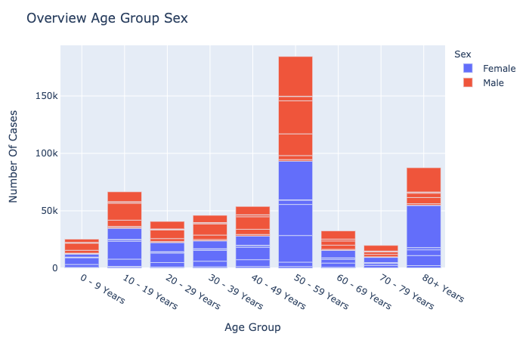
Question 3
Overview of data indicates what Race, Sex, and age groups are most susceptible to covid.

Slide 9
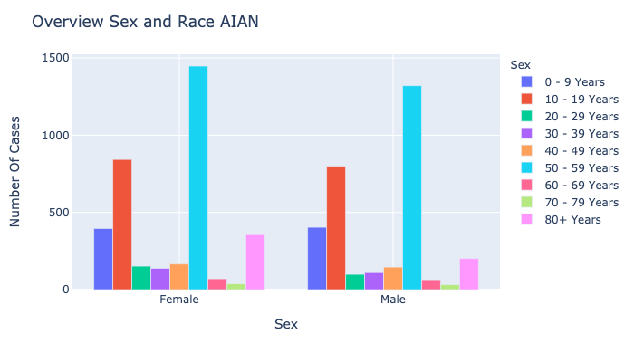
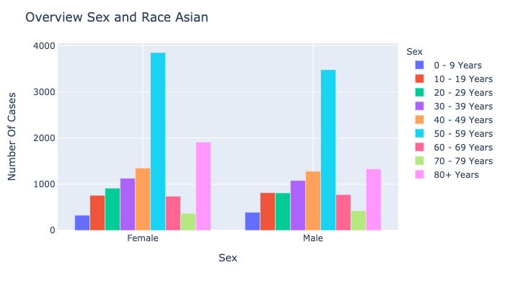
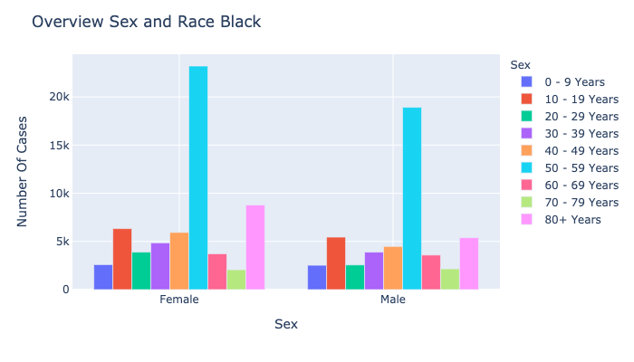
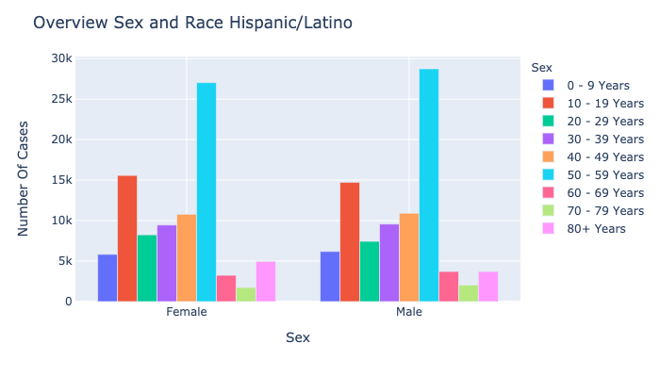
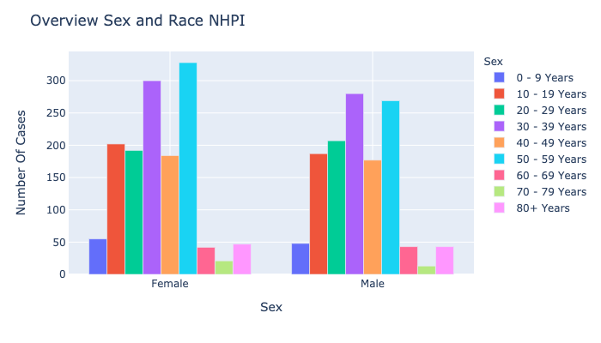
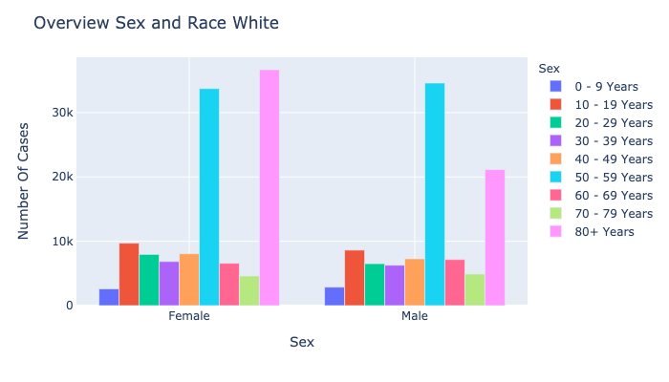
Question 3
Further digging into specific race confirms the findings from the overall data.

Slide 10
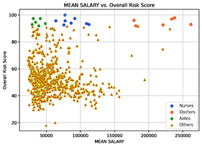
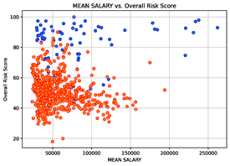


Question 4

Slide 11
Findings
There are many factors that affect your chances of getting covid, from our findings we see that race plays a role along with one race having an effect on other races chances. We also see that different races have a higher growth rate in terms of contracting covid. We find that Average income by race does have a slight correlation in infection percentage of a given race, however not very large.
Sex and age group also seem to play a key factor in susceptibility. Contrary to the belief Males were more prone to infection, the data shows females are at the greatest risk. Especially those in the 50-59 age group. Females in the 80-89 age range are the second most at risk. Race also shows to be a significant factor alluding to other findings in this presentation.
In an analysis to find what professions had the highest risk score we found that health care workers were disproportionately affected compared to non health care workers and that within this occupation segment, We also found that jobs that paid the most tended to have higher risks of contracting covid. Such as health care workers.

Slide 12
https://covidtracking.com/
https://www.bls.gov/cps/cpsaat11.htm
https://www.pgpf.org/blog/2019/10/income-and-wealth-in-the-united-states-an-overview-of-data
Covid Risk Scores from the US Department of Labor’s O’Net Database
https://www.cdc.gov/covid-data-tracker/index.html#demographics
Sources

