Slide 1

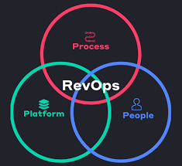
Revenue Operations , “Rev-Ops” – The Future
Revenue Operations (RevOps) is a strategic business function that aligns and optimizes all revenue-generating activities and departments—specifically marketing, sales, and customer success—to drive efficient and predictable growth.
RevOps serves as the central nervous system for a business, aiming to break down traditional departmental silos by unifying processes, data, and technology across the entire customer lifecycle, from initial lead generation to post-sale retention and expansion.
What - Why in this course?
There is no single "no code" for "revenue operations" because revenue operations (RevOps) is a professional function, not a single piece of software. However, many RevOps professionals use low-code or no-code tools to automate workflows and connect different systems, which helps them overcome the limitations of a manually-integrated tech stack, which is often necessary because they aren't typically software engineers themselves. RevOps is a function, not a product.
The adoption of a dedicated RevOps function has increased significantly, from 33% of companies in 2020 to 48% in 2024, with predictions that 75% of high-growth companies will adopt this model by 2025. This growth is reflected in the job market, with over 174,000 RevOps job postings found on ZipRecruiter in mid-2024. The revenue operations software market alone was valued at $3.71 billion in 2023 and is projected to reach $15.9 billion by 2033, demonstrating substantial investment in the field. Companies with aligned processes and technology due to RevOps have shown significant revenue growth and profitability.
References:
https://www.salesforce.com/ap/sales/revenue-lifecycle-management/what-is-revenue-operations/
https://www.cognism.com/blog/revenue-operations
https://www.revenueoperationsalliance.com/what-is-revenue-operations-revops/

