Slide 1
Introduction to Verilog

Slide 2
Hardware Design flow
Design idea to actual implementation either on FPGA or ASIC
Synthesis
Implementation
Device programming
Design entry can be done through Hardware descriptive language
We use programming languages to create software
We use HDL to describe the behavioral characteristics of digital logic circuits
Used for designing processors, CPUs, motherboards etc.

Slide 3
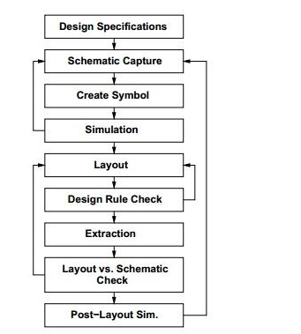
Design flow

Slide 4
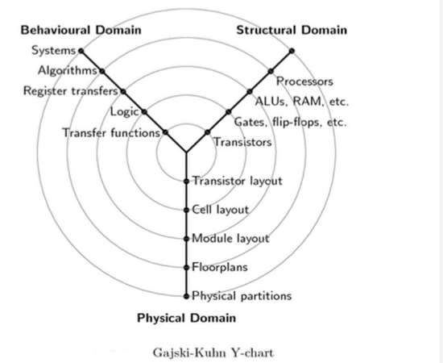
Y chart

Slide 5
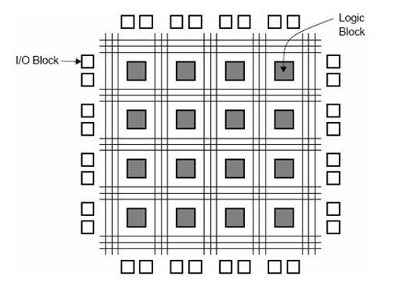
FPGA – Introduction
Contains more then a million logic gates with programmable interconnections

Slide 6
Verilog
Hardware description language
Used for describing a digital system like microprocessor
Using HDL we can describe any digital hardware
Support design at many level of abstraction
Gate level
Behavioral
Register-transfer level

Slide 7

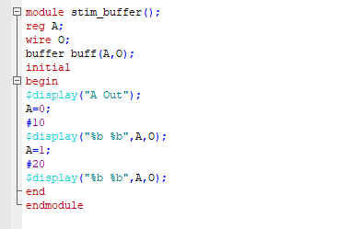
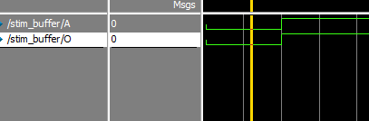
Buffer
Testbench

Slide 8
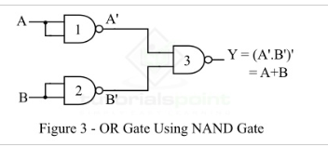
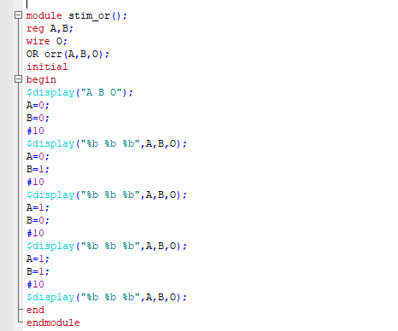
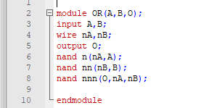
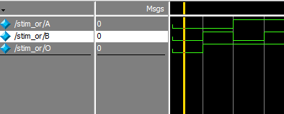
OR gate using NAND gate

