Slide 1
MERN STACK DEVELOPMENT
FOR ABSOLUTE BEGINERS

Slide 2
Web development
Before discussing web development
What is web application ?

Slide 3
Web development
Web development refers to the creating, building, and maintaining of websites. It includes aspects such as web design, web publishing, web programming, and database management. It is the creation of an application that works over the internet i.e. websites.

Slide 4
The word Web Development is made up of two words, that is:
Web: It refers to websites, web pages or anything that works over the internet.
Development: It refers to building the application from scratch.
Web Development can be classified into two ways:
Frontend Development
Backend Development
Frontend Development

Slide 5
The word Web Development is made up of two words, that is:
Web: It refers to websites, web pages or anything that works over the internet.
Development: It refers to building the application from scratch.
Web Development can be classified into two ways:
Frontend Development
Backend Development
Frontend Development
The part of a website where the user interacts directly is termed as front end. It is also referred to as the ‘client side’ of the application.

Slide 6
Frontend Development
The part of a website where the user interacts directly is termed as front end. It is also referred to as the ‘client side’ of the application.

Slide 7
Popular Frontend Technologies
HTML ( HyperText Markup language)
CSS (cascading Style Sheet)
JavaScript
ReactJs

Slide 8
Popular Frontend Technologies
Angular
Bootstrap
Tailwind CSS
Vue Js

Slide 9
Popular Frontend Technologies
TypeScript
NextJS
JQuery

Slide 10
HTML(HYPERTEXT MARKUP LANGUAGE)
The standard language for creating web pages.
Defines the structure and layout of web content using elements like headings, paragraphs, images, links, etc.
acts as a skeleton for a website
CSS(CASCADING STYLE SHEET)
It is used to style our website.
Defines styles like colors, fonts, layouts, spacing, and animations.
JAVASCRIPT
JavaScript is a scripting language used to provide a dynamic behavior to our website

Slide 11
The programming language that enables interactivity on web pages.
Allows for dynamic content updates, animations, form validation, etc
React.js
A JavaScript library developed by Facebook for building user interfaces, especially single-page applications.
Known for its component-based architecture and virtual DOM for fast rendering.
Vue.js
A progressive JavaScript framework for building user interfaces.
Offers an easy learning curve and is suitable for both small and large-scale projects.

Slide 12
Angular
A TypeScript-based web application framework developed by Google.
Well-suited for building large-scale, enterprise-level applications.
Comes with tools for routing, HTTP client, and more.
Bootstrap
A popular front-end framework for building responsive, mobile-first websites using pre-designed components and grid system.
Provides ready-to-use styles for buttons, forms, modals, etc.

Slide 13
Tailwind CSS
A utility-first CSS framework that allows you to apply styles directly to HTML elements using predefined classes.
Offers great flexibility and customization compared to traditional CSS frameworks.

Slide 14
TypeScript
A superset of JavaScript that adds static typing.
Helps catch errors early and makes larger JavaScript codebases more manageable.
Next.js
A React framework that enables server-side rendering, static site generation, and other performance optimizations.
Great for building SEO-friendly and fast web applications.

Slide 15
jQuery
A fast and small JavaScript library that simplifies HTML document manipulation, event handling, and AJAX interactions.
Although it's becoming less popular with the rise of modern frameworks, it is still used in many legacy projects.

Slide 16
BACKEND DEVELOPMENT
Backend is the server side of a website. It is part of the website that users cannot see and interact with. It is the portion of software that does not come in direct contact with the users. It is used to store and arrange data.

Slide 17
Popular Backend Technologies
PHP
Java
Python
Node.js

Slide 18
PHP
PHP is a server-side scripting language designed specifically for web development.
JAVA
Java is one of the most popular and widely used programming languages. It is highly scalable.
PYTHON
Python is a programming language that lets you work quickly and integrate systems more efficiently.

Slide 19
NODE.JS
Node.js is an open source and cross-platform runtime environment for executing JavaScript code outside a browser.
Built on the V8 JavaScript engine,
Node.js enables server-side scripting, making it ideal for creating fast, scalable network applications.
It uses an event-driven, non-blocking I/O model, which makes it lightweight and efficient for handling multiple requests simultaneously.
With its package manager, npm, developers can easily install libraries and tools, making Node.js a popular choice for building web servers, APIs, and real-time applications like chat apps and online gaming servers.

Slide 20
HTML

Slide 21
HTML
CSS

Slide 22
JAVASCRIPT

Slide 23
JAVASCRIPT
REACT

Slide 24
NODEJS

Slide 25
NODEJS
EXPRESS

Slide 26
MONGODB
FIREBASE

Slide 27
HTML
CSS
JAVASCRIPT
REACT
NODEJS
MONGODB
EXPRESS
FIREBASE

Slide 28
DATABASES
In web technology, a database is a structured collection of data that is stored electronically and accessed via a web application.
It serves as the backend component where data is stored, managed, and retrieved.
Databases can be relational (like MySQL, PostgreSQL) using structured tables and SQL for queries, or non-relational (like MongoDB) which store data in flexible, document-oriented formats.
They enable web applications to handle dynamic content, user data, transactions, and more by providing efficient storage, retrieval, and manipulation capabilities.

Slide 29
NOW LET’S START INTO
DEVELOPMENT AND DESIGNING

Slide 30
IDE (INTEGRATED DEVELOPMENT ENVIREMONT)

Slide 31

IDE (INTEGRATED DEVELOPMENT ENVIREMONT)
a software application that provides a comprehensive set of tools to assist developers in writing, testing, debugging, and managing code.
How to install ?

Slide 32
IDE (INTEGRATED DEVELOPMENT ENVIREMONT)
a software application that provides a comprehensive set of tools to assist developers in writing, testing, debugging, and managing code.
How to install ?
https://code.visualstudio.com/docs/setup/windows

Slide 33
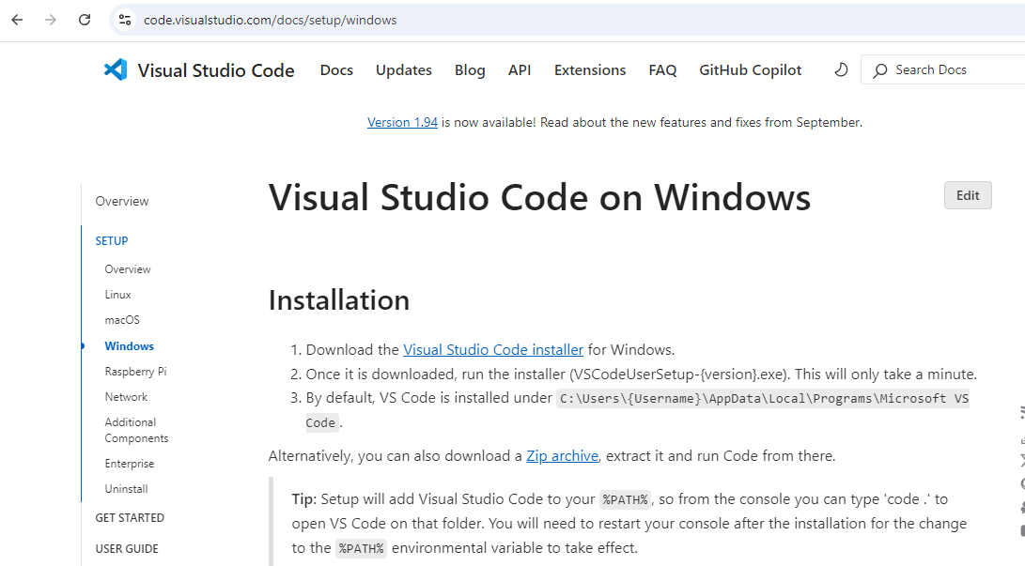

Slide 34
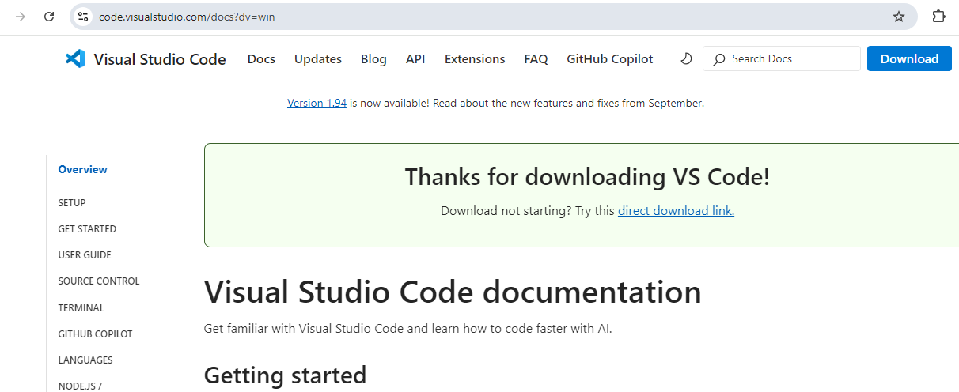

Slide 35
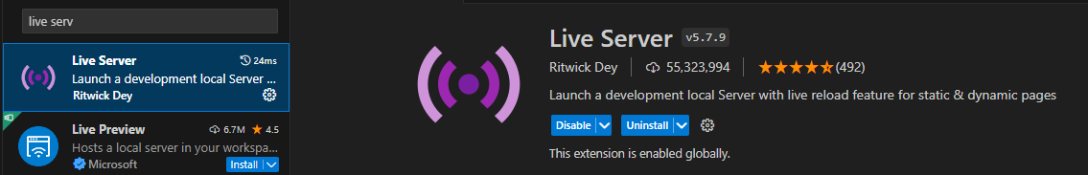
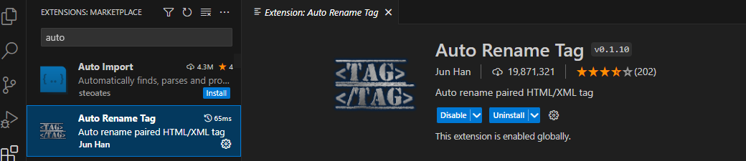
INSTALL SOME USE FUL EXTENSIONS

Slide 36
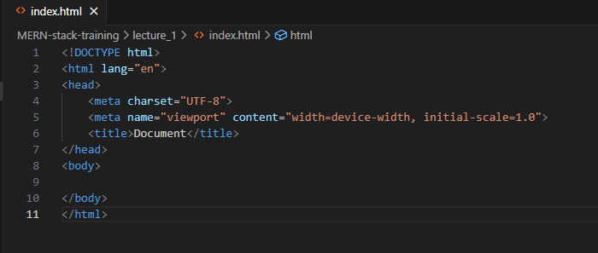
Lets create our first website !

Slide 37
What is an HTML Element?
An HTML element is defined by a start tag, some content, and an end tag:
<tagname> Content goes here </tagname>
The HTML element is everything from the start tag to the end tag:
<h1>My First Heading</h1>
<p>My first paragraph.</p>

Slide 38
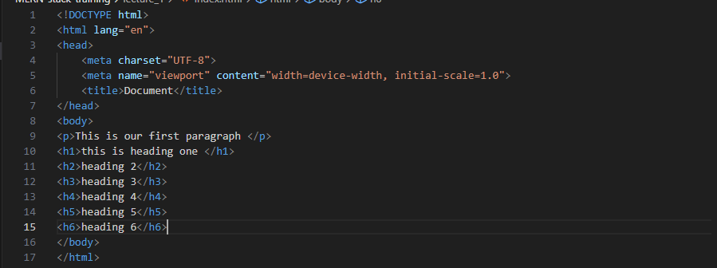

Slide 39
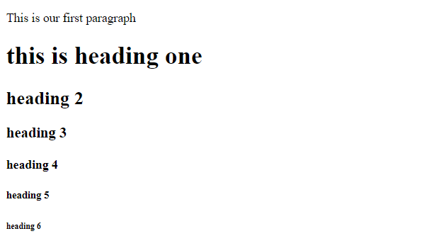

Slide 40
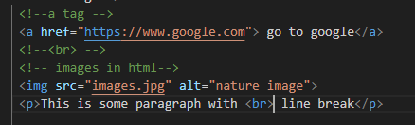
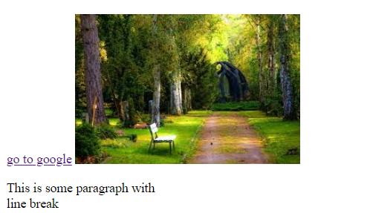
Anchor <a> tag and img tag :

Slide 41
HTML Attributes
HTML attributes provide additional information about HTML elements.
All HTML elements can have attributes
Attributes provide additional information about elements
Attributes are always specified in the start tag
Attributes usually come in name/value pairs like: name="value"
<img src="images/images.jpg" alt="nature image">

Slide 42
There are two ways to specify the URL in the src attribute:
1. Absolute URL - Links to an external image that is hosted on another website. Example: src="https://www.google.com/images/img.jpg".
2. Relative URL - Links to an image that is hosted within the website. Here, the URL does not include the domain name. If the URL begins without a slash, it will be relative to the current page. Example: src="img_girl.jpg". If the URL begins with a slash, it will be relative to the domain. Example: src="/images/img.jpg".
<img src="images/images.jpg" alt="nature image" height="200px" width="200px">
<img src="images/images.jpg" alt="nature image" height="100%" width="100%">

Slide 43


Slide 44
Unit | Description
in | inches (1in = 96px = 2.54cm)
px * | pixels (1px = 1/96th of 1in)
pt | points (1pt = 1/72 of 1in)
pc | picas (1pc = 12 pt)

Slide 45
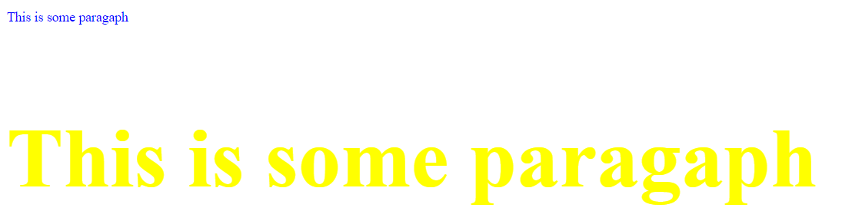
The style Attribute
The style attribute is used to add styles to an element, such as color, font, size, and more.
<p style="color: blue;">This is some paragaph </p>
<p style="
color: yellow;
font-size: 100px;
font-family: 'Times New Roman', Times, serif;
font-weight: bold;
">This is some paragaph </p>

Slide 46
<!-- The CSS background-color property defines the background color for an HTML element.-->
<h1 style="background-color:yellow;">This is a heading</h1>
<p style="background-color:tomato;">This is a paragraph.</p>
<!--The CSS color property defines the text color for an HTML element:-->
<h1 style="color:brown;">This is a heading</h1>
<p style="color:red;">This is a paragraph.</p>
<!--The CSS font-family property defines the font to be used for an HTML element:-->
<p style="font-family: 'Courier New', Courier, monospace;">This is a paragraph</p>
<h2 style="font-family: 'Gill Sans', 'Gill Sans MT', Calibri, 'Trebuchet MS', sans-serif;">This is heading 2</h2>
<!--The CSS font-size property defines the text size for an HTML element:-->
<h1 style="font-size:500%;">This is a heading</h1>
<p style="font-size:160%;">This is a paragraph.</p>
<!-- The CSS text-align property defines the horizontal text alignment for an HTML element: -->
<h1 style="text-align:center;">Centered Heading</h1>
<p style="text-align:center;">Centered paragraph.</p>

Slide 47
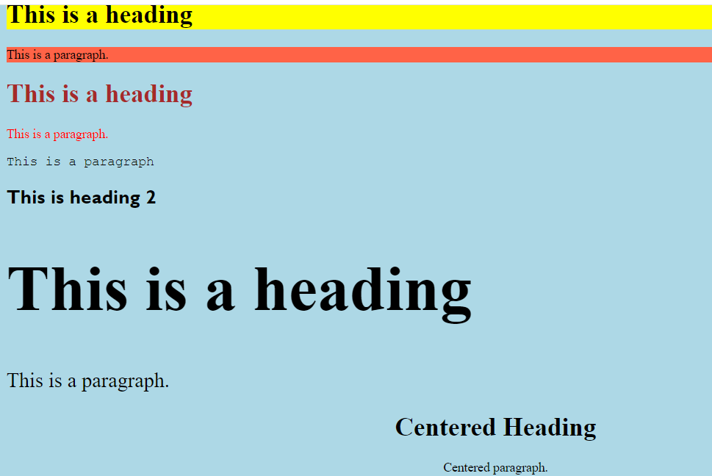

Slide 48
All HTML elements can have attributes
The href attribute of <a> specifies the URL of the page the link goes to
The src attribute of <img> specifies the path to the image to be displayed
The width and height attributes of <img> provide size information for images
The alt attribute of <img> provides an alternate text for an image
The style attribute is used to add styles to an element, such as color, font, size, and more
The lang attribute of the <html> tag declares the language of the Web page
The title attribute defines some extra information about an element
The <hr> tag is an empty tag, which means that it has no end tag.

Slide 49
<p title="Title of paragaph">This is title</p> <p>
This paragraph contains a lot of lines in the source code, but the browser ignores it.
</p>
<p>
This paragraph contains a lot of spaces in the source code,but the browser ignores it.
</p>
<hr>
<p>this paragraph contains some <br> usefull information</p>
<pre> <!– pre formatted text> -- >
My Bonnie lies over
the ocean.
My Bonnie lies over the sea.
My Bonnie lies over the ocean.
Oh, bring back my Bonnie to me.
</pre>

Slide 50
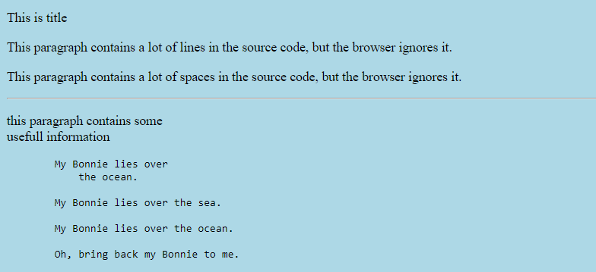
Title of paragaph

Slide 51
<!--HTML Formatting Elements
Formatting elements were designed to display special types of text:
<b> - Bold text
<strong> - Important text
<i> - Italic text
<em> - Emphasized text
<mark> - Marked text
<small> - Smaller text
<del> - Deleted text
<ins> - Inserted text
<sub> - Subscript text
<sup> - Superscript text-->
<b>This is bold text</b>
<strong> this is strong text</strong>
<i>Italic</i>
<em>Emphasized</em>
<mark>marked text</mark>
<small>small text</small>
<del>Deleted text</del>
<ins>Inserted text</ins>
<sub>subscript text</sub>
<sup>Superscript text</sup>

Slide 52
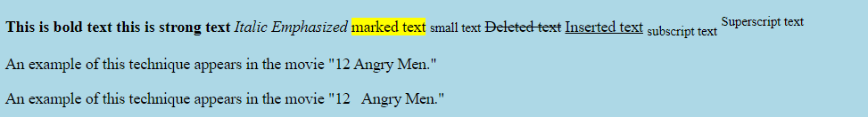
<!--Non breaking space -->
<p>An example of this technique appears in the movie "12 Angry Men."</p>
<p>An example of this technique appears in the movie "12&nbsp;&nbsp;&nbsp;Angry Men."</p>

