Slide 1
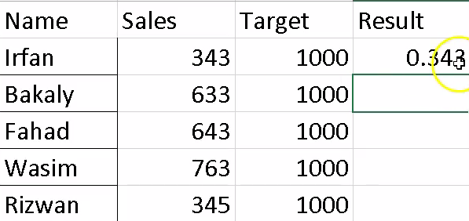
How to calculate sales in percentage?
=Sales/Target

Slide 2
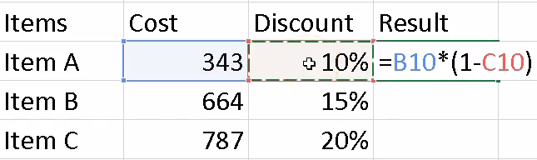
How to calculate cost after giving discount?
=Cost*(1-Discount)

Slide 3
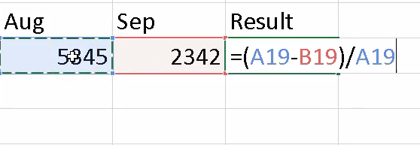
Want to see the difference between two months?
=(Aug-Sep)/Aug

Slide 4
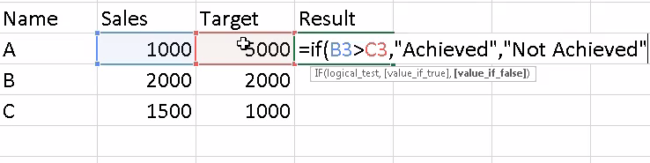
How to show achieved if sales is grater then target?
=if(sales > target, ‘’Achieved”, ‘’Not Achieved”)

Slide 5
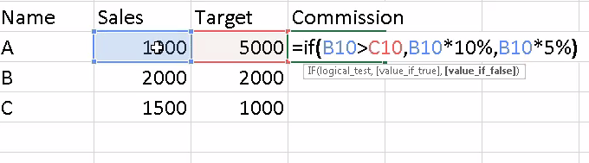
How to calculate commission ?
=if(sales > target, Sales*10%, ‘’sales*5%”)

Slide 6
Topics
Transpose
Remove Blank cells
Remove Duplicate values

Slide 7
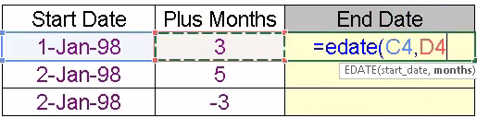
EndDate
=Edate(startDate,NoOfMonth)

Slide 8
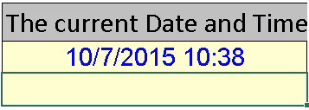
Now
=Now()

Slide 9

Today
=today()

Slide 10
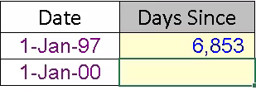
No Of Days
=today()-Date
=today()-Date+1

Slide 11
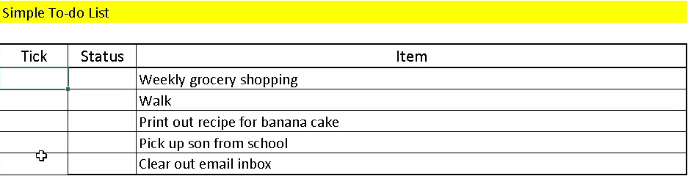
Conditional Formatting
=if(Status=“Done”,1,0)

Slide 12
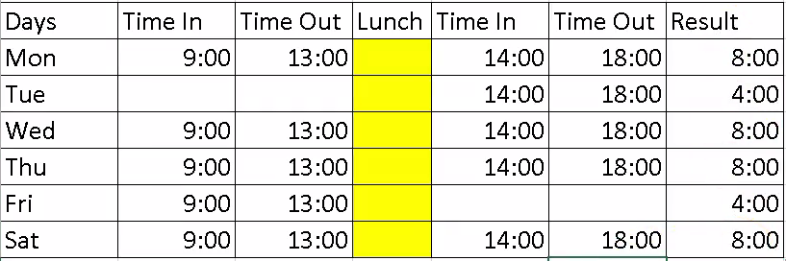
Time Sheet
=(timeout-timein)+(timeout-timein)

Slide 13
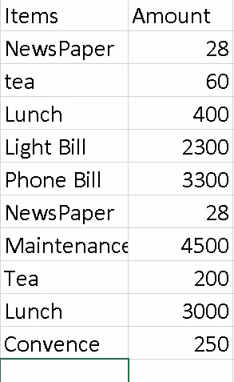
Sub Total
Sorting
Subtotal

Slide 14
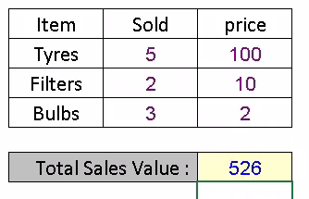
Sum Product
=sumproduct(Array1,Array2)

Slide 15
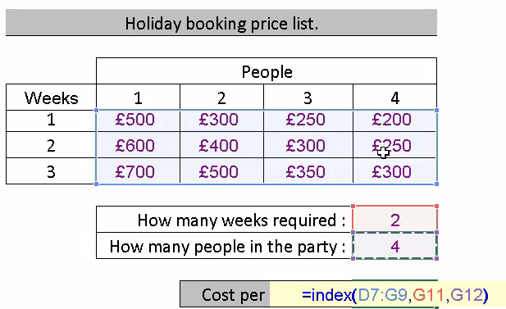
Index

Slide 16
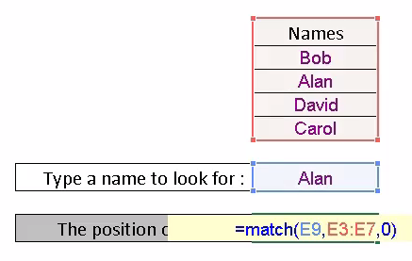
Match

Slide 17
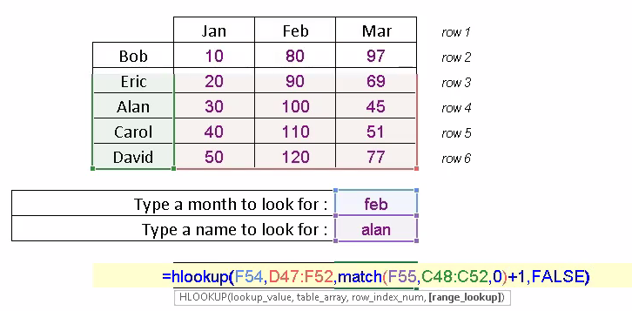
HLookup

Slide 18
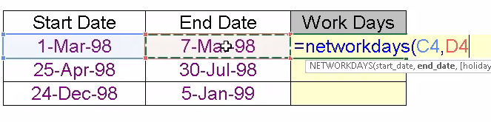
Network days

Slide 19
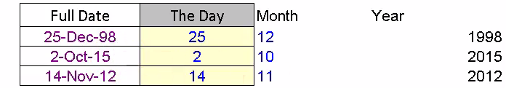
Day, Month, Year

Slide 20
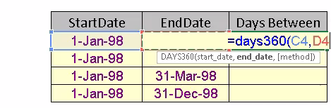
Days360

Slide 21
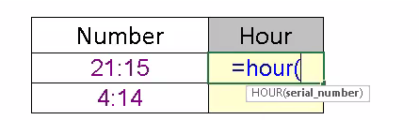
Hour, Minutes

Slide 22
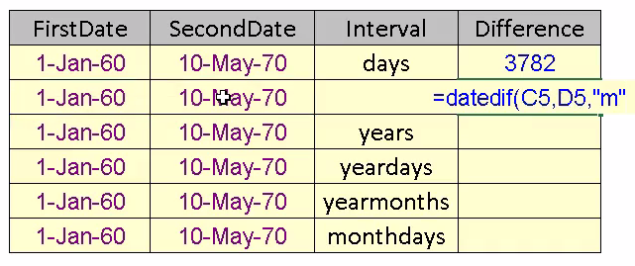
DatedIf

Slide 23
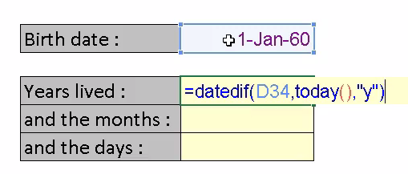
Birth Date

Slide 24
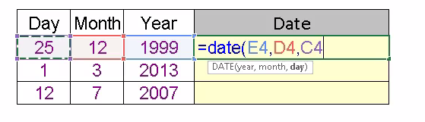
Date

Slide 25
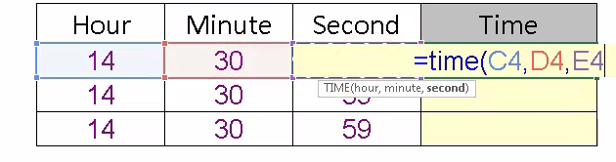
Time

Slide 26
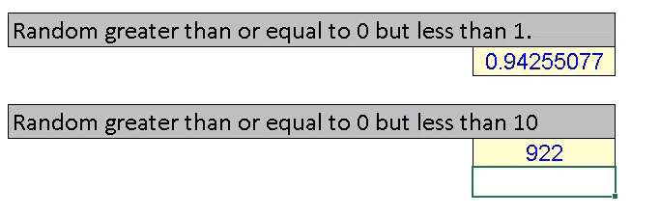
=rand()*10
Random

Slide 27
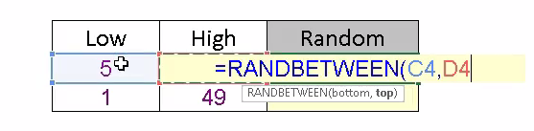
RandomBetween

Slide 28
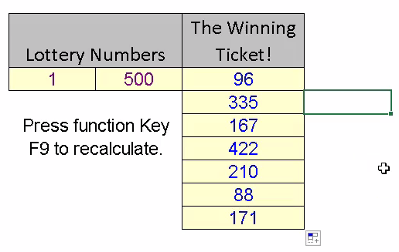
Random Between

Slide 29
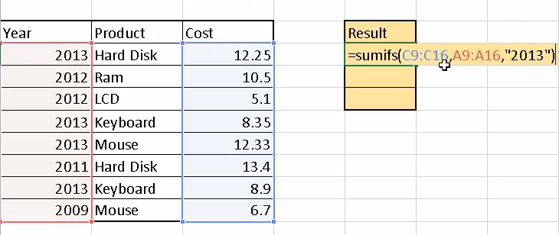
Sumifs

Slide 30
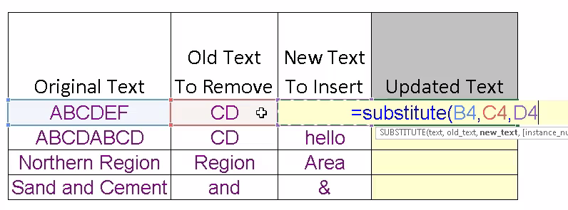
Substitute

Slide 31
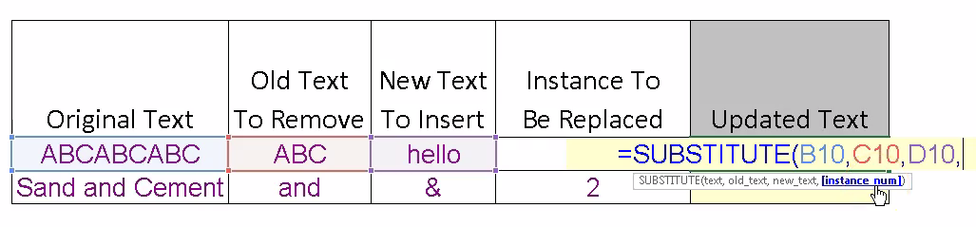
Substitute

Slide 32
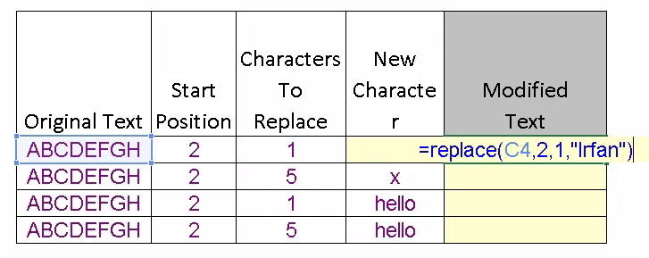
Replace

Slide 33
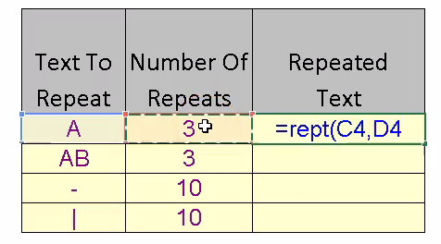
Rept

Slide 34
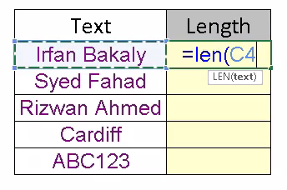
Len

Slide 35
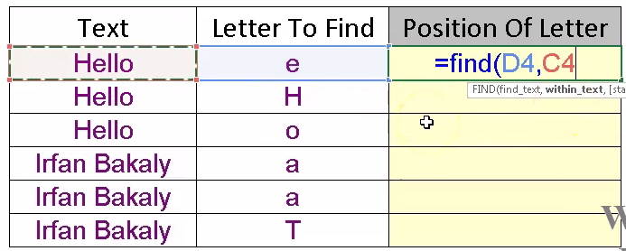
Find

Slide 36
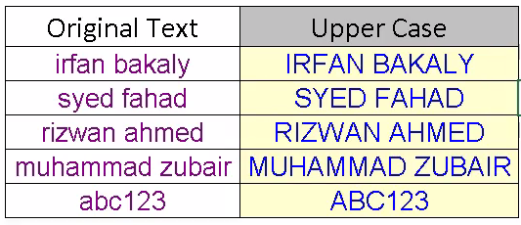
Upper

Slide 37
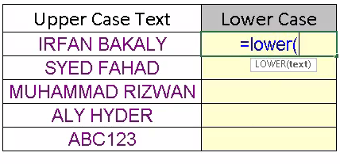
Lower

Slide 38
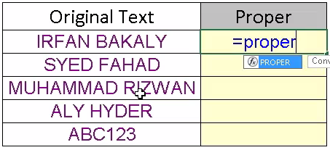
Proper

Slide 39
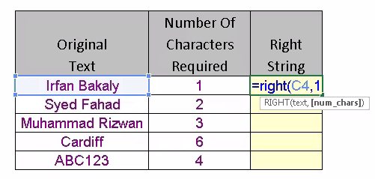
Right

Slide 40
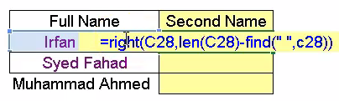
Right

Slide 41
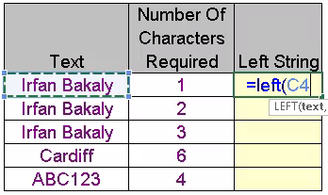
Left

Slide 42

Left

Slide 43
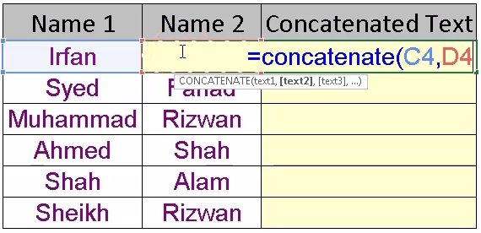
Concatenate

Slide 44
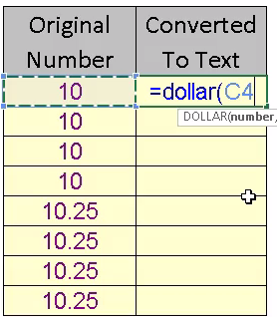
Dollar

Slide 45
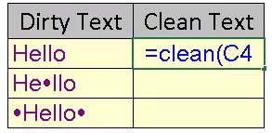
Clean

Slide 46
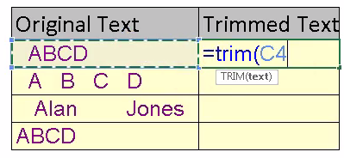
Trim

Slide 47
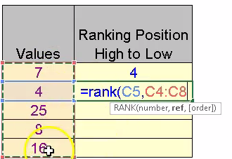
Rank

Slide 48
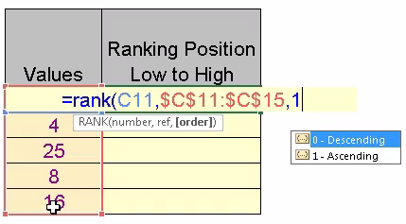
Rank

Slide 49
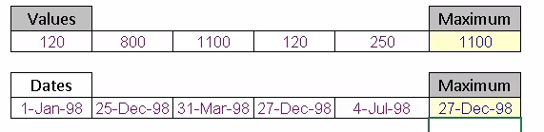
Max

Slide 50
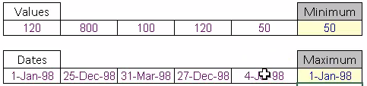
Min

Slide 51
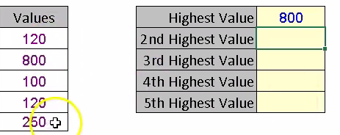
Large

Slide 52
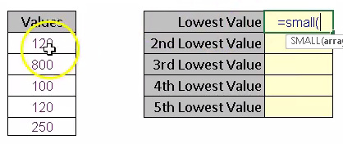
Small

Slide 53
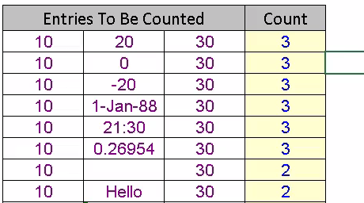
Count and CountA

Slide 54

CountIf

Slide 55

CountIfs

Slide 56

VLookUp

Slide 57

Database

Slide 58


Slide 59

Vlookup and Match

Slide 60

Days Name

Slide 61

Find Weekend

Slide 62

Sum Multiple Column using Vlookup

Slide 63

Sum Unique Value

